Slide 1



Slide 2



B TECH. 2ND Year (Sem III)
Subject name : Discrete Mathematics and Graph theory ( ICT ) Subject Code : 01CT0310

Slide 3
B TECH. 2ND Year (Sem III)
UNIT 5:
Representation of Graph using Matrix

Slide 4
Although a pictorial representation of a graph is very convenient for a visual study, other representations are better for computer processing. A matrix is a convenient and useful way for representing a graph to a computer.
In many applications of graph theory, such as in network analysis , matrices also turn out to be the natural way of expressing the problem.

Slide 5
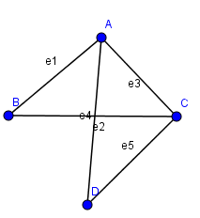
In a graph, two vertices are said to be adjacent , if there is an edge between the two vertices.
In a graph, two nonparallel edges are said to be adjacent, if there is a common vertex between the two edges.
Here A and B are adjacent vertices, because there is edge e1 between A and B.
Vertices B and D are not adjacent vertices.
Edges e1 and e3 are adjacent edges, as there is a common vertex A between them.
Edges e1 and e5 are not adjacent edges, as there is no common vertex.

Slide 6
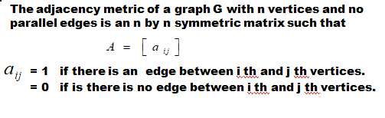
Adjacency Matrix

Slide 7
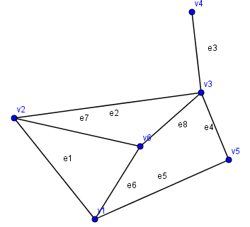

Slide 8
Observations
The entries along the principal diagonal of the adjacency matrix A are 0’s if and only if the graph has no self-loops. If a self-loop at the i th vertex then corresponding =1 in the adjacency matrix A
The definition of adjacency matrix makes no provision for parallel edges.
If the graph has no self loop, the degree of vertex equals the number of 1’s in the corresponding row or column of A.
A graph is disconnected and is in two components g and f then its adjacency matrix A can be partitioned as

Slide 9
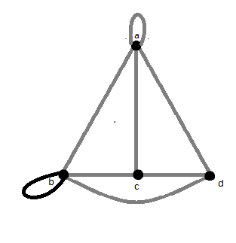
Examples
Evaluate an adjacency matrix for the following graph.
1)

Slide 10
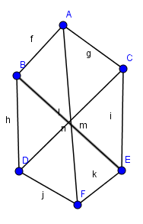
2

Slide 11
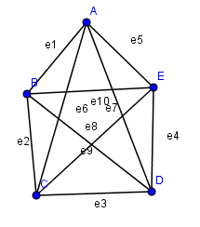
3

Slide 12
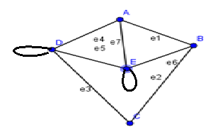
4

Slide 13
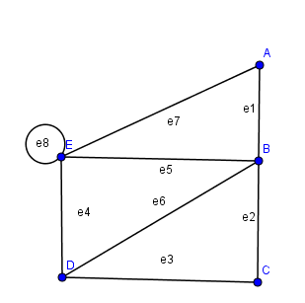
5

Slide 14
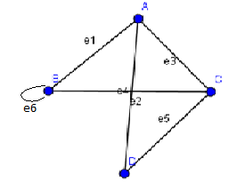
Draw a graph for the following adjacency matrix.
1

Slide 15
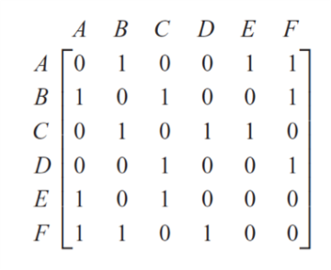
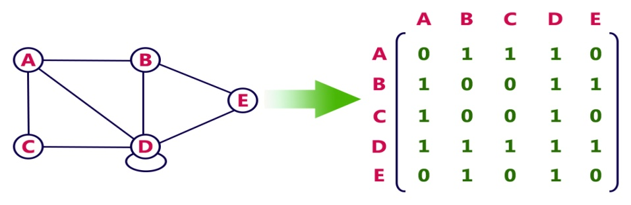
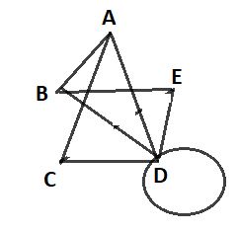
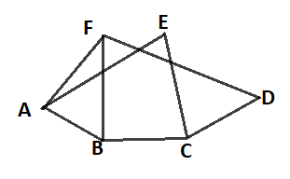
2
3

Slide 16
Incidence matrix
Let G be a graph with m vertices, n edges and no self loops, Define
matrix of size m x n,
where m rows correspond to the m vertices and the n columns correspond to the n edges as follows
The elements of matrix A are
= 1 if jth edge is incident on ith vertex
= 0 otherwise

Slide 17
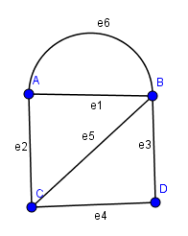
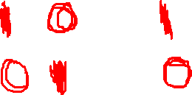
Incidence matrix of the given graph is

Slide 18
Observations
Since every edge is incident on exactly two vertices, each column of incidence matrix A has exactly two 1.
The numbers of 1 in each row equal to the degree of the corresponding vertex.
A row with all 0 elements represents an isolated vertex.
Parallel edges in a graph produce identical columns in its incidence matrix.

Slide 19
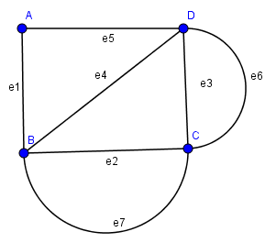

Examples
Evaluate the incidence matrix of the following graph.
1)

Slide 20
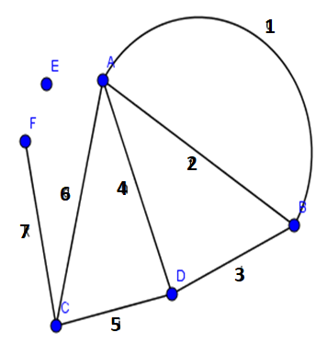

2)

Slide 21
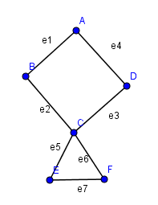
3)

Slide 22
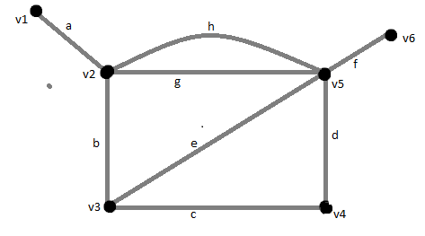
4)

Slide 23
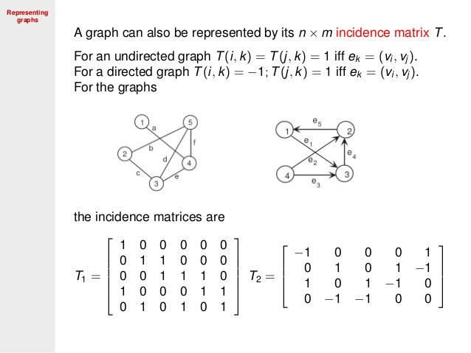
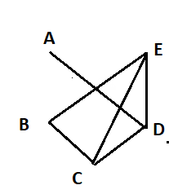

Draw a graph for the following incidence matrix.
1)

Slide 24
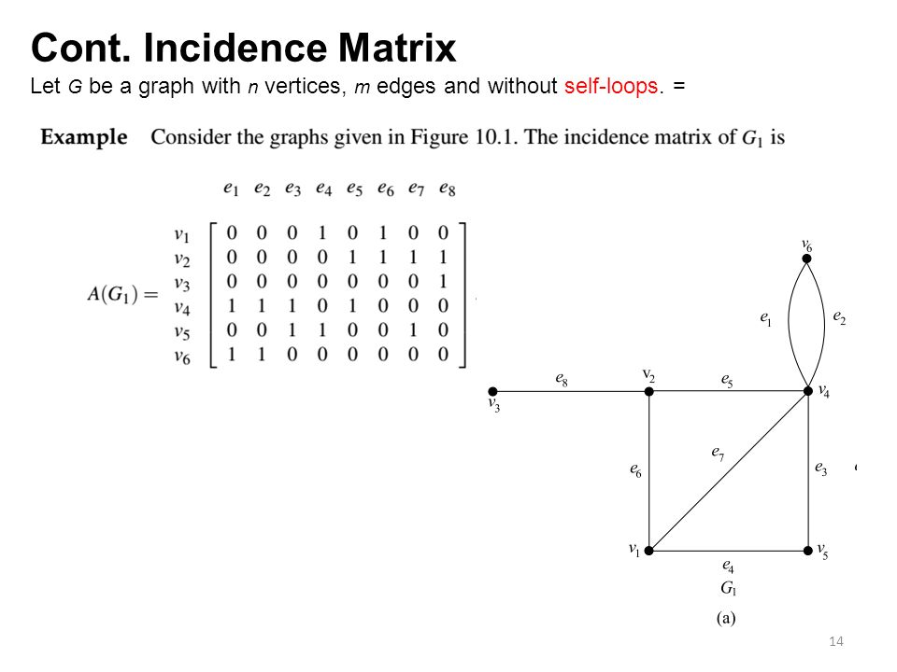
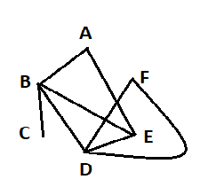

2)

Slide 25
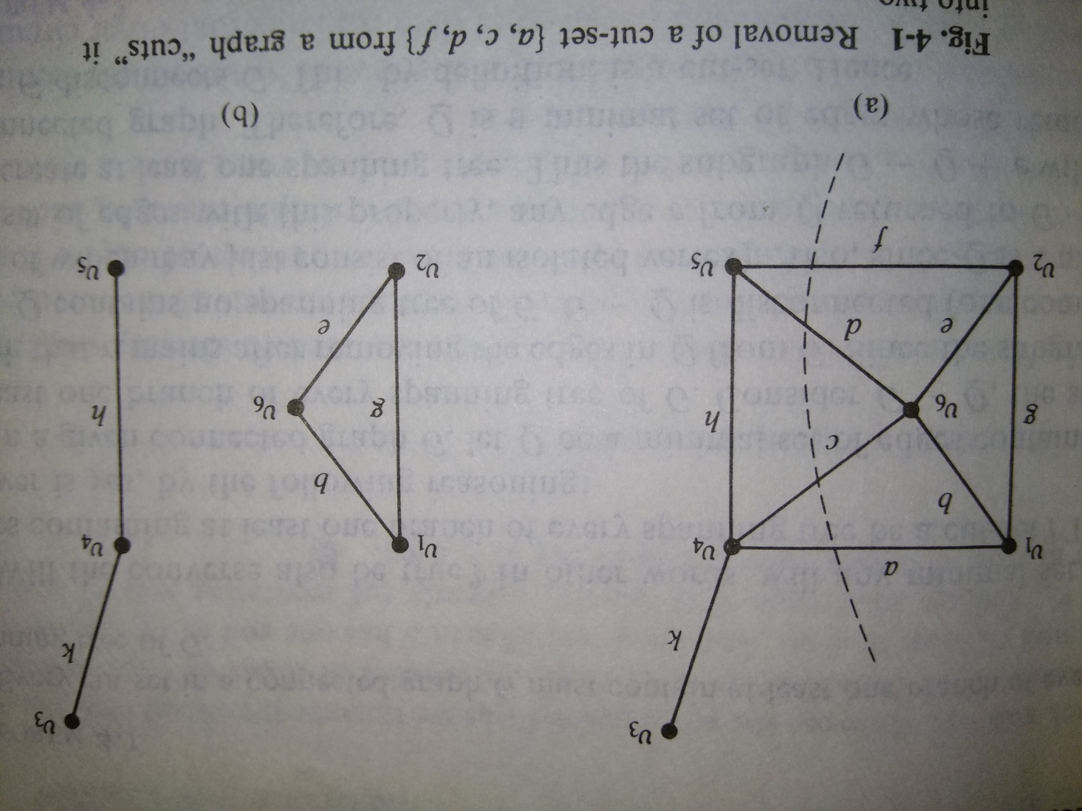
Cut sets
In a connected graph G, a cut set is a set of edges whose removal from G leaves disconnected, provided removal of no proper subset of these edges disconnects G
In this figure the set of edge {a, c, d, f } is a cut set

Slide 26
There are many other cut set such as {a, b, g}, {a, b, e, f}, {d, h, f} and {k}.
The set of edge {a, c, h, d} is not cut set because one of its proper subset {a, c, h} is a cut set.
The Cut set is also known as co cycle.
Since removal of any edge from a tree breaks the tree into two parts, so every edge of a tree is a cut set.

Slide 27
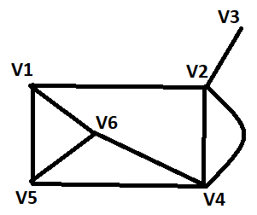
One Application
Cut sets are important in studying properties of communication and transportation networks.
Suppose there are six vertices in the graph represent six cities connected by telephone lines.
We wish to find out if there are any weak spots in the network that need strengthening by means of additional telephonic lines .
We look at all cut set of the graph and the one with the smallest number of edges is the most vulnerable .
In figure the city represented by vertex v3 can be isolated from the rest of the network by the destruction of the just one edge.

Slide 28
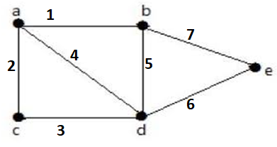
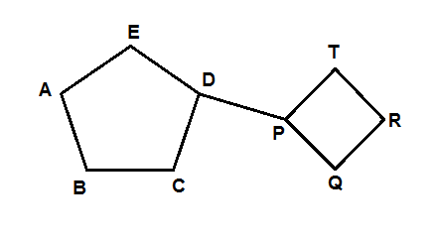
Examples
Find 7 cut sets of the following graphs
1)
2)
{ 6, 7 }
{ 2, 3 }
{ 1, 4, 3}
{ 1, 2, 4}
{ 1, 5, 7}
{ 1, 5, 6}
{ 3, 4, 5, 6}

Slide 29
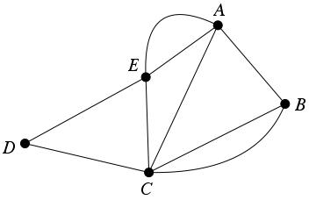
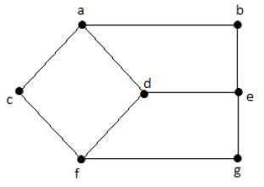
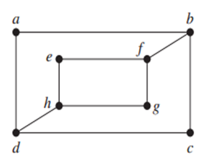
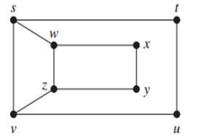
3)
4)
5)
6)

Slide 30
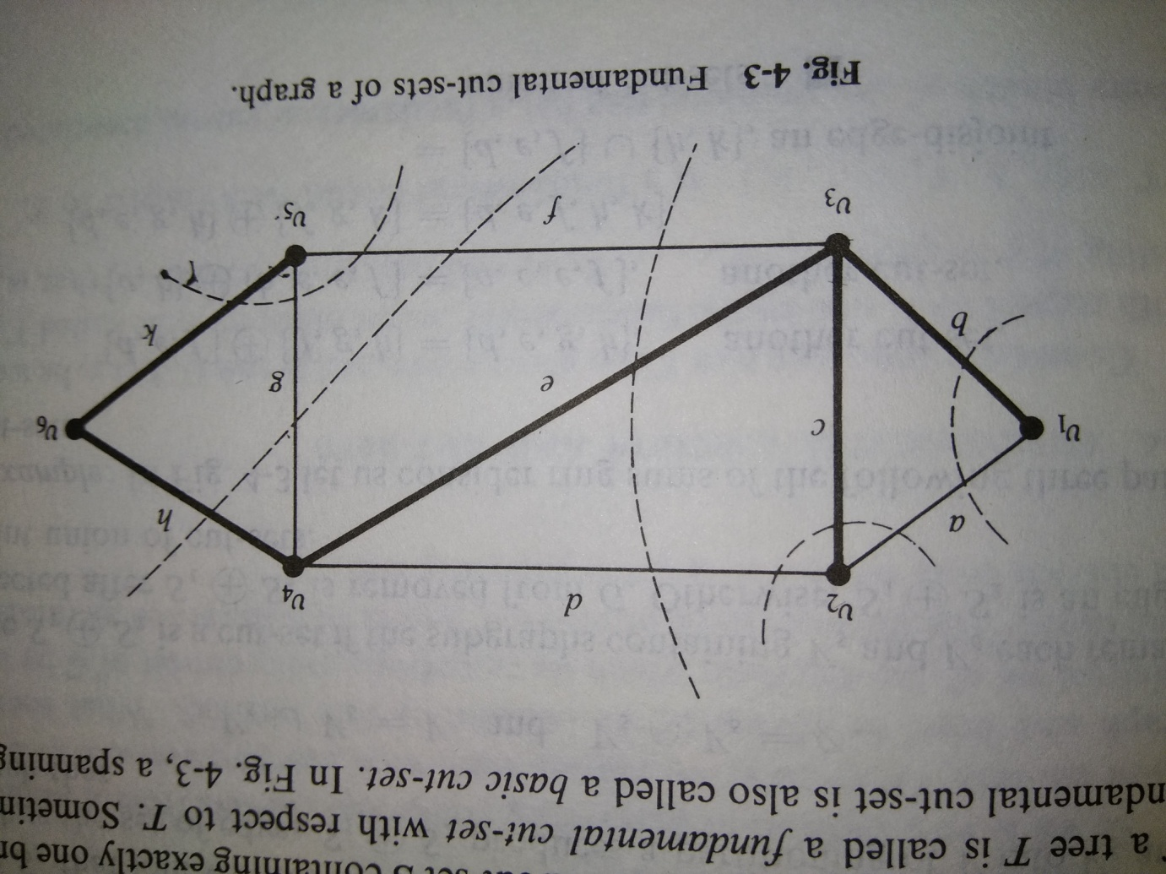
Fundamental cut sets and Fundamental Circuit
An edge in a spanning tree T is known as a branch and an edge of G that is not in a spanning tree T is known as chord.
Cut set S of the graph G containing exactly one branch of spanning tree T of G is called Fundamental cut set with respect to T
Sometimes a Fundamental cut set is also known as basic cut set.
Consider a spanning tree T of a connected graph G.

Slide 31
In above graph G, e is a branch of G with respect to spanning tree T
Consider cut set S={ d, e, f } of graph G
Cut set S contains only one branch e of T and the rest of the edges in S are chords with respect to T.
Here S is Fundamental cut set of G
Fundamental Circuit
Consider the spanning tree T of connected graph G, let c be the chord with respect to T and let the circuit R made by chord c and branches b₁, b₂, ....., b_{k} of G with respect to T then R is called fundamental circuit with respect to T.
As in above example ????????? are fundamental circuits with respect to T.

Slide 32
Connectivity of graph
Edge Connectivity
Each cut set of a connected graph G consists of a certain number of edges .The number of edges in the smallest cut set is defined as the edge connectivity of G
The edge connectivity of the tree is one.
Vertex Connectivity
The vertex connectivity of a connected graph G defined as the minimum number of vertex whose removal from G leaves the remaining graph disconnected.
The vertex connectivity of a tree is one.

Slide 33
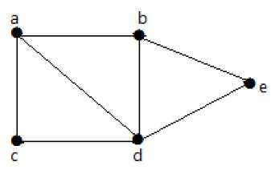
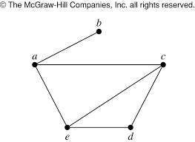
Examples
Find the vertex connectivity and edge connectivity of the following graphs.
The edge connectivity of this graph is two.
The vertex connectivity of this is graph is two.

Slide 34
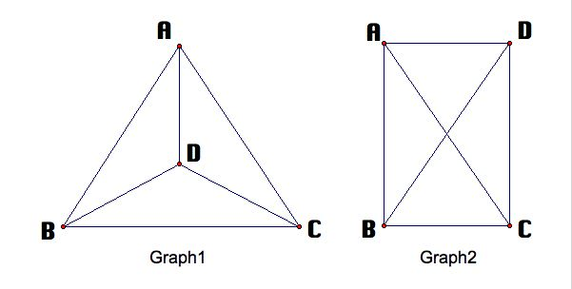
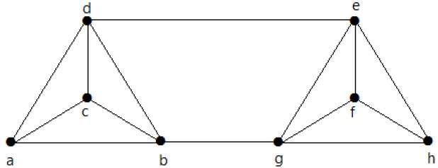
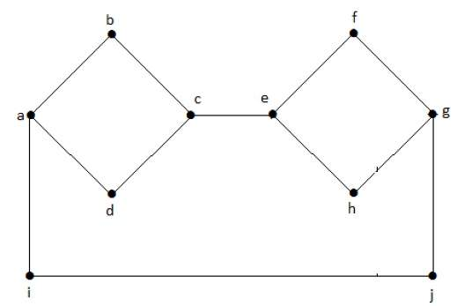
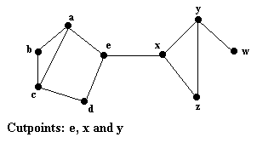
Find the vertex connectivity and edge connectivity of the following graphs.

Slide 35
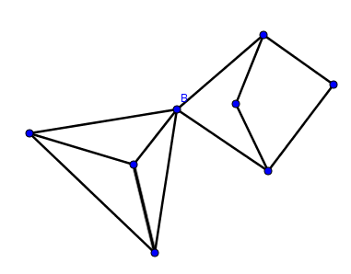
Separable graph
A connected graph is said to be separable if its vertex connectivity is one.
In a separable graph a vertex whose removal disconnects the graph is called a cut vertex.
In tree every vertex with degree greater than one is known as cut vertex
In this graph cut vertex is B and this is separable graph

Slide 36
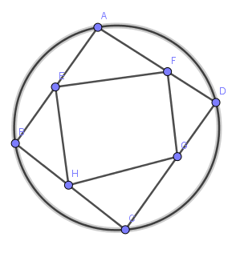
What is best way of connecting?
In this graph we have 8 vertices and 12 edges. It has 1 vertex connectivity and 2 edge connectivity.
It can be easily seen that the edge connectivity of this graph is 3, vertex connectivity of this graph is 3. Consequently, even after any three stations are bombed or any three line destroyed the remaining stations can still continue to “communicate” with each other.
Thus the second graph is batter connected than that of first graph.

Slide 37
Isomorphic graphs
When we say graphs are “essentially the same” mean that they differ only in the way they are drawn.
There should be a one to one correspondence between the vertices of the graphs and a one to one correspondence between their edges such that corresponding vertices are incident with corresponding edges. The proper term for essentially the same is isomorphic.
Definition : let G1 = (V1, E1) and G2 = (V2, E2) be two graphs. G1 and G2 are isomorphic if there exist bijective functions f: V1 → V2 and g: E1 → E2 such that for any two vertices u and v in V1, (u, v) is an edge in E1 if and only if (f(u), f(v)) is an edge in E2. Similarly, for any two edges e and f in E1, (e, f) is an edge in E1 if and only if (g(e), g(f)) is an edge in E2.

Slide 38
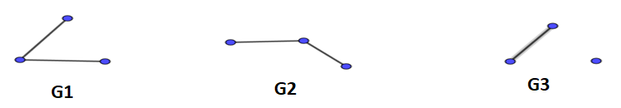
Example 1
Consider the three graph with number of vertices are three.
Graph G1 and G2 in figure each consist of two edge incident with a common vertex. they drawn differently ,but the graphs are same. G1 and G2 are isomorphic.
The graph G3 indicates that this graph has only one edge, G3 is different from G1 and G2 in an essential way, it is not isomorphic to G1 and G2.

Slide 39
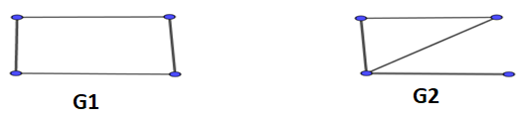
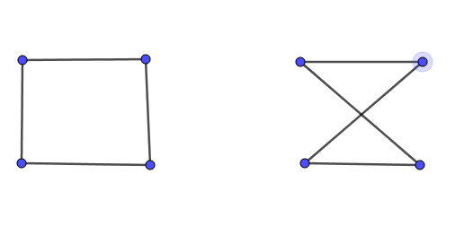
Example 2
These two graphs are not isomorphic. Each graph consists of four vertices and four edges, but G2 contains a vertex of degree 1 while G1 has no such vertex.
Example 3
These graphs are isomorphic .

Slide 40
Suppose two graphs G1 (V1, E1) and G2 (V2, E2) are isomorphic graphs. Then
1. │E1│= │E2│and │V1│= │V2│ i. e. Graphs G1 and G2 must have the same number of edges and vertices.
2. Graphs G1 and G2 must have the same number of regions formed by an equal number of edges.
3. Graphs G1 and G2 must have an equal number of loops.
4. Graphs G1 and G2 must have the same number of parallel edges.
5. Graphs G1 and G2 must have the same number of bridges.

Slide 41
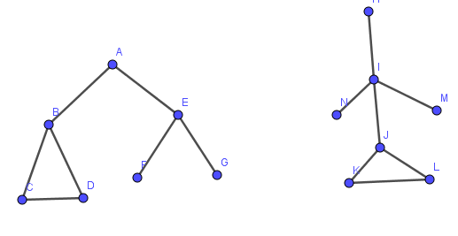
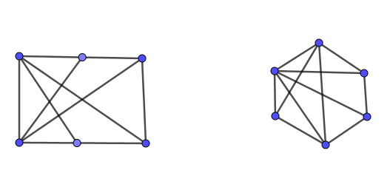
Explain which of the two graphs are isomorphic
1)
2)

Slide 42
END OF UNIT 5

