Slide 1



Slide 2



Slide 3



B TECH. 2ND Year (Sem III)
UNIT 6:
Planar and Non planar graph

Slide 4
Content:
Planar and Non-planar Graphs
Graph embedding
Kuratowski’s first and second graphs
Euler’s formula
Dual graph
Graph coloring and Region coloring

Slide 5
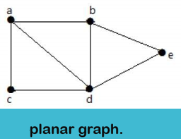
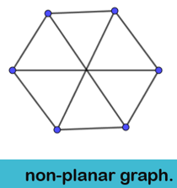

Planar graph
A graph G = (V, E) is said to be planar if it can be drawn on a plane so that no two edges cross each other at a non-vertex point; otherwise it is called non-planar graph.

Slide 6

Embedding
A drawing of a geometric representation of a graph on any surface such that no edge intersects is called embedding.
A geometric graph G is planar if there exists a graph isomorphic to G that is embedded in a plane.
Otherwise G is non planar
An embedding of a planar graph G on a plane is called a plane representation of G.

Slide 7
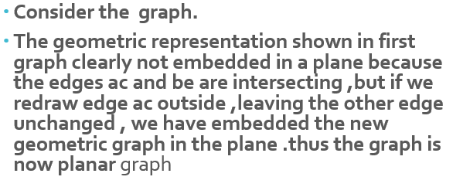
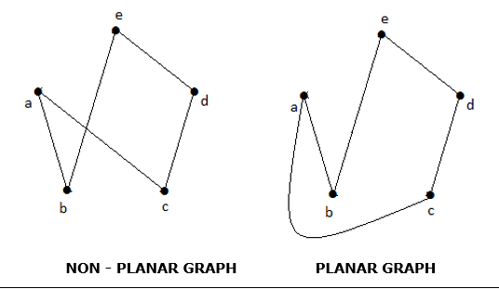

Example

Slide 8
Application
Application of planar graph:
Sometimes, it's really important to be able to draw a graph without crossing edges.
connecting utilities (electricity, water, natural gas) to houses. If we can keep from crossing those lines, it will be safer and easier to install.
Connecting components on a circuit board: the connections on a circuit board cannot cross. If we can connect them without resorting to another layer of traces, it will be cheaper to produce.

Slide 9
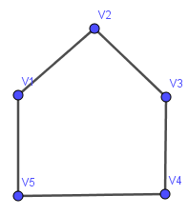
Theorem:
The complete graph with five vertices is nonplanar.
Proof:
Let the five vertices in the complete graph be named V₁, V₂ V₃, V₄, and V5.
A complete graph as you may recall is a simple graph in which every vertex is joined to every other vertex by means of an edge.
This being the case, we must have a circuit going from V₁ to V₂ to V₃ to V₄ to V₅ to V₁ that is pentagon. See the first figure . This pentagon must divide the plane of the paper into two regions, one inside and the other outside.

Slide 10
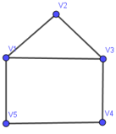
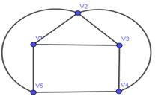
Proof continues….
Since the vertex V₁ is to be connected to V₃ by means of an edge this edge may be drawn inside or outside the pentagon (without intersecting the five edges drawn previously). Suppose that we choose to draw a line from V₁ to V₃ inside the pentagon. See in figure (b) (if we choose outside, we end up with the same argument
Now we have to draw an edge from V₂ to V₄ and another from V₂ to V₅. Since neither of these edge can be drawn inside the pentagon without crossing over the edge already drawn, we draw both of these edges outside the pentagon see the figure

Slide 11
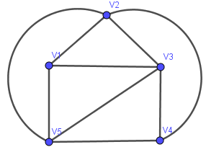
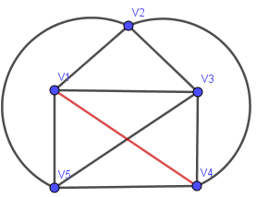
Proof continues….
The edge connecting V₃ and V₅ cannot be drawn outside the pentagon without crossing the edge between V₂ and V₄.
Now we have yet to draw an edge between V₁ and V₄. This edge cannot be placed inside or outside the pentagon without a crossover .Thus the graph cannot be embedded in a plane.
Thus the complete graph of five vertices is nonplanar.

Slide 12
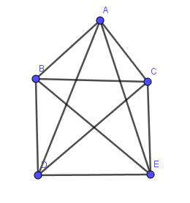
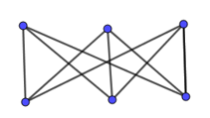
Kuratowski’s two graphs:
The graph K₅ and K _{3, 3} are known as Kuratowski’s graph.

Slide 13
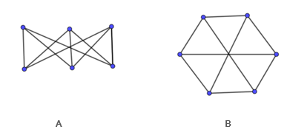
Kuratowski’s Second graph K _{3, 3}
The second graph of Kuratowski’s is a connected graph with six vertices and nine edges, Shown in the two common geometric representation in the following figure (A) and (B)
Employing visual geometric arguments similar to those used in proving above theorem, it can be shown that the second graph of Kuratowski’s is nonplanar.

Slide 14
Properties
(1) Both graph are simple graph
(2) Both are nonplanar
(3) Removal of one edge or a vertex each a planar graph.
(4) kuratowski’s first graph is the nonplanar graph with the smallest number of vertices and the kuratowski’s second graph is the nonplanar with the smallest number of edges. Thus both are simplest nonplanar graphs.

Slide 15
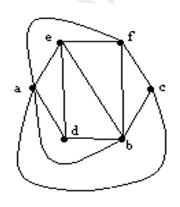
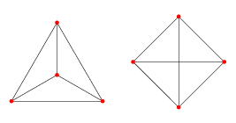
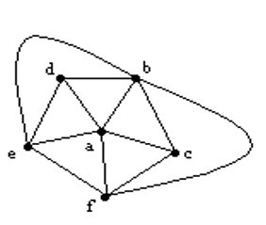

1 . which of the following graph is planar graph :

Slide 16
2 . Check whether the following graphs are planar or not.
K₄
K _{2, 3}
K _{4, 3}
Petersen Graph

Slide 17
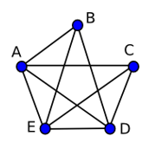
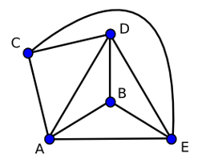
Embedding of following graph into planar graph is possible?

Slide 18
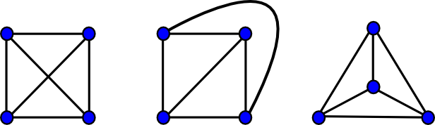
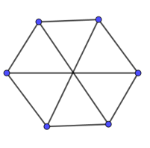
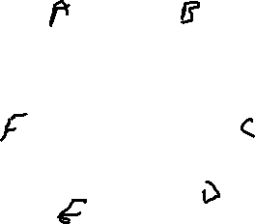

Slide 19
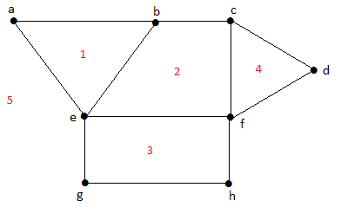

Regions
Definition
Every planar graph divides the plane into connected areas called regions.
See below example
The regions lying inside the graph (i. e. 1, 2, 3, 4) are called interior faces and the region lying outside the graph on the plane is called exterior face (i. e. 5).
Note that the region is not defined in non planar graph.

Slide 20
Euler formula:
A connected planar graph with n vertices and e edges and f is the number of faces (region) then n – e + f = 2.
Proof: By induction on the number of edges in the graph.
Base: For e = 0, the graph consists of a single vertex with a single region surrounding it. So we have 1 − 0 + 1 = 2 which is clearly right.
Induction:
Suppose the formula works for all graphs with no more than e edges. Let G be a graph with e + 1 edges.
Case 1:
G is a tree with e +1 edges. Tree has no cycles. So, it will contain only one face which is exterior face. Thus f = 1. Also in a tree with e +1 edges, the number of vertices are e+2.
Thus, n – e + f = e+2 – (e + 1) + 1 = 2. Thus the formula works for tree with any number of edges.

Slide 21
Proof continues….
Case 2:
Let G be a graph with e + 1 edges and G contains at least one cycle. Pick an edge p that’s on a cycle. Remove p to create a new graph G’. Since the cycle separates the plane into two regions, the regions to either side of p must be distinct. When we remove the edge p, we merge these two regions. So G′has one fewer regions than G. Since G′ has e edges, the formula works for G′by the induction hypothesis.
That is n′− e′ + f′ = 2. But n′= n, e′= e , and f′ = f − 1.
Substituting, we find that n − e + (f − 1) = 2. So n – (e + 1) + f = 2. This proves the formula for G.

Slide 22
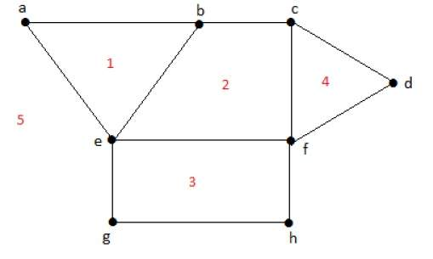
Examples: Verify the Euler theorem for the following graph:
1]
Here number of vertices is n = 8
Number of edges are e = 11, number of faces are f = 5
Now Euler formula is n – e + f
= 8- 11+ 5
= 2 Verified.

Slide 23
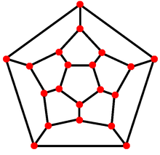
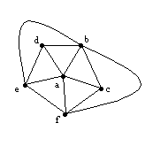

Examples: Verify the Euler theorem for the following graph:
2] 3]
4]
5]

Slide 24
Answer the following questions. 2] 3]
How many faces a Planar graph which contains 8 vertices, 9 edges will have?
How many vertices a Planar graph which contains 7 faces, 11 edges will have?
How many faces a Planar graph which contains 5 vertices, 10 edges will have?
]

Slide 25
Graph duality or Geometric dual: 2] 3]
Definition:
Given a planar graph G, its geometric dual G* is constructed by placing a vertex in each region of G (including the exterior region) and, if two regions have an edge e in common, joining the corresponding vertices by an edge e’ crossing only e. The dual G* of G is again planar graph.
]

Slide 26
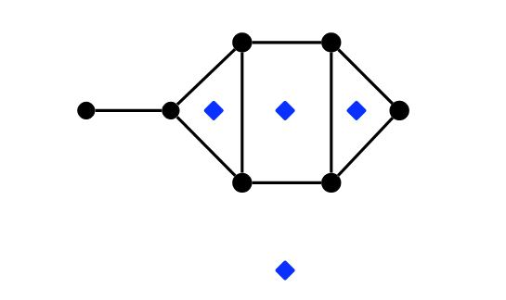
Graph duality or Geometric dual: 2] 3]
Given a planar graph G, its geometric dual G* is constructed by following steps.
Take a plane drawing of G.
Choose one point inside each face of the plane drawing. These points are vertices of G*. (As shown in following figure)
]

Slide 27
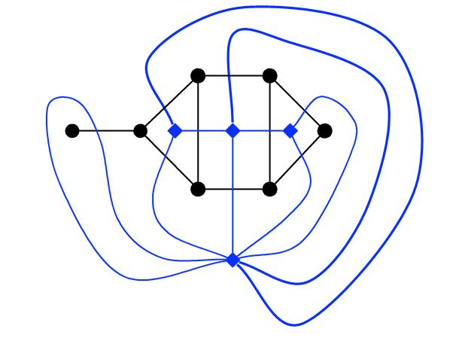
Graph duality or Geometric dual: 2] 3]
For each edge ‘e’ of the graph G, draw a line connecting the vertices of G* on each side of ‘e’. (This means connect the vertices of two adjacent faces by an edge which intersect the edges which connects both the adjacent faces)
For an edge ‘e’, lying entirely in one region, draw a self-loop at that point intersecting the edge ‘e’ exactly once.

Slide 28
Observations
Some observations about geometric duals
If G is connected planar than G* is also connected and planar.
Each plane drawing of G gives rise to only one dual graph G*.
No. of vertices of G* = No. of Faces of G
No. of edges of G* = No. of edges of G
No. of faces of G* = No. of vertices of G
]

Slide 29
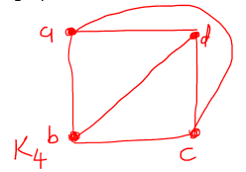
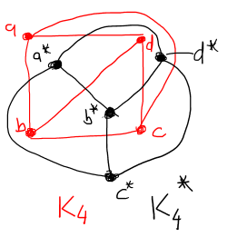
Self-dual graph:
A Graph G is called self-dual graph if G and G* are isomorphic.
For example K₄ and K₄* are isomorphic graphs. Thus it is self-dual graph.
All the wheel graphs are self-dual.
]

Slide 30
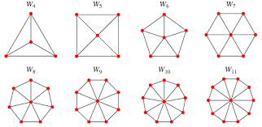
WHEEL GRAPH :
A wheel graph is a graph formed by connecting a single universal vertex to all vertices of a cycle.
Its denoted by Wn, n>3. The no of edges in a wheel graph Wn is ?
Examples
]

Slide 31
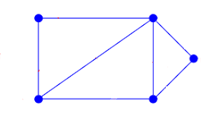
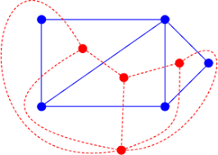
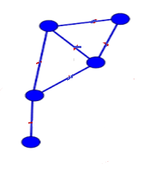
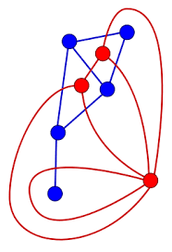
Find Geometric duals for following graphs.
]

Slide 32
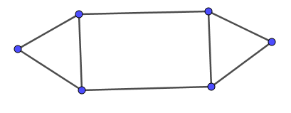
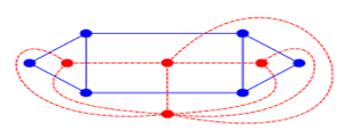
]

Slide 33
Graph coloring:
Graph coloring is nothing but a simple way of labelling graph components such as vertices, edges, and regions under some constraints.
Vertex Coloring
Vertex coloring is an assignment of colors to the vertices of a graph ‘G’ such that no two adjacent vertices have the same color. Simply put, no two vertices of an edge should be of the same color.
Chromatic Number
The minimum number of colors required for vertex coloring of graph ‘G’ is called
as the chromatic number of G, denoted by X(G).
X(G) = 1 if and only if ‘G’ is a null graph. If ‘G’ is not a null graph, then X(G) ≥ 2.
]

Slide 34
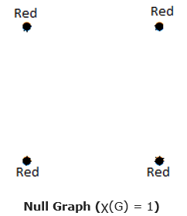
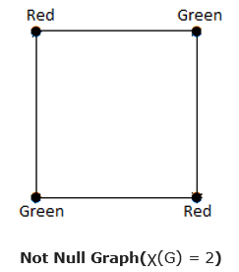
Examples
]
Note: In the complete graph, each vertex is adjacent to remaining (n – 1) vertices. Hence, each vertex requires a new color. Hence the chromatic number of
Kn = n.

Slide 35
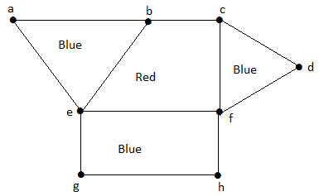
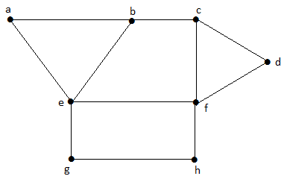
Examples
Region Coloring
Region coloring is an assignment of colors to the regions of a planar graph such that no two adjacent regions have the same color. Two regions are said to be adjacent if they have a common edge.
Example
Take a look at the following graph. The regions ‘aeb’ and ‘befc’ are adjacent, as there is a common edge ‘be’ between those two regions.
Similarly the other regions are also coloured based on the adjacency. This graph is coloured as follows:
]

Slide 36
Applications of Graph Coloring
Graph coloring is one of the most important concepts in graph theory. It is used in many real-time applications of computer science such as:
• Clustering
• Data mining
• Image capturing
• Image segmentation
• Networking
Resource allocation
• Processes scheduling
]

Slide 37
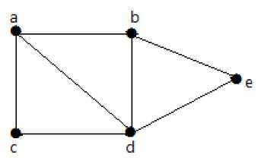
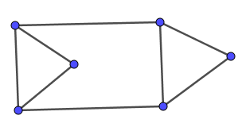
Find the chromatic number for following graphs.
]

Slide 38
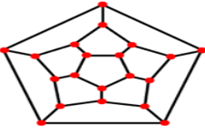
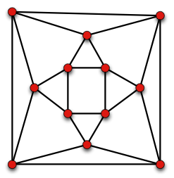
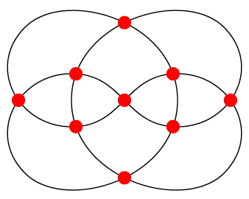














Apply regions coloring
]

