Slide 1
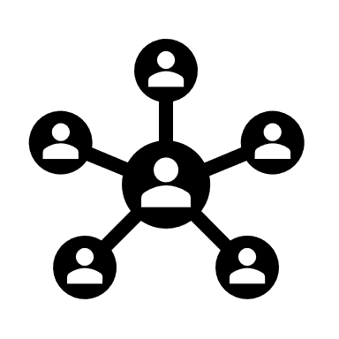
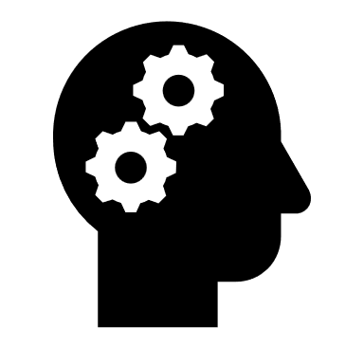
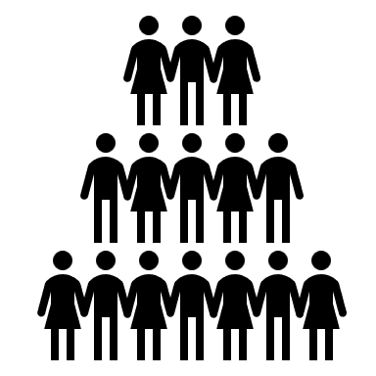
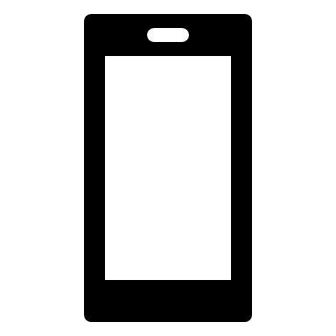
DevConnect
Code Connect Collaborate Your Developer Social Network

Slide 2
Problem Statement
There are nearly 27 million developers worldwide, yet there is not a single platform where you can discover developers, learn through their projects and experiences, and collaborate.
Although there is GitHub where you can showcase your projects but it still lacks the functionality to discover new collaborators.

Slide 3
OUR SOLUTION
A social media platform that showcases your projects promoting collaboration between like minded developers

Slide 4
Features
You can showcase your projects as posts
You explore new projects by other developers and collaborate with them
A personalized recommendation system that helps developers to connect with other’s of similar as well as complimentary skills.
An explore section where you can browse through different projects, personalized by the recommendation system
Log in via GitHub to directly import your existing repositories as projects

Slide 5
Approach
Our approach is to build a webapp using a technology called MERN (MongDB, Express, React, Node.js) to make it strong and easy to use
This helps us store data efficiently, create a reliable backend, and provide user-friendly interface.
With these tools, our app can connect developers and make it simple for them to work together and share their skills and ideas.

Slide 6
UI/UX

Slide 7
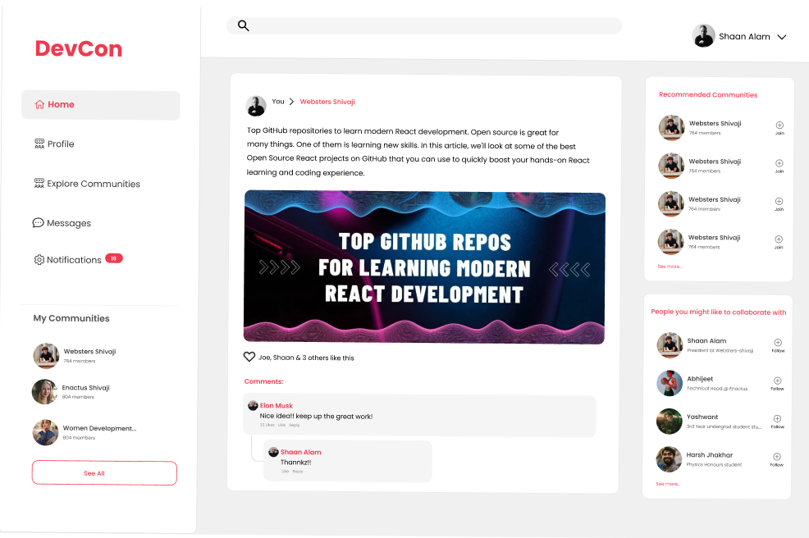
HomePage

