Slide 1
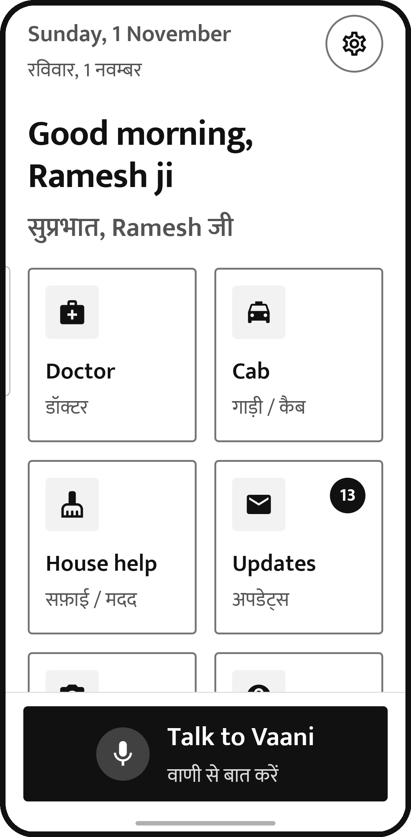

Vaani
वाणी
A voice companion that uses Android for people who find phones hard
Speak in Hindi, English or Hinglish. Nothing irreversible happens until you say “haan”.
Notes:
Vaani lets older, blind and non-technical people use their phone by talking. The screen on the right is the real app: big tiles, Hindi and English side by side, and one large Talk to Vaani button.

Slide 2



THE PROBLEM
Phones now run daily life, and many people are left out
Cabs, doctors, bills and bank OTPs all arrive through apps built for young, literate, sighted users
149 million
42%
₹1,935 cr
Indians aged 60+ in 2022 (10.5%). Projected to be 20.8% of India, 347 million people, by 2050.
of people aged 70+ have smartphone access. Only about two in five people over 60 can use the internet.
lost to “digital arrest” scams in 2024, across 1,23,672 cases, nearly triple the cases of 2023.
Today they hand the phone, and the OTP, to whoever is nearby, go without, or get scammed. Voice assistants can’t finish a task in another app; screen readers can’t complete a booking.
Sources: India Ageing Report 2023, UNFPA & IIPS (via Down To Earth); NSS CMS:T 2025 analysed by LEAD at Krea University (ThePrint); MHA written reply, Rajya Sabha, 12 Mar 2025 (PTI)
Notes:
Three facts: India is ageing fast, older people are being left off the internet, and phone scams are growing fastest among the people least able to spot them.

Slide 3
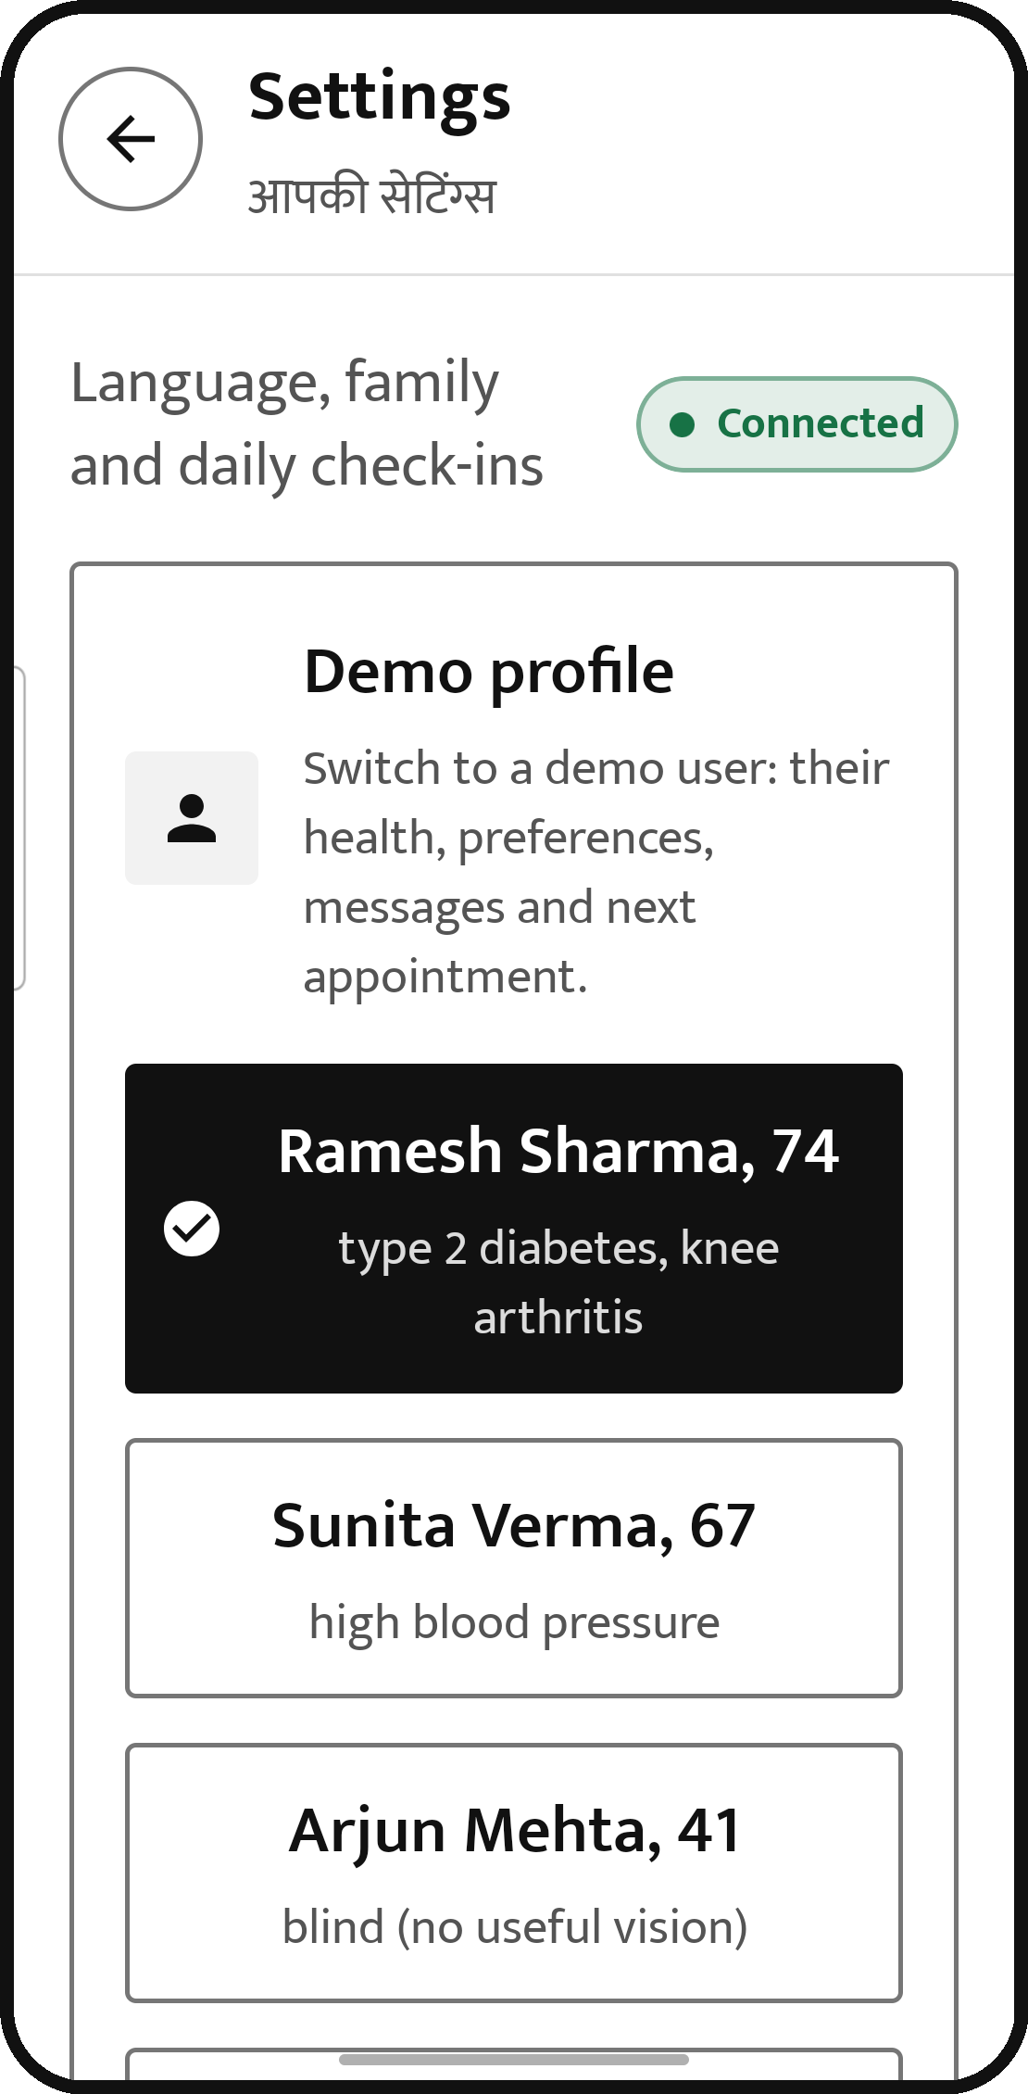
WHO IT IS FOR
Built around three very different people
Same app, three different assistants: language, memory, appointments and skills all change with the person
R
Ramesh Sharma, 74
Hindi only · type 2 diabetes, knee arthritis
Reports his sugar every morning before chai. Son Amit lives in Pune.
S
Sunita Verma, 67
Hinglish · high blood pressure
Checks BP after her evening walk. Loves achaar, asked Vaani to watch her salt.
A
Arjun Mehta, 41
English · totally blind, uses TalkBack
Every number must be spoken. Pays by UPI, splits the bill after Friday dinners.
Real app: Settings → Demo profile
Notes:
We designed for three personas who stand for different kinds of users: an older person living with a chronic condition, an independent person managing hers through diet, and a younger blind user. Picking one in Settings switches the whole assistant.

Slide 4











HOW IT WORKS
The AI suggests. The phone’s code decides. You say “haan”
The rules live in the phone’s code, so they hold even if the AI is fooled
You speak
Vaani understands
AI picks one step
Code checks it
Asks “haan?”
Acts in the app
Hindi, English or Hinglish
What you want, and where
Tap, type or scroll
Rules the AI can’t override
Before anything final
Then looks again
A yes before anything final
Stops at secret screens
A short list of apps
Book, pay, send and add to cart wait for your yes.
PIN, OTP, password and login screens stop it.
Never banking, UPI, WhatsApp or email.
Only links it built
Hard limits
Screen text is data
The AI can’t open a link it made up.
25 steps at most; “Stop” works at any moment.
Orders hidden in a message are ignored.
Notes:
The model only ever proposes one action. SafetyPolicy and AgentLoop on the phone check it, and anything irreversible becomes a yes/no question; a direct tap on a Book button is turned into a question too. These rules are unit-tested.

Slide 5
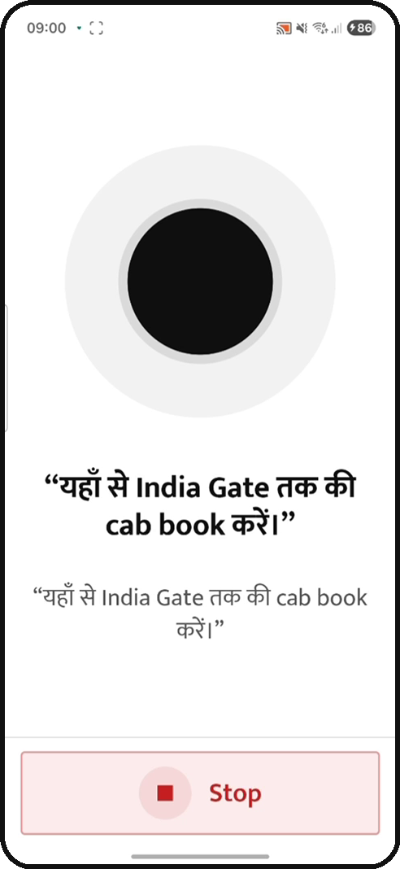
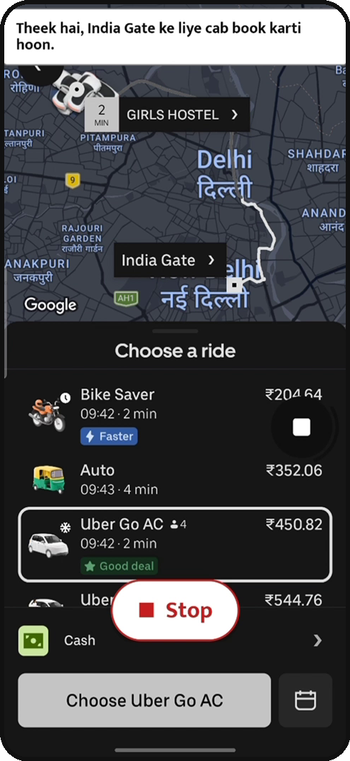
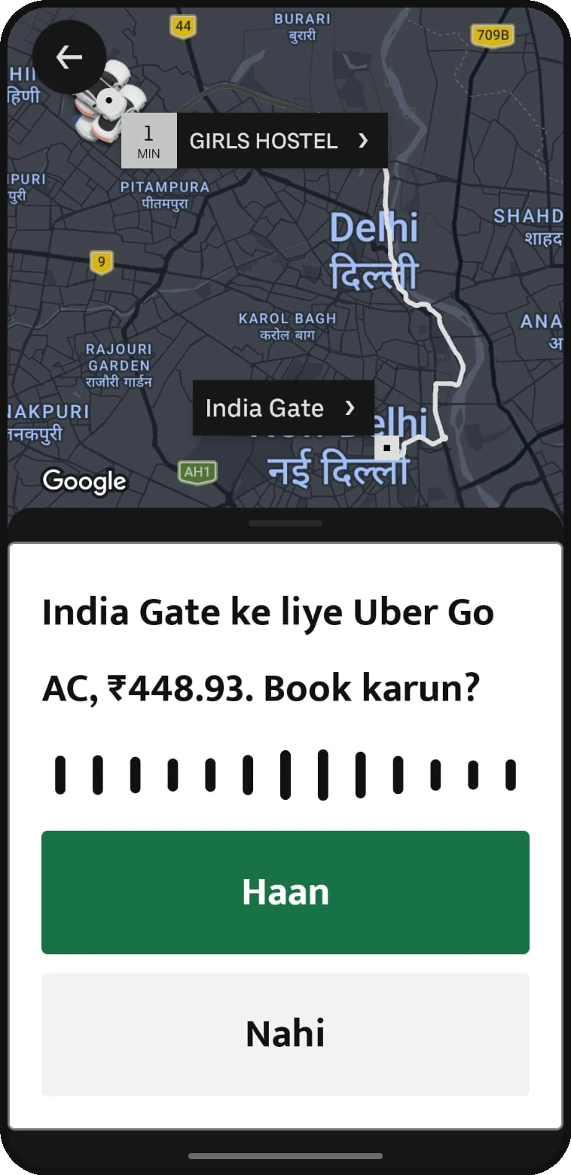
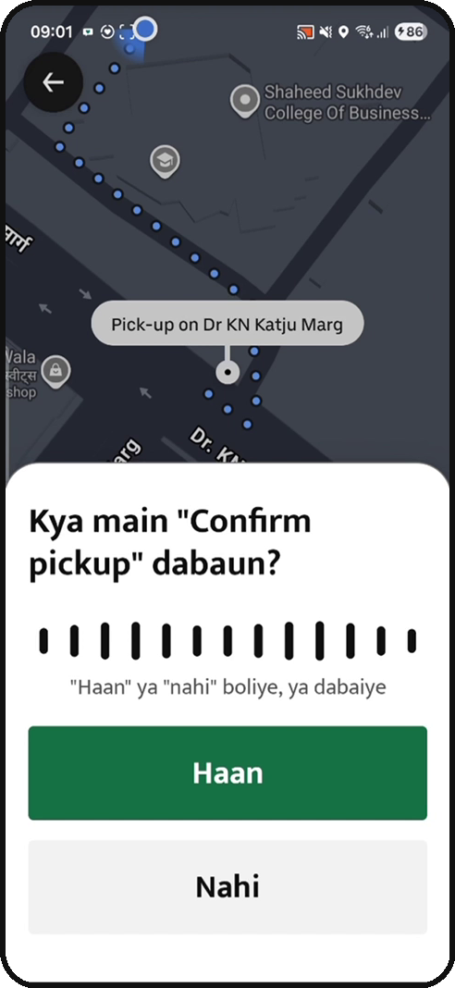
USING APPS FOR YOU
A real run: “Yahan se India Gate tak cab book karein”
Captured from our run on a phone with the real Uber app
1
It listens
Vaani repeats the request back in the user’s own words.
2
It picks a car
“Cab” means a car, so it chooses Uber Go AC, not the cheaper bike.
3
It asks first
Ride and fare read aloud. Only “haan” or a tap books it.
4
Again at pickup
Confirming the pickup spot is also a yes/no question.
Notes:
This is footage from a real run. Vaani heard the request, opened Uber with the destination already set by its own code, chose a car rather than the cheaper bike, and stopped twice for a spoken yes. The confirm sheet in frame 3 is from a second run of the same booking.

Slide 6

USING APPS FOR YOU
Two kinds of apps, one set of rules
Vaani uses the same screen a person sees, read through Android’s accessibility service
Uber: the screen describes itself
Pronto: parts of the screen are hidden
Vaani reads every button as text
Vaani adds a screenshot and taps by position
Where to?
[1] text “Where to?”, button
Cleaning 60 min
screenshot
Uber Go AC ₹450
[2] “Uber Go AC ₹450”, tappable
Go to cart
Book
[3] “Book”, commit button
Go to cart
tap x 812, y 1904
Uber. Vaani’s own code builds the deep link with the destination set; the AI never invents links. Taps go to named elements, so a routine can later replay them.
Pronto. “Added” and the “Go to cart” bar never reach accessibility, so the AI reads the picture. Code still needs a screenshot before any position tap, and Vaani stops at the cart.
Notes:
Uber labels its screen well, so Vaani works from text. Pronto is a React Native app whose tree misses state changes, so every Pronto step also sends a screenshot (with Vaani's own overlays hidden) and the AI taps by coordinates. The safety rules on the next slide hold in both.

Slide 7
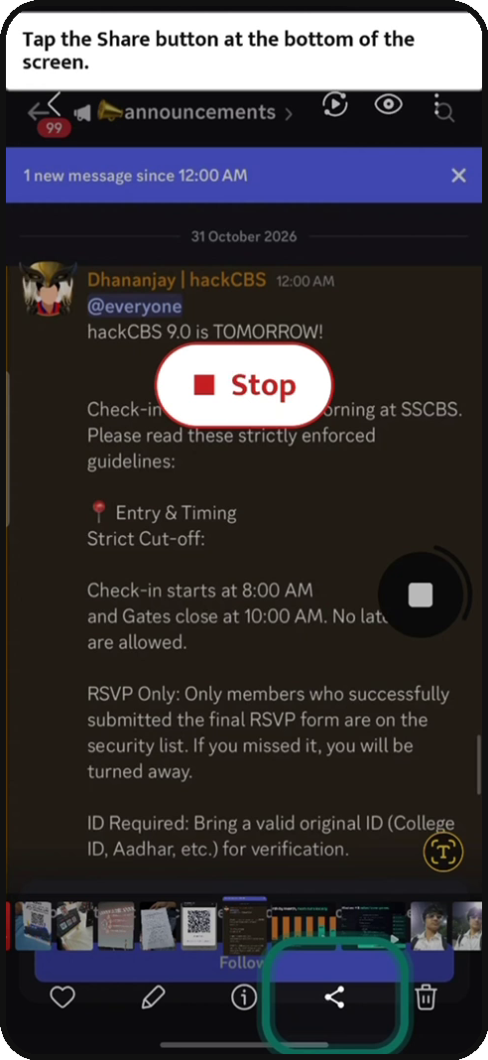
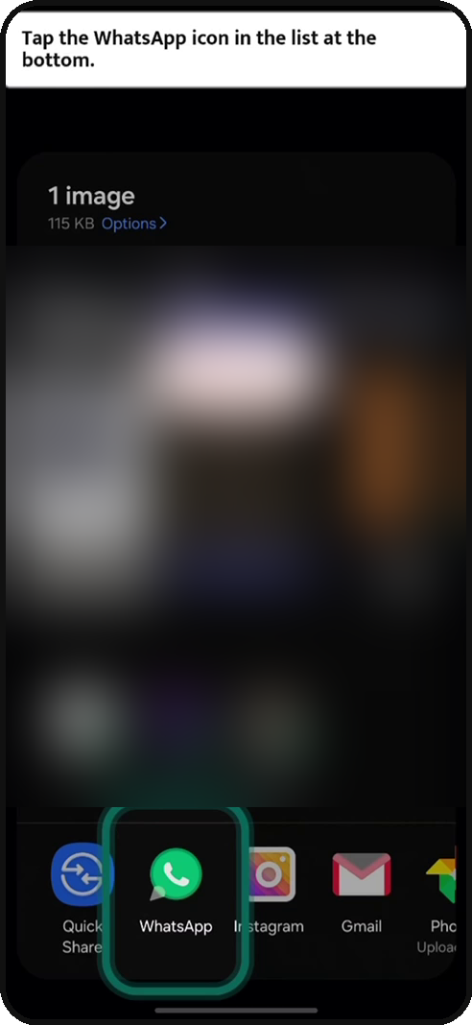
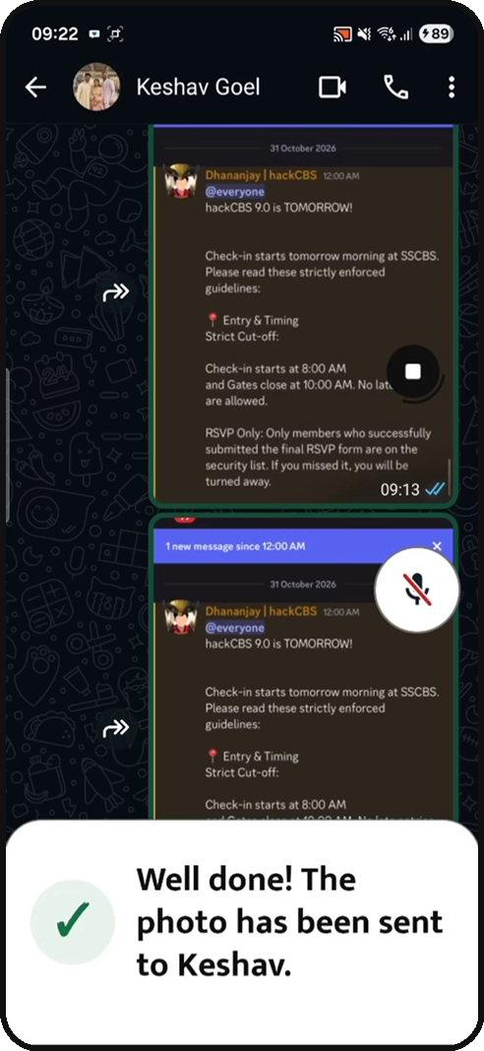
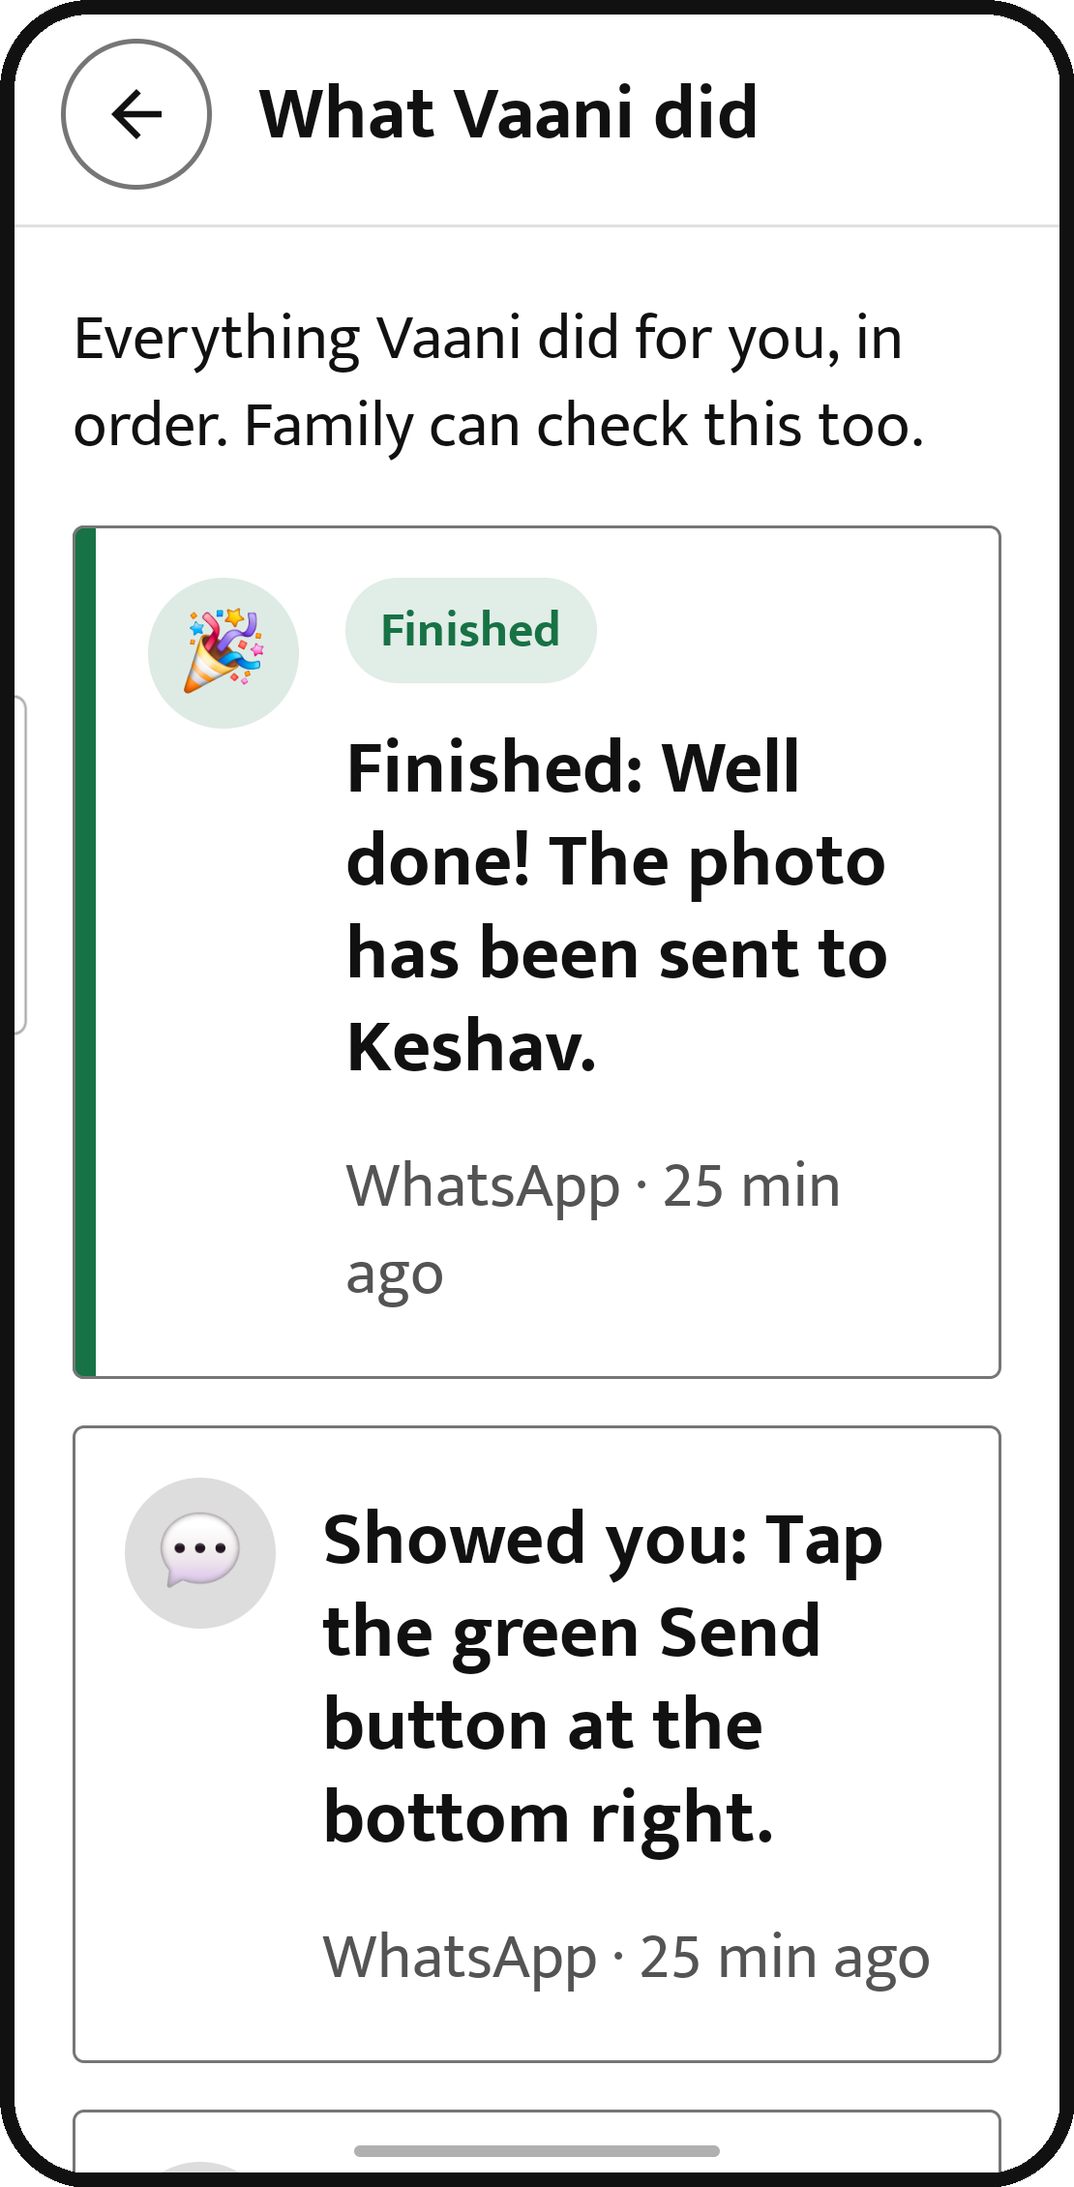
USING APPS FOR YOU
“Show me how”: Vaani points, you tap
A real run: “I want to send this photo to Keshav.” Vaani never taps in this mode
1
Rings the button
“Tap the Share button at the bottom of the screen.”
2
One step at a time
Waits for the user’s tap, then rings the next one.
3
Praises the finish
“Well done! The photo has been sent to Keshav.”
4
Family can check
Every step is in “What Vaani did”, in plain words.
Notes:
Guide mode teaches instead of doing. The teal ring is drawn over WhatsApp by Vaani's overlay; the user does every tap. Part of frame 2 is blurred to hide a contact's number.

Slide 8
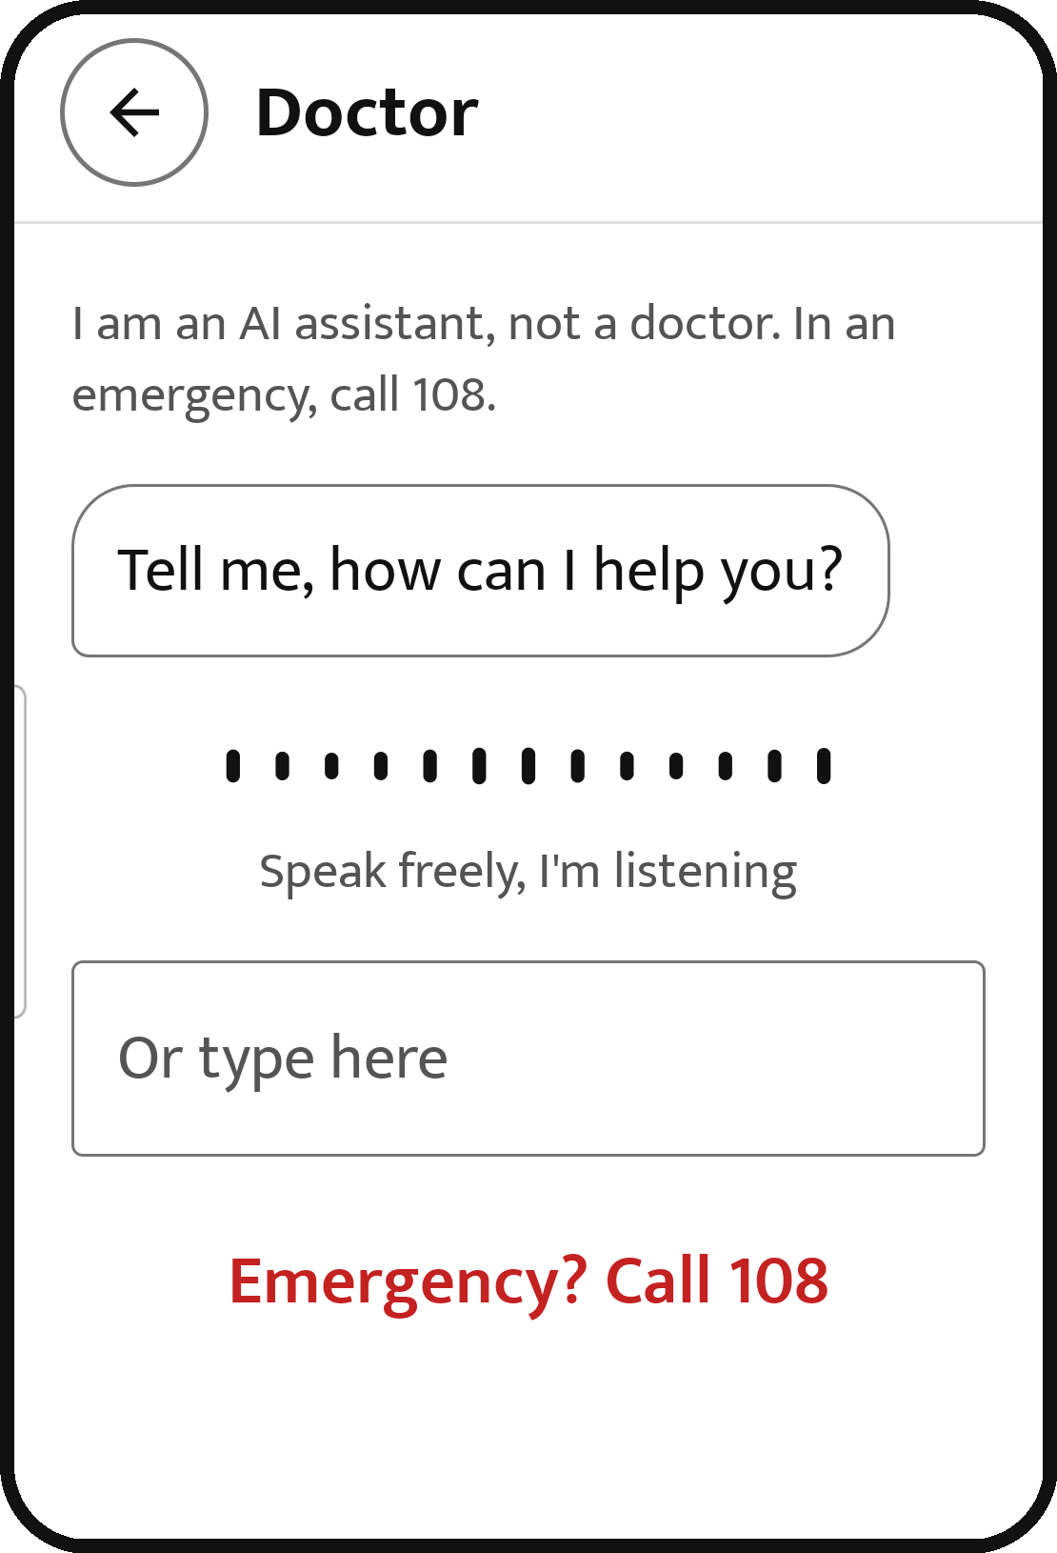
HEALTH
Doctor: is this an emergency? Checked on every sentence
A rule-based safety net runs before any AI, so a slow model never delays help
You describe it
In your own words and language
Safety net, no AI
16 red flags in 3 languages; understands “paseena nahi hai”
Emergency
Not an emergency
Siren and a 15-second countdown; “I’m OK” cancels
Ambulance request with priority, life-support level, GPS and a paramedic handover
Live map with ETA. Never dials 108 by itself
An AI nurse asks at most 3 questions, red flags first
It must answer YES, NO or UNCERTAIN; uncertain is treated as an emergency
Then: find the right hospital
Real app: the doctor screen listens first
India’s 108 has no public API, so dispatch goes to our own realistic ambulance API stand-in, built so a real provider can be plugged in.
Notes:
Two layers so an emergency is never missed because an AI was slow or wrong: deterministic rules first, then an AI intake nurse whose uncertainty counts as an emergency.

Slide 9
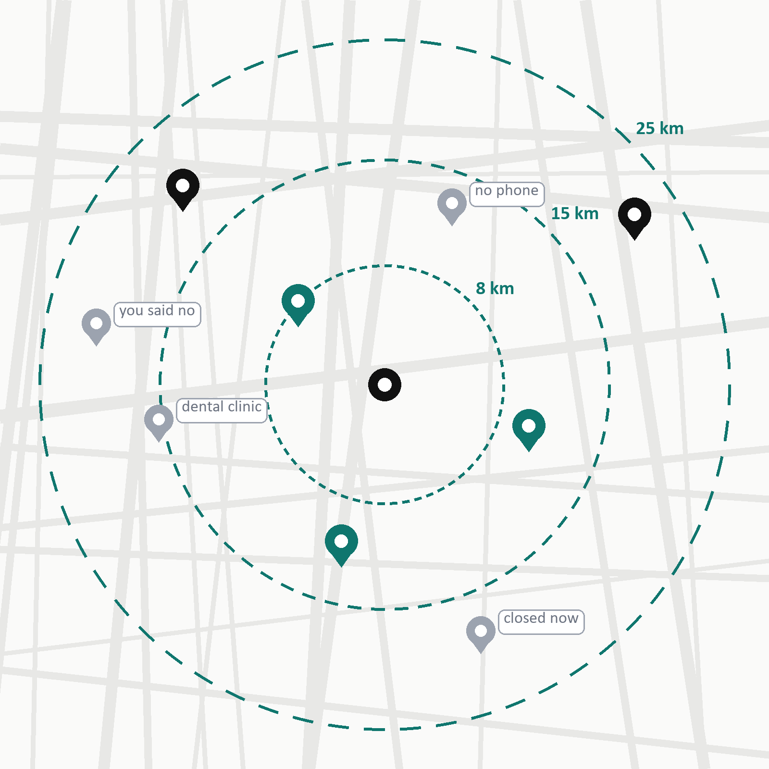




HEALTH
Picking a hospital, then checking with a real person
Facilities, urgency, fee limit, insurance and hospitals to avoid all come from the conversation
Find
Real places from Google, widening 8 → 15 → 25 km, with real driving times.
Filter
Drop no phone, closed now, the wrong kind, and hospitals you said no to.
Score
Can they treat this need, how near, how well reviewed; urgency changes the weights.
Call, and book while they hold
The top 3 are phoned at once to confirm the specialist, facilities, fee and slots. On your “haan”, it books on that same call.
Demo safety: the hospitals shown are real, but every number is swapped for our own test phone. Only allow-listed numbers can ever be dialled.
Notes:
Drawn illustration: grey pins are filtered out with the reason shown, teal pins are the three called first, black pins are backups. The agent shares only an age band and the complaint until the patient says yes, and 'booked' is only reported when the call transcript proves it.

Slide 10



PERSONAL
One memory per person, written by seven agents
Each fact records which part of Vaani learnt it, and where, in that person’s own Meko datapack
voice
Learnt by the care agent “while the hospital was on the line”
Appointment with Dr. Rakesh Gupta at Fortis Memorial Gurugram, Sector 44, Tue 3 Nov, 11:00 · address and map location attached
care
tasks
Sunita’s
memory
Days later: “Mere doctor appointment ke liye cab book kar do”
inbox
The cab goes to Fortis, Sector 44.
She never said where. Vaani says the destination before booking, and it still works after a reinstall or on a new phone.
camera
abilities
family
Notes:
Meko holds one datapack per person, so one person's facts never show up in another's search. Every part of Vaani writes as its own named agent with a learned_from note; that is what lets a booking made by the doctor feature become the destination of a later cab.

Slide 11

PERSONAL
Each person grows different skills
The code keeps the numbers right; the AI words the reply in that person’s own style
R
Ramesh
S
Sunita
A
Arjun
Sugar diary checked against Dr. Kapoor’s targets
Metformin countdown: tells Amit when to reorder
BP diary with a 7-day average; 180/120 is always urgent
Salt budget against WHO’s 5 g a day
Spoken expense log by day, week or category
Bill splitter: ₹2,350, 4 people, 10% tip → ₹647 each
Shows a mango drink to the camera
Shows a packet of chips
Shows either pack
≈ 7 teaspoons of sugar in this pack
0.9 g salt: 18% of her day
Just the label, read aloud
Urgent results (sugar under 70, BP 180/120) are spoken exactly as the code wrote them, without waiting on a model.
Notes:
Six abilities across three people, in three languages. The camera thresholds are the UK FSA front-of-pack 'high' values; code measures, the AI decides how to nudge, once per product. A nudge, never medical advice.

Slide 12
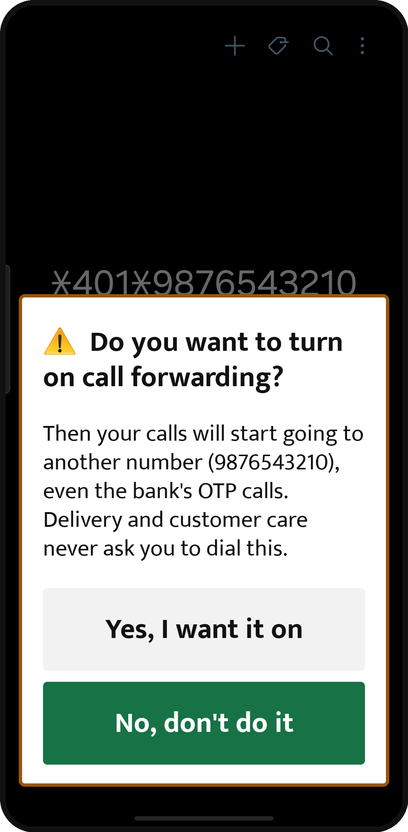
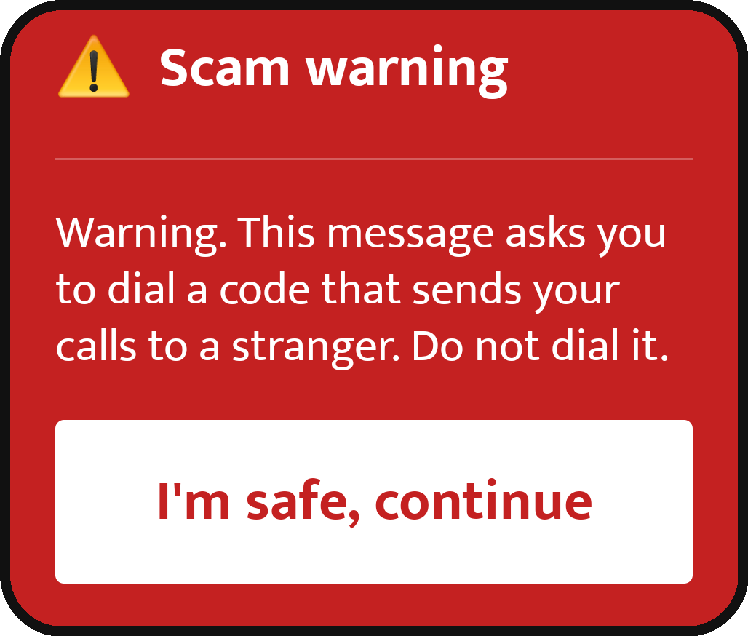

TRUST
Scam Shield warns before money moves
Real screens from the app
Call-forwarding codes
A message asking you to dial *401* gets a red warning. Typing such a code in the dialler asks first.
During a call with a stranger
If an OTP arrives, or a payment or screen-sharing app opens, a loud warning plays in the earpiece.
Links and fake banks
APK links and lookalike bank sites are flagged; links open in our sandbox browser, never on the phone.
Checked on this phone
Scam Shield runs on the device. OTPs never leave it, even when a warning is raised.
Never waits on the internet
Safety voice clips are bundled in the app.
Notes:
Left: typing a call-forwarding code in the phone app triggers a plain-language question. Middle: the red card that covers a forwarding-code SMS. The Safety alerts screen shows Scam Shield is on and that checks happen on the phone.

Slide 13


TRUST
Privacy, measured on our own test set
An audit script runs these checks, and the same checks run as automated tests
Nothing private left the phone
Nothing personal in server logs
We passed 12 realistic SMS, email and WhatsApp messages holding 22 private values (OTPs, account, card, Aadhaar and PAN numbers, UPI IDs, amounts) through the real notification path. None appeared in what would be sent.
We sent 32 requests packed with names, phone numbers and the same secrets through every server route and captured all logs at debug level. None of those values appeared.
Only the owner’s phone can read
Links checked without personal parts
Each install holds its own secret; the server keeps only its hash. Every forged or cross-device request we tried was rejected.
Query strings, tokens and IDs are stripped before a link is checked. All 10 of our test links came out exactly as expected.
How: OTPs and messages from saved contacts never leave the phone. Other private values become placeholders like [P12], and the phone reads the real value aloud itself. The audit also found two gaps; both are fixed.
Notes:
We describe results as what happened on our test set and how we tested. Retention: messages 30 days, task steps 7 days, the doctor session 6 hours; 'forget everything' deletes all memory.

Slide 14
UNDER THE HOOD
Repeated work becomes tested, sealed code
Routines, recognisers and personal abilities all follow this loop; the AI still writes every reply
AI handles it
Our DigitalOcean server: every layer, every run
Static check: safe imports only; no files, network, eval or exec
Candidate
Fingerprint: SHA-256 checked before every run
Tested on runs it never saw
Docker container per job: no network, read-only, 128 MB
Limits: 10 s per case, checked output
Family approves
run(job)
Shadow: runs beside the AI
Fails a check?
Off at once; the AI takes over
Active: code does the work
~0.55 s
0.7 s
Any error
per sandboxed run
to kill a test memory bomb
and the AI answers instead
Notes:
Ported from our earlier project Sorted. Routines compile after 3 good runs and need 90% of held-out runs to replay; recognisers need 40 samples and 95% precision. Model-written code is untrusted: it passes a size cap, a static check and a fingerprint, then runs in a fresh locked-down Docker container. Personal abilities are re-tested in the sandbox at every backend start.

Slide 15
UNDER THE HOOD
Open models, and less AI over time
Every model choice lives in one server file, so providers change without an app update
Qwen 3.8 Max
compiles skills, second opinion
Sarvam
listens and speaks
What keeps costs down
Repeated work becomes code, with no model call
Simple cab requests are understood on the phone
Screenshots only when needed, and compressed
An on-phone classifier when the network is down
Every feature runs without API keys in mock mode
Gemma 4 31B
open-weight · DigitalOcean serverless
~55,000
38%
Gemini
fallback only
Compiled code
no model call at all
model tokens per person per month (simulated estimate)
fewer AI steps once the cab routine is learnt
Notes:
Most reasoning runs on Gemma 4 31B, an open-weight model, on DigitalOcean serverless inference. Qwen 3.8 Max compiles skills; Gemini is a fallback. We have not put rupee prices on it: only token counts are measured.

Slide 16
Your codes never leave your phone. Nothing happens until you say “haan”.
github.com/Aryannnthakurrr/Vaani
Aryan Thakur · Keshav Goel · Anish Manchanda
Notes:
Close on the promise: private by default, and the person stays in charge.

