Slide 1






FROMLIFT
HYBRID NLP SYSTEM FOR INFORMAL-TO-FORMAL TEXT STYLE TRANSFER
ARCHITECTURE HIGHLIGHTS: RULE ENGINE + FINE-TUNED T5-SMALL + FLASK REST API
Name: Aryan Prakash Pilwalkar
UIN: 231A016
Rollno: 40
Class : BE (AI & DS)

Slide 2
PROBLEM STATEMENT
The Problem: Informal digital text contains SMS abbreviations (u, asap), slang (gonna), missing punctuation, and contractions (cant).Pure spelling/grammar correction tools fail to adjust sentence tone and formality structure.
Why Pure Transformer Alone Fails: Neural models can hallucinate, alter meaning, or inconsistently handle simple abbreviations.
Why Pure Rule Engine Alone Fails: Rules are context-blind and cannot restructure complex sentences or adjust pragmatic tone.

Slide 3
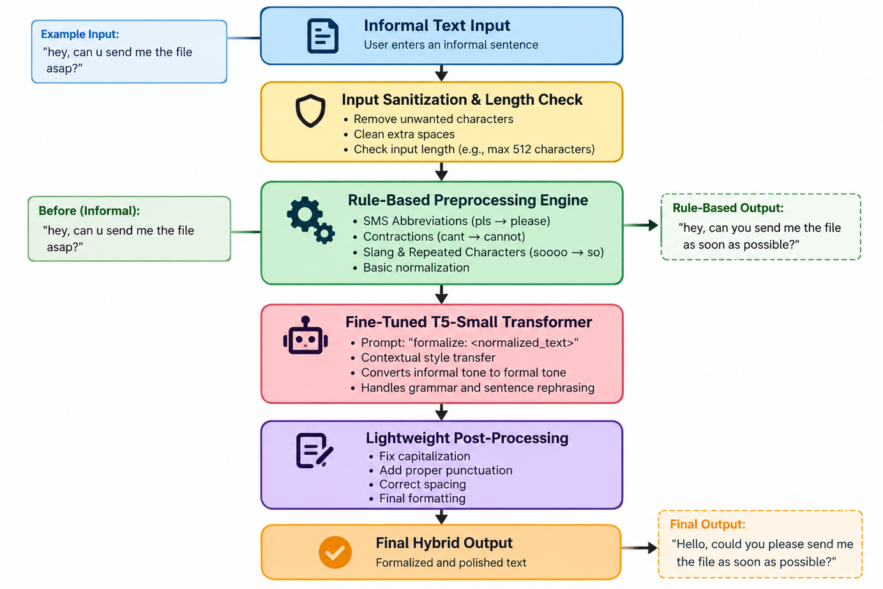
SYSTEM ARCHITECTURE

Slide 4
DATASET & TRANSFORMER FINE-TUNING
Dataset Selection:
  Source: Grammarly CoEdIT Dataset (grammarly/coedit, Apache 2.0)
  Filter: ~16,000 clean informal–formal sentence pairs
  Split: 80% Train | 10% Validation | 10% Test
Model Selection:
  Backbone: google-t5/t5-small (~60 Million Parameters)
  Reasoning: Lightweight for CPU inference, zero-shot task prefix support, fits free Colab GPU limits.
Training Setup (Google Colab T4 GPU):
  Max Sequence Length: 64 tokens (covers >98% of inputs based on token length distribution)
  Hyperparameters: 4 Epochs, Batch Size = 32, Learning Rate = 5e-4, Weight Decay = 0.01

Slide 5
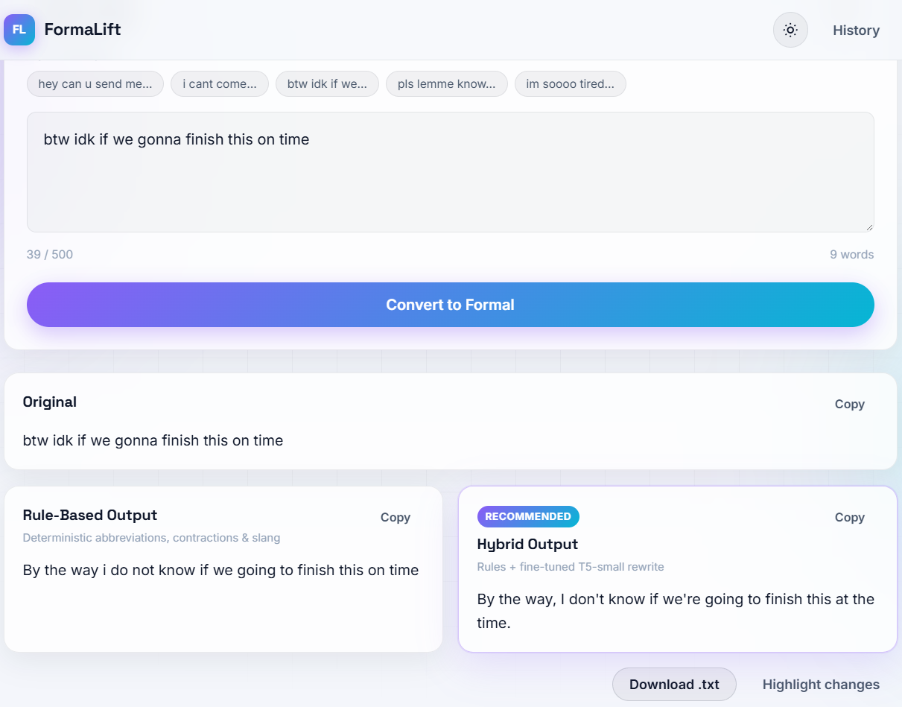
OUTPUT

Slide 6
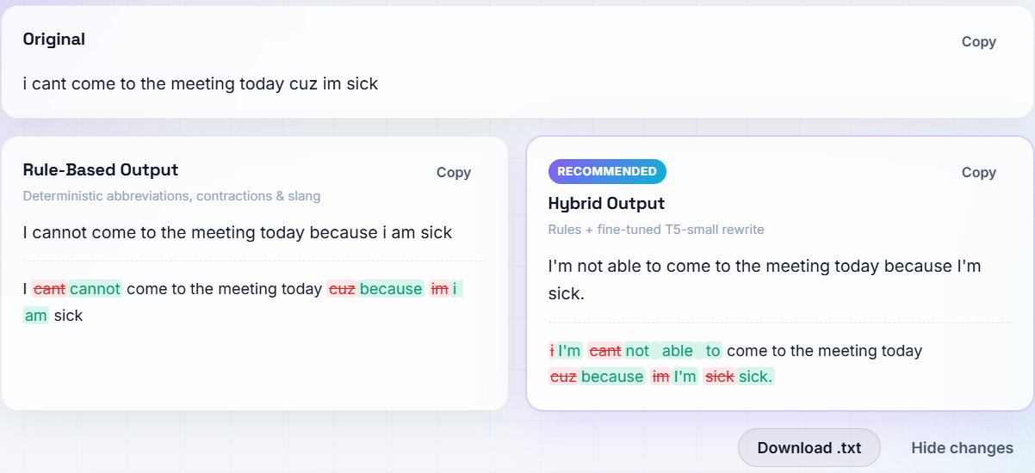
OUTPUT

Slide 7
APPLICATION FEATURES & TECH STACK
Web Application Features:
  Side-by-Side Output Comparison (Rule-Based vs. Hybrid)
  Word-Level Difference Highlighting
  Conversion History (localStorage)
  One-Click Copy, Clear, and .txt Download
  Dark / Light Theme Toggle & GSAP Entrance Animations
Technology Stack:
  Backend: Flask REST API, PyTorch, Hugging Face Transformers
  Frontend: Vanilla HTML5, CSS3 Glassmorphism, JavaScript, GSAP

