Slide 1
JupyterHub
Presentors:
ISAIC

Slide 2

Today’s Discussion
About JupyterHub and Jupyter Notebooks
How to Access JupyterHub
Login into JupyterLab
JupyterLab Environment
How to install different Libraries in JupyterLab
Difference between Jupyter Notebooks and Python Files
Different Python Modules in Data Science and Neural Networks

Slide 3
Today’s Discussion
Shell Command in Jupyter Notebook
GPU Information
Out Of Memory Error
Convenient Features/Commands
Download a Notebook
Upload files in the File Directory
ISAIC’s Role in JupyterHub
Admin Controls

Slide 4
About JupyterHub and Jupyter Notebooks
JupyterHub is the best way to serve Jupyter notebook for multiple users. It can be used in a class of students, a corporate data science group, or scientific research group. It is a multi-user Hub that spawns, manages, and proxies multiple instances of the single-user Jupyter notebook server.
The Jupyter Notebook is an open-source web application that allows you to interact with data, create and share documents that contain live code, equations, visualizations, narrative text and program using python, Julia, Spark etc.
We provide ISAIC branded the Littlest JupyterHub which is a branch of JupyterHub. It is small scale, easy to install, deploy and manage JupyterHub which is available for Ubuntu 18.04 or Ubuntu 20.04 on a amd64 or arm64 CPU architecture.
With the proxies and how it handles port forwarding one IP address can be representative of the Hub and hence multiple users can login and use Jupyter Notebooks from that one IP address.

Slide 5
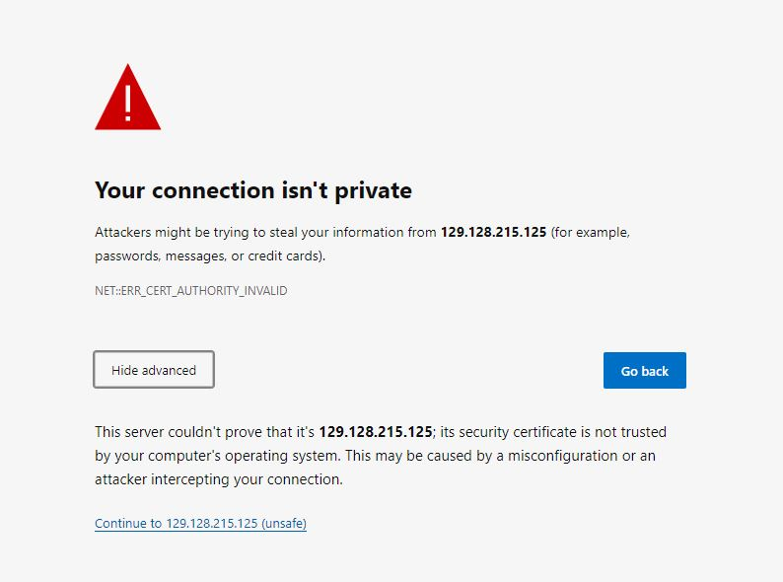
How to Access JupyterHub
Go to the browser and enter the IP address Link that has been provided to you
Note that It says the connection is not secure. This is because we use a self signed SSL certificate and the browser doesn’t recognise it
Click on the “Advanced” button and then click on the “proceed to <IP address> (unsafe)” link at the bottom
In case there is no Advanced option Just follow the instructions in this link https://dev.to/brettimus/this-is-unsafe-and-a-bad-idea-5ej4

Slide 6
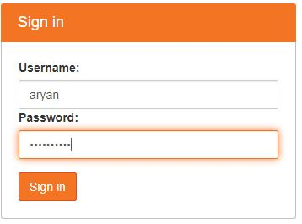
Login into JupyterLab
This should take you to the login page of the JupyterHub
Here you enter the username that has been assigned to you and create your own password that you will use to login from the next time
This should take you to JupyterLab home page.

Slide 7
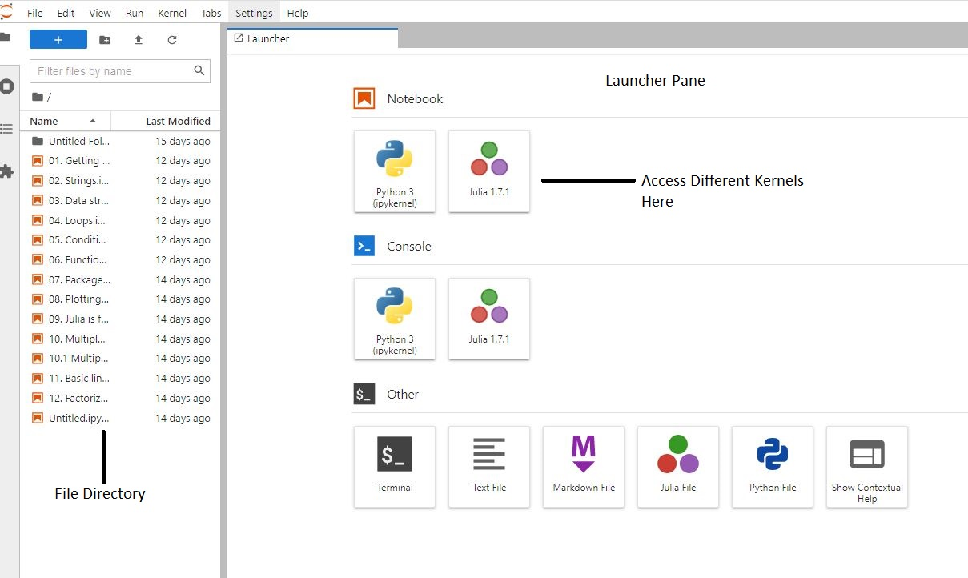
JupyterLab Environment
JupyterLab is the latest web-based interactive development environment for notebooks, code, and data
In the launcher pane you can create a jupyter notebook
In the file directory you can access the newly created notebook or you can upload existing notebooks
When you right click on a notebook in the file directory you are also able to:
Rename the notebook
Delete the notebook
Download the notebook
And, Other basic functions
To create a new python notebook you have to click the python3 kernel under the Notebook title. It creates an untitled.ipynb notebook.(IPYthon NoteBook)

Slide 8

How to install different Libraries in JupyterLab
To run any libraries in the notebook you have to download the libraries in the terminal. For example if you cannot run Numpy in the notebook then you have to download Numpy in the terminal that you can find in the launcher page using this code:
$ sudo -E pip install numpy
Or you can run the same command in the Jupyter Notebook by preceding it with an exclamation mark “!” as follows:
! sudo -E pip install numpy
Now if you restart your kernel from the kernel tab you will see that you are able to run numpy
This way you can download any libraries that are not pre installed
In the JupyterHub launcher you can also open a python file under the “Other” section

Slide 9
Difference between Jupyter Notebook and Python File
The main difference between a Jupyter Notebook and a python file is that in the notebook you can run each block of code separately and this makes it easier to debug your code and only run the cell that you want, whereas in a python file it is harder to locate the bugs and even after solving the bugs you will have to run the whole code each time making it inefficient
You can run the Jupyter Notebook by just clicking the run button where as to run the python file you have to use the terminal and run the file similar to:
$ python3 test.py
You can add headings in the Notebook as well by changing the cell to a markdown and using ‘#’ to change the size of the heading. For eg: ‘# Heading 1’ will be larger than ‘## Heading 2’ in the markdown.

Slide 10
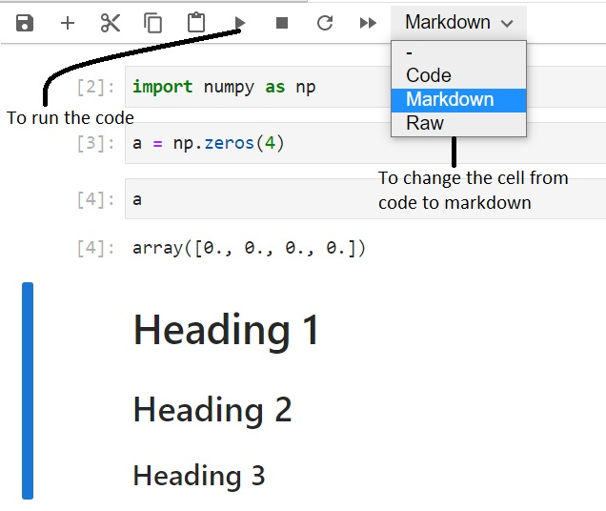
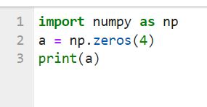

Jupyter Notebook Python File
To run a Python File in the terminal:
(Here isaictest.py is the name of the python file.)

Slide 11
Different Modules for Data Science and Neural Networks
Python is adapted by data scientists more than any other language
It has good support for neural networks and data science modules
For e.g.:
Apache MXNet
PyTorch
Tensorflow
Keras
Scikit-Learn
Etc.

Slide 12
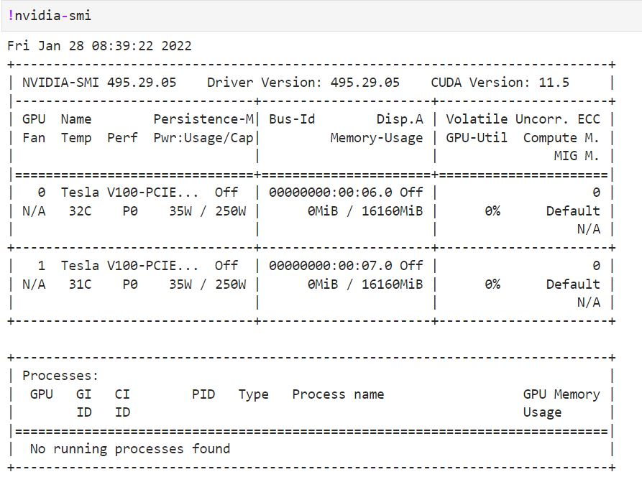
Shell Command in Jupyter Notebook
To use shell command in the notebook you can use the ‘!’ before your command and it will work.
For e.g.:

Slide 13
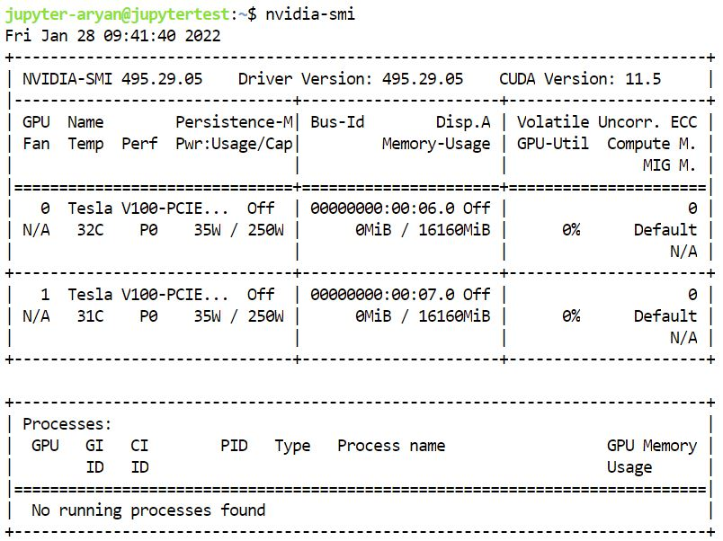
GPU information
At ISAIC when we provide JupyterHub we sometimes include GPUs for the users.
If your service comes with GPUs then the ‘nvidia-smi’ command that was used in the last slide gives you the information on our GPUs.
It tells us:
The driver version
CUDA version
Memory usage (out of 16160MB)
Number of GPUs (2 for this example
server)
Processes running on the GPUs
Power usage of the GPUs
….

Slide 14
Out Of Memory Error
In some cases when the users are running their codes in the GPUs, based on the configuration of the model for eg: PyTorch the code by default runs on GPU 0. Hence if there are a lot of users using this configuration then they are all using the same GPU meaning GPU number 0. So once the memory of the GPU is completely used then any users who try running their code will get an “out of memory” error.
Solution: When this happens you need to tell the python kernel to use a different GPU that has compute resources available.
We can specify which PCI Express devices are available to each kernel hence specifying which GPU to ultimately used as they are PCI Connected devices on the servers.

Slide 15

Command for specifying which PCIE connection to use on the OS:
For python file (in the terminal)- CUDA_VISIBLE_DEVICES=x python ./prog.py
Here ‘x’ is the free GPU index that the user wants to use that you can get by running and observing the resource usage through the Nvidia-smi command. The user can get the GPU index from the nvidia-smi command and ‘prog.py’ is the name of your python file. This parameter can be passed on through the command line as follows:
Here the code was executed on the second GPU since the indexing starts from 0.
For Jupyter Notebook code to specify which GPU- import and use the os Module;
os.environ[‘CUDA_VISIBLE_DEVICES’]=”x”
Here ‘x’ is the free GPU index that the user wants to use.
(Note: This code should be the first block of code should be executed in the notebook)

Slide 16
Convenient Features/Commands
When we use nvidia-smi command it gives us the details for a specific time stamp. Instead we can use a command to automatically call nvidia-smi in regular time intervals: watch -n t nvidia-smi
Here, “t” is time in seconds
This command will update the nvidia-smi table every 2 seconds. You can set “t” to whatever interval you want.
Another convenient feature is that you can drag the terminal to the side or bottom of your screen and run your Notebook or python file simultaneously while having the terminal open.
Just drag by your mouse until the panes rearrange on the next slide there is an example of this.

Slide 17
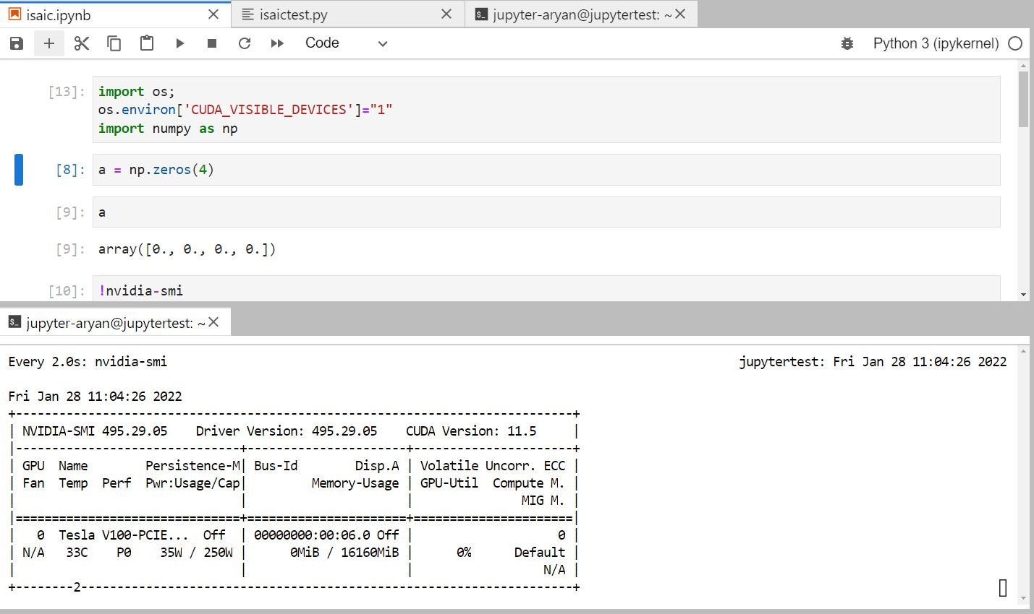

Slide 18
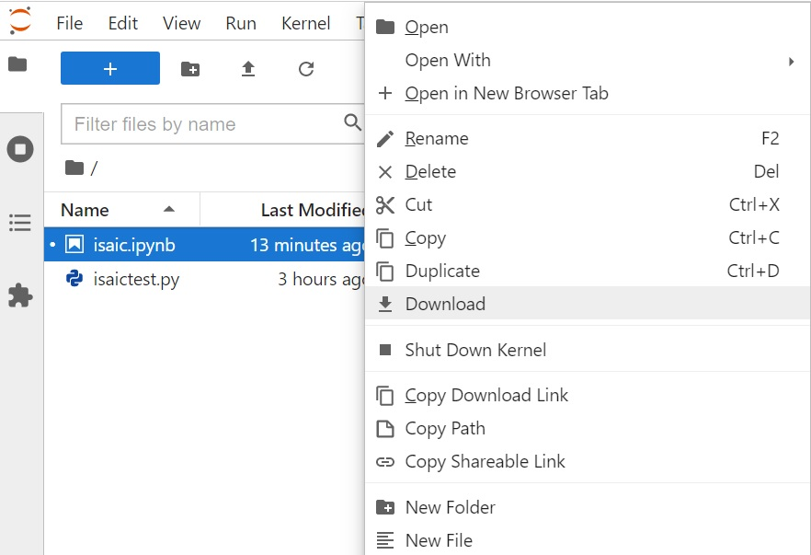
Download Files
When you download your notebook (or any files), it gets downloaded in your downloads folder of your computer. Following you can see how one can download their notebook by right clicking on the file for the corresponding notebook in the File browser pane

Slide 19
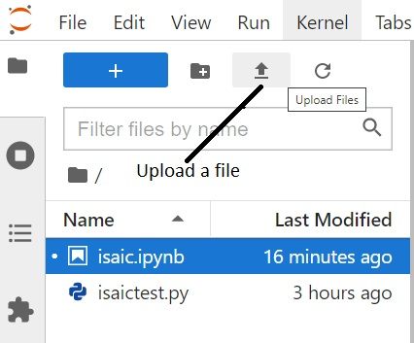
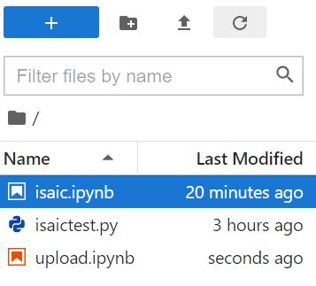
Upload Files in the File Directory
You can also upload any file that you want into the file directory:
Once uploaded the file will show up in the current file directory that you have added this to:

Slide 20
ISAIC’s Role in JupyterHub
We can limit users to a specific number of CPU cores and available memory.
We can set the idle time culling to a certain time which means that if the kernel has been ideal for more than the specified time then it automatically shuts down releasing the memory in the GPU.
Password Recovery
When you complete running your code and send some data to the GPU, the memory of the GPU device gets utilised and even after the code is finished the kernel is loaded in the GPU hence the kernel keeps using the memory of the GPU for no reason at all.
After your computations are done and you have saved your models. To free up the memory of the GPU you need to shutdown the kernel. We usually solve it by using an specified timeout for the idle kernels but shutting down the kernel is a good practice to develop when you finish executing your code to free up resources for others to use.
Shutting Down your Kernels

Slide 21
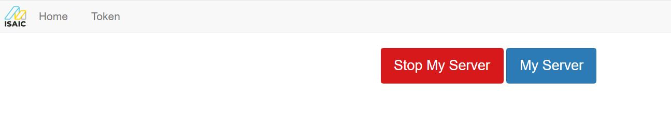
Hub Controls For Users
You can access the controls from the ‘hub control panel’ under the File tab in the JupyterLab.
Here you can:
Stop/start your own server (Don't ShutDown the HUB on your own and ask ISAIC for this)
Under the token tab you can set your API. For e.g. you can connect your Visual Studio code

Slide 22
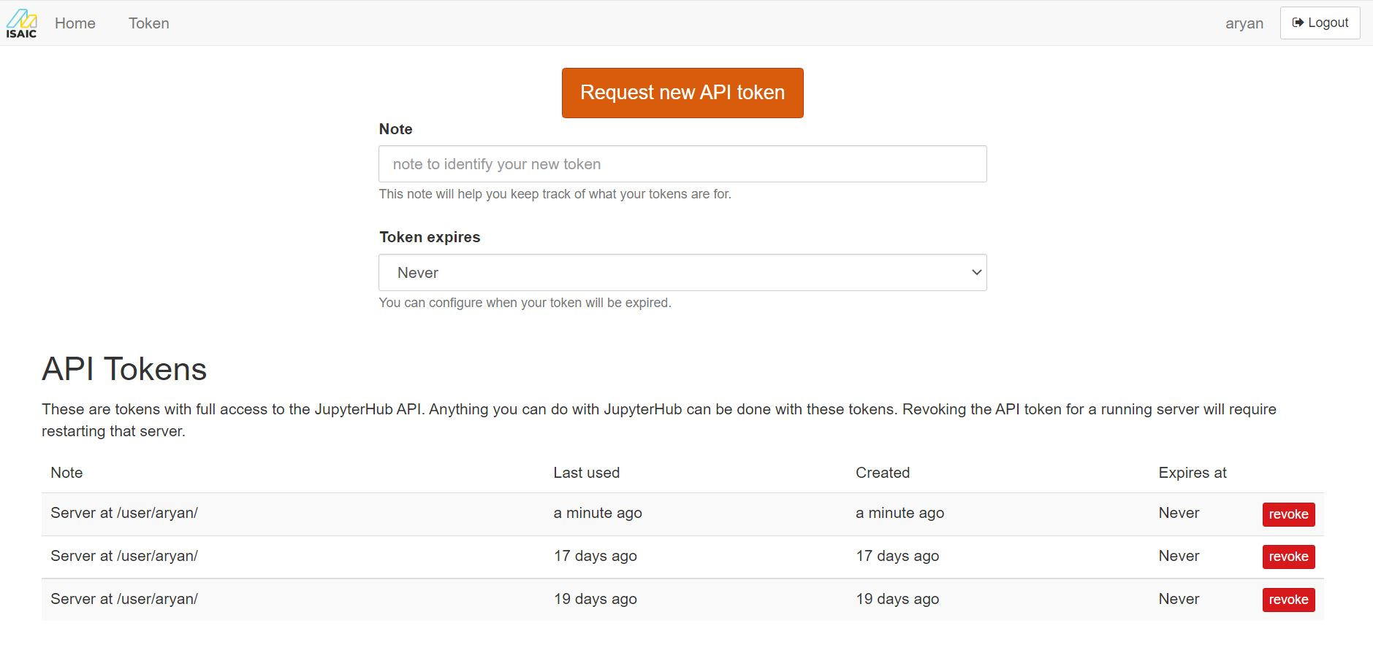

Slide 23
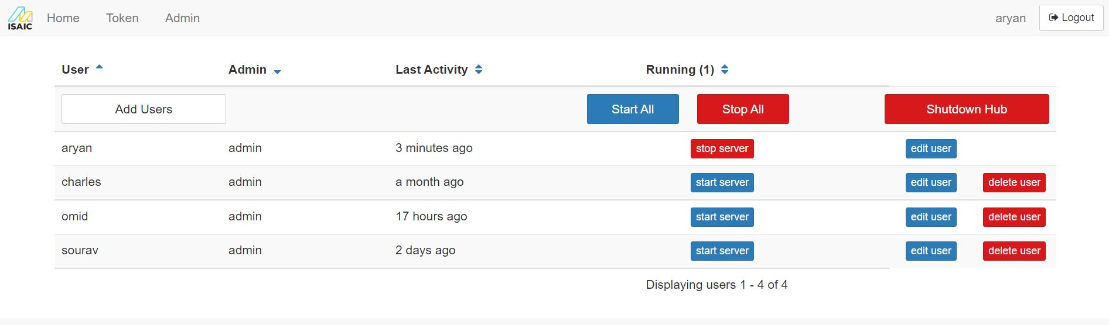
Hub Controls For Admin
Under the Admin tab you get access to all the users
You can see when all the users were last active
You can add, delete, and edit users
You can start and stop all the servers

