Slide 1
Natural Language Query-based Table Retrieval
Team – 8
Aryan Gupta (2022202028)
Utkarsh Pathak (2022201018)

Slide 2
Problem Statement
The goal of this project is to develop an efficient and user-friendly system that allows users to query a corpus of structured tables using natural language queries.
The system should be capable of understating and interpreting user questions, translating them into actionable queries against the corpus, and presenting relevant answers.

Slide 3
Overview
Given natural language questions and a large table corpus, an end-to-end table
retrieval and QA system unifies two tasks:
Answering the questions using table cell(s)
Locating a list of tables—highly relevant to the given questions, and

Slide 4
Datasets
Given natural language questions and a large table corpus, an end-to-end table
WikiSQL consists of a corpus of 87,726 hand-annotated SQL queries and natural language question pairs.
TabMCQ is a multiple-choice, lookup TableQA dataset over general science tables. We discard the multiple-choice setting and treat it as a standard open-ended QA task.
WikiTableQuestions comprised question-answer pairs on HTML tables and was constructed by selecting data tables from Wikipedia that contain at least 8 rows and 5 columns.

Slide 5
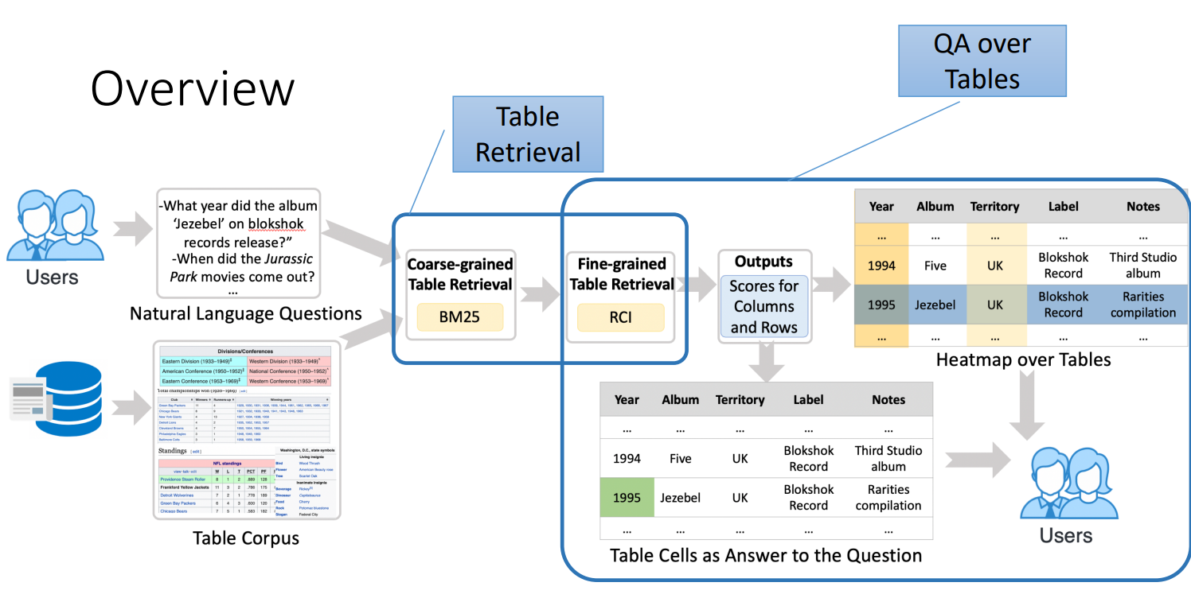
Architecture

Slide 6
Row Column Intersection (RCI)
Two approaches to the sequence-pair classification task in RCI:
Interaction: models use the self-attention of a transformer over the concatenated two sequences. This is the standard approach to sequence-pair classification tasks
Representation: models independently project each sequence of the sequence-pair to a vector, then compare those vectors

Slide 7
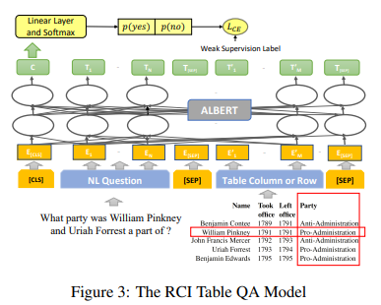
Interaction model

Slide 8
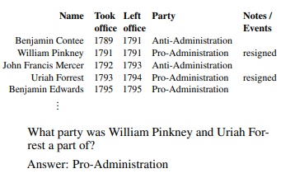
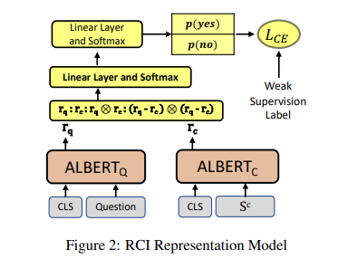
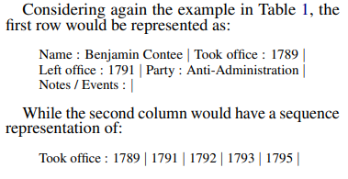
Representation model

Slide 9
Baselines
Google’s TAPAS
TAPAS (Table-based Pretraining and Sequential Reasoning for Question Answering) is a language model designed for answering natural language questions using tables as the primary source of information.
Facebook’s TABERT
TaBERT is the first model that has been trained to learn representations for both natural language sentences and tabular data.

Slide 10
Evaluation Metrices
Mean Reciprocal Rank is computed by finding the rank of the first correct cell prediction for each question and averaging its reciprocal.
Hit@1 simply measures the fraction of questions that are correctly answered by the first cell prediction.

Slide 11
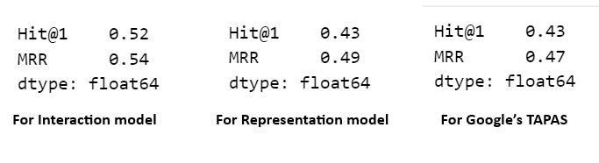
Results

Slide 12
THANK YOU!

