Slide 1
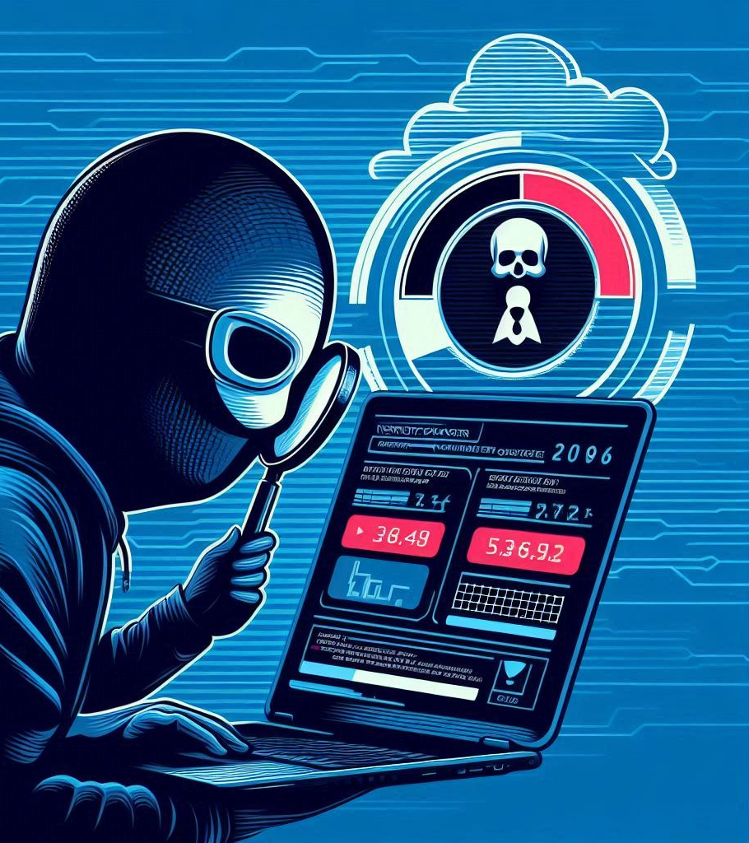
Vulnerability Scanner
Team Details:
Team name: Tech Breakers
Team leader name: Aryan Shukla
Build Name: Safe Guard(Vulnerability Scanner)
Problem Statement:Organizations struggle to identify and mitigate network vulnerabilities, such as open ports, weak services, and misconfigurations, which can lead to unauthorized access and data breaches.

Slide 2







About Project:
Develop a network vulnerability scanner that can accurately detect and report on network-level vulnerabilities, providing actionable insights to prioritize remediation efforts.
Vulnerability scanners are automated tools that identify potential security weaknesses in systems, networks, and software. They work by scanning for known vulnerabilities, such as outdated software, missing patches, or misconfigurations. By proactively detecting these vulnerabilities, organizations can take steps to fix them before they can be exploited by attackers.

Slide 3
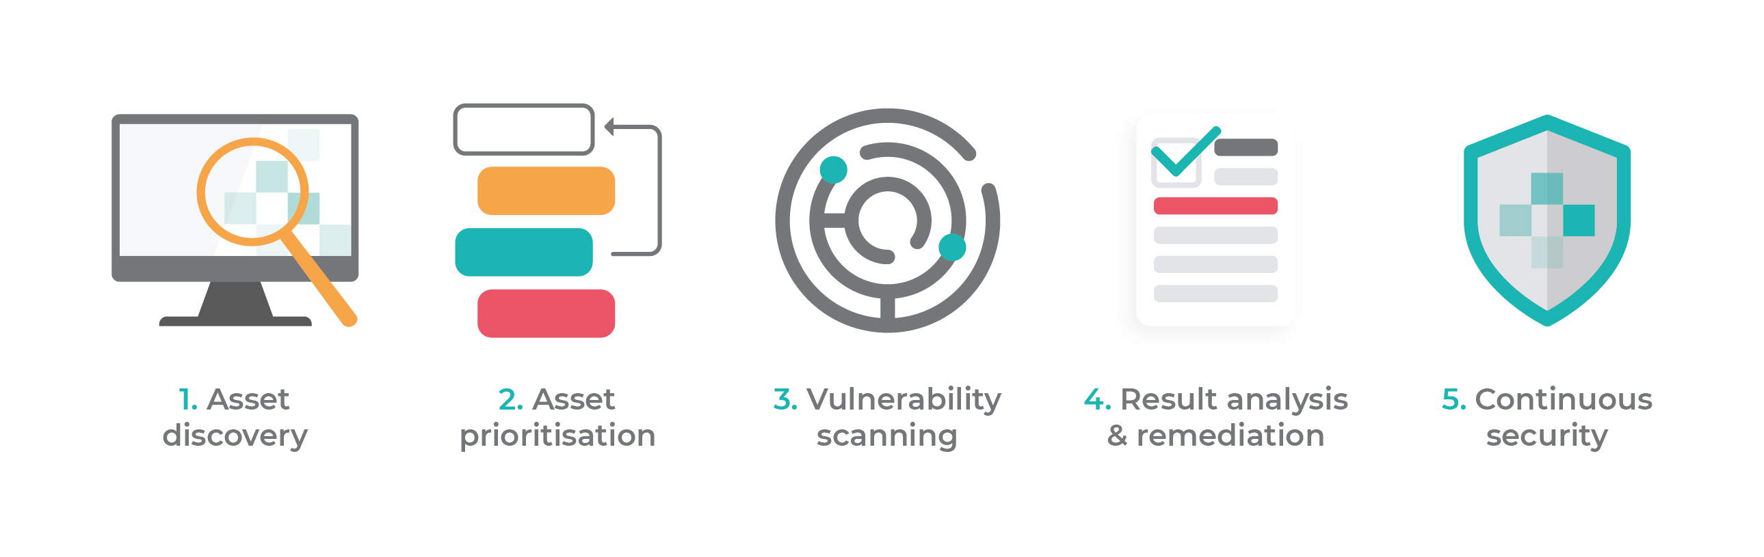
Opportunities:
1)How different is it from any of the other existing ideas?
1. Scanning Techniques:
Signature-based: Relies on known vulnerability signatures to identify weaknesses.
Heuristic-based: Uses pattern recognition to detect potential vulnerabilities.
Hybrid: Combines signature-based and heuristic-based techniques for broader coverage.
2. Scanning Scope:
Network-level: Scans network devices, ports, and services for vulnerabilities.
Web application-level: Scans web applications for vulnerabilities like SQL injection, XSS, etc.
2)How will it be able to solve the problem?
Develop a system and software vulnerability scanner that can accurately identify and report on outdated software, missing patches, and other system-level vulnerabilities, facilitating timely remediation.
3)USP of the proposed solution
1. Advanced Threat Detection
2.User-Friendly interface
3. Rapid Vulnerability Assessment and Remediation

Slide 4

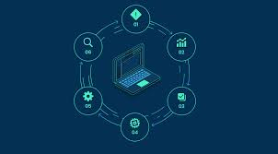
List
List of features offered by the solution are:
Scanning
Network Scanning: Scan networks for open ports, services, and vulnerabilities like weak passwords and misconfigurations.
Web
Web Application Scanning: Identify vulnerabilities in web applications, such as SQL injection, cross-site scripting (XSS), and insecure authentication.
Detect
System and Software Scanning: Detect outdated software, missing patches, and other system-level vulnerabilities.
Maintain
Vulnerability Database: Maintain a comprehensive and up-to-date vulnerability database to ensure accurate detection.
Reporting and Alerting
Reporting and Alerting: Generate detailed reports on identified vulnerabilities, including severity, potential impact, and remediation recommendation.

Slide 5
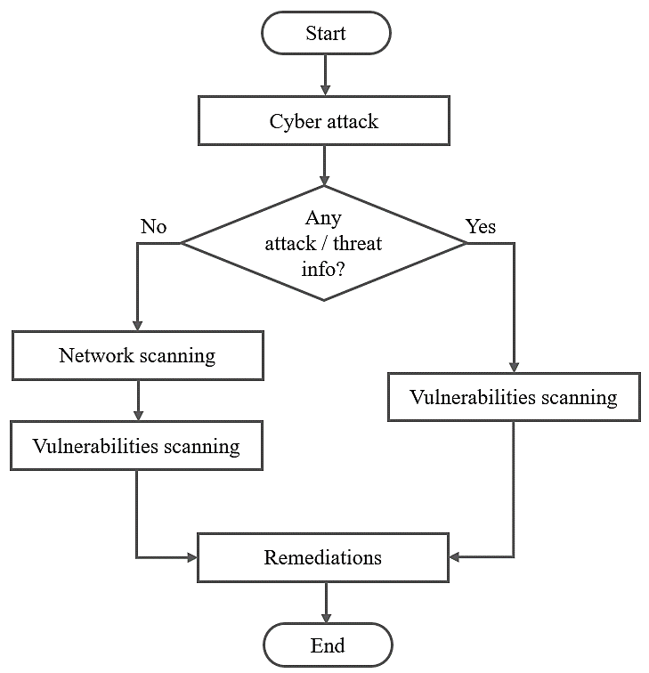
Process flow diagram or Use-case diagram:

Slide 6
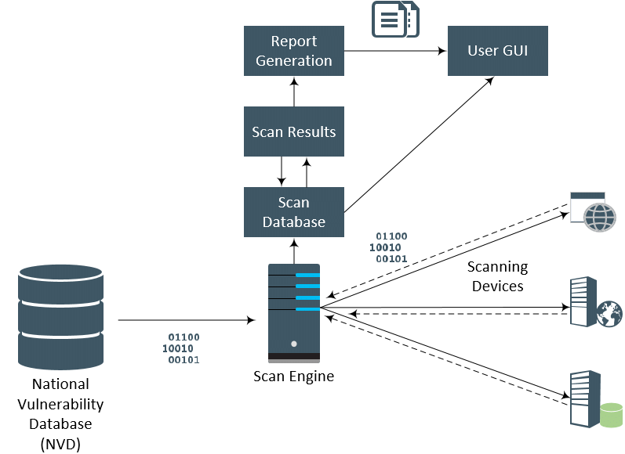
Architecture diagram of the proposed solution

Slide 7
Technologies to be used in the solution:
Core Technologies:
Network Scanning:
Port Scanning: Techniques like TCP/UDP port scanning to identify open ports and services.
Protocol Analysis: Analyzing network traffic to identify protocol vulnerabilities and misconfigurations.
Web Application Scanning:
HTTP Requests: Sending crafted HTTP requests to test for vulnerabilities like SQL injection, XSS, and CSRF.
Web Crawling: Automatically discovering and analyzing web pages and their interactions.
System and Software Scanning:
Signature-Based Scanning: Comparing system configurations and software versions against known vulnerability databases.
Heuristic Analysis: Using behavioral analysis to identify potential vulnerabilities.
Programming Languages and Frameworks:
Python: Widely used for its simplicity and versatility, often used for scripting and automation.
Java: Used for large-scale enterprise security solutions.
JavaScript: Used for web application scanning and interactive interfaces and many more.

Slide 8
THANK YOU

