Slide 1



EventEase:
Event Registration
Platform
Team Members:-
Aryan sinha
Shriya garg
Elango Sowmya

Slide 2
INTRODUCTION
EventEase is a full-stack cloud-based event management and registration platform.
Designed to overcome common issues like poor user experience, lack of responsiveness, and limited admin control.
Provides a unified solution for both event attendees (easy discovery & booking) and organizers (secure management tools).
Built using Next.js, Node.js, MongoDB, and JWT authentication with cloud deployment on Vercel.
Ensures real-time booking, secure authentication, and automated confirmations for a seamless experience.
01

Slide 3
PROBLEMS
Traditional event registration is manual and inefficient.
Poor user experience with clunky interfaces.
No mobile responsiveness, limiting accessibility.
Security issues in handling user data.
Limited tools for organizers to manage events.
Unreliable email confirmations and communication gaps.
02

Slide 4
FEATURES
Secure Authentication – User & admin login with JWT
Responsive Design – Works seamlessly on mobile, tablet, and desktop
Real-Time Booking – Instant registration with unique booking IDs
Automated Emails – Professional confirmations via SendGrid
Smart Filters – Search by date, price, category, and location
Event History – Easy tracking of past and upcoming bookings
Admin Dashboard – Event creation, booking management, analytics
03

Slide 5
MODULES
Authentication – Secure user & admin login/signup
Event Management – Create, edit, delete events; track availability
Booking System – Real-time booking, unique IDs, instant confirmation
User Interface – Responsive browsing, filters, event history
Admin Dashboard – Manage events, users, bookings, analytics
Email & Notifications – Automated confirmations & updates
04

Slide 6
FLOW CHART
05

Slide 7
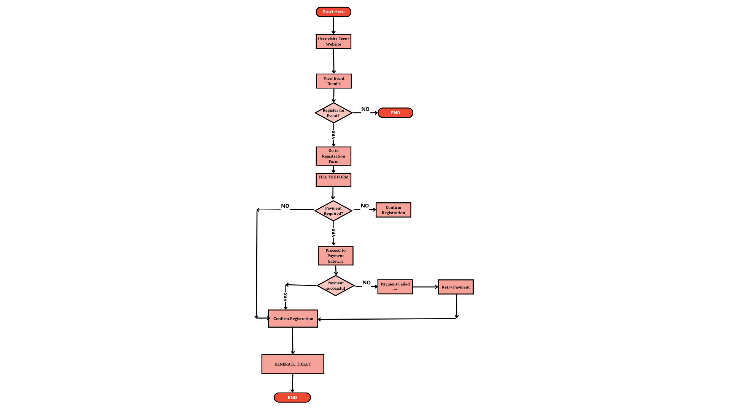

Slide 8
IMPLEMENTATION
08

Slide 9
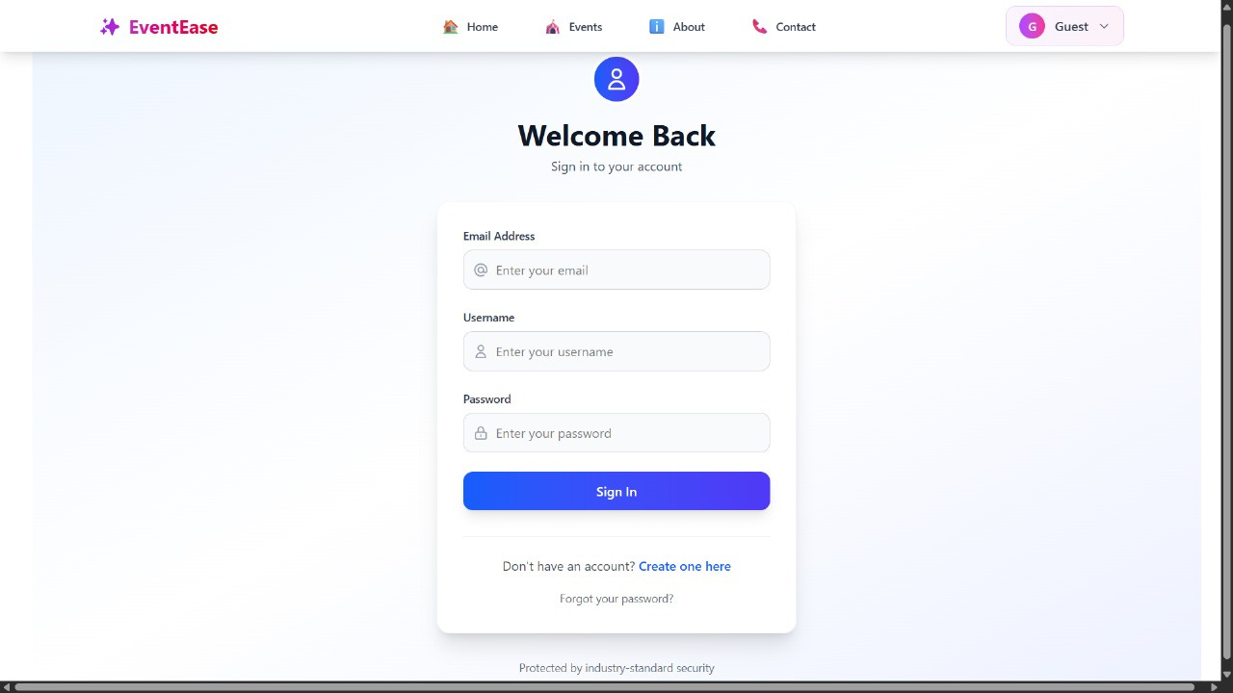

Slide 10
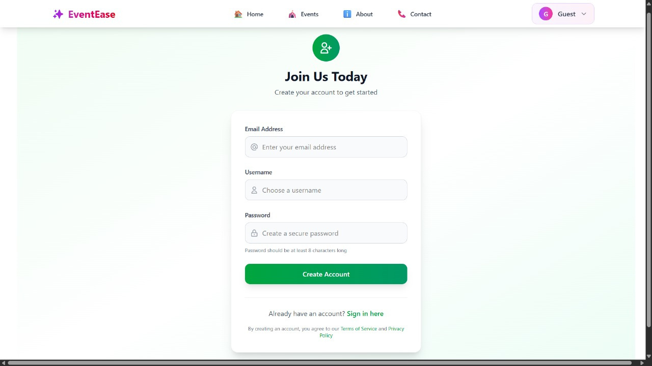

Slide 11
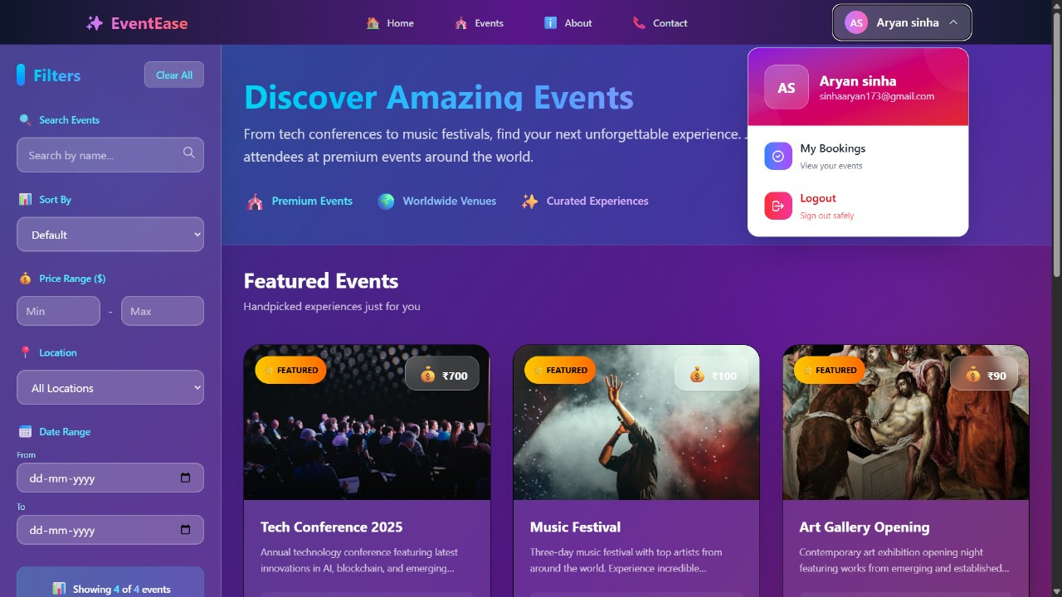

Slide 12
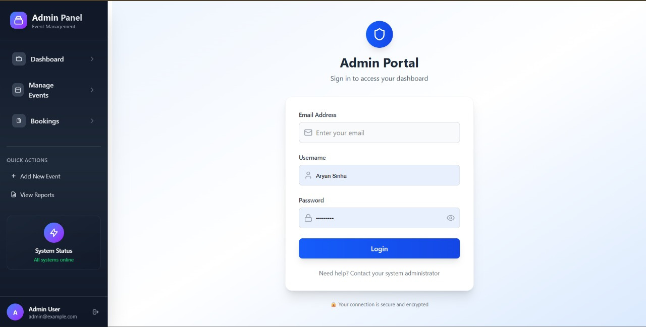

Slide 13
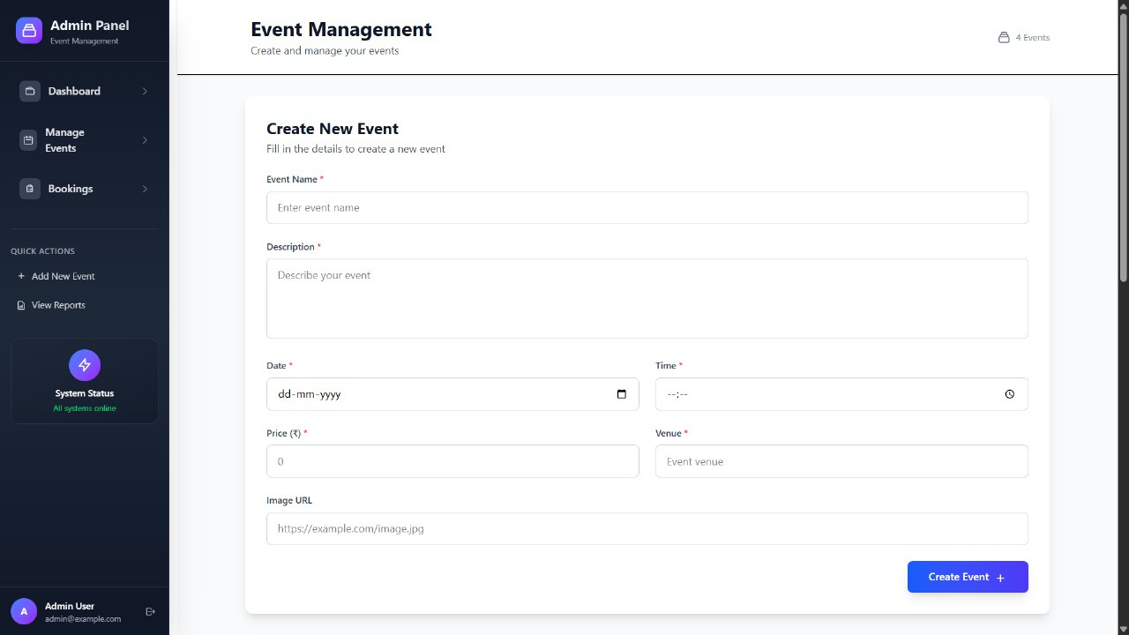

Slide 14
Thank You

