Slide 1
✦ QUANTITATIVE BANKING ANALYTICS & RETENTION STRATEGY
Customer Engagement & Product
Utilization Analytics
An Empirical Investigation into 10,000 European Retail Banking Accounts Across France, Germany, and Spain
European Central Bank Case Framework & Basel III Liquidity Standards
Author & Presenter: Aryan | Unified Mentor Analytics Capstone
Repository: github.com/Aryansp04/RETENTION-INTELLIGENCE

Slide 2
✦ EXECUTIVE CONTEXT & PROBLEM STATEMENT · UNIFIED MENTOR BANKING STUDY
The Core Banking Loyalty Paradox
✦ The Dangerous Misconception
Retail banks routinely mistake ledger balance for customer loyalty. Affluent account holders are assumed to be safe assets simply because they maintain significant deposit balances.
✦ The Empirical Reality
Account balances are static ledgers; retention is driven by active transacting velocity. 49.1% of high-balance accounts (>€100k) are dormant, generating a 32.8% churn rate.
✦ The Strategic Objective
Develop a quantitative behavioral scoring framework (RSI), identify optimal product bundling thresholds, and simulate capital preservation strategies to protect liquidity.

Slide 3
✦ STANDARDIZED BANKING KPI SUITE · UNIFIED MENTOR BANKING STUDY
Audited Portfolio Health & Metrics
METRIC I
METRIC II
METRIC III
20.37%
1.17x
49.09%
<b>PORTFOLIO CHURN</b><br>Baseline Portfolio Attrition across 10,000 folios
<b>ENGAGEMENT RATIO (ERR)</b><br>Active accounts retain at 85.7% vs 73.1% inactive
<b>HIGH-BAL DISENGAGEMENT</b><br>Dormant accounts control €312.27M in deposits
METRIC IV
METRIC V
56.5 / 100
€102.32M
<b>RELATIONSHIP STRENGTH</b><br>Composite behavioral loyalty score (Retained = 60.0)
<b>CAPITAL AT RISK</b><br>Liquidity flight risk among inactive VIP accounts

Slide 4
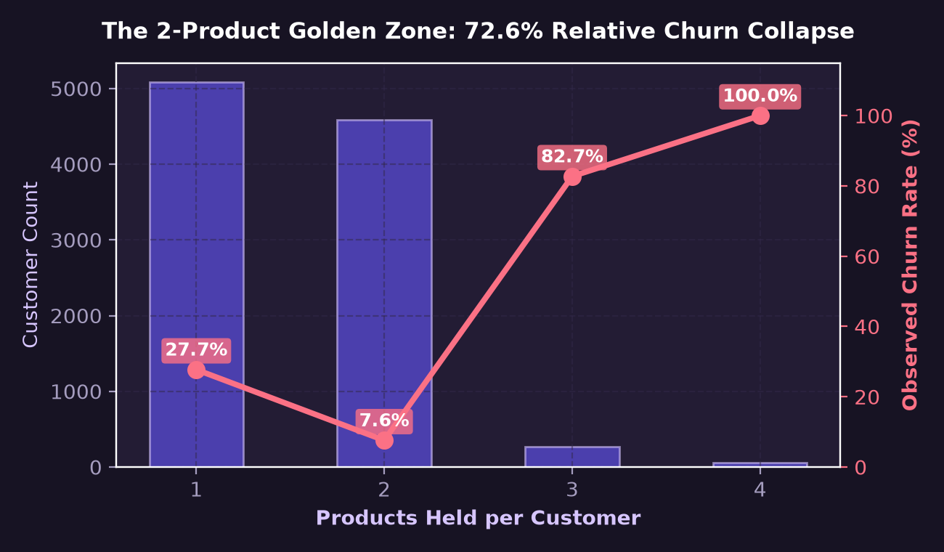
✦ EMPIRICAL PRODUCT DEPTH OPTIMIZATION · UNIFIED MENTOR BANKING STUDY
The '2-Product Golden Zone' Discovery
1 Product (50.8% of base): 27.71% Churn
Near-zero friction to switch banks. Lack of secondary anchors makes customers vulnerable to competitors.
2 Products (45.9% of base): 7.58% Churn
The Golden Zone! A 72.6% relative collapse in attrition. Pairing checking with savings or mortgage maximizes stickiness.
3 & 4 Products: 82.7% to 100% Churn
The forced-bundling hockey stick. Customers pushed into unwanted insurance or taking distressed debt lines.

Slide 5
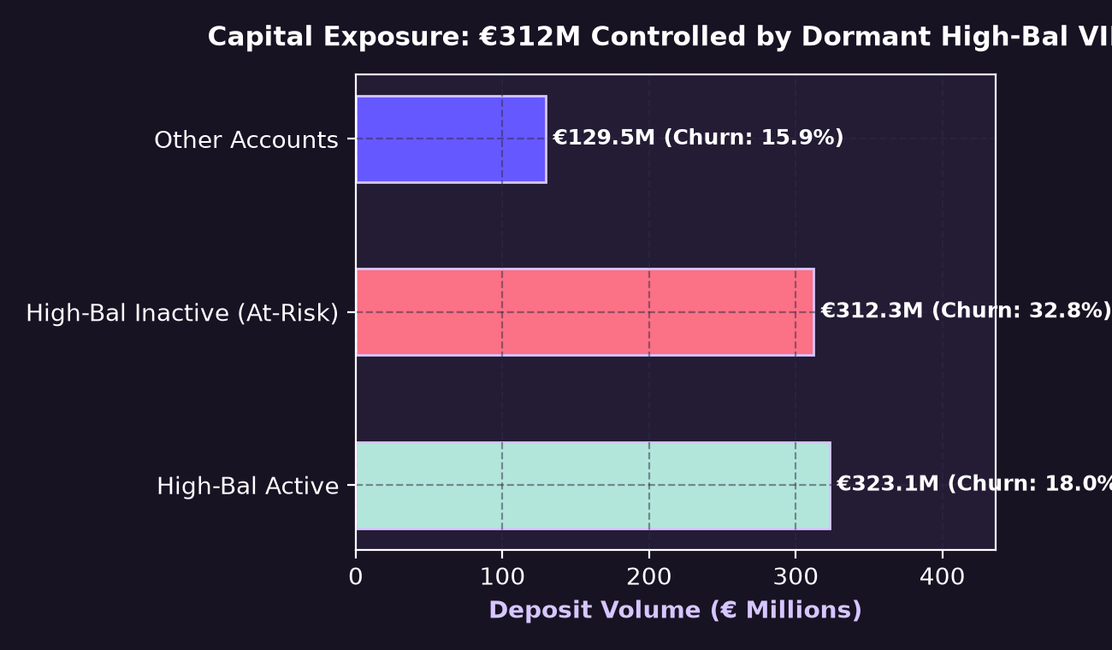
✦ WEALTH CONCENTRATION VS LOYALTY RISK · UNIFIED MENTOR BANKING STUDY
The High-Balance Disengagement Paradox
Deposit Concentration
Account holders with >€100k balance control €312.27 Million—accounting for 40.83% of the entire bank's deposit reserves.
The Dormancy Trap (49.1%)
Nearly half of these high-value depositors are completely inactive. They do not log into the app, transact, or engage with branch advisors.
€102.32M Flight Exposure
Observed churn among dormant VIPs reaches 32.77%. A critical liquidity hazard under Basel III Net Stable Funding Ratio rules.

Slide 6
✦ COMPOSITE BEHAVIORAL SCORING MODEL · UNIFIED MENTOR BANKING STUDY
Relationship Strength Index (RSI: 0–100)
✦ Component Weights
✦ Empirical Separation
✦ Operational Actionability
Formulated from multi-dimensional behavior:
• Active Member Engagement: 35%
• Optimal Product Anchor (2 Prods): 30%
• Account Balance Stability: 20%
• Customer Relationship Tenure: 15%
Statistically validates retention health:
• Retained Customers: Mean RSI = 60.0 / 100
• Churned Customers: Mean RSI = 42.8 / 100
• Clear 17.2-point predictive margin
Enables real-time risk stratification:
• Sticky Anchor (RSI ≥ 75): 10.2% Churn
• Moderate (50–74): 15.6% Churn
• Vulnerable (30–49): 28.4% Churn
• Critical Flight Risk (RSI < 30): 44.8% Churn

Slide 7
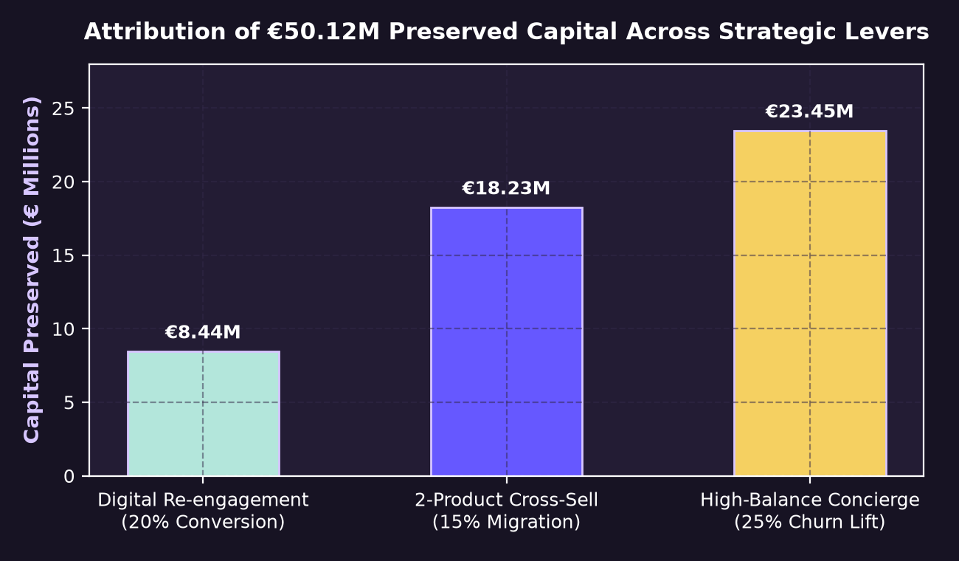
✦ RETENTION STRATEGY WHAT-IF SIMULATOR · UNIFIED MENTOR BANKING STUDY
Quantified Capital & Revenue Impact
Intervention 1: Digital Re-engagement
20% inactive conversion via automated notifications and fee waivers saves 160 accounts and €8.44M in capital.
Intervention 2: 2-Product Cross-Sell
15% single-to-dual product migration saves 153 accounts and €18.23M in deposit volume.
Intervention 3: High-Balance Concierge
Dedicated wealth manager outreach to accounts >€100k reduces VIP churn by 25%, saving €23.45M.
Total Preserved Return
Preserves €50.12M in capital reserves and protects €1.25M in annual Net Interest Margin at 2.5% deposit spread.

Slide 8
✦ EMPIRICAL ECONOMETRICS & MODEL PROOFS · UNIFIED MENTOR BANKING STUDY
Statistical Hypothesis Validations
✦ Pearson's Chi-Square Test · Test Statistic: 1503.63 | p-Value < 10⁻¹⁰⁰ (Statistically Significant)
Proves product depth and churn probability are fundamentally non-independent; confirms 2-product golden zone.
✦ Mann-Whitney U Test (RSI Distribution) · Test Statistic: 1.15 × 10⁷ | p-Value < 10⁻¹⁰⁰ (Statistically Significant)
Rejects the null hypothesis that retained and churned customer loyalty scores follow identical distributions.
✦ Credit Card Independence Test · Test Statistic: 0.472 | p-Value = 0.492 (Not Statistically Significant)
Proves passive credit card possession provides zero baseline retention benefit without active usage velocity.
✦ Random Forest Gini Feature Importance · Age (24.2%), RSI (21.8%), Balance (16.4%), Products (14.7%) vs Salary (3.8%)
Confirms behavioral indicators outweigh static demographic earnings by nearly 10 to 1.

Slide 9
✦ EXECUTIVE & CENTRAL BANK ALIGNMENT · UNIFIED MENTOR BANKING STUDY
Prudential Policy Recommendations
✦ Mandate Behavioral Liquidity Stress Buffers
ECB and national supervisors should require banks to incorporate High-Balance Disengagement Rates (HBDR) into internal liquidity stress tests (ILAAP), as dormant balances exhibit sudden run-off characteristics.
✦ Enforce 'Smart Dual-Anchor' Product Guidelines
Restrict predatory branch incentives that push customers into 3+ products. Incentivize primary checking accounts paired with recurring automated savings sweeps or mortgages.
✦ Deploy Proactive Early-Warning Concierge Workflows
Implement the Relationship Strength Index (RSI) across branch CRM systems to trigger automated concierge outreach when a customer's score drops below 50 points.

Slide 10
✦ CAPSTONE DEFENCE & INTERNSHIP REFLECTION
Thank You, Unified Mentor
This internship has been a transformative experience, cementing my passion for quantitative banking analytics, fintech data science, and predictive risk engineering.
Deep appreciation to the program leadership, mentors, and peers at Unified Mentor for an exceptional learning experience.
Presented by Aryan · Quantitative Analytics & Retention Strategy Intern
GitHub Repository: https://github.com/Aryansp04/RETENTION-INTELLIGENCE
Live Web App: http://localhost:8501

