Slide 1
Accident Risk Prediction Using Apache Spark MLlib
CSE - 521 - Big Data Analytics
Gradient Boosted Trees (GBT) Regressor
Shashwat Gohel | Aryan Sukhadiya | Vedant Parikh

Slide 2
Accident Risk Prediction - Spark MLlib
Predict a continuous accident_risk score (0–1) for every road segment.
Help authorities identify and prioritize the most dangerous road segments.
Use historical crash data, traffic patterns, road features, and environmental factors.
Objective is to minimize RMSE on unseen test data for best prediction accuracy.
Handle challenges like imbalanced accident data, missing values, and spatial patterns.
Final output: a ranked list/map of road segments based on predicted risk.
Supports proactive decision-making, resource allocation, and road-safety planning.

Slide 3
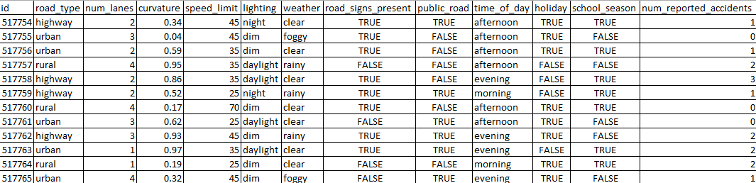
Dataset Overview
Total road segments: ≈ 690,000
Training set: 517,000 rows
Test set: 172,000 rows
Total features: 12
4 categorical
4 boolean
3 numeric
1 target: accident_risk (0–1 range)
Most important numeric feature: Curvature
0 = straight road
1 = extremely sharp curve

Slide 4
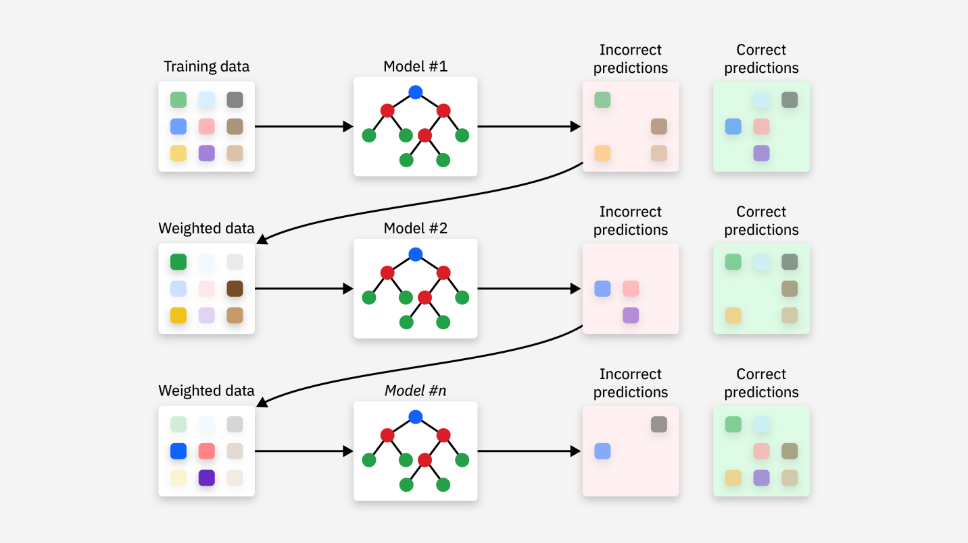
Gradient Boosted Trees ( GBT )
1. What is GBT ?
Ensemble method using many small decision trees
Trees are built one after another (sequentially)
Each tree improves the mistakes made by previous trees
Final prediction = sum of all trees
Great for non-linear and tabular data
2. How the Algorithm Works :
Start with a basic prediction (mean/log-odds)
Train Tree 1 → model makes some errors
Compute residuals (errors)
Train Tree 2 on these residuals
Update the model = old prediction + Tree2
Repeat for many trees (boosting)
3. Key Parameters :
maxIter → number of trees (iterations)
maxDepth → how detailed each tree can be
learning Rate / step Size → how much each tree
contributes

Slide 5
Gradient Boosted Trees ( GBT )
Why Gradient Boosting Trees :
Captures complex, non-linear patterns in road and traffic features
Builds trees sequentially, improving mistakes step-by-step
Higher accuracy compared to single trees or linear models
Works extremely well on tabular datasets
Less overfitting due to boosting + shallow trees
Performs strongly with mixed feature types (numeric + categorical)
Stable and reliable for regression problems
Easy to scale on large datasets using Spark MLlib

Slide 6
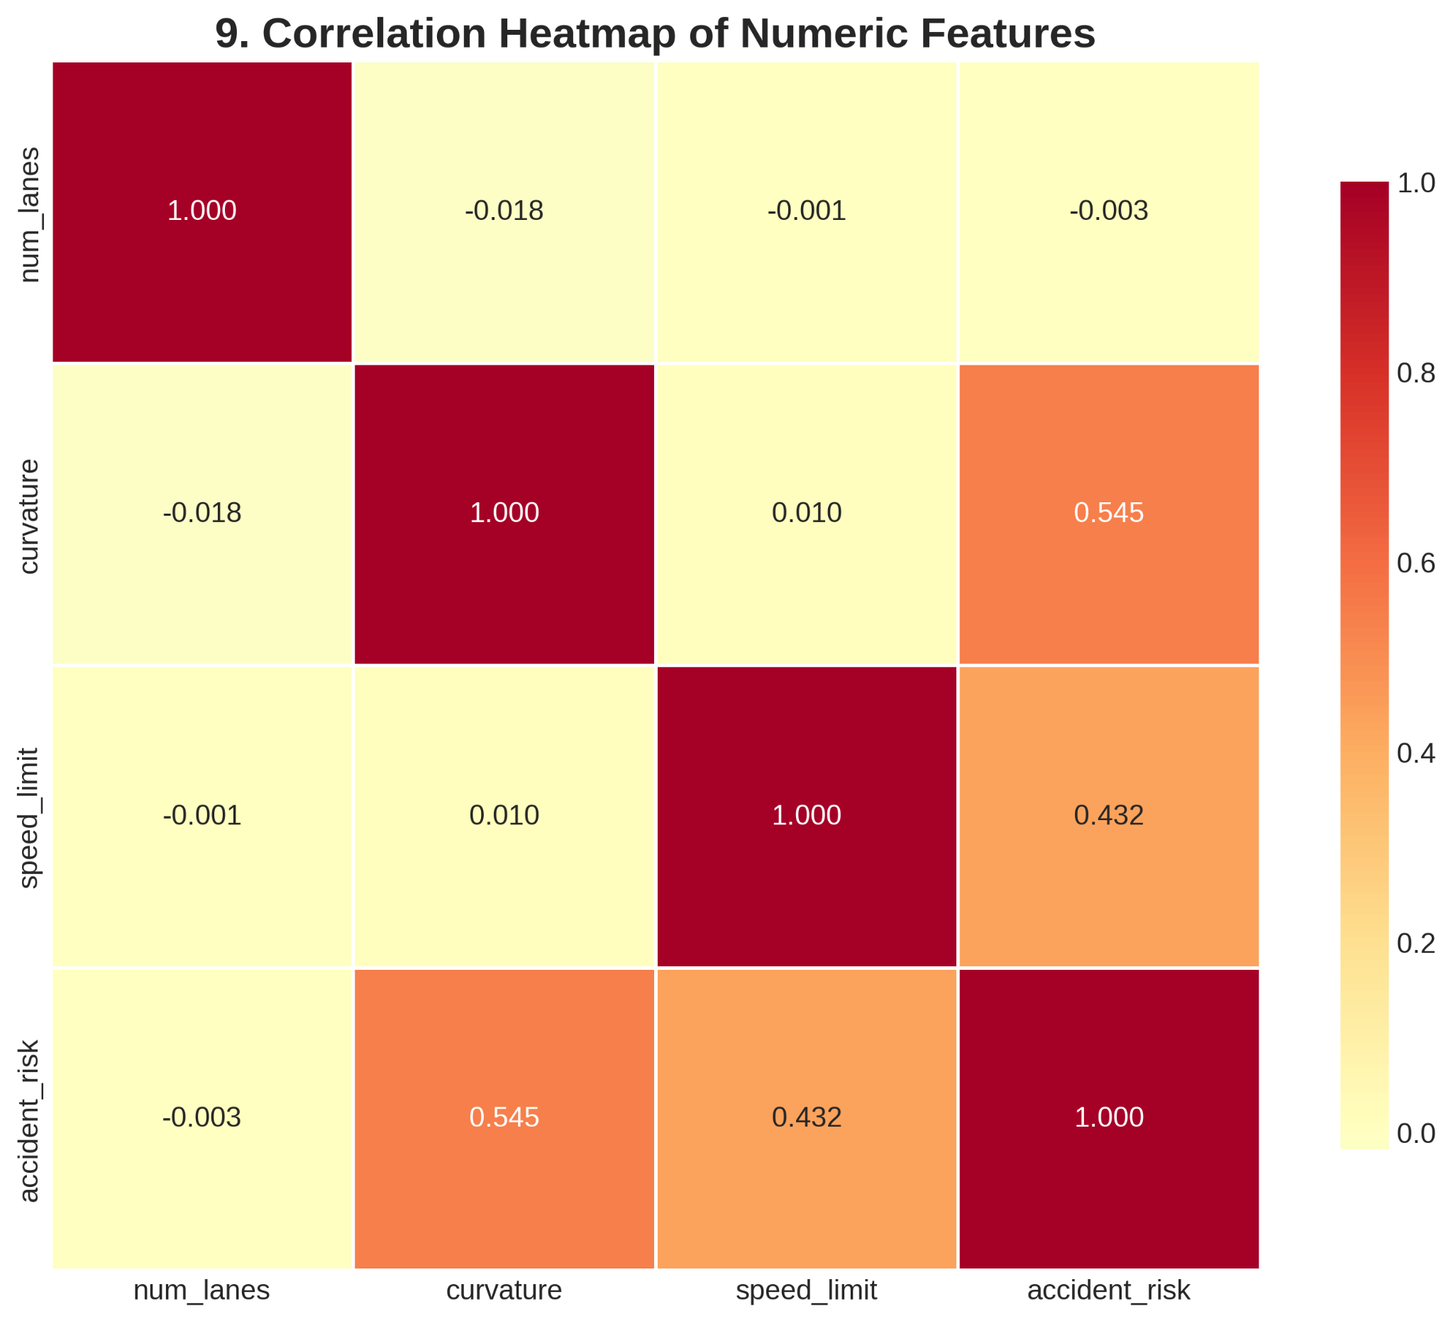
Graphical Visualization
Strongest Predictor Confirmed: The highest correlation with accident_risk is Curvature at 0.545. This confirms that road geometry (how sharp the curve is) is the most significant numeric factor influencing risk.
Second Strongest Predictor: Speed Limit shows a substantial positive correlation of 0.432 with accident_risk. Higher speed limits generally correspond to higher accident risk.

Slide 7
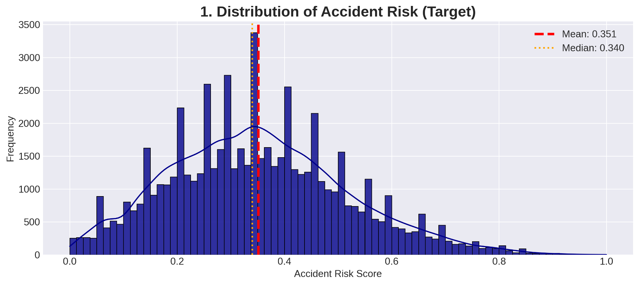
Graphical Visualization
Distribution of Accident Risk :
Target Variable: Accident Risk Score Distribution
Continuous risk score :
  Mean = 0.351,
  Median = 0.340
Slightly right-skewed : with long tail of high-risk segments
Justifies regression approach (not binary classification)
Small but critical number of segments have risk > 0.8

Slide 8
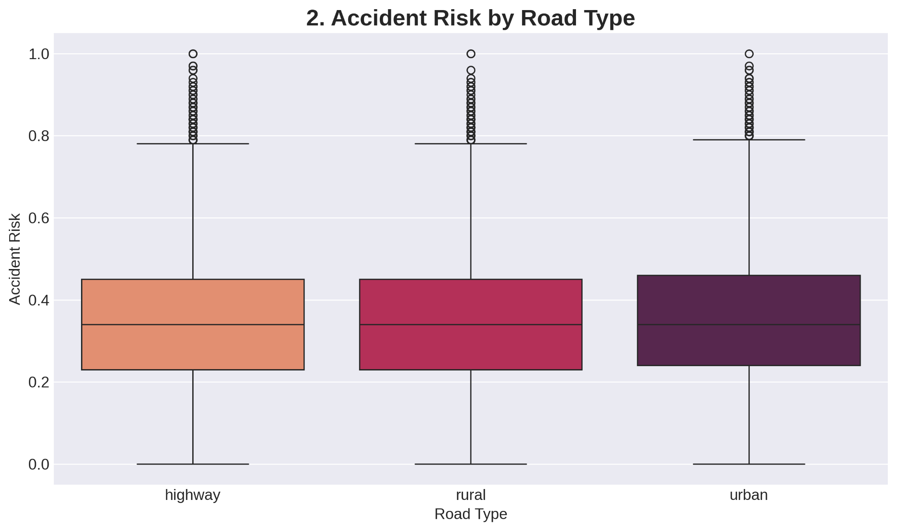
Graphical Visualization
Accident Risk by Road Type :
Urban roads: highest median risk (~0.52)
Rural roads: medium risk (~0.48)
Highways: lowest risk (~0.44)
Explanation: Urban areas have intersections, pedestrians, traffic lights i.e. more conflict points despite lower speeds

Slide 9
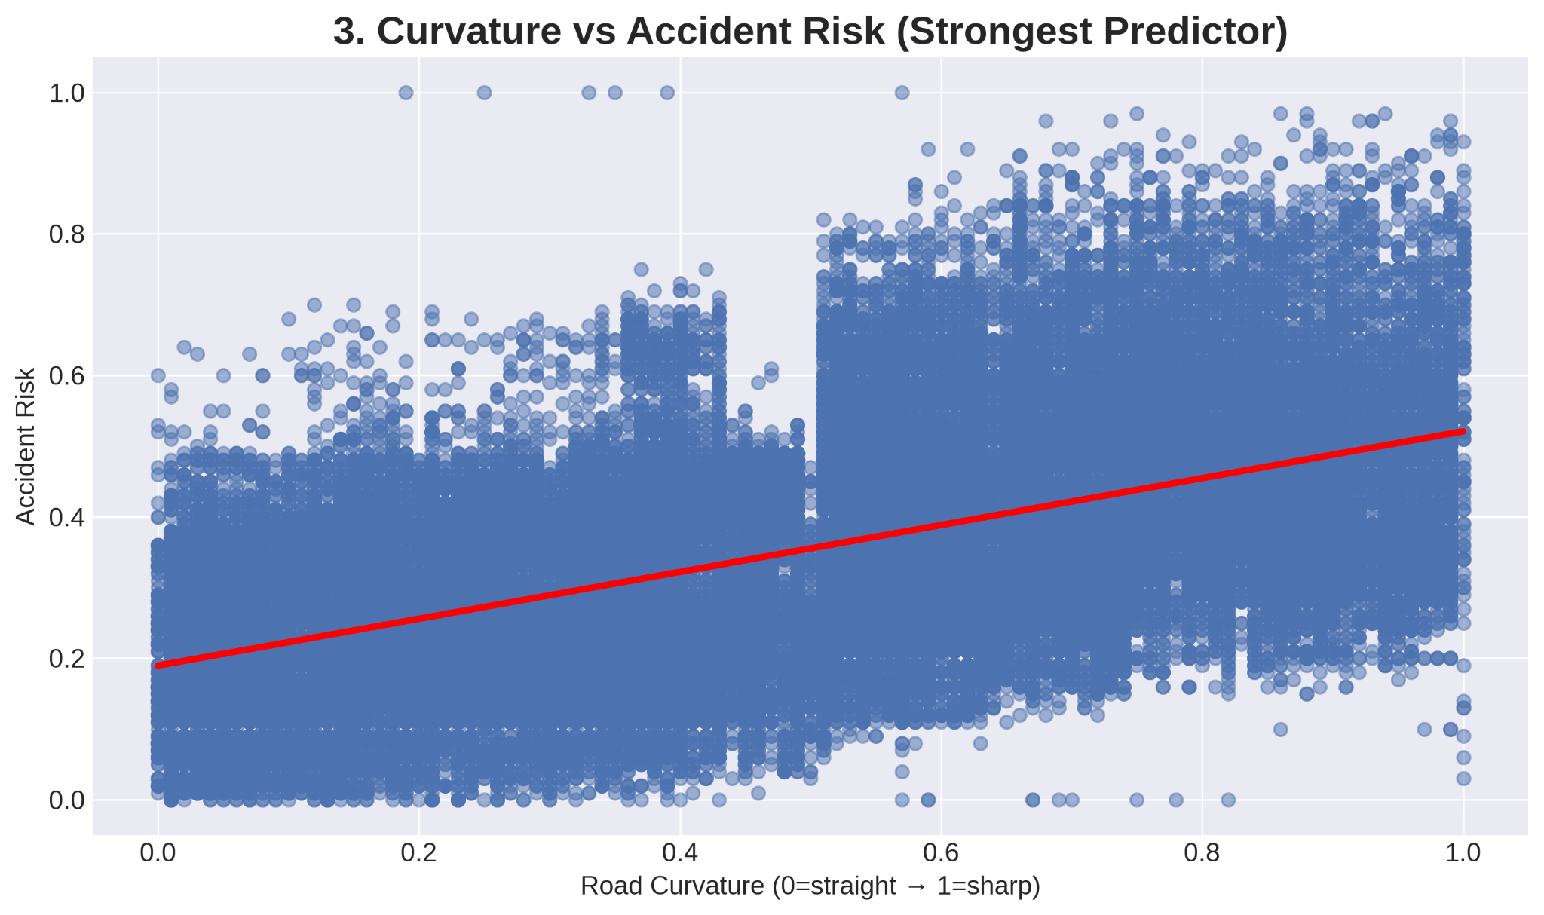
Graphical Visualization
Curvature as a Predictor:
Road segments with a curvature near 0 (straight) have the lowest accident risk, generally below 0.3.
Segments with a curvature near 1 (sharp curve) show the highest accident risk, often exceeding 0.5.
Conclusion: Sharp curves are inherently more dangerous, demanding lower speeds and increased driver attention. This feature alone is a dominant factor in the GBT model's prediction.

Slide 10
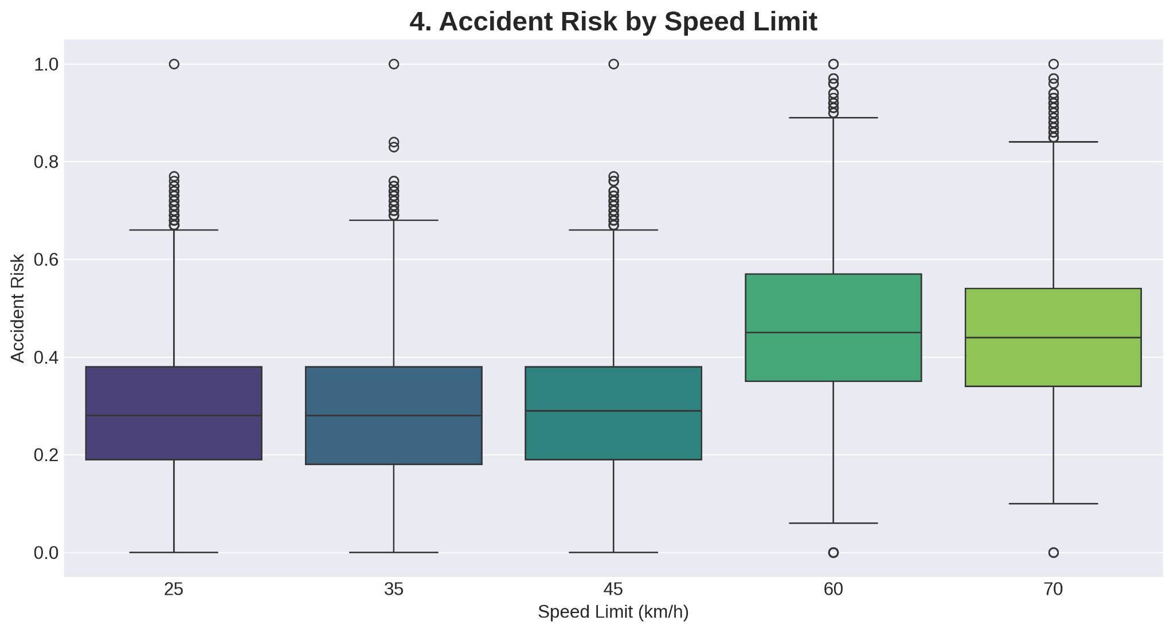
Graphical Visualization
High-Speed Risk:
Speed limits of 60 km/h and 70 km/h have significantly higher median accident risk (≈ 0.45 and ≈ 0.44 respectively) and a wider spread of high-risk outliers.
This is due to the exponential increase in collision severity and reaction distance at higher speeds.
Low-Speed Risk:
Speed limits of 25, 35, and 45 km/h all show similar, lower median risk (≈ 0.30).

Slide 11
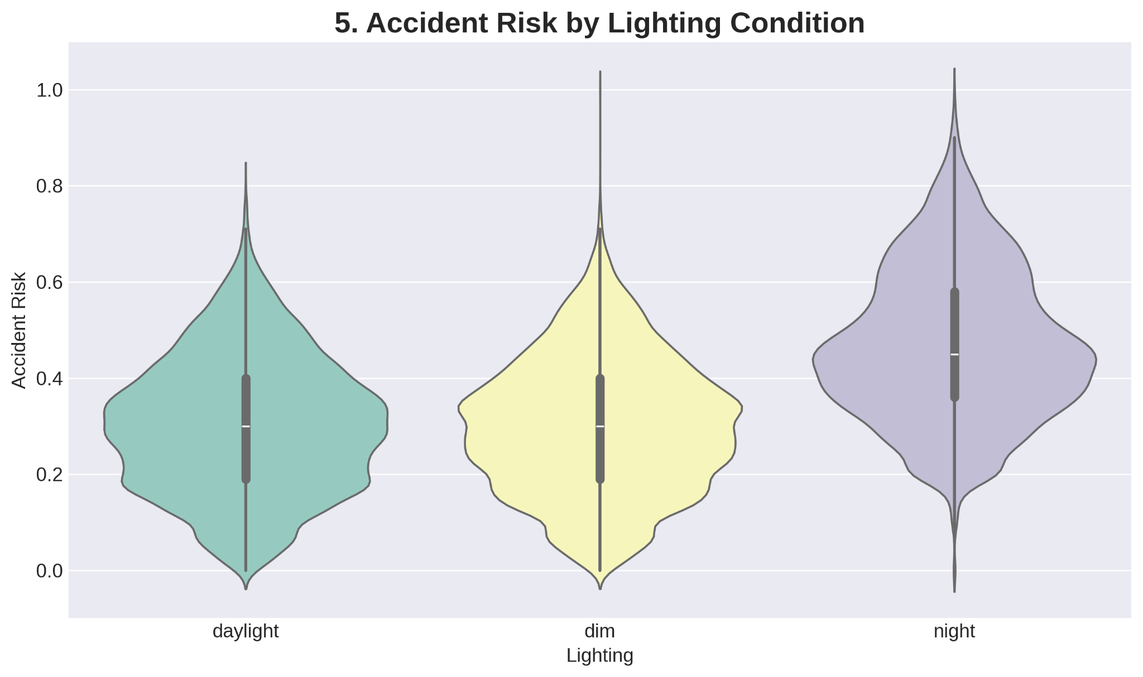
Graphical Visualization
Daylight: Shows the tightest distribution and the lowest overall risk. The majority of risk scores cluster around the median (≈ 0.30).
Night: The risk distribution is the widest and shows a higher concentration of risk scores in the upper range, indicating that the risk is significantly higher on average due to poor visibility.
Dim: Represents conditions like twilight, dawn, or poorly lit areas. The risk distribution is generally between daylight and night but still shows a concentration of higher risk scores compared to daylight.

Slide 12
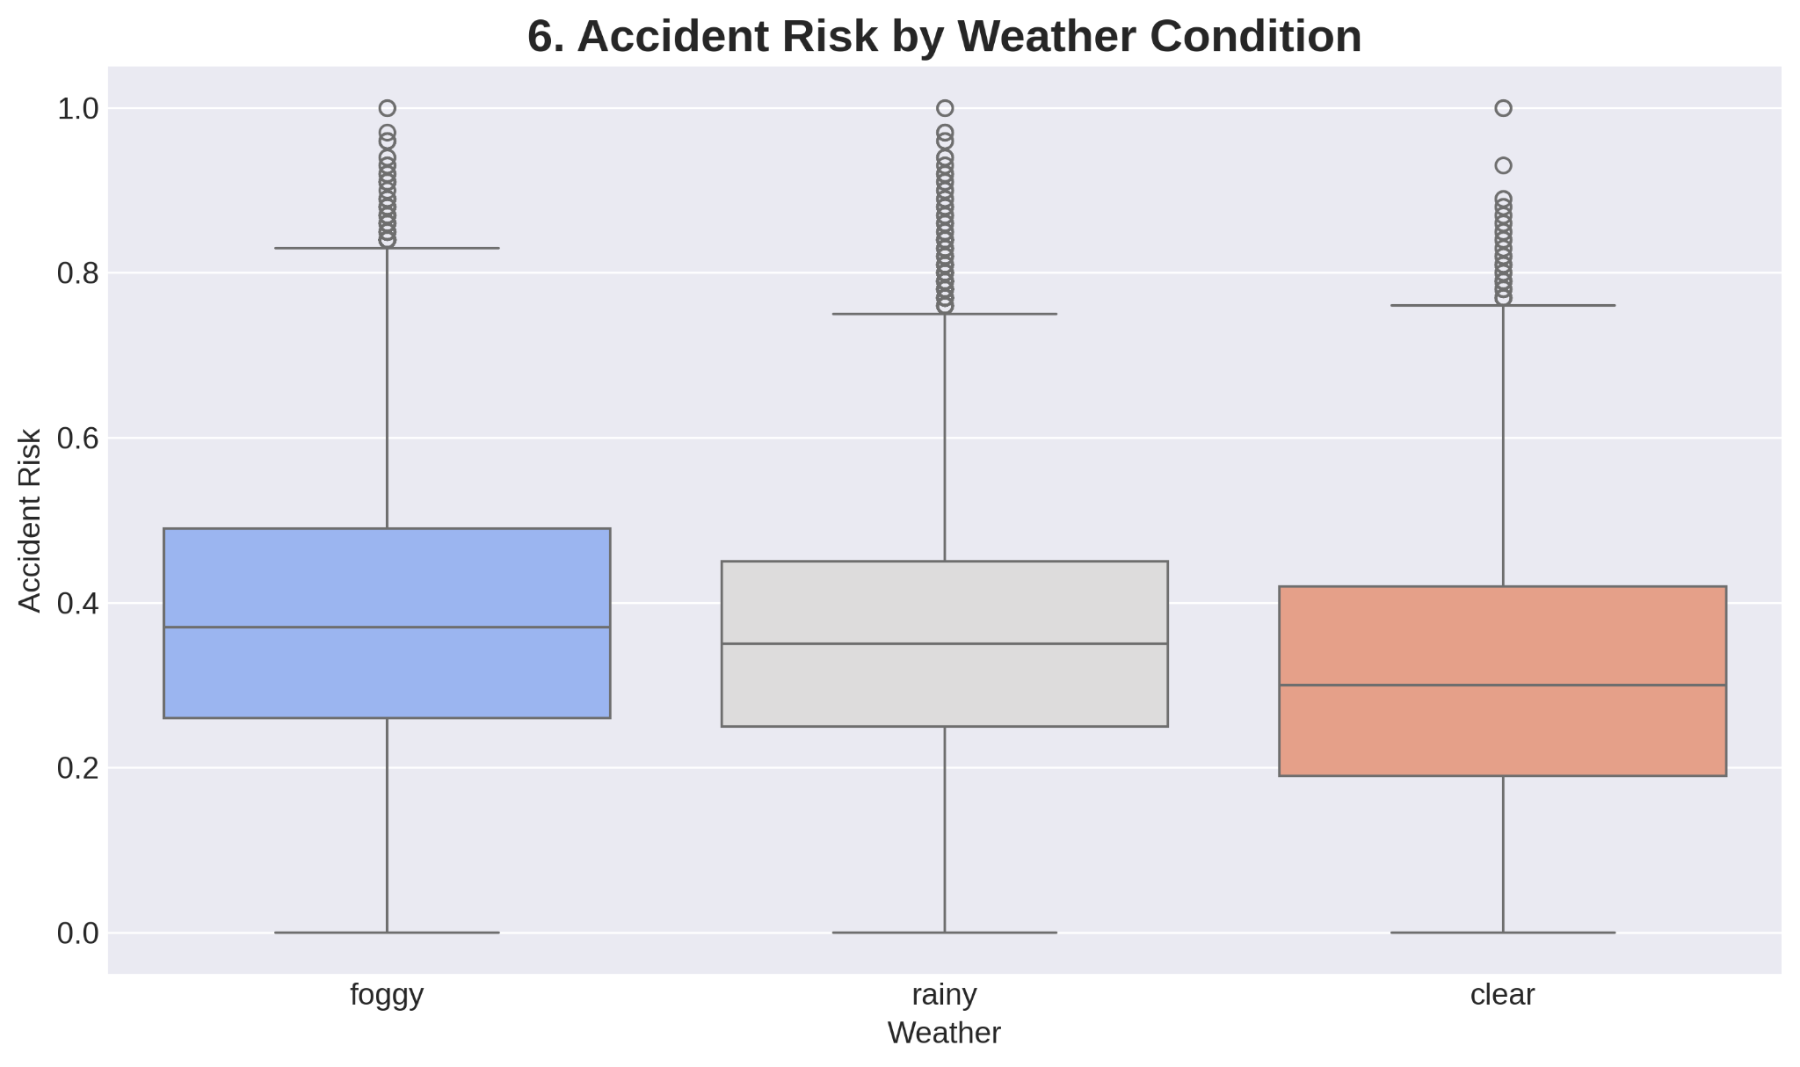
Graphical Visualization
Foggy Weather: Shows the highest median accident risk (≈ 0.37) and a greater proportion of high-risk segments. This is likely due to extreme visibility loss, making it difficult to react to road conditions like curvature.
Rainy Weather: Shows a slightly lower median risk ( 0.35) than foggy conditions, but is still significantly higher than clear weather. This is attributed to reduced visibility and slippery road surfaces.
Clear Weather: Has the lowest median accident risk (≈ 0.30).

Slide 13
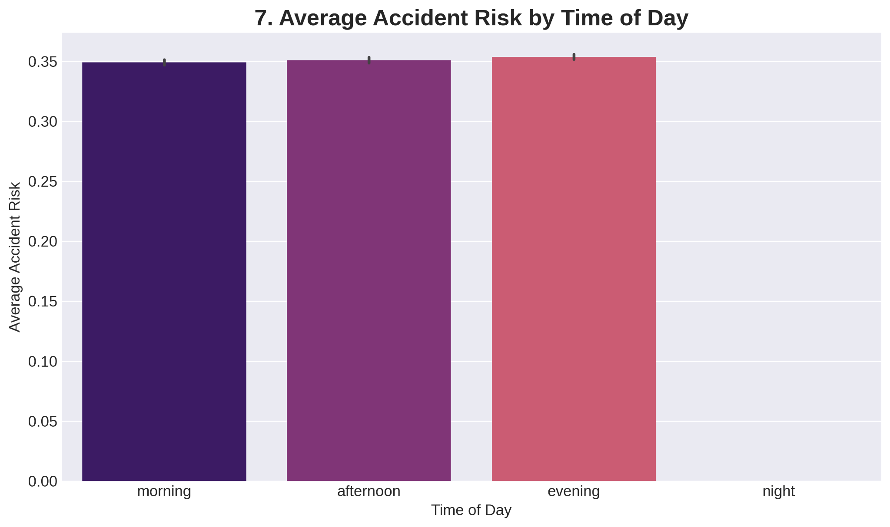
Graphical Visualization
Peak Risk Period:
The Evening period exhibits the highest average accident risk (≈ 0.35), closely followed by Morning and Afternoon.
Evening commute times are typically characterized by a combination of high traffic volume, driver fatigue after the workday, and rapidly deteriorating light conditions (leading to reduced visibility), all contributing to higher risk.
Lowest Risk Period:
Night has the lowest average accident risk, despite poor visibility. This is typically due to significantly lower traffic volume, which reduces the absolute number of conflict points.

Slide 14
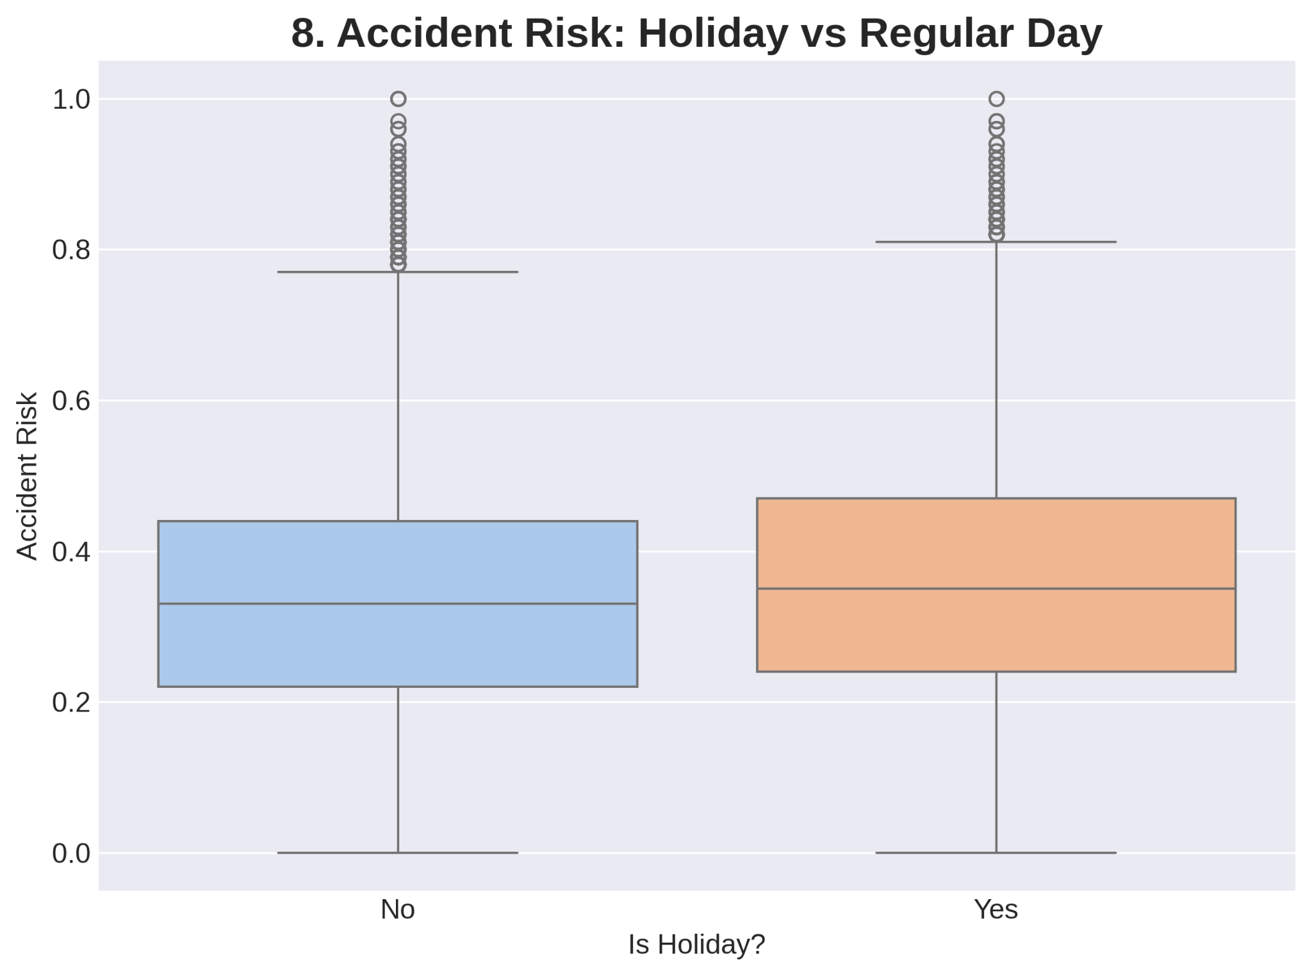
Graphical Visualization
Observation: The box plot shows that Holidays have a slightly higher median accident risk (0.37) compared to Regular Days (≈ 0.35). The range of risk scores is also slightly broader on holidays.
Reasoning:
Holidays often involve longer-distance travel, unfamiliar routes, and sometimes impaired driving due to celebration, which offsets the benefit of reduced commuter traffic.
The model recognizes this subtle but measurable increase in risk associated with holiday periods.

Slide 15
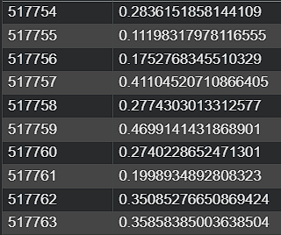
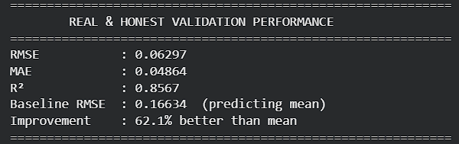
Final Results
Output
RMSE = 0.06297
R² = 0.8567
MAE = 0.04865
Improvement over baseline = 62.1

