Slide 1

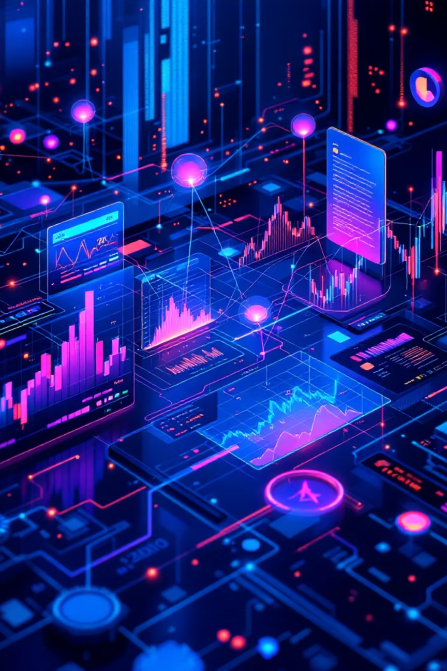

Multi-Branch Deep Learning Trading System
Institutional-grade architecture leveraging 2024-2025 IEEE research for quantitative trading
Aryant Jadhav - 23101A0022
Kashyap Nathoo - 23101A0023
Devashree Pavle - 23101C0048
Gauri Kamble - 23101C0056
Dr. Rugved Deolekar -Project Guide
Notes:
1

Slide 2
Abstract
This project presents a Multi-Branch Deep Learning Trading System designed to perform intelligent, data-driven financial market analysis and decision-making. The system integrates multiple specialized neural network models, each focusing on a distinct aspect of trading, including short-term execution, long-term forecasting, trend memory, inter-stock relationships, and market sentiment analysis.
By combining architectures such as CNN-LSTM with attention mechanisms, Temporal Fusion Transformers, Graph Neural Networks, and reinforcement learning-based sentiment models, the system is capable of processing diverse financial data sources simultaneously. It leverages advanced data engineering techniques like TFRecords optimization and Gramian Angular Field encoding to improve computational efficiency and model accuracy.
The multi-branch design enables the system to capture both micro-level patterns (like short-term price movements) and macro-level dynamics (such as sector correlations and market sentiment). Additionally, it incorporates uncertainty estimation and risk-aware decision-making to enhance trading reliability.
Overall, the system aims to provide a scalable, high-performance, and intelligent framework for quantitative trading by combining predictive analytics, relational modeling, and real-time data processing.
Notes:
2

Slide 3
Five-Branch Architecture Overview
Our integrated system combines specialized neural network architectures, each engineered for distinct trading functions—from tactical execution to risk management. This multi-branch approach enables simultaneous processing of diverse market signals.
Branch A: Tactical
Branch B: Strategic
Branch C: Memory
Short-term execution via HCLA
Context & forecasting with TFT
Long-term trend analysis
Branch D: Relational
Branch E: Sentiment
Sector correlation networks
Risk & imbalanced data
Notes:
3

Slide 4
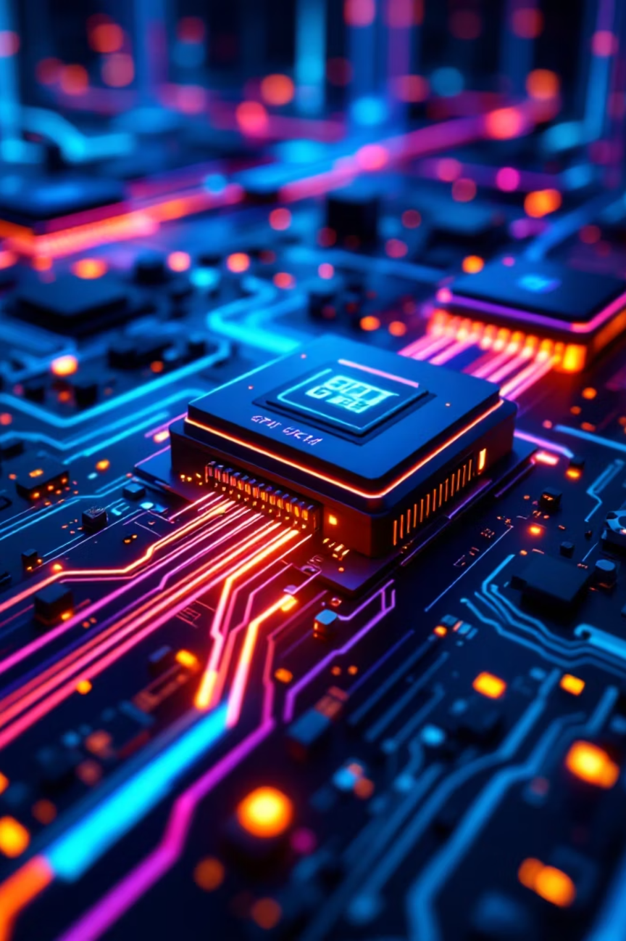

Data Engineering Layer
1
TFRecords Format
Transition all historical data to TFRecords for maximized GPU utilization and elimination of CPU bottlenecks during training
2
C++ Optimization
Avoid wrapping tf.io.parse_single_example with tf.py_function to prevent degradation from Python environment
3
GAF Encoding
Encode time-series into 2D images using Gramian Angular Field with polar coordinate representation
4
CULR Features
Use Close, Upper shadow, Lower shadow, Real-body instead of standard OHLC for 92%+ CNN accuracy
Notes:
4

Slide 5

Branch A: Tactical Execution
Hybrid CNN-LSTM with Attention (HCLA)
This 2025 architecture replaces standalone CNN + GRU approaches. It employs CNN for spatial feature extraction, LSTM for temporal learning, and attention mechanisms for dynamic focus.
Key Innovations
Attention-Weighted Hybrid Feature Extraction (AHFE): Dynamically focuses on volatile time steps in order book data
Dynamic Error Feedback Adjustment (DEFA): Adaptive correction based on recent prediction errors
Notes:
5

Slide 6

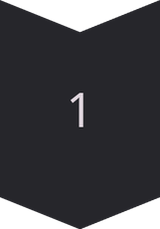
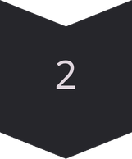
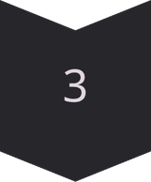
Branch B: Strategic Forecasting
Temporal Fusion Transformer with Quantile Loss
The TFT handles static metadata alongside past prices, producing probabilistic forecasts via quantile loss function.
Quantile Loss
Generates confidence intervals (10%, 50%, 90%) instead of single price predictions
Uncertainty Quantification
Provides mathematical boundaries for fuzzy logic risk manager
Position Sizing
Enables precise position sizing based on market uncertainty levels
Notes:
6

Slide 7

Branch C: Memory & Trends
Transductive LSTM (TLSTM)
Hybrid LSTM-Transformer
Standard LSTMs apply rigid global rules from training data. TLSTM dynamically modulates parameters based on similarity to recent data, prioritizing immediate temporal patterns.
Integrates localized sequential learning of LSTM with global contextual awareness of Transformer, significantly outperforming standalone LSTMs.
Notes:
7

Slide 8







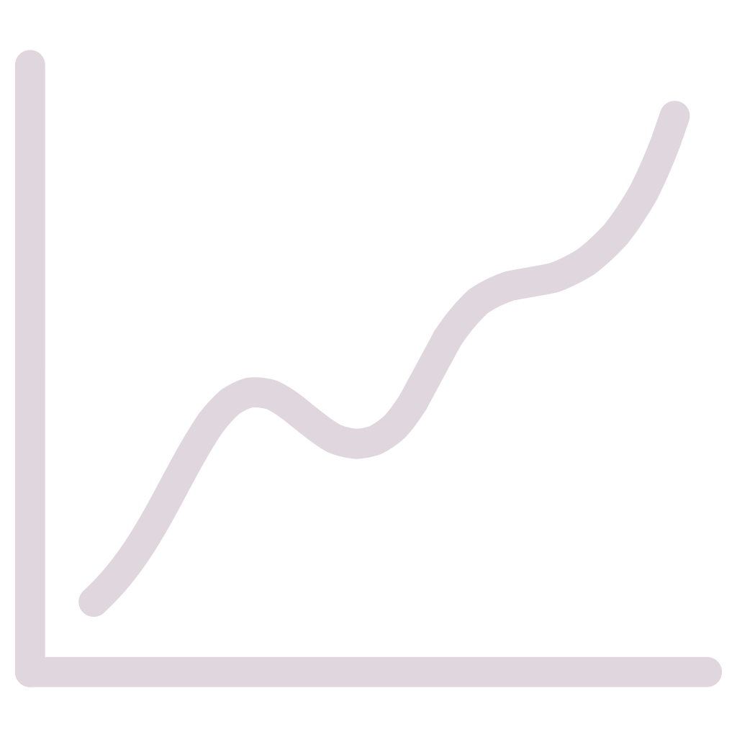
Branch D: Relational Networks
SM2PNet / TRNet using Graph Neural Networks
Adjacency Matrix
NIFTY 50 Mapping
Constructed using Pearson's correlation coefficient
Maps linkages between peer companies
Predictive Power
Real-Time Ingestion
Forecasts index movements from peer signals
Processes correlated peers during live trading
Stocks do not move in isolation—this branch captures sector-wide dynamics for enhanced predictive accuracy.
Notes:
8

Slide 9

Branch E: Sentiment & Risk
Off-Policy PPO + FinBERT for Imbalanced Data
The Challenge
Financial news suffers from imbalanced classification—mostly neutral/positive with rare crash signals.
Our Solution
FinBERT: LLM trained on financial text
Off-Policy PPO: Higher rewards for rare minority class
Combo Loss (CL): Amplifies complex, rare samples
Notes:
9

Slide 10
Future Evolution: Phase 1
01
02
03
Generative AI Integration
Alternative Data Streams
Dynamic Adaptation
Incorporate GPT-3, GPT-4, and FinGPT to process unstructured text, summarize SEC filings, and generate qualitative forecasts from macroeconomic prompts
Expand beyond social media to integrate macroeconomic indicators, specialized forums, blogs, and real-time news directly into the pipeline
Implement adaptive learning rates and specialized modules to detect and adapt to sudden market shocks through online learning mechanisms
Notes:
10

Slide 11







Future Evolution: Phase 2
Advanced Relational Networks
Morphological Recognition
Move beyond intra-sector linkages to study dynamic, time-evolving relations and inter-sector connections (e.g., IT sector's influence on Banking)
Expand GAF-CNN visual vocabulary to identify complex patterns like "W-head M-bottom" beyond basic candlestick signals
Interpretability
Develop attention-based explanations for human traders and implement advanced regularization to mitigate overfitting risks
Notes:
11

