Slide 1
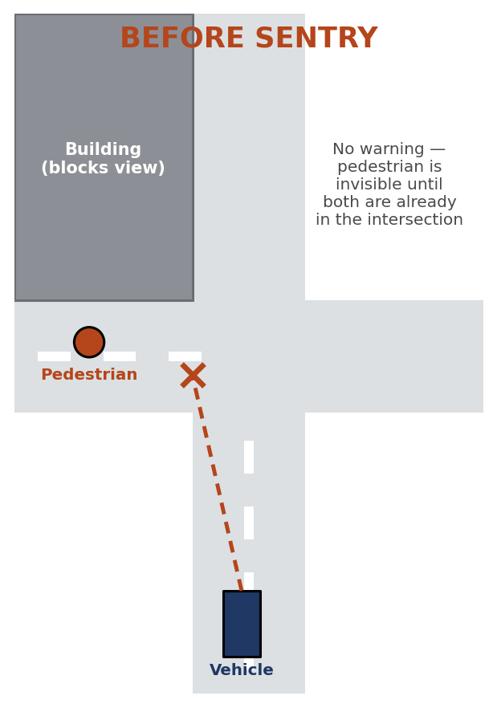
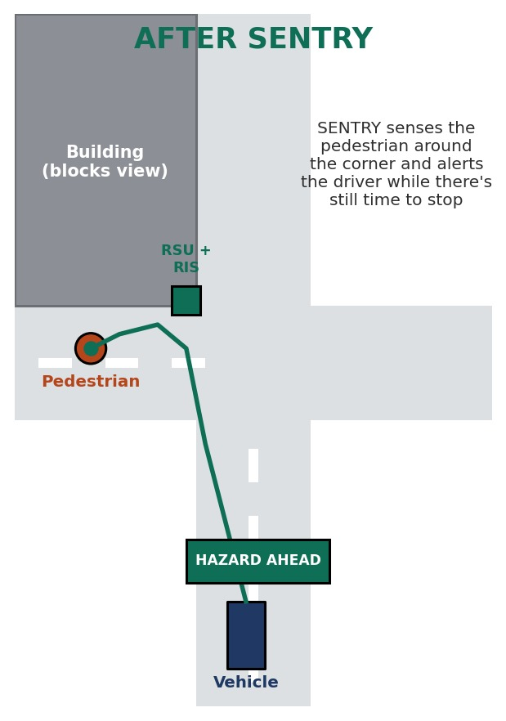
SENTRY: 6G ISAC for Non-Line-of-Sight Road Safety
Team CacheMe — Aryan Iyengar (Waveform); Mou (RIS); Om Goyal (Edge AI); Faculty mentor: [Add name]
Problem Statement
At a blind, obstructed intersection, a building blocks the line of sight between an approaching vehicle and a pedestrian or cyclist. Cameras, radar, and LiDAR need direct line of sight. SENTRY senses hazards beyond it, without a second powered sensor per corner.
Methodology
Simulate OTFS vs OFDM performance under vehicular Doppler shift (Simulation A).
Model RIS coverage across the blind intersection using an SNR heatmap (Simulation B).
Pre-code the roadside unit's transmission using known intersection geometry.
Classify the reflected echo via micro-Doppler signature and compute Time-to-Collision.
Broadcast the alert via C-V2X (Uu + PC5), prioritized by O-RAN Near-RT RIC.
Objective
Develop a roadside unit transmitting one OTFS waveform for sensing and communication.
Use a hybrid RIS to redirect the signal around the blind corner.
Classify the reflected signal and compute Time-to-Collision.
Deliver a prioritized hazard alert via C-V2X (Uu + PC5).
Hardware/software requirements
Software-defined radio (SDR) platform for OTFS waveform generation
Sionna for OTFS waveform simulation and RIS ray tracing
128-element Active-Reflection RIS panel
Edge AI on college MEC server with TensorRT
O-RAN Near-RT RIC-compatible network stack
Dual-path V2X delivery (cellular Uu + PC5 sidelink)
System Model
Roadside Unit → Transmits OTFS-encoded signal.
Hybrid RIS → Redirects signal around obstruction.
Edge AI → Classifies hazard, computes Time-to-Collision.
O-RAN Near-RT RIC → Delivers prioritized alert to vehicle.
Result and discussion
• OTFS resists Doppler shift; OFDM's error rate exceeds 70%.
• Simulated 8.7 ms sense-to-act latency across five stages.
• RIS coherent gain recovers most of the ~45 dB blockage penalty.
• Open gaps: fractional-Doppler validation, hardware profiling.
• Hybrid RIS active elements could double as a local angle-of-arrival sensor (future work).

