Slide 1
DeckAgent
Autonomous pitch deck generator from repositories and structured facts.
Notes:
Welcome to DeckAgent, an autonomous tool for generating professional pitch decks directly from code repositories and structured data.

Slide 2
The Problem
Manual creation of presentation slides and architecture diagrams is tedious.
Need to handle architecture diagrams and presentation slides automatically.
Ensuring sensitive tokens and keys are redacted before LLM processing.
Notes:
Creating decks and diagrams manually wastes valuable engineering time while introducing security risks with sensitive tokens.

Slide 3
The Solution
Scans GitHub repositories or local directories to extract structured facts.
Uses Graphviz dot to render component graphs into SVG and PNG images.
Renders professional 10-slide PowerPoint presentations with custom palettes.
Notes:
DeckAgent solves this by scanning your repository, generating component graphs, and producing complete presentations.

Slide 4
Key Features
Deterministic layout mapping and provenance tracking with source badges.
Interactive voice dictation editing and prompt-based refinement.
FastAPI backend architecture with asynchronous job event streaming.
React frontend studio layout with TanStack React Query integration.
Notes:
Our platform combines robust asynchronous backend processing with an interactive React frontend and voice dictation.

Slide 5
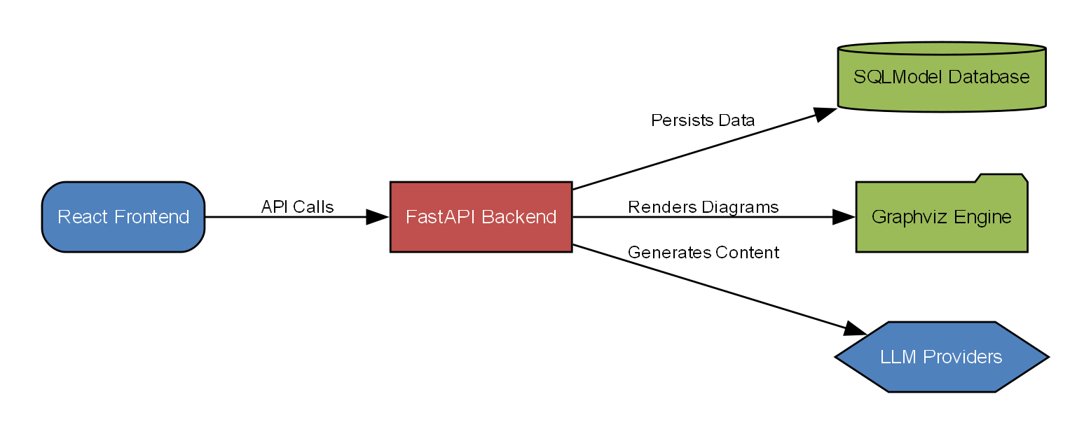
System Architecture
FastAPI backend architecture with asynchronous job event streaming.
React frontend studio layout with TanStack React Query integration.
Notes:
The architecture cleanly separates the React frontend from the FastAPI backend services and generation engines.

Slide 6
Technology Stack
FastAPI backend framework with SQLModel and Pydantic v2.
React 19 frontend application built with Vite and Tailwind CSS.
Python libraries python-pptx and pymupdf for document processing.
Google GenAI and Anthropic integrations for intelligent slide generation.
Notes:
We leverage modern technologies including FastAPI, React 19, Tailwind CSS, and leading LLM provider integrations.

Slide 7
Demonstration
Configure repository source URL or local path via the inputs pane.
Start the deck generation job and monitor real-time SSE progress events.
Review generated slides and architecture diagrams in the deck studio.
Notes:
Here is a quick walkthrough of configuring a repository source and watching real-time progress events unfold.

Slide 8
Impact & Metrics
TODO: Supply measured time reduction for pitch deck creation.
TODO: Supply user adoption or generated presentation metrics.
Notes:
Measured metrics and adoption rates will be populated as user telemetry and feedback accumulate.

Slide 9
Roadmap
TODO: Define upcoming roadmap milestones and integrations.
Notes:
Our upcoming roadmap includes expanded integrations and advanced customization options.

Slide 10
Thank You
Autonomous pitch deck generator from repositories and structured facts.
Notes:
Thank you for your time. We are happy to answer any questions and help you get started with DeckAgent.

