Slide 1
Graph_hack
Graph-Backed Organizational Intelligence Agent powered by FalkorDB and Model Context Protocol
Notes:
Welcome to Graph_hack, our graph-backed organizational intelligence agent powered by FalkorDB and Model Context Protocol.

Slide 2
The Problem
Prevent knowledge silos across growing engineering teams.
Address architecture decision drift in engineering teams.
Notes:
Growing engineering teams frequently struggle with knowledge silos and architecture decision drift.

Slide 3
The Solution
Unify Git activity, ADRs, team ownership, and communications into a FalkorDB knowledge graph.
Provide an MCP-based AI assistant to trace decisions, detect code drift, and identify code owners.
Notes:
We unify Git activity, ADRs, and communications into FalkorDB, providing an MCP-based AI assistant to trace decisions.

Slide 4
Key Features
Identifies formal module owners and de facto contributors highlighting ownership gaps.
Locates subject-matter experts for topics using weighted graph scoring across PRs and chat.
Traces provenance chain, historical rationale, and linked PRs behind architecture decisions.
Derives decision drift dynamically at query time by counting subsequent merged PRs.
Writes back to graph by creating a ReviewRequest node linked to the decision.
Notes:
Our features include ownership gap detection, subject-matter expert location, decision tracing, and dynamic drift calculation.

Slide 5
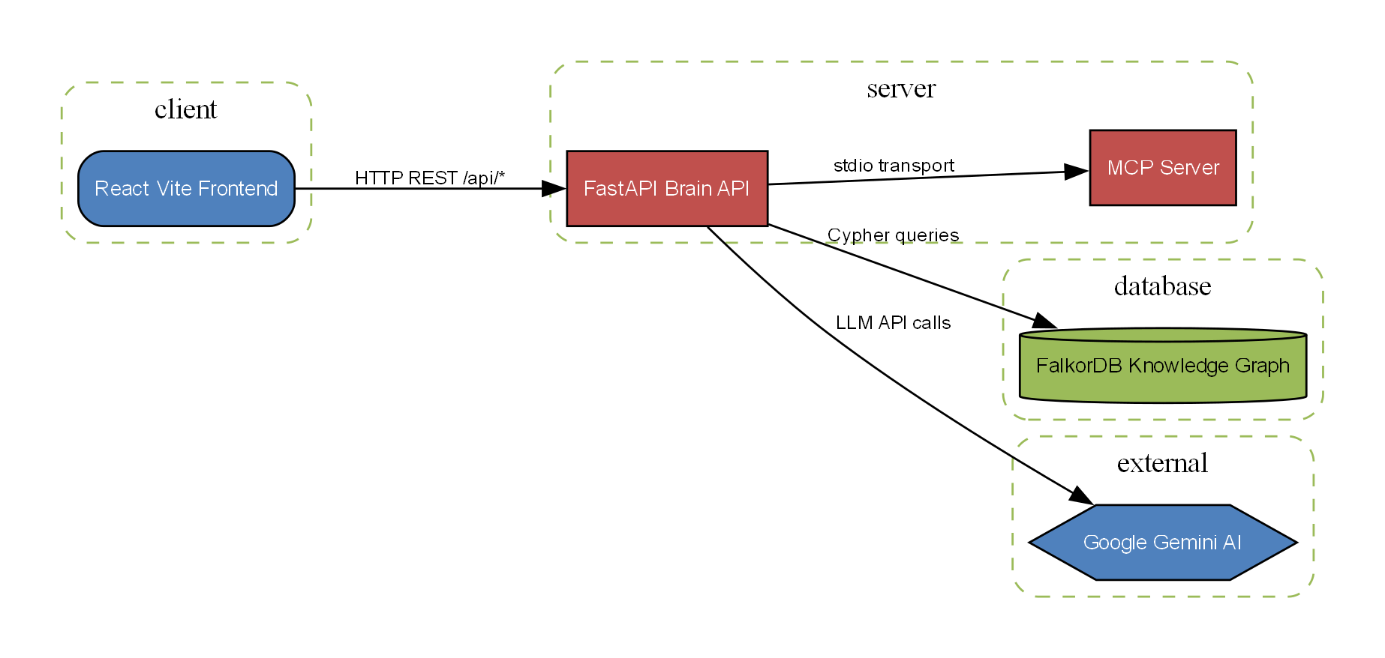
System Architecture
React Vite frontend communicating via HTTP REST with a FastAPI backend.
FastAPI connects to an MCP server and FalkorDB knowledge graph.
Google Gemini AI integration powers intelligent reasoning.
Notes:
The architecture connects a React frontend to a FastAPI brain, interacting with FalkorDB and Google Gemini.

Slide 6
Technology Stack
FalkorDB graph database
FastAPI backend
Google GenAI SDK with Gemini models
Model Context Protocol (MCP)
React and Vite frontend with Tailwind CSS and Cytoscape for visualization
Notes:
We leverage FalkorDB, FastAPI, Google Gemini models, MCP, and a React-Vite frontend with Tailwind and Cytoscape.

Slide 7
Demonstration
TODO: Supply step-by-step demonstration instructions for the UI.
Notes:
Let us walk through the user interface and demonstrate the capabilities in action.

Slide 8
Impact & Metrics
TODO: Supply quantitative metrics regarding team efficiency and knowledge discovery.
Notes:
We expect significant improvements in team efficiency and knowledge discovery.

Slide 9
Roadmap
TODO: Supply future roadmap milestones and expansion plans.
Notes:
Our upcoming roadmap includes broader integrations and enhanced agentic workflows.

Slide 10
Thank You
Graph-Backed Organizational Intelligence Agent
Notes:
Thank you for your time. We are ready for any questions.

