Slide 1
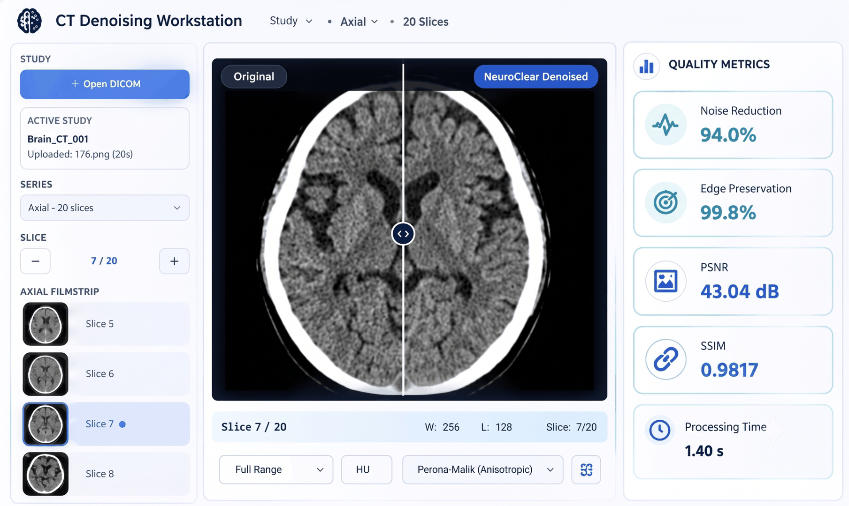
NeuroClear
CT Image Denoising with Transparent Verification
TEAM NAME
PROBLEM STATEMENT
NeuroClear
CT image denoising
THEME
PROBLEM SOLUTION CATEGORY
Smart Automation
Software
ONE-LINE CONCEPT
Prototype workstation view
Detect frequency-domain artifacts, remove them selectively, and verify what changed - without relying on blind smoothing.
Transparent by design: intermediate results + quantitative verification.
NeuroClear
1

Slide 2
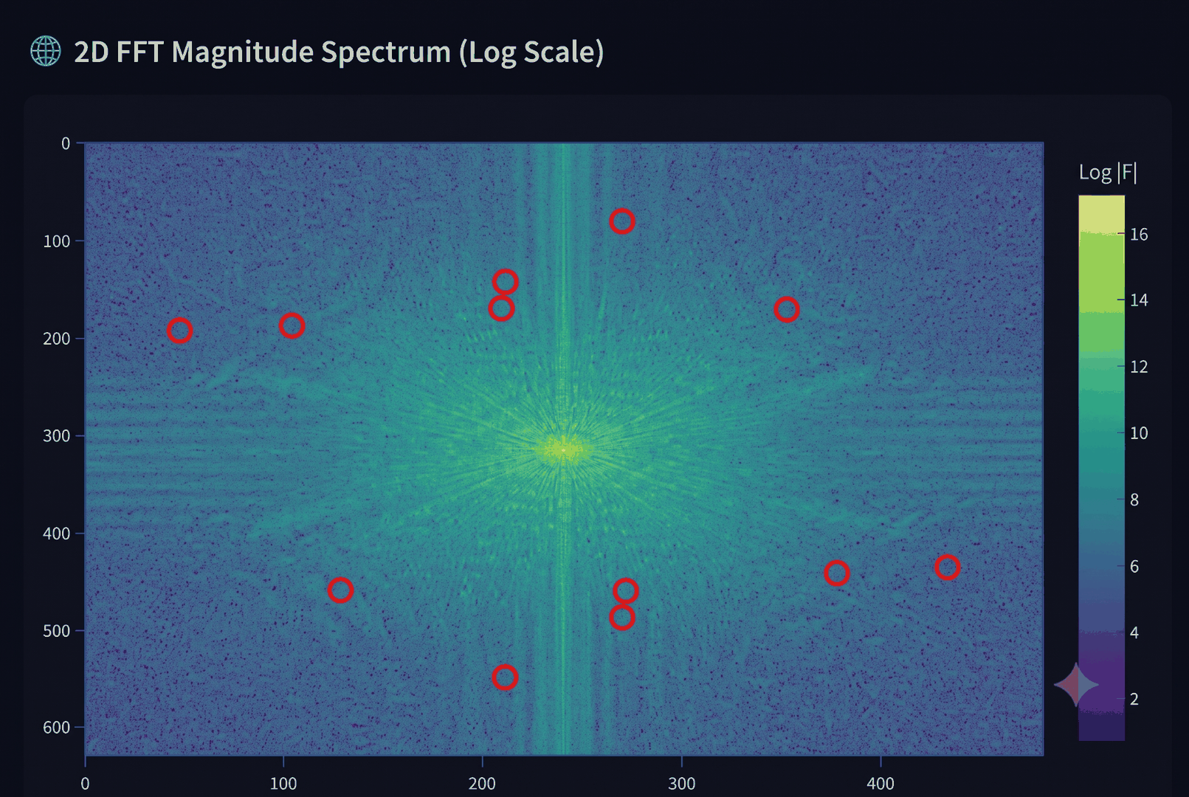
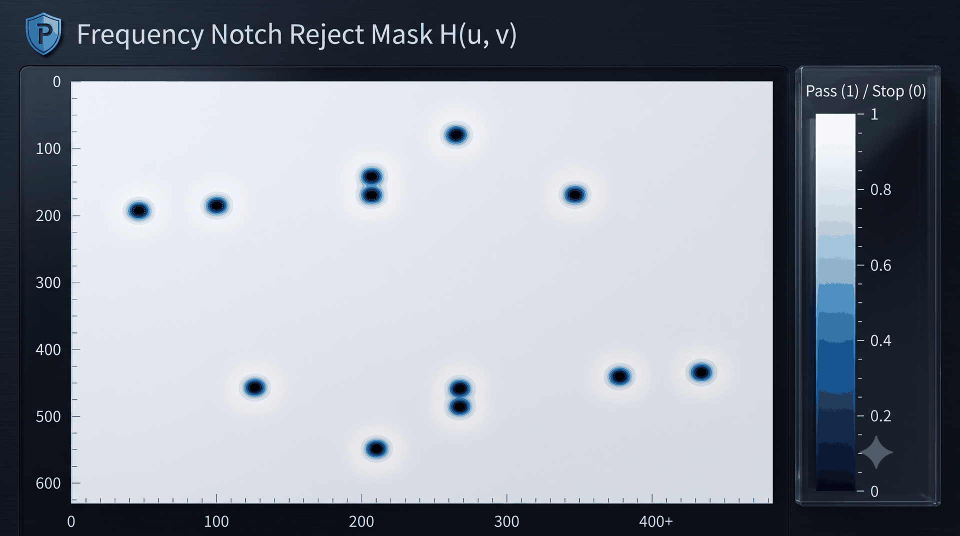
PROPOSED SOLUTIONS AND INNOVATION
NEUROCLEAR
TARGETED REMEDIATION
FFT-based screening identifies periodic, ring and stripe signatures.
Frequency notch masks target only the detected artifact components.
TRACEABLE PROCESSING
Visible intermediate outputs make each processing decision traceable.
Artifact frequencies highlighted
Selective notch reject mask
Difference maps expose where intensity changed after denoising.
WHAT MAKES NEUROCLEAR DIFFERENT
VERIFIABLE OUTPUT
Physics-aware
Structure-aware
Audit-ready
Residual histograms and SSIM/PSNR/SNR support quantitative review.
Uses frequency-domain cues before image-space denoising.
Perona-Malik + NLM preserve meaningful micro-structure.
Difference map + residual statistics document the change.
Risk-gated export keeps verification attached to the output.
NeuroClear
2

Slide 3
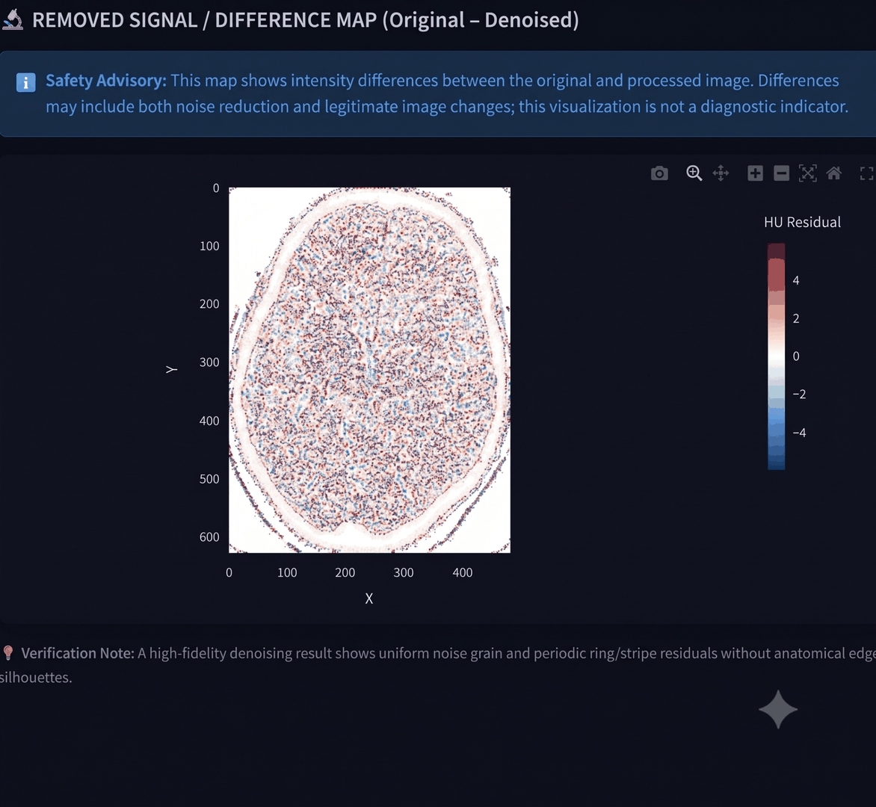
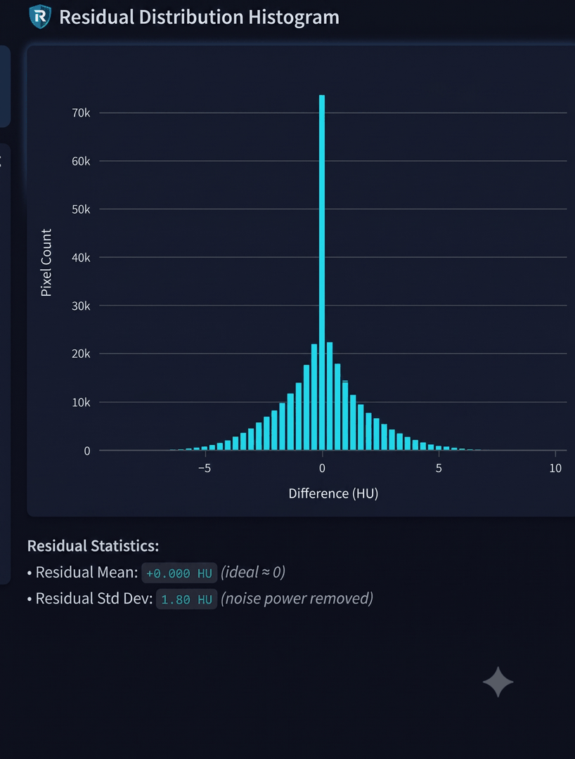
TECHNOLOGIES USED
NEUROCLEAR
INPUT & INTEROPERABILITY
DENOISING & ENHANCEMENT
NOISE ANALYSIS
VERIFICATION
DICOM, PNG, JPG, TIFF and multi-slice series
Non-local Means (NLM)
FFT / frequency-domain screening
Difference map
Hounsfield Unit scaling and medical image metadata
Perona-Malik anisotropic diffusion
Anscombe transform for Poisson-like noise
Residual histogram
CLAHE + unsharp enhancement
SSIM / PSNR / SNR
IMPLEMENTATION & SAFETY CONTEXT
Standards
IEC 62304 • ISO 14971 • IEC 62366-1 • DICOM
Interface
PACS-style split view, filmstrip and quantitative metrics
Export
DICOM / PNG output with verification trail
Difference map: removed signal
NeuroClear
3

Slide 4
FEASIBILITY AND VIABILITY
NEUROCLEAR
TECHNICAL
WORKFLOW
RISK CONTROL
Built from established image-processing methods; modular stages can be tested independently.
Supports common CT formats and a workstation-style review flow with visible quality checks.
Difference maps, residual analysis and metric checks provide a verification gate before export.
CHALLENGE -> RESPONSE
Noisy / low-dose input
->
Noise-power screening + calibrated preprocessing
Risk of over-smoothing
->
Selective frequency removal + structure-preserving denoising
Need for explainability
->
Difference map + residual statistics
Prototype workstation evidence
Feasibility is supported by an implemented, testable prototype workflow.
NeuroClear
4

Slide 5
IMPACTS AND BENEFITS
NEUROCLEAR
CLARITY
TRACEABILITY
Lower noise can make low-dose CT review more readable while keeping structural detail visible.
Intermediate outputs show what was detected, removed and changed.
WORKFLOW VALUE
ACCESSIBILITY
A PACS-style workstation combines image review and quantitative verification in one place.
Multi-format input and open-source-oriented architecture can lower the barrier to experimentation and adoption.
Prototype residual statistics
Noise reduction
94.0%
Edge preservation
99.8%
PSNR
43.04 dB
SSIM
0.9817
Processing time
1.40 s
Metrics shown are from the supplied prototype UI screenshot.
NeuroClear
5

Slide 6
RESEARCH AND REFERENCES
NEUROCLEAR
1. Buades, Coll & Morel (2005). A non-local algorithm for image denoising. IEEE CVPR.
6. IEC (2015). IEC 62366-1: Medical devices - Usability engineering.
2. Perona & Malik (1990). Scale-space and edge detection using anisotropic diffusion. IEEE TPAMI, 12(7), 629-639.
7. Manduca et al. (2009). Projection space denoising with bilateral filtering and CT noise modeling for dose reduction in CT. Medical Physics, 36(11), 4911-4919.
3. Zuiderveld (1994). Contrast Limited Adaptive Histogram Equalization. Graphics Gems IV.
8. Chen et al. (2017). Low-dose CT with a residual encoder-decoder convolutional neural network. IEEE TMI, 36(12), 2524-2535.
4. IEC (2015). IEC 62304: Medical device software - Software life cycle processes.
9. NEMA / ACR. DICOM Standard PS 3.x - Digital Imaging and Communications in Medicine.
5. ISO (2019). ISO 14971: Medical devices - Application of risk management.
10. Anscombe (1948). The transformation of Poisson, binomial and negative-binomial data. Biometrika, 35(3/4), 246-254.
Research base preserved from the original NeuroClear reference slide; no additional sources added.
NeuroClear
6

