Slide 1
Automated Visual Inspection
using Convolutional Neural Networks (CNN)
Team Members: Abhi P Vijay · Anamika A · Arya R
GitHub: github.com/Aryaremani/Automated-Visual-Inspection-using-CNN
Streamlit App: automated-visual-inspection-using-cnn.streamlit.app

Slide 2

Problem Statement
Problem Statement
Manual inspection of bottles in manufacturing is:
Time-consuming & inconsistent
Prone to human error
Inefficient for high-speed lines
Solution: An automated CNN-based system to accurately detect defects in real time — consistently and at scale.

Slide 3

Dataset Overview
Dataset Overview
Bottle Category from MVTec AD Dataset
Purpose: Industrial anomaly detection benchmark
Defects: Cracks, contamination, scratches
Dataset Size: 5,354 images across 15 categories
Training: Defect-free bottle images
Test Data: Normal + anomalous with pixel-level annotations

Slide 4
Methodology & Pipeline
Data Science Life Cycle
1. Problem Definition
& Literature Review
2. Data Collection
& Analysis
3. Data Preprocessing
4. Exploratory
Data Analysis
5. Feature Extraction using CNN
6. Model Building
& Training
(ResNet18)
7. Model Evaluation
& Performance Analysis
8. Model Interpretation
& Explainability
(Grad-CAM)
9. Deployment
(Streamlit)
10. Documentation
(README, GitHub)
CNN Pipeline Architecture
Input Image
Preprocessing
CNN Feature
Extraction
Classification Layer
Output
Classification
Notes:
The CNN pipeline begins with the input image, which is preprocessed through resizing, normalization, and augmentation techniques. The processed image is then passed through convolutional layers of the ResNet18 model, where hierarchical features such as edges, textures, and defect patterns are automatically extracted.
Pooling layers reduce spatial dimensions while preserving important information. The extracted feature maps are then passed to fully connected layers, which perform the final classification into good or defective categories. Finally, the model outputs prediction probabilities for each class.

Slide 5
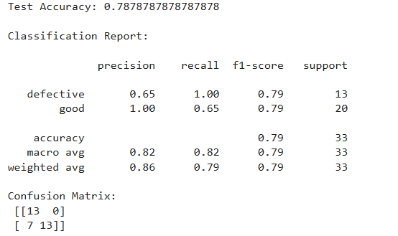
Key Results
~79%
1.00
100%
Test Accuracy
Defect Recall
Defect Detection
Rate

Slide 6

Deployed Application
Streamlit Web Application
Features:
Upload bottle images for instant inspection
Real-time defect classification
Normal vs Defective prediction output
Confidence score display
Clean, user-friendly interface
URL: automated-visual-inspection-using-cnn.streamlit.app

Slide 7
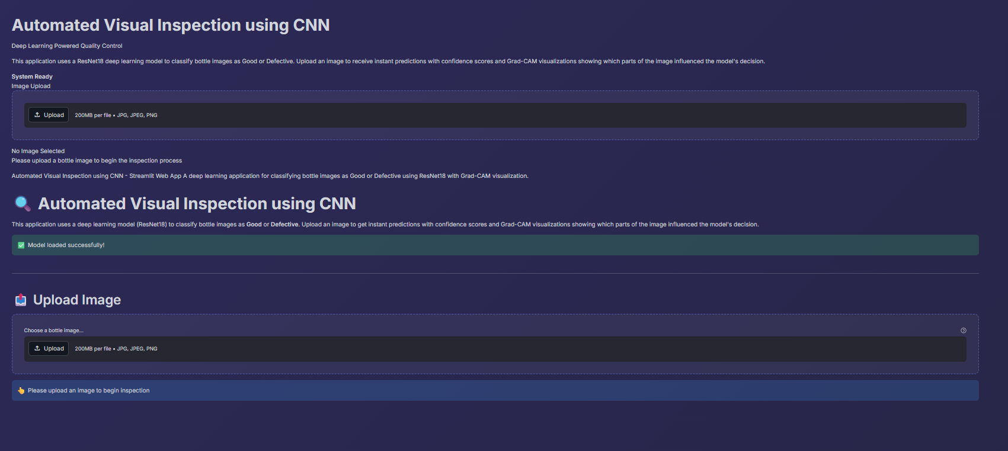
Deployed Application

Slide 8



Conclusions, Limitations & Future Work
Conclusions
Limitations
Future Work
Achieved ~79% test accuracy
Recall of 1.00 — zero missed defects
CNN effectively automates visual inspection
System is deployable on Streamlit for real use
Bias towards defect detection (class imbalance)
Limited dataset reduces generalization
Struggle with complex/unseen defect types
Some normal images misclassified as defective
Increase dataset size & diversity
Real-time defect detection in production
Extend to multi-class defect classification
Explore advanced architectures

Slide 9
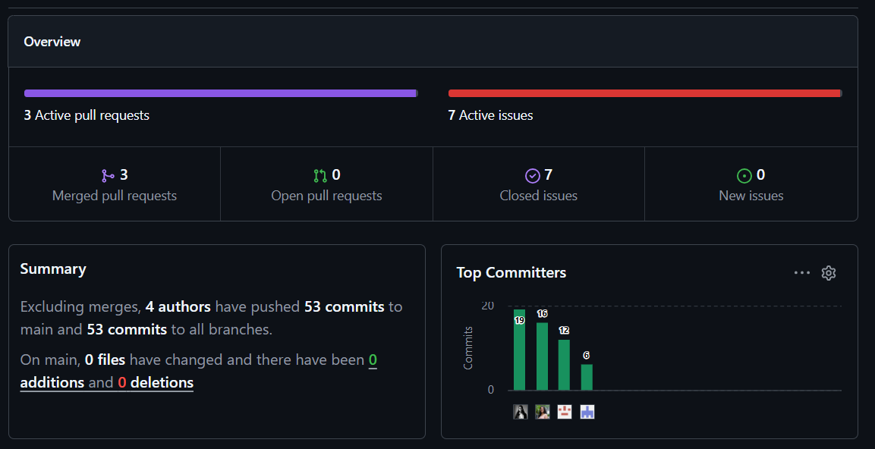
Github Insights

Slide 10
Thank You!
GitHub Repository
github.com/Aryaremani/Automated-Visual-Inspection-using-CNN
Abhi P Vijay · Anamika A · Arya R

