Slide 1
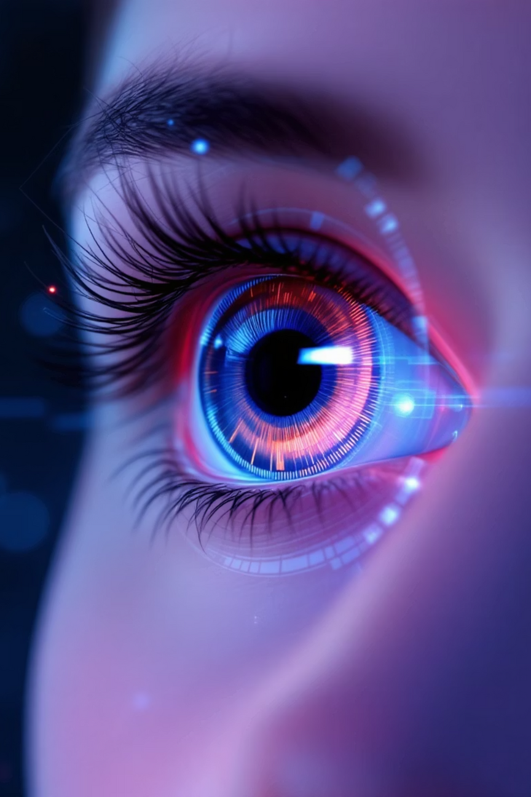

Drishti: Preventing Blindness Through AI-Powered Diabetic Retinopathy Detection
Introducing Drishti: an innovative web application transforming ophthalmology through artificial intelligence. By leveraging advanced AI models to detect and predict Diabetic Retinopathy (DR) and its associated risks, Drishti addresses one of the leading causes of preventable blindness in diabetic patients worldwide.
Notes:
1

Slide 2
The Growing Threat of Diabetic Retinopathy
537M
84%
#1
Global diabetics
Unaware patients
Leading cause
Adults living with diabetes worldwide in 2021
Diabetics who don't know they have the condition
DR is the primary cause of blindness in working-age adults
Diabetes has emerged as a global health crisis, affecting hundreds of millions worldwide. Among its most devastating complications, Diabetic Retinopathy stands out as the leading cause of vision loss in diabetic patients. The alarming reality is that approximately 84% of diabetics remain unaware of their condition due to inadequate screening infrastructure. Early detection and timely intervention are absolutely crucial to preventing irreversible damage and preserving sight.
Notes:
2

Slide 3
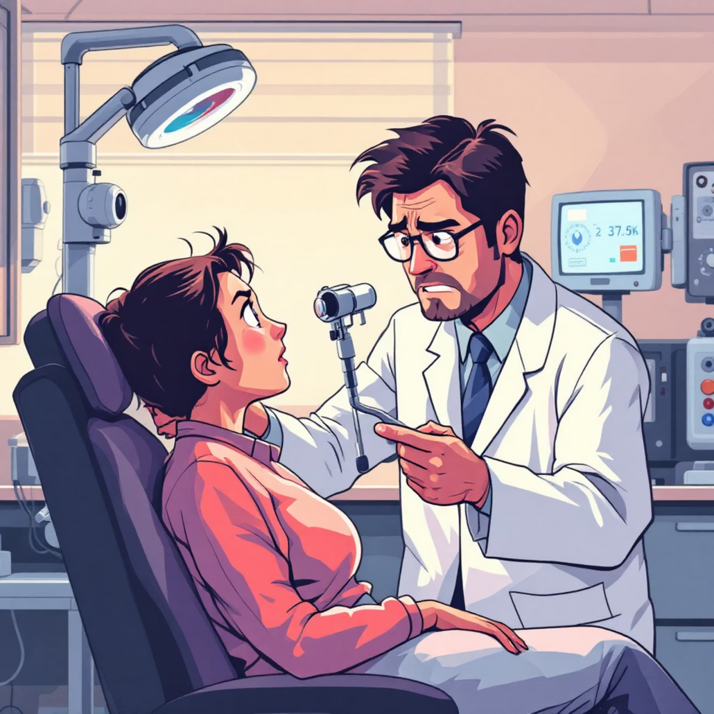
The Problem: Inadequate Screening and Diagnosis
Complex Traditional Methods
Conventional DR screening requires expensive equipment, specialized facilities, and time-intensive manual examination processes
Limited Specialist Access
Rural and underserved communities face critical shortages of trained ophthalmologists and screening infrastructure
Delayed Diagnosis Risk
Late detection leads to advanced DR stages, significantly increasing the risk of permanent vision loss and blindness
The consequence is clear: preventable vision loss and dramatically reduced quality of life for millions of diabetic patients who could have been saved with timely screening.
Notes:
3

Slide 4
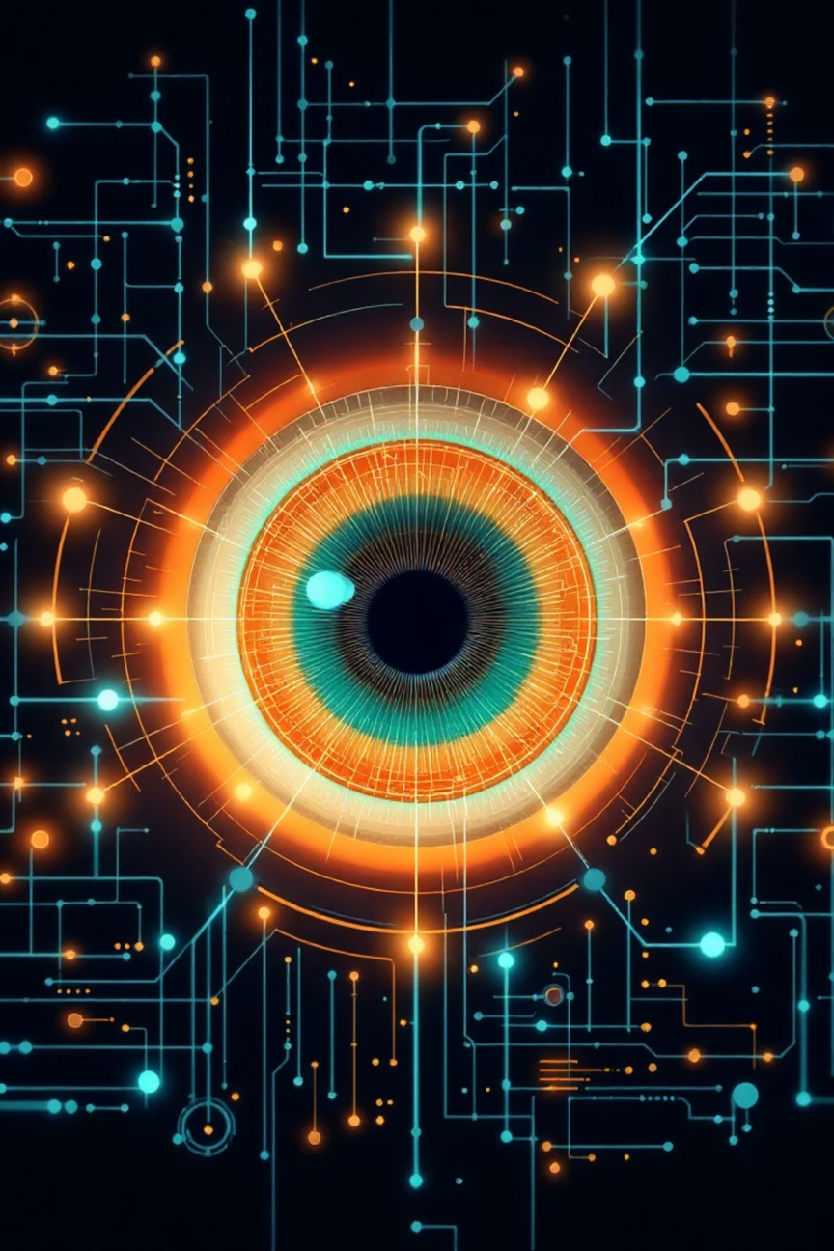
Drishti: AI-Powered Solution for Early Detection
Advanced AI Analysis
Utilizes cutting-edge deep learning models to analyze retinal images with exceptional precision and speed
Rapid Detection
Delivers accurate DR screening results in minutes, providing timely insights for ophthalmologists to act upon
Cloud-Based Platform
Accessible anywhere with internet connectivity, breaking down geographical barriers to quality care
Intuitive Interface
Designed for ease of use, requiring minimal training while maximizing efficiency for healthcare professionals
Notes:
4

Slide 5
Key Features and Benefits of Drishti
Automated Image Analysis
Early DR Detection
Risk Prediction
Enhanced Workflow
Identifies subtle pathological signs and microaneurysms before patients experience any symptoms, enabling preventive intervention
Leverages patient data and AI models to predict DR progression likelihood, facilitating personalized treatment planning
Streamlines the entire screening process from image capture to diagnosis, dramatically improving clinic efficiency and patient throughput
Significantly reduces manual workload and minimizes human error through intelligent automation, allowing clinicians to focus on patient care
Notes:
5

Slide 6

Advanced AI Models Driving Drishti
Deep Learning Architecture
Powered by convolutional neural networks trained on extensive datasets containing hundreds of thousands of annotated retinal images from diverse patient populations
Exceptional Accuracy
Demonstrates high sensitivity (>95%) and specificity (>90%) in detecting various stages of DR, matching or exceeding human expert performance
Continuous Learning
Models continuously improve through exposure to new clinical data and feedback, adapting to evolving medical knowledge and diverse patient presentations
Seamless Integration
Designed to integrate effortlessly with existing hospital information systems, PACS, and electronic health records without disrupting established workflows
Notes:
6

Slide 7

Real-World Impact and Future Directions
Transforming Patient Outcomes
Clinical implementations of Drishti have demonstrated remarkable results across diverse healthcare settings. In pilot programs, the platform has successfully screened over 50,000 patients, identifying early-stage DR in individuals who would have otherwise gone undiagnosed until vision loss occurred.
Proven Clinical Effectiveness
Real case studies show 40% increase in early-stage DR detection rates compared to traditional screening methods
Future AI Innovation
Exploring applications in glaucoma detection, age-related macular degeneration, and other vision-threatening conditions
Expanding Global Access
Bringing world-class DR screening to rural clinics, mobile health units, and underserved regions across continents
Notes:
7

Slide 8

Empowering Ophthalmologists, Protecting Vision
1
Our Mission
Drishti represents a transformative leap forward in Diabetic Retinopathy management, combining cutting-edge AI with accessible technology to prevent blindness worldwide
2
Join the Movement
Partner with Drishti to combat preventable blindness, improve patient outcomes, and revolutionize ophthalmic care in your practice or healthcare system
Notes:
8

