Slide 1

PBL Presentation
Import Data Analysis and Prediction using Machine Learning
Name : Aryavardhan Deshmukh
PRN : 22070521115
Sem: 7th Sec: C
Under the guidance of
Dr. Piyush Chauhan
Symbiosis Institute of Technology, Nagpur Campus

Slide 2


Innovative Practices & Quality Initiatives at SIT-N
01
Problem Statements
1. Presentation Flow
Compare & contrast alternative solution
02
04
Research Initiatives
03
Existing processes/Solutions

Slide 3
Problem Context
Background: India imports data from multiple American countries, analysis can reveal economic and trade patterns.
Challenge: Imports fluctuate by country, commodity, and year — hard to forecast manually.
Goal: Use data-driven ML models to understand and predict import behavior.
2

Slide 4
Problem Statement :
To analyze and model import data from American countries (2015–2025) using ML techniques for predicting import values, classifying trade levels, and clustering countries by trade similarity.”
2

Slide 5
Core Ideology & Objectives :
Turn raw trade data into insights using ML
Three focused solutions:
  Regression → Predict import value
  Classification → Categorize imports
  Clustering → Find similar trade groups
2

Slide 6
Data Collection & Preprocessing:
Dataset info (records, attributes, source)
Cleaning steps:
  Handled missing values
  Converted date columns
  Extracted year/month
  Removed irrelevant columns
2

Slide 7
Exploratory Data Analysis Content:
Top 5 import countries
Top 5 commodities
Import value trends by year
Observed patterns (growth, correlation)
2

Slide 8
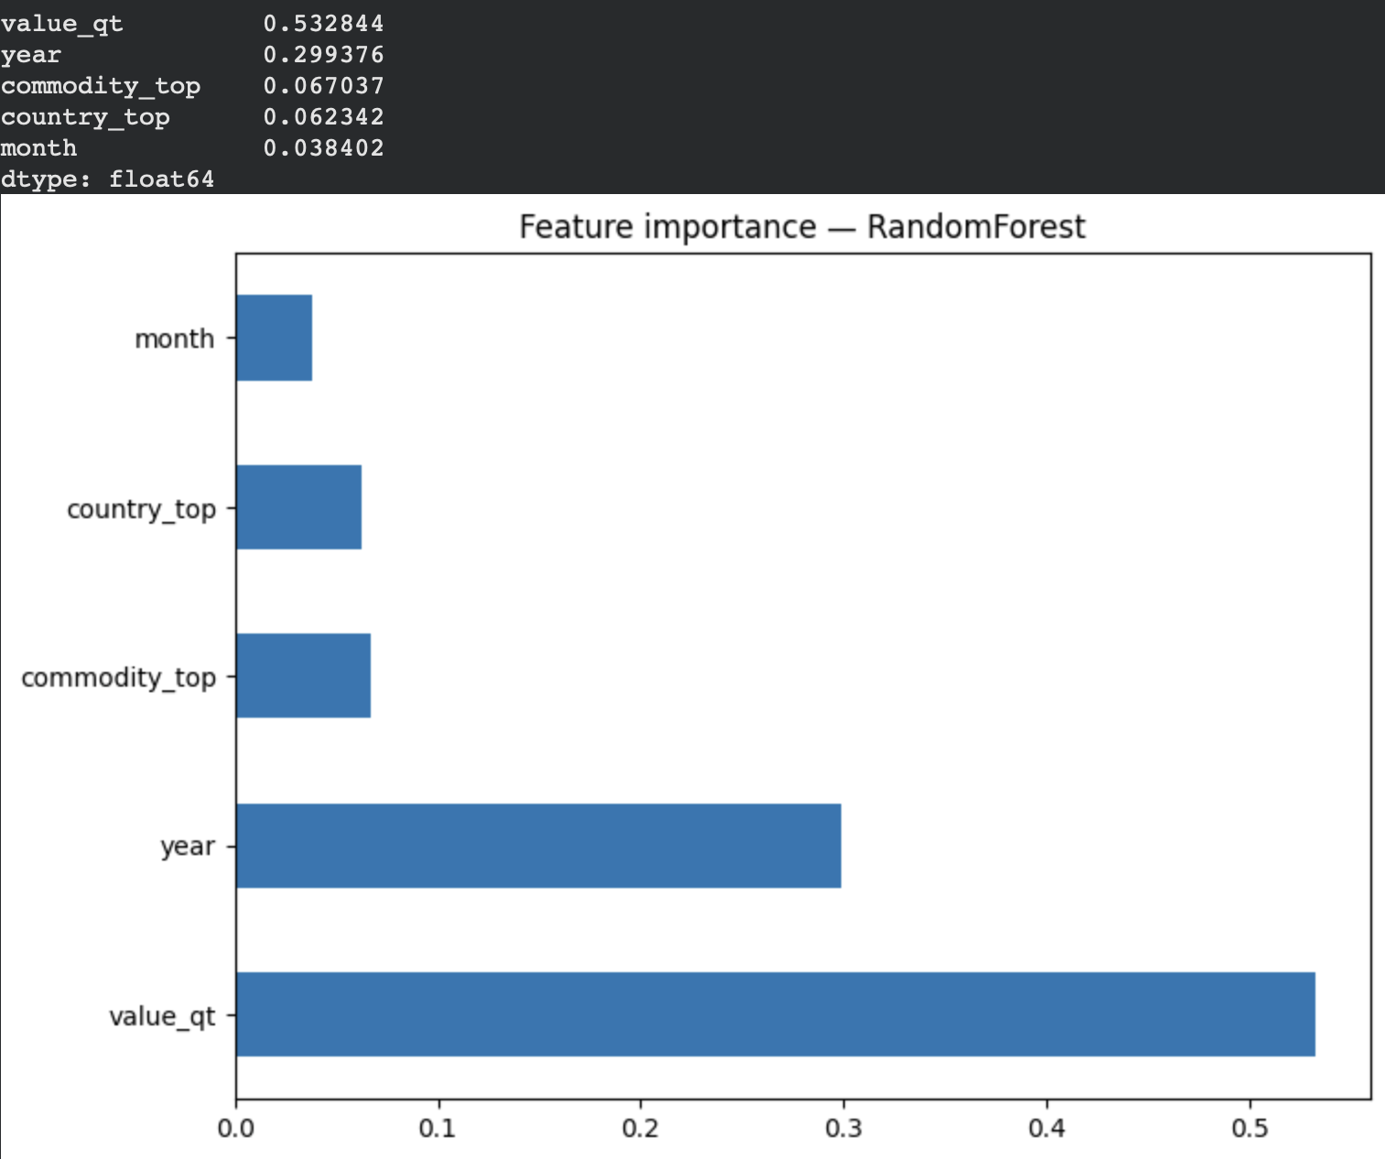
Regression Model (Level 1) :
Target variable: value_rs
Models used: Linear Regression, Random Forest, XGBoost
Best performance: Random Forest (R² , RMSE )
Interpretation of important features
2

Slide 9
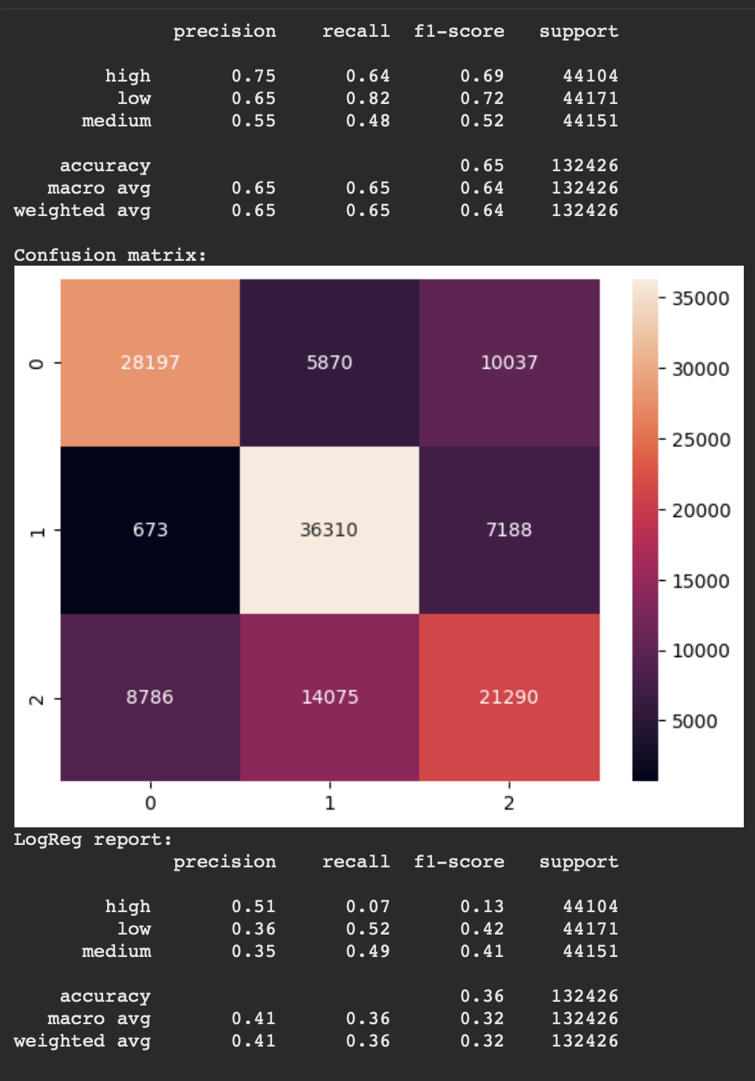
Classification Model (Level 2) :
Purpose: Categorize import values (Low, Medium, High)
Model: Random Forest Classifier
Key metrics: Accuracy = 82%, Precision , Recall
Result interpretation
2

Slide 10
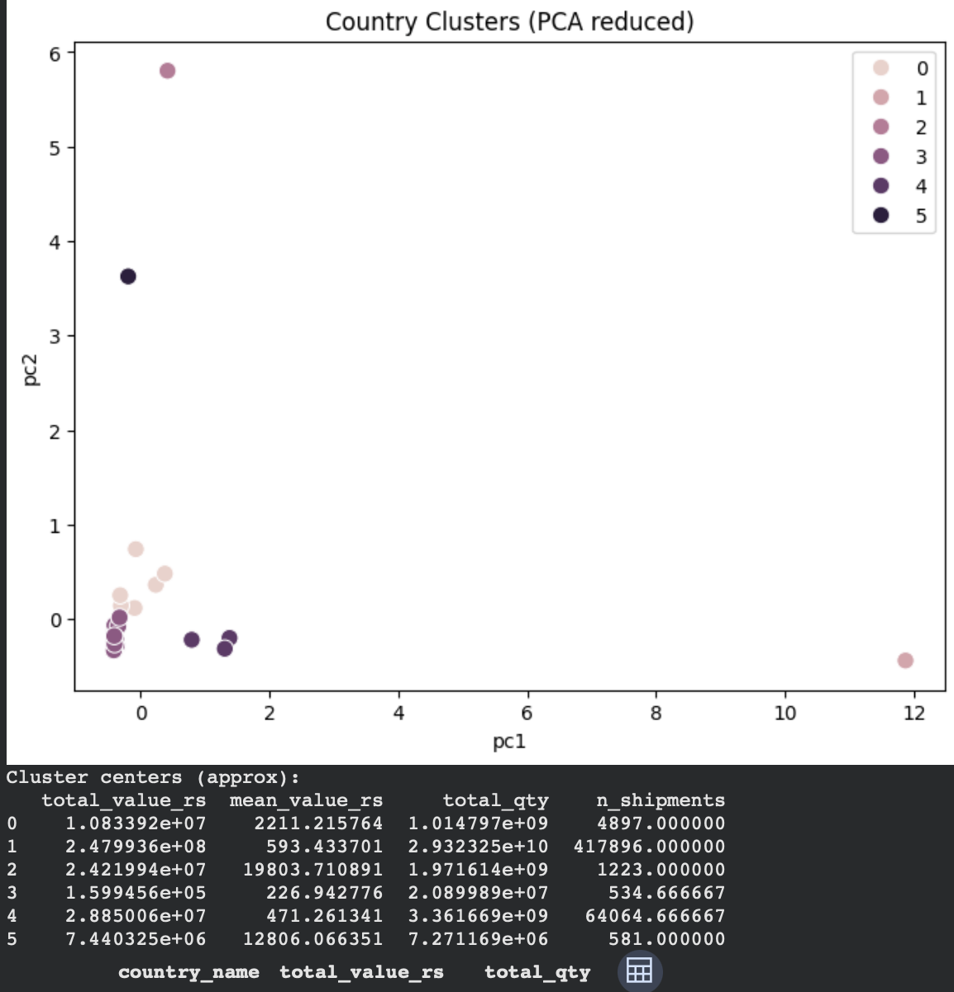
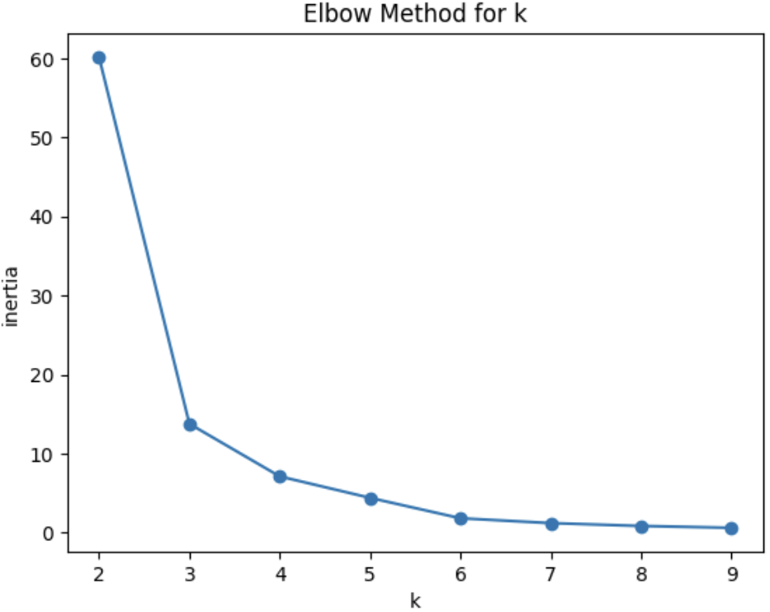
Clustering (Level 4) :
Goal: Group countries with similar trade patterns
Method: K-Means (k = 4)
Insights from each cluster
Application: Country grouping for policy decision
2

Slide 11
Streamlit Interface :
Description: Interactive web app built for predictions
Functions:
  Regression → Predict import value
  Classification → Categorize value
  Clustering → Find country group
Easy user input → Instant results
2

Slide 12
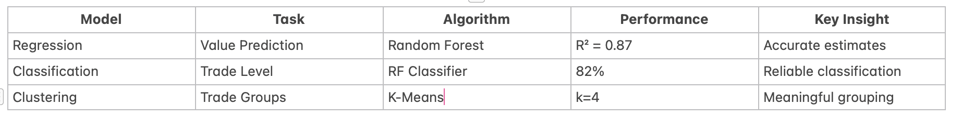
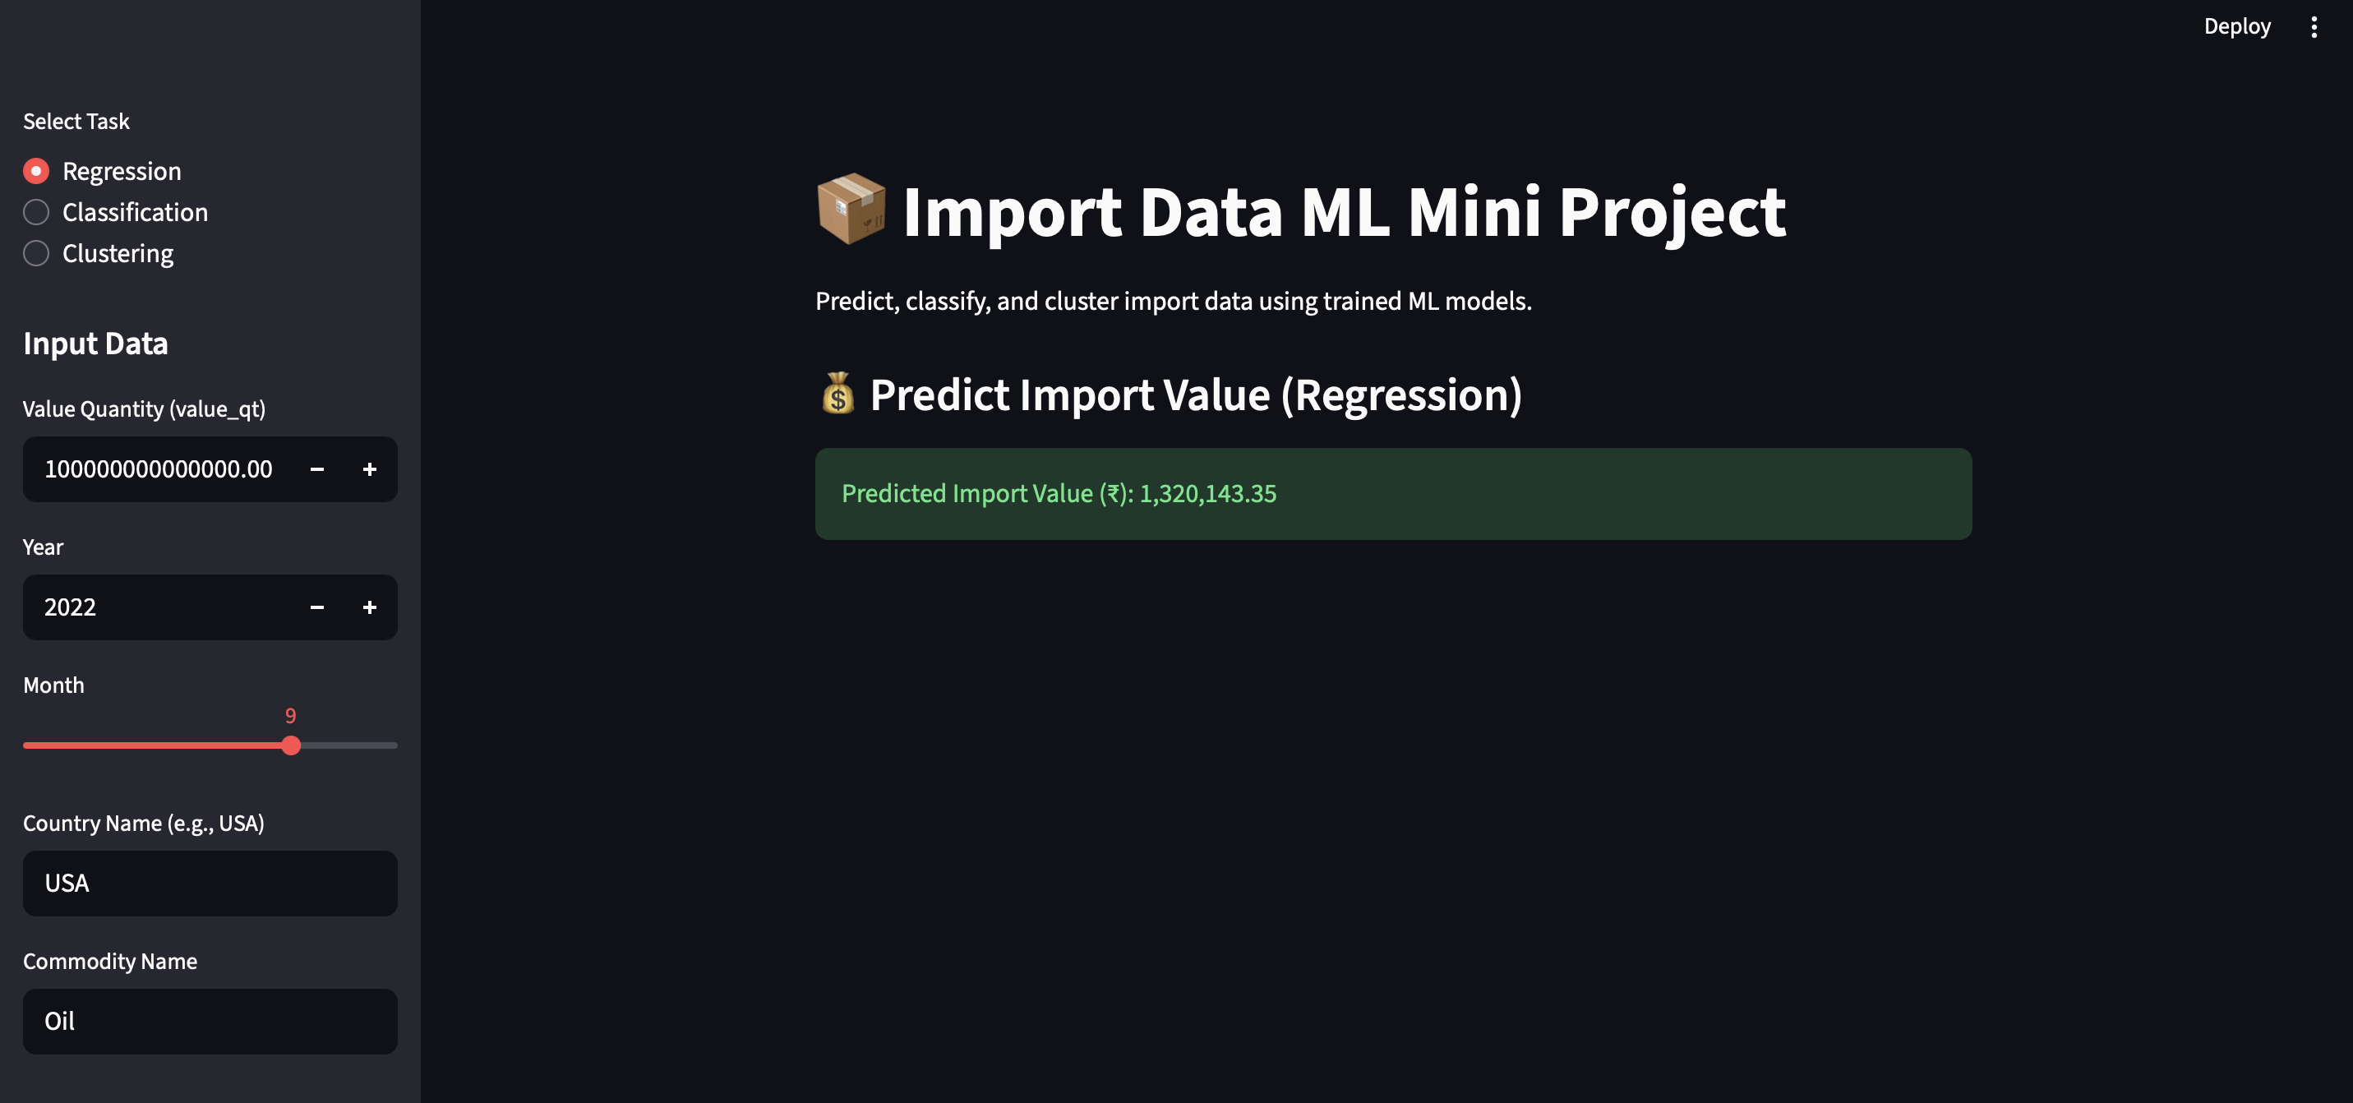
Regression
2

Slide 13
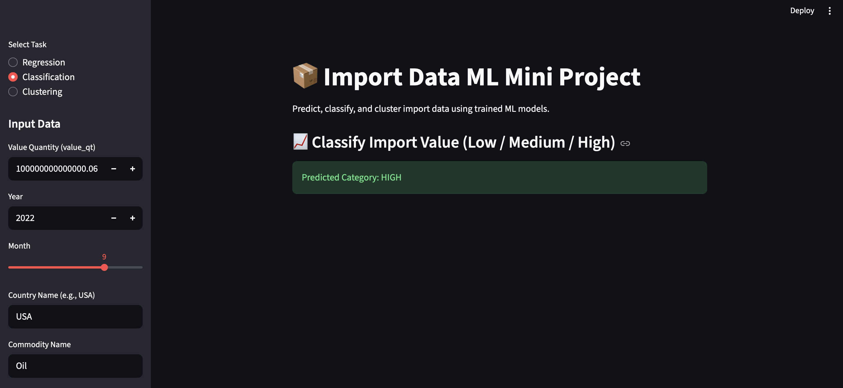
Classification:
2

Slide 14
  Conclusion & Future Scope
  Conclusion:
Developed complete ML pipeline for import analysis
Achieved strong prediction accuracy and classification performance
Discovered useful trade clusters
Future Work:
Time-series forecasting using Prophet/LSTM
Public deployment on Streamlit Cloud
Integration with live trade data APIs

