Slide 1
Electric Motor Winding Temperature Estimation and Thermal Monitoring Using Machine Learning
A history-aware virtual sensor for a permanent-magnet synchronous motor
UCS321 · MST Mini Project #6 · General Electric (GE) Power Systems case study
[Your name] · [Roll number] · [Group / Instructor]
Dataset: Paderborn University LEA test bench (public, CC BY-SA 4.0) - not GE hardware.

Slide 2
Problem and motivation
Why estimate a temperature we could in principle measure?
• Winding insulation ageing and demagnetisation limit motor torque; the controller must know how hot the stator winding is.
• Direct sensing: accurate, but extra cost, wiring, failure points and hard to retrofit.
• Virtual sensing: reuse signals the drive already has (speed, torque, d-q currents/voltages, coolant, ambient) and learn the mapping from data.
• Research question: can ML estimate winding temperature on unseen operating profiles without the winding temperature as input?
• Also: use the estimate as a reference - a persistent residual can flag something unusual (experimental, not a protection function).
Direct sensor
+ measured truth
- cost / failure point
Virtual sensor
+ no hardware
+ redundancy / plausibility check
- statistical, limited to training domain
GE Power Systems is the case-study framing of the assignment. The data comes from a university test bench, not GE equipment.
UCS321 · MST Mini Project #6 · PMSM winding-temperature virtual sensor · 2

Slide 3
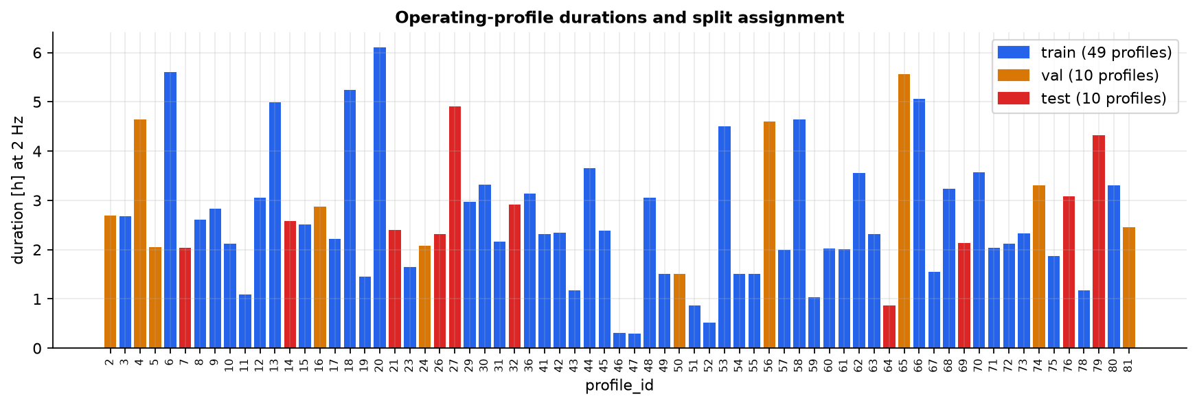
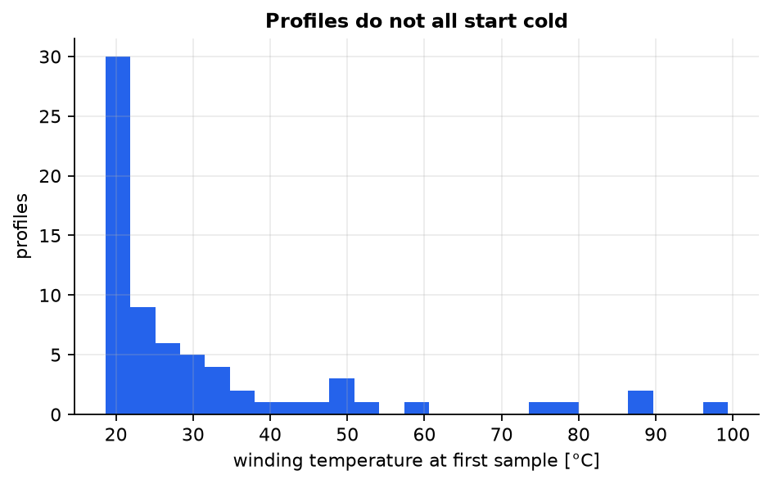
Dataset and provenance
Paderborn University LEA PMSM test bench - Kaggle 'electric-motor-temperature'
• measures_v2.csv · 300 MB · 1,330,816 rows · 69 operating profiles · ≈ 185 h at an assumed 2 Hz
• Target: stator_winding. Inputs: ambient, coolant, motor_speed, torque, i_d, i_q, u_d, u_q.
• Never used as inputs: stator_tooth, stator_yoke, pm (internal temperatures), profile_id.
• No missing values, no duplicate rows; each profile is one contiguous block (row order = time).
• 22 of 69 profiles start with a warm motor - not all recordings are cold starts.
• SHA-256: 78f3d150f0f2ad9c… · licence CC BY-SA 4.0 (attribution in README).
UCS321 · MST Mini Project #6 · PMSM winding-temperature virtual sensor · 3

Slide 4
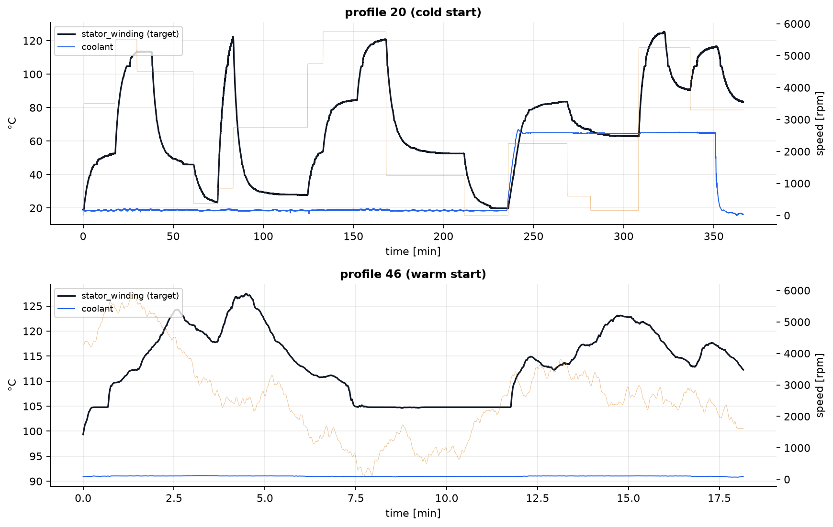
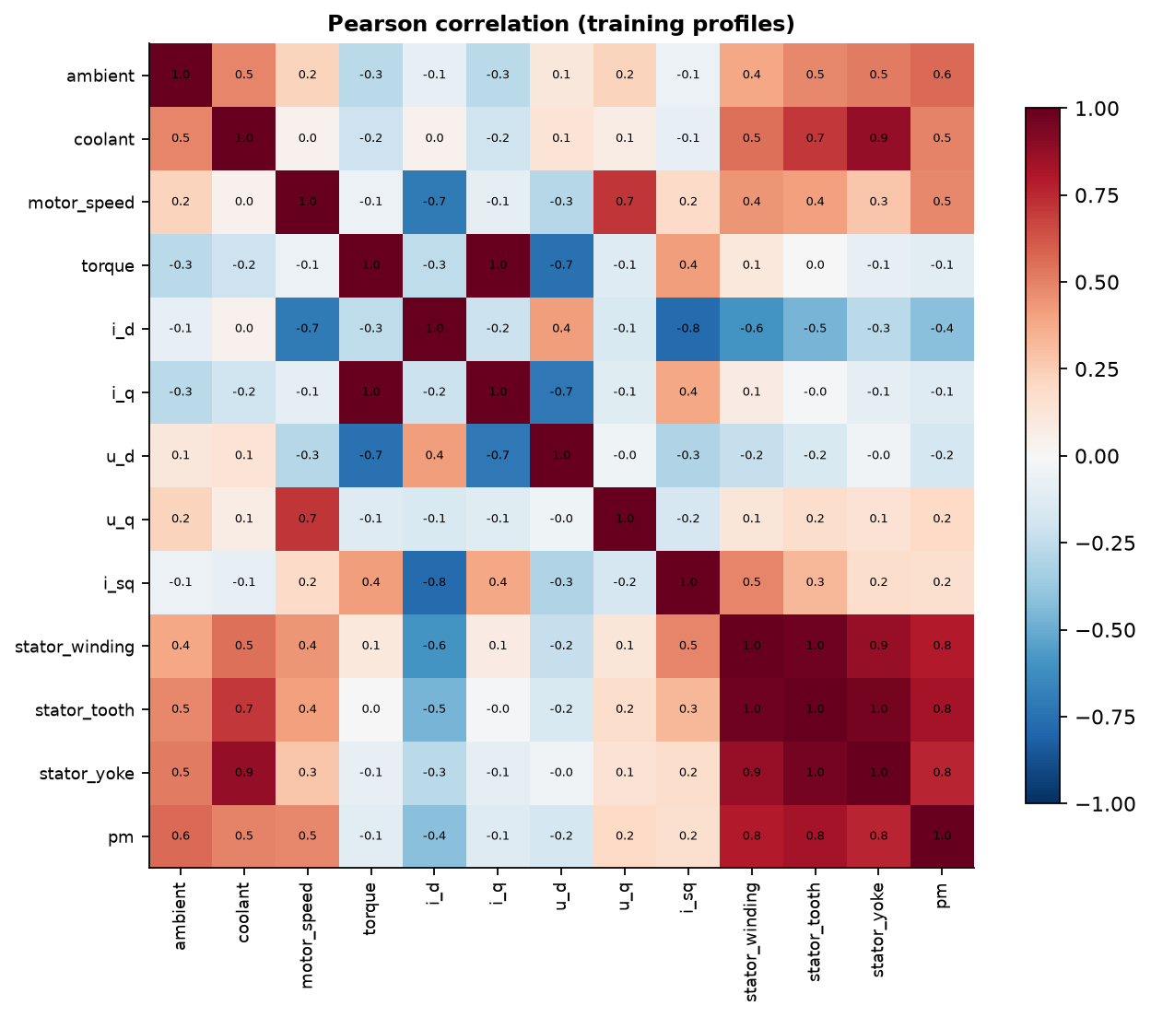
Exploratory data analysis
What the measurements look like
• Winding temperature spans ≈ 19-141 °C; instantaneous |i|² explains only part of it.
• Internal temperatures (tooth, yoke, magnet) are near-collinear with the target → excluded as inputs.
• Speed-torque coverage differs between profiles → split by whole profile.
UCS321 · MST Mini Project #6 · PMSM winding-temperature virtual sensor · 4

Slide 5
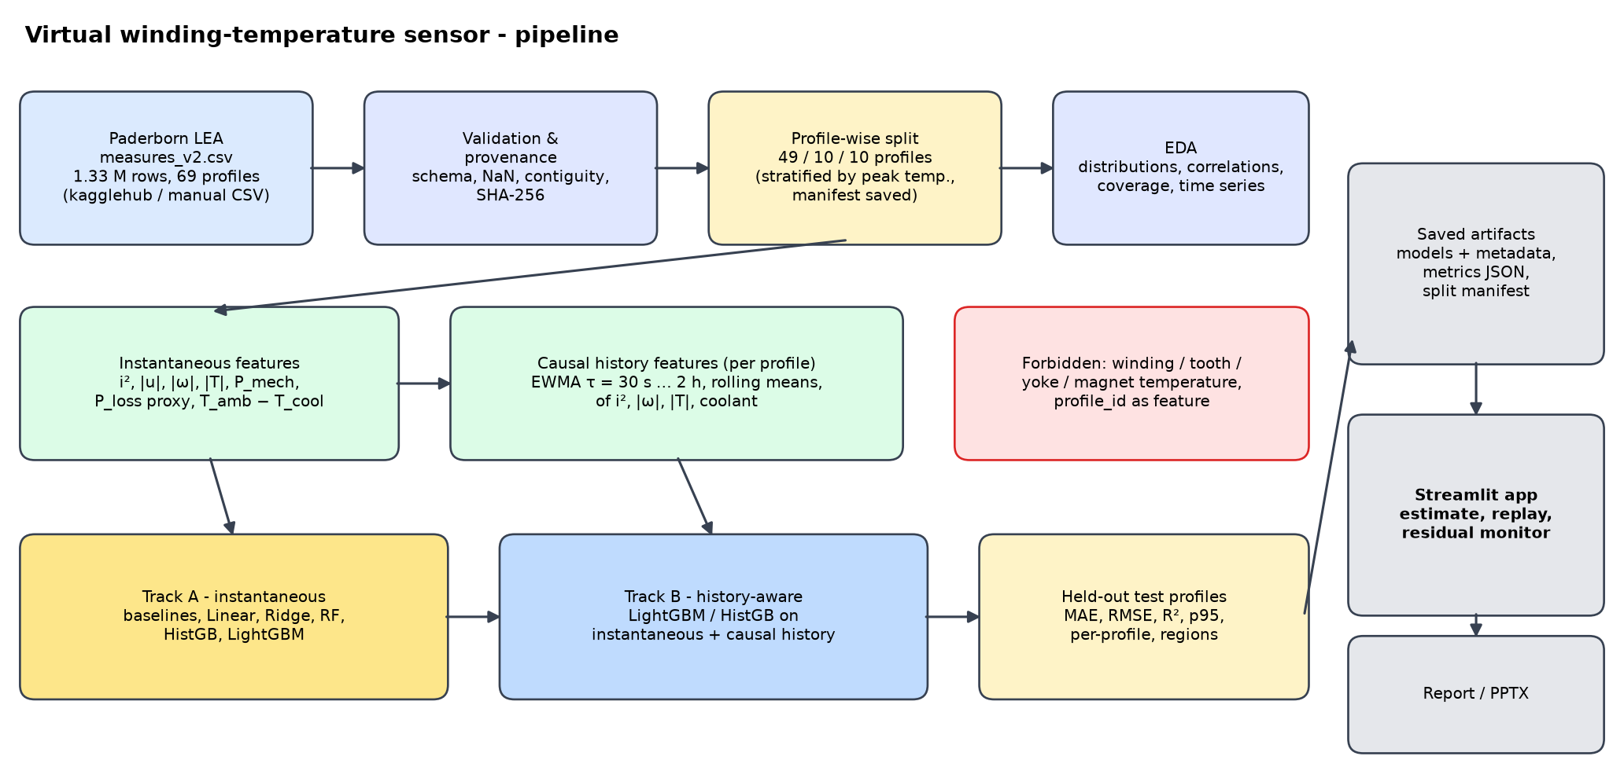
Pipeline and leakage-safe validation
• Split by whole profile: 49 train / 10 val / 10 test profiles (68 / 17 / 15 % of rows).
• Stratified by peak winding temperature; manifest saved.
• Scaler and statistics fitted on training rows only (Pipeline).
• Features are causal and reset at every profile start.
• Test profiles opened only after the model selection is frozen.
• Unit tests fail if any of this breaks.
Why not a random row split? Samples are 0.5 s apart and nearly identical to their neighbours, so a random split would put a near-copy of every test row into training and reward memorisation. Whole operating profiles are held out instead.
UCS321 · MST Mini Project #6 · PMSM winding-temperature virtual sensor · 5

Slide 6
Feature engineering and thermal inertia
Physics → features
C·dT/dt = P − (T − T_coolant)/R ⇒ T[k+1] = (1−α)·T[k] + α·(T_coolant + R·P[k]), α = Δt/τ
The temperature is an exponentially weighted average (EWMA) of the heating history.
• Track A (instantaneous): 8 raw signals + 9 derived: i², |i|, |u|, |speed|, |torque|, P_mech (exact), P_elec / P_loss (proxies), T_amb − T_cool.
• Track B (history-aware): + causal EWMAs (τ = 30 s, 2 min, 10 min, 30 min, 2 h) and rolling means (60 s, 5 min) of i², |speed|, |torque| and coolant temperature → 45 features.
• Windows defined in seconds, computed on the full 2 Hz series, per profile, no future samples.
• Cold start is explicit: rolling means are NaN until the window is full (LightGBM handles NaN); no arbitrary fill values.
• Offline (vectorised) and streaming implementations are unit-tested to agree.
UCS321 · MST Mini Project #6 · PMSM winding-temperature virtual sensor · 6

Slide 7
Models compared
Held-out test profiles · MAE / RMSE in °C
Candidate | Track | MAE | RMSE | R² | p95 AE | Worst-profile MAE | Fit [s]
A/mean_baseline/basic | A | 25.20 | 29.65 | -0.013 | 54.67 | 42.91 | 0.0
A/linear/physical | A | 15.17 | 20.08 | 0.535 | 39.25 | 24.55 | 0.0
A/ridge/enhanced | A | 11.65 | 15.43 | 0.725 | 30.17 | 18.66 | 0.1
A/random_forest/enhanced | A | 13.20 | 17.32 | 0.654 | 34.87 | 17.63 | 57.4
A/hist_gb/enhanced | A | 11.02 | 14.76 | 0.749 | 28.12 | 16.02 | 8.5
A/lightgbm/enhanced | A | 10.32 | 14.11 | 0.771 | 29.37 | 14.27 | 3.9
A/lightgbm[t2]/enhanced | A | 9.53 | 13.34 | 0.795 | 27.31 | 13.19 | 3.9
B/lightgbm/enhanced+ewma_long | B | 3.45 | 5.64 | 0.963 | 10.78 | 6.03 | 8.4
B/hist_gb/enhanced+ewma_long_rolling | B | 2.54 | 3.89 | 0.983 | 7.78 | 4.35 | 16.6
B/lightgbm[t2]/enhanced+ewma_long_rolling | B | 2.35 | 3.37 | 0.987 | 6.43 | 3.16 | 31.7
• Instantaneous models plateau far above history-aware ones - algorithm choice matters much less than representing thermal memory.
• Winners were chosen on validation profiles only; the test table is a single pass.
UCS321 · MST Mini Project #6 · PMSM winding-temperature virtual sensor · 7

Slide 8
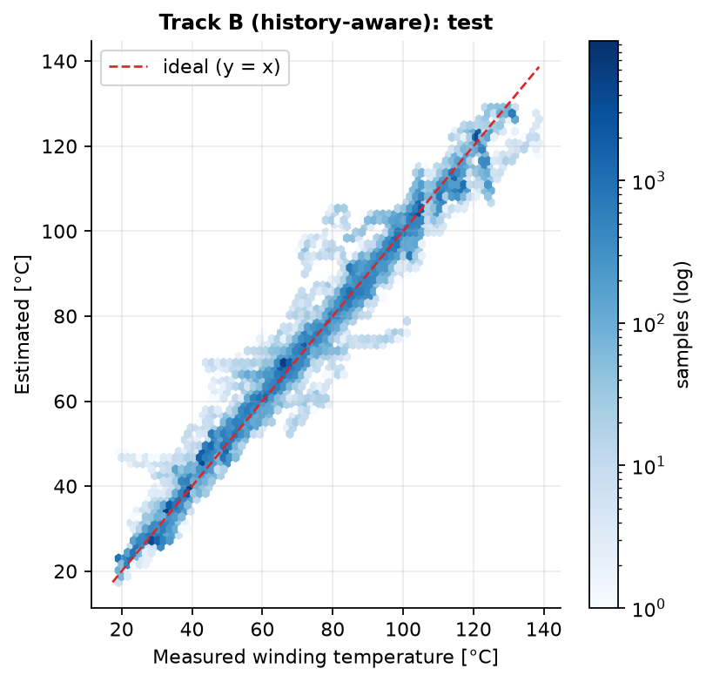
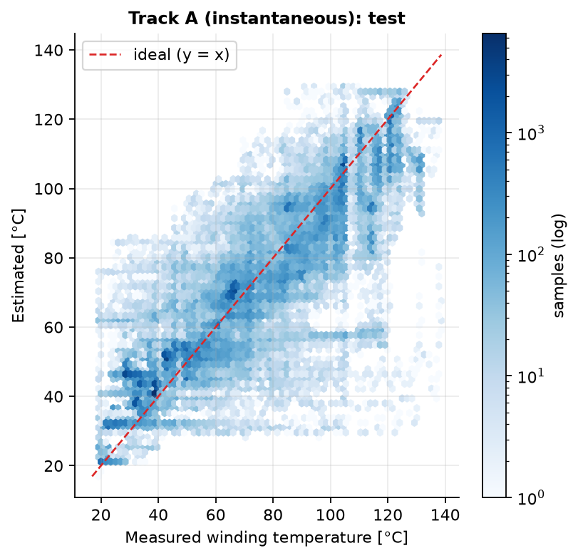
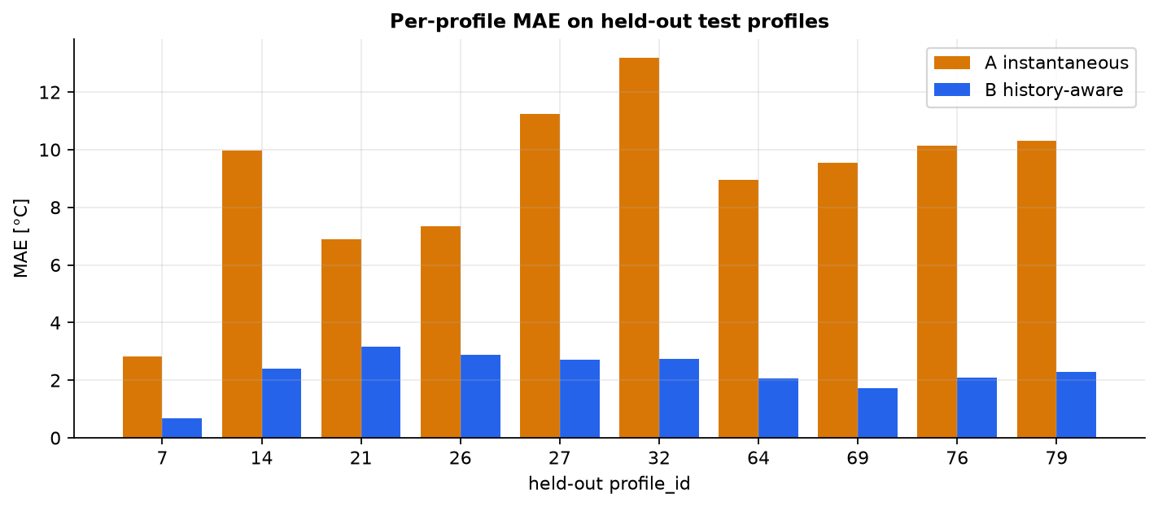
Results on unseen profiles
Track B history-aware vs Track A instantaneous
Metric | Track A | Track B
MAE [°C] | 9.53 | 2.35
RMSE [°C] | 13.34 | 3.37
R² | 0.795 | 0.987
median AE | 6.94 | 1.73
p95 AE | 27.31 | 6.43
worst profile MAE | 13.19 | 3.16
• Test: 10 whole profiles, 198,499 samples.
• R² alone hides °C-level errors - read MAE, p95 and the worst profile.
UCS321 · MST Mini Project #6 · PMSM winding-temperature virtual sensor · 8

Slide 9
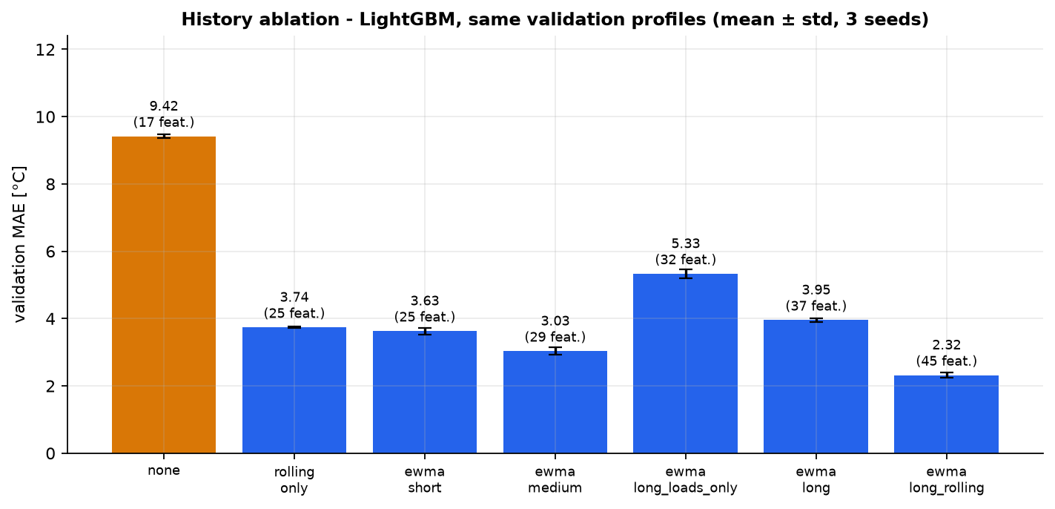
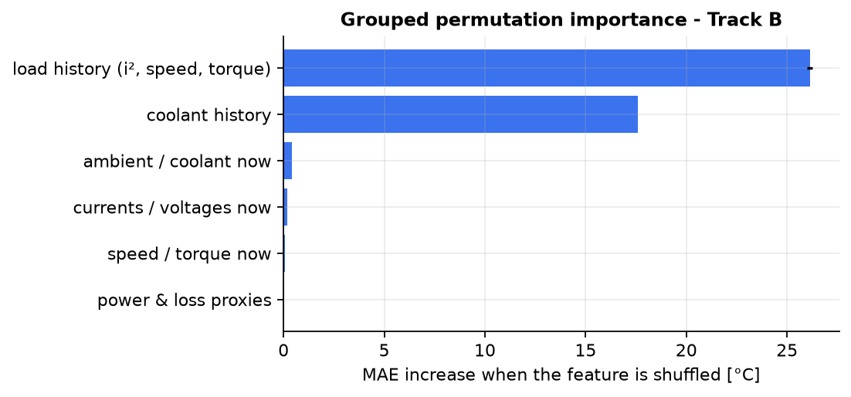
Does history help? What does the model use?
Ablation (validation) and permutation importance
• Same train/validation profiles for every row of the ablation; mean ± std over seeds.
• Importance by feature family (correlated features are shuffled together); importance is predictive, not causal.
• On the validation profiles, every history set beats the instantaneous model (9.42 °C); the best set ('ewma_long_rolling') reaches 2.32 °C (± 0.08 across seeds). Differences between history sets are smaller than the gap to the instantaneous model, and the seed spread shows differences below ≈ 0.3 °C should not be over-interpreted.
UCS321 · MST Mini Project #6 · PMSM winding-temperature virtual sensor · 9

Slide 10
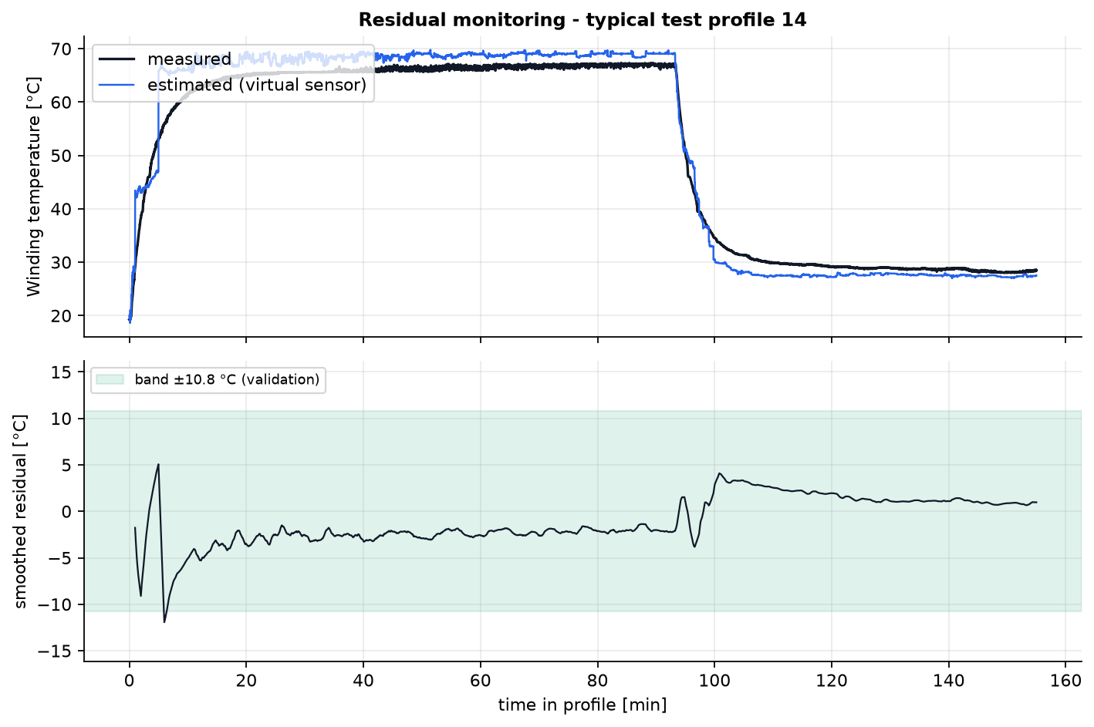
Thermal residual monitoring (experimental)
residual = measured − estimated
• Band ±10.8 °C: 99.5th percentile of the 60 s-smoothed |residual| on validation profiles; alarm needs ≥ 120 s persistence.
• On healthy test profiles: 0.13 % of time in alarm, 2 of 10 profiles raise ≥ 1 alarm (= false alarms / model error).
• Synthetic +offset sensitivity: +2 °C → 2 newly alarming of 10 profiles (median first alarm 16 min); +5 °C → 3 newly alarming of 10 profiles (median first alarm 17 min); +10 °C → 7 newly alarming of 10 profiles (median first alarm 26 min); +15 °C → 8 newly alarming of 10 profiles (median first alarm 4 min)
Not fault detection: no labelled faults exist, so no detection accuracy is claimed. A persistent residual may mean a sensor issue, cooling change, unseen operating point, model error or a real defect. Not a certified protection system.
UCS321 · MST Mini Project #6 · PMSM winding-temperature virtual sensor · 10

Slide 11
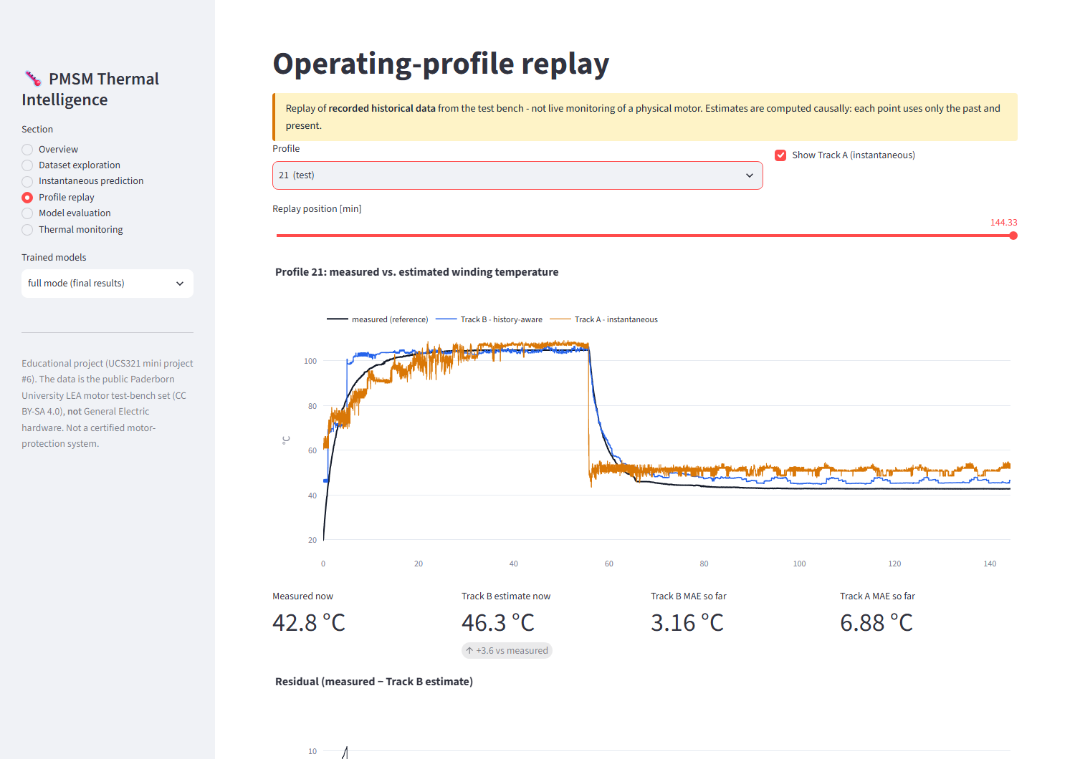
Application and extension
Streamlit dashboard · 60 s-ahead forecasting experiment
• Sections: overview, dataset exploration, instantaneous prediction, profile replay, model evaluation, thermal monitoring.
• Loads the saved models + metadata; never fakes predictions; warns about out-of-range inputs.
• Replay is historical data, clearly labelled.
• 60 s-ahead forecasting (separate experiment): persistence MAE 2.66 °C, sensor-independent forecast 3.24 °C, sensor-assisted forecast 2.27 °C.
• Run: uv run streamlit run app/streamlit_app.py
UCS321 · MST Mini Project #6 · PMSM winding-temperature virtual sensor · 11

Slide 12
Conclusions, limitations and references
• On 10 unseen test profiles the history-aware virtual sensor reaches MAE 2.35 °C (RMSE 3.37 °C, R² 0.987, 95 % of errors below 6.4 °C) versus 9.53 °C for the best instantaneous model - 4.0× lower error.
• Limitations: one test bench / motor; cold-start and warm-restart effects; coolant behaviour is operator-controlled on the bench; trees do not extrapolate; no fault labels.
• Future work: sequence models for comparison, warm-start initialisation, per-motor calibration, uncertainty estimates, validation on real fault data.
• References: Kirchgässner, Wallscheid, Böcker - Paderborn LEA PMSM temperature data & deep-pmsm; Ke et al., LightGBM (NIPS 2017); scikit-learn model-validation and common-pitfalls guides.
UCS321 · MST Mini Project #6 · PMSM winding-temperature virtual sensor · 12

