Slide 1
App Opener
Andy Lee, ahl88@scarletmail.rutgers.edu
Parthkumar Patel, parth.14@rutgers.edu
Robert Riso, rar267@scarletmail.rutgers.edu
Aryeh Ness, akn45@scarletmail.rutgers.edu

Slide 2
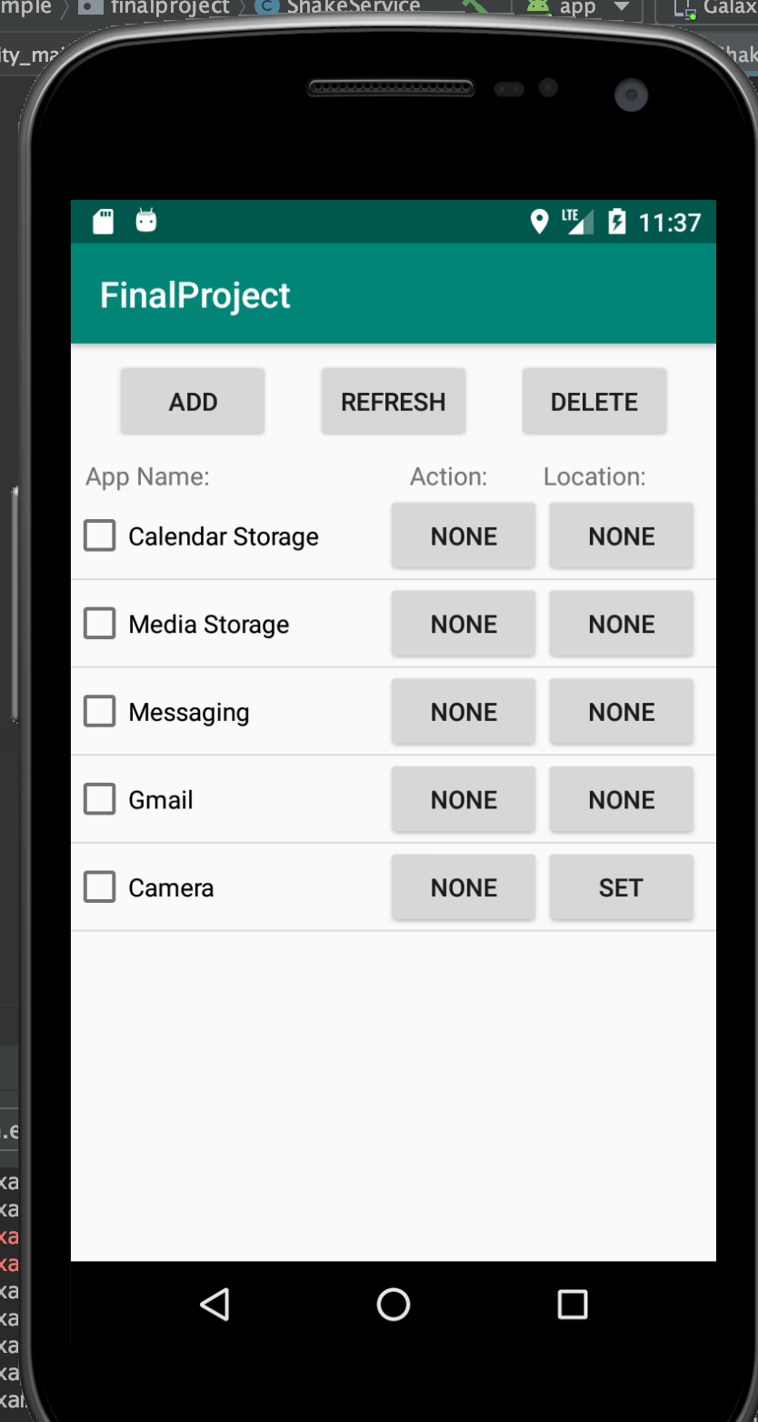
What is the app and motivation of the app
Describe what is the app. You can use images!
Our app allows users to select an app they like to open quickly and assign the app an action such as shaking or rotation to open the app the user has selected. The user can do this both in the app, and outside of it as a background service.
The app can also store user selected locations, and search for the two closest places by name. The app will then open a selected app when a user approaches these locations.
Describe why your app is needed. What problem does it solve?
This app seems very simple but can save a lot of time for users that like to have quick access to their apps.
No swiping through screens or searching for the icon. Do the action and the app opens for you.
Saves time

Slide 3
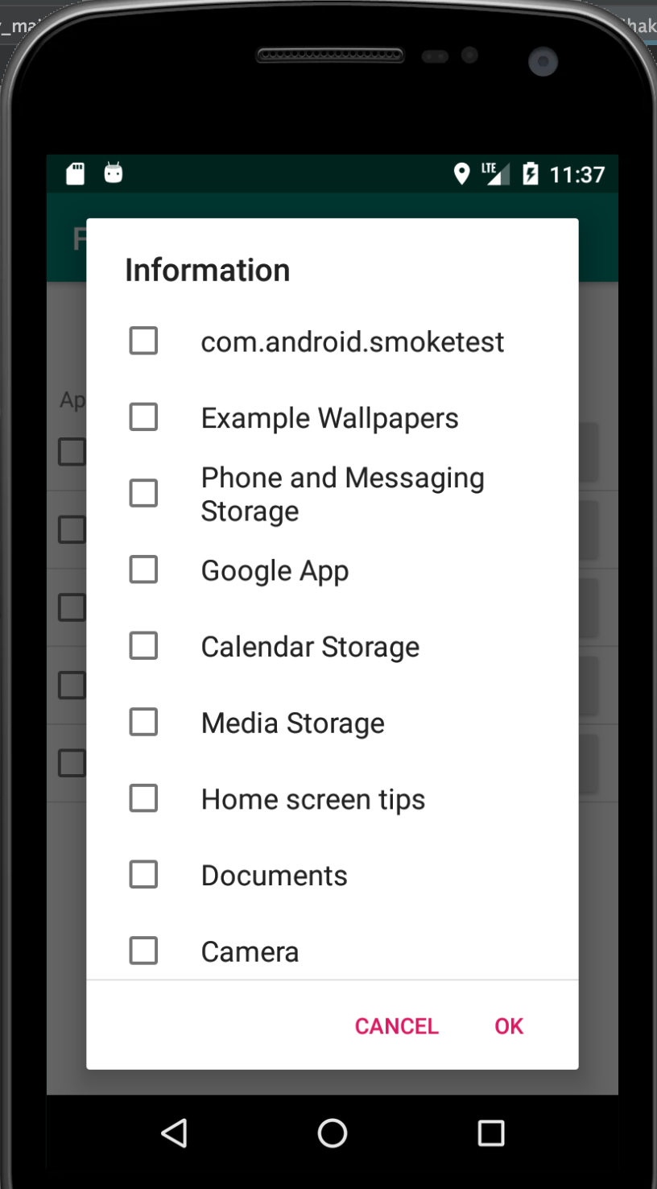
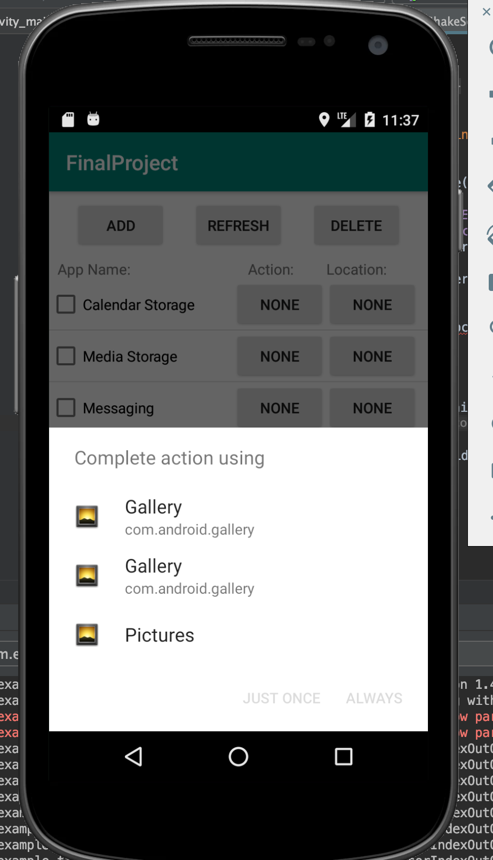
Main features in the app
Introduce three main features of your app. You can use images.
The main feature of our app is being able to open selected apps through unique and personalized actions.
Shaking or Rotating the phone to open an app of your choice is something new.
The user stores physical locations of the locations on the map if the user wishes to do so.
This feature works only after the user has selected an app that they want to open.
When walking within a certain distance of a selected location a selected app will open

Slide 4
Difficulties in developing the app
We had a hard time running the app in the background as a permanent service. Since this was a new concept it took a lot of researching and time to implement in our app, especially since the function to do so is called the foreground, which is rather unintuitive.
Linking the location saved by the user to the current location of the user. Geofencing was a good tool to use but it was too complicated to implement for this project.
Setting up the database that can keep track of all the apps on the phone, and select which ones work with the selected actions. The database needed to be large and flexible, and this was hard to keep track of.

