Slide 1

Urban mobility challenge - UPC Sostenible
Participants:
Arystan Igen
Srirupa Ghoshal

Slide 2
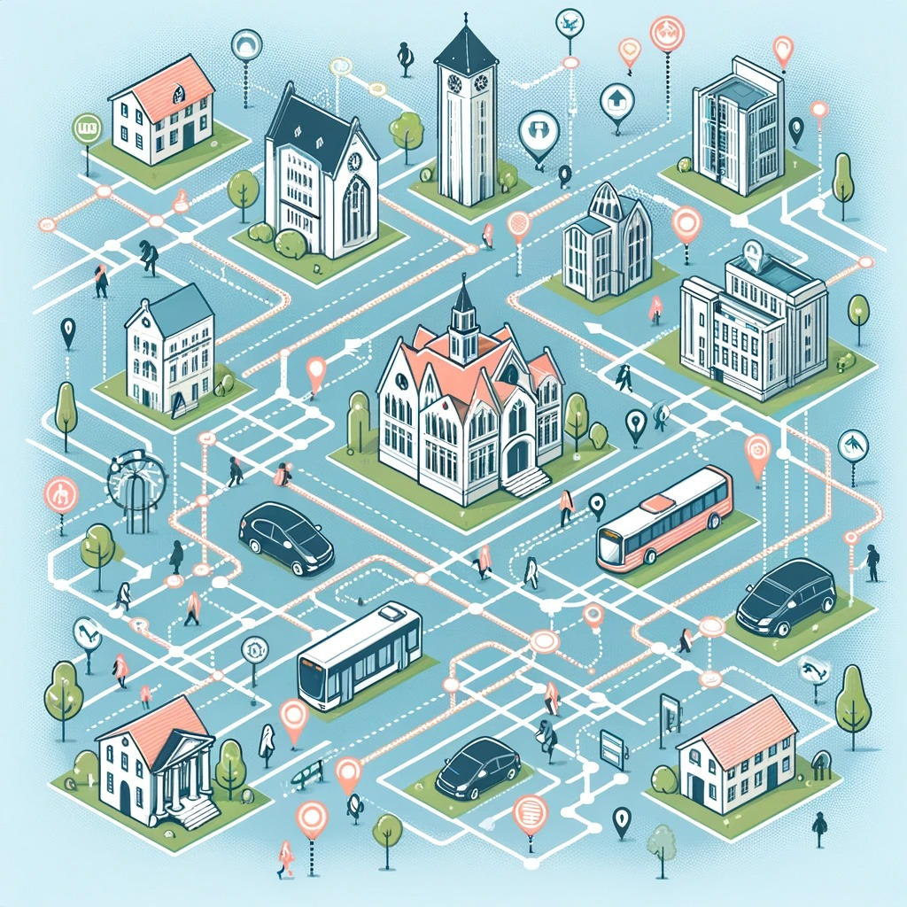
Main factors determining the mode of transport of the students

Slide 3
Distance
Shorter distance encourages students for active mobility
Students are likely to take private/public transportation if the distance is longer from their residency to the university.

Slide 4
Convenience and Time
If public transport is time-efficient, it may be preferred over driving, considering traffic congestion and parking issues.
Walking and cycling is quicker in densely populated or urban areas.

Slide 5
Cost
Students often have limited budgets.
The cost of public transportation. Often there are student discounts for public transportation
Parking fees or maintaining a private vehicle can influence the mode of transportation chosen.

Slide 6
Infrastructure and Facilities
Safe walking paths, cycling tracks and other infrastructure can encourage active mobility.
Availability of secure bike parking might encourage cycling
Again convenient parking facilities can impact the choice of private transportation.

Slide 7
Based on the survey of the student’s mobility data, we analysed the challenges and constructed the following bar charts

Slide 8
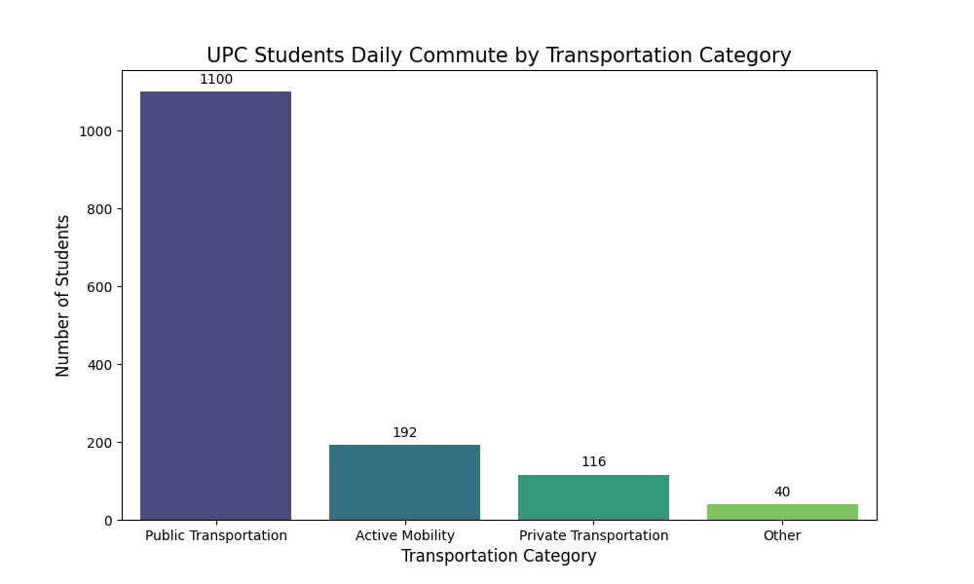
The bar chart below visualizes the daily people flow of UPC students by transportation category
Public Transportation:1100
Active Mobility: 192
Private Transportation: 116
Other: 40

Slide 9
General Observations:
Walking: A significant number of students include walking as part of their commute, either entirely or combined with other modes of transport.
Public Transportation: Usage of buses, metro, and other public transport is common, often combined with walking. This indicates a reliance on public transport for longer distances.

Slide 10
General Observations:
(cont.)
Private Transportation: Some students use private vehicles, like cars or motorcycles. This mode is more prevalent among students coming from areas possibly not well-served by public transportation.
Combination of Modes: Multimodal transportation is a common theme, where students might walk to a bus stop or metro station, use public transport, and then walk again to their final destination.

Slide 11
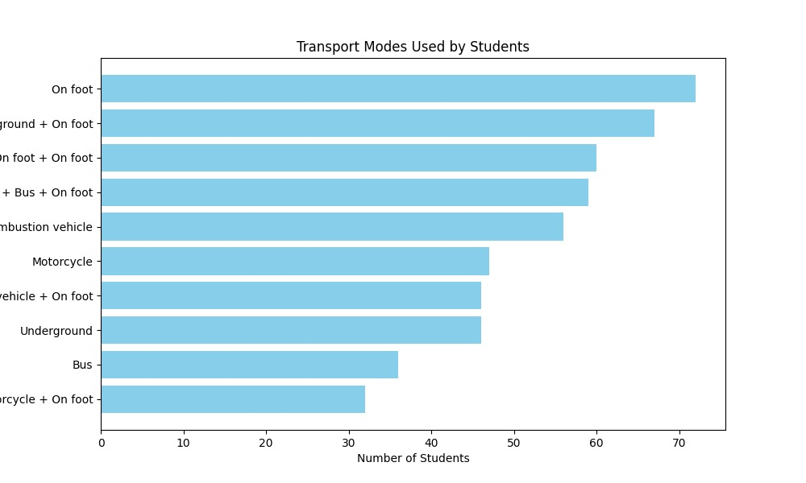
Results obtained for Common combination of transport modes used by the students:

Slide 12
Common combination of transport modes used:
foot: 72 students
foot + Underground + foot: 67 students
foot + foot + foot: 60 students
foot + Bus + foot: 59 students
Combustion vehicle (non-plug-in hybrid, electric or plug-in hybrid with non-renewable source charging): 56 students
Combustion or electric motorcycle with non-renewable source charging: 47 students
Combustion vehicle (non-plug-in hybrid, electric or plug-in hybrid with non-renewable source charging) + foot: 46 students
Underground: 46 students
Bus: 36 students
Combustion or electric motorcycle with non-renewable source charging + foot: 32 students

Slide 13
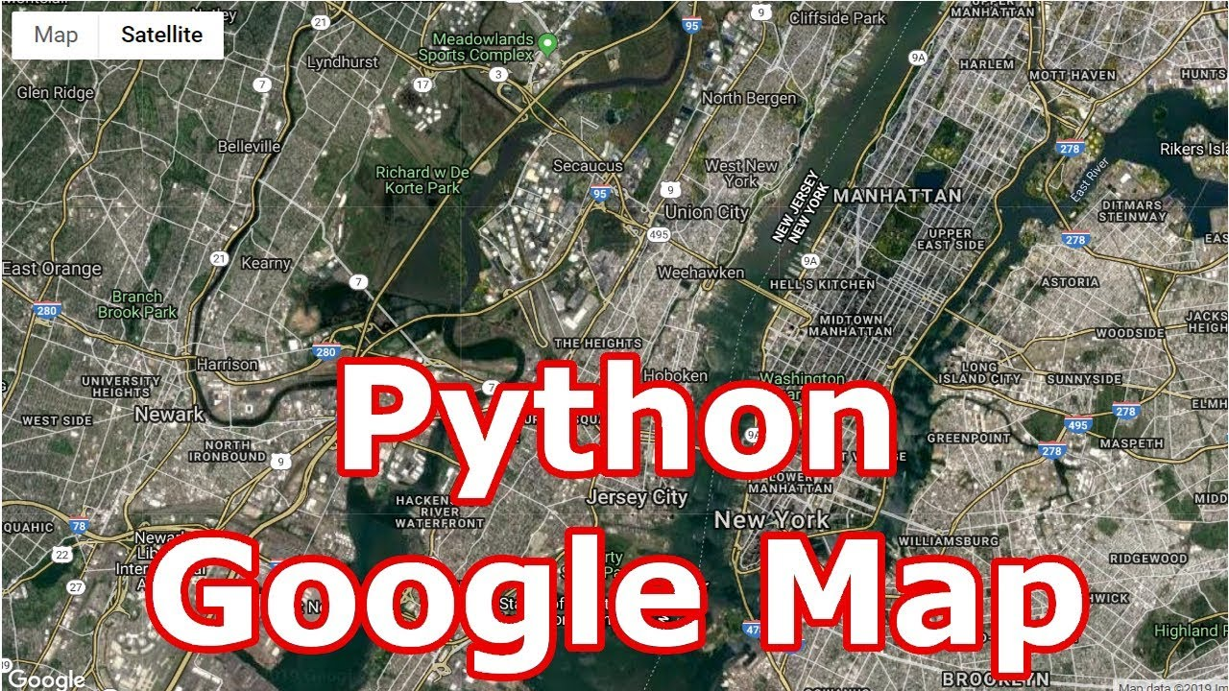

Slide 14
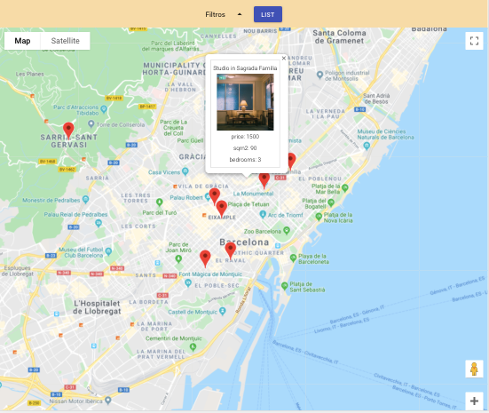
Script sends requests to Google's Distance Matrix API for each postal code and retrieves the estimated travel time to the specified university address.

Slide 15
Conclusion:
It was difficult at first to find out the objective in terms of programming logic but we analysed and solved some of the challenges.
We learned how to face new challenges but time management

Slide 16
Thank You

