Slide 1
Project 1
INF1E – Group 5

Slide 2
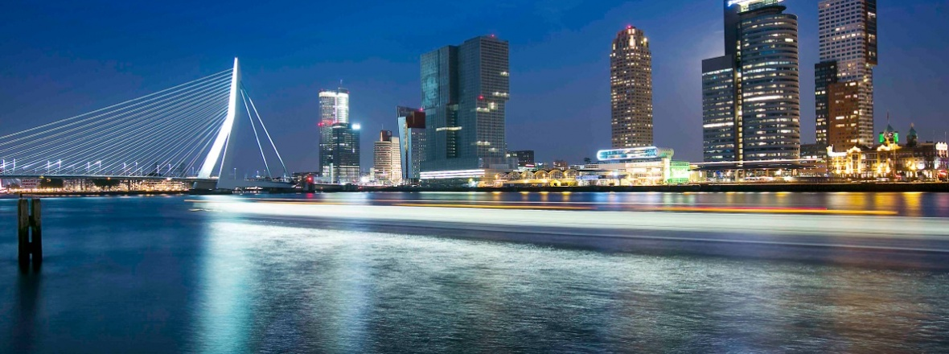
Theme
City of Rotterdam
2

Slide 3
Team & Roles
SCRUM Team:
Maher Mussa
Frank de Jong
Gürkan Gündüz
SCRUM Master:
Stefan de Wit
3

Slide 4
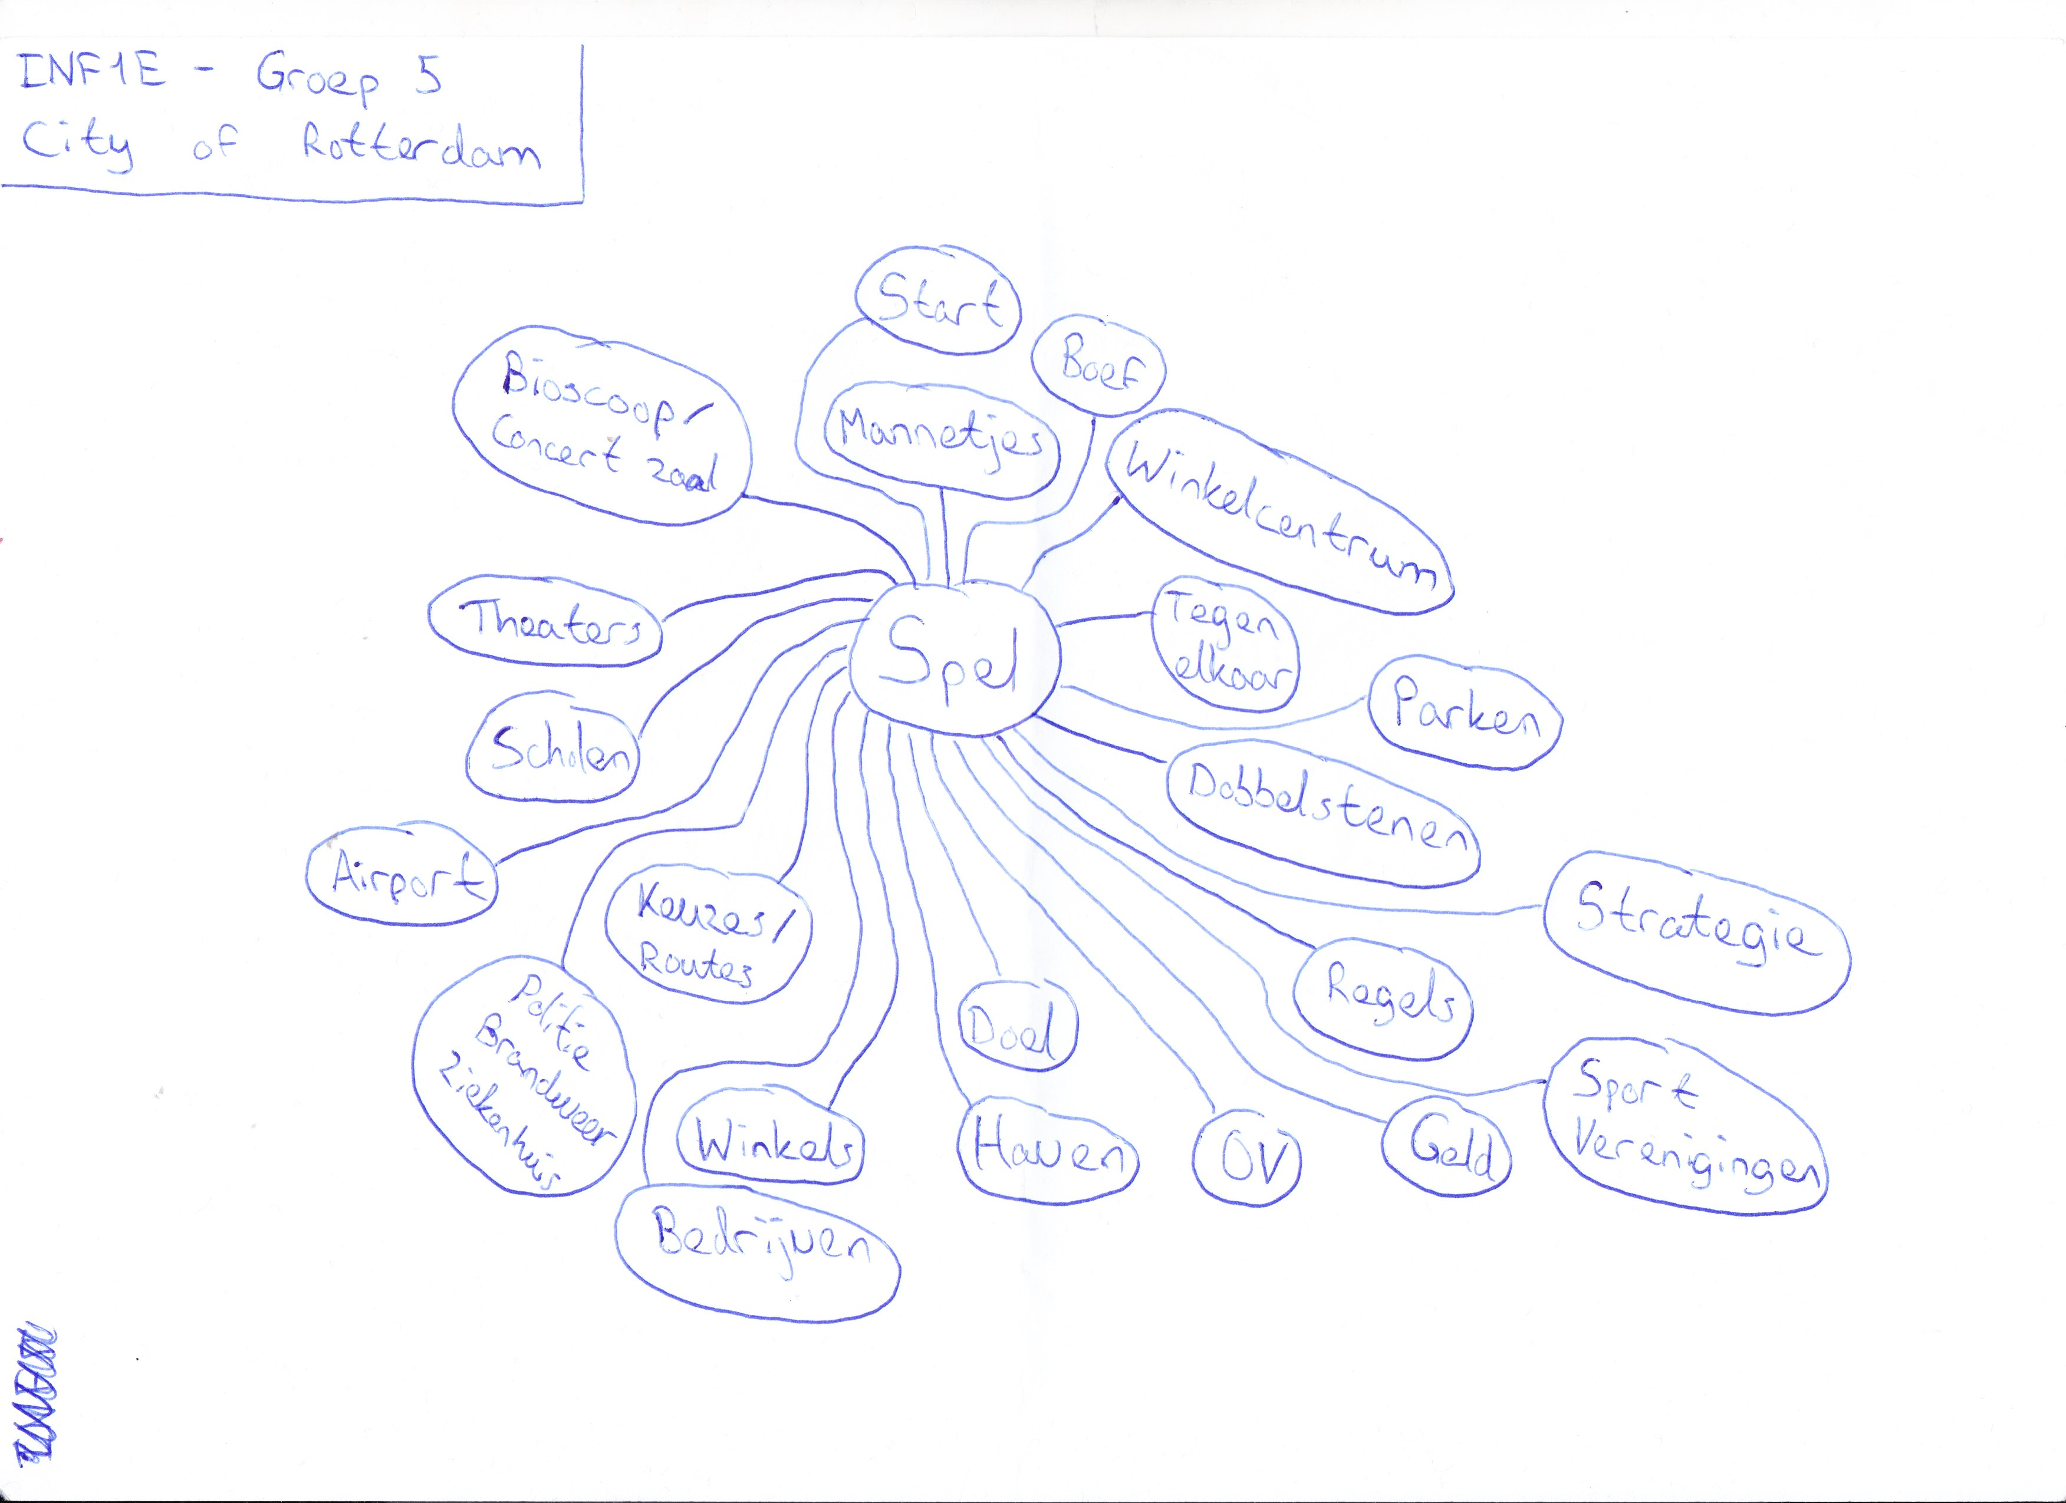


Process Review
4

Slide 5
Process Review
Ideas:
Monopoly based
2 - 4 players
Dice roll based
Stores
Specials (Stars, Diamonds, Trophies)
Start
Lose / Prison / Penalties
Movement counter-clockwise
Money (Buffer / Income)
Arrow tiles
5

Slide 6
Process Review
Sprint 1:
Maher:
Create game pylons design
Stefan:
Create game board design
Frank:
Create gameplay flowcharts
Gürkan:
Create game rules document
6

Slide 7
Process review
Sprint 2:
Team:
Create usability test plan
Create usability test schedule
Excecute usability test
Document usability test findings
Create improvements list
Design rule book
Write rule book in English
Print rule book
7

Slide 8
Process Review
Sprint 3:
Team:
Create absolute game design document
Print physical copy of game
Create online instruction video for the game
Translate rule book to Dutch
Print rule book in Dutch
8

Slide 9
Process review
Teamwork:
Communication & Platforms:
Phone / What’s App
GitHub
Trello
Agreements:
Presence
Shared Documents
Tasks
9

Slide 10
Usability Test
Test Criteria
Tasks
Test Method
Measurments
Test Users
10

Slide 11
Usability Test
Findings:
Increase starting money
Increase money from passing Start
Start bonus in all circles
11

Slide 12
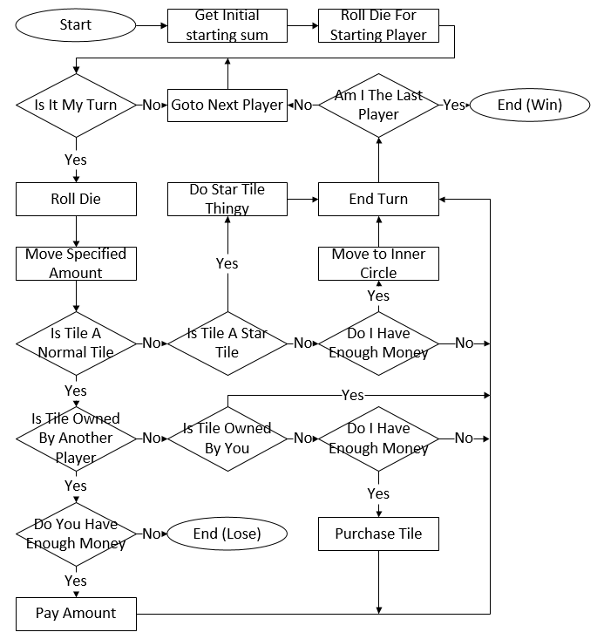
Flow Chart
12

Slide 13
Demo Shippable product
Items:
Game Board
Die
Pawns
Special Cards
Shop Cards
Money Bills: 10, 50, 100, 200, 500
Rule Book
13

Slide 14

Demo Shippable product
Players
Movements
Elimination
Winning Conditions
Start
Shops
Special Cards
Prison
14

Slide 15
THE END
INF1E – Group 5

