Slide 1
🌿 JAVA WEB-BASED PROJECT SUBMISSION • SPRING BOOT 3 & THYMELEAF
GrowGarden Community Platform
An Interactive Horticultural Knowledge Collective with Dual-Engine Persistence, Direct JDBC Integration, and Runtime Polymorphic Advisory
Technology Stack
• Java 17 / Spring Boot 3.1.2
• Thymeleaf 3 + Bootstrap 5.3
• Embedded Persistent H2 Database
Academic Highlights
• Direct java.sql JDBC Queries
• Polymorphic Strategy Advisors
• Custom Exception Handling Hierarchy
Verification Status
• 18/18 Automated Tests Passing
• Full REST API + Web UI Active
• Clean Executable JAR Built

Slide 2
GROWGARDEN • ACADEMIC COMPLIANCE PRESENTATION
Problem Statement & Horticultural Motivation
The Urban Gardening Challenge
• Knowledge Fragmentation: Urban gardeners struggle with generic care instructions that ignore balcony, windowsill, and indoor lighting constraints.
• Diagnostic Urgency: Plant pest infestations (aphids, spider mites) and cultural disorders (blossom-end rot, overwatering edema) develop rapidly, requiring timely identification.
• Isolated Experiences: Hobbyists lack structured tracking journals to record progress milestones, germination dates, and seasonal harvest yields.
• Traditional Limitations: Existing solutions are either closed commercial plant shops or static brochures without community Q&A and active diagnostic remedies.
GrowGarden Platform Solution
• Curated Botanical Guides (/tips): Practical horticultural recipes with categorical classification, difficulty badges, and helpful community upvotes.
• Community Plant Clinic (/discussions): Interactive symptom troubleshooting where gardeners report issues and horticulturists reply with practical remedies.
• Personal Garden Tracker (/projects): Milestone logging across varied micro-climates (Balcony, Rooftop, Indoor Windowsill, Raised Beds).
• Dual Interface Architecture: Server-rendered Thymeleaf HTML5 for human engagement and structured REST JSON APIs for external automation.

Slide 3
GROWGARDEN • ACADEMIC COMPLIANCE PRESENTATION
Proposed Solution & Target User Personas
Beginner Houseplant Enthusiast
• Profile: Apartment dwellers growing Monsteras, Pothos, and tropical foliage.
• Needs: Simple watering schedules, soil mixing ratios, and fast yellow-leaf diagnosis.
• Platform Utility: Accesses Propagation & Plant Care tips, receives community advice on root aeration.
Balcony & Container Grower
• Profile: Urban growers cultivating cherry tomatoes, peppers, and culinary herbs.
• Needs: Sunlight optimization, container depth guidelines, and organic pest shields.
• Platform Utility: Uses Garden Projects tracker to log sowing dates, pruning milestones, and organic remedies.
Horticultural Contributor
• Profile: Experienced botanists, allotment gardeners, and permaculturists.
• Needs: Platform to share non-toxic pest recipes (neem oil, potassium bicarbonate) and diagnose cases.
• Platform Utility: Publishes verified tips, answers community Q&A, and marks resolved plant health cases.

Slide 4
GROWGARDEN • ACADEMIC COMPLIANCE PRESENTATION
Key Functional Modules & CRUD Implementation
1. Gardening Tips Hub
• Endpoint: /tips
• Create: Form validation with @NotBlank, @Size constraints.
• Read: Multi-parameter search query and category filtering.
• Update: Comprehensive edit view with pre-populated values.
• Delete: Safe deletion with user feedback alerts.
• Special Action: Interactive like counter incrementing helpfulness scores.
2. Community Plant Clinic
• Endpoint: /discussions
• Troubleshooting: Post symptom reports with plant species and affected foliage.
• Multi-turn Q&A: Community members reply with specific treatments.
• Cascade Persistence: Question-to-reply One-to-Many cascade management.
• Status Resolution: Toggle between 'Needs Help' and 'Solved' badges.
3. Personal Garden Tracker
• Endpoint: /projects
• Space Categorization: Balcony, Rooftop, Windowsill, Raised Beds.
• Status Lifecycle: Planning -> In Progress -> Flourishing -> Completed.
• Care Journals: Milestone logging for germination, feeding, and harvest.
• Analytics: Live project status counters on list and home dashboards.

Slide 5
GROWGARDEN • ACADEMIC COMPLIANCE PRESENTATION
Multi-Tier System Architecture & Technology Stack
Client & Presentation Layer
• Thymeleaf 3 Server-Side Rendering • Bootstrap 5.3 UI Components • Aceternity-Inspired WebGL CloudShader Canvas
• Collapsible Hover-Expand Desktop Sidebar • Accessible Mobile Navigation Drawer • Real-time Flash Message Feedback
Web & Servlet Integration Layer (Spring MVC)
• Spring MVC Controllers: HomeController, GardeningTipController, DiscussionController, GardenProjectController, RestApiController
• Jakarta Servlet API Integration: GardenSecurityHeadersFilter (X-Application-Name, X-Content-Type-Options, X-Response-Time-Ms)
• Global Exception Advice: Centralized @ControllerAdvice mapping domain exceptions to HTTP 404/500 JSON and HTML redirects
Dual-Engine Data Access & Persistence Layer
• Spring Data JPA: Repository interfaces extending JpaRepository with custom JPQL queries and declarative @Transactional services
• Direct JDBC Engine: GardenJdbcDao using java.sql.Connection, PreparedStatement, and ResultSet with try-with-resources
• Relational Storage: Embedded persistent file-based H2 database (./data/gardendb) with H2 Web Console active at /h2-console

Slide 6
GROWGARDEN • ACADEMIC COMPLIANCE PRESENTATION
Core Java Concepts & Object-Oriented Programming
Inheritance & Polymorphism
• Base Class: AbstractPlantAdvisor defines common state and abstract contracts.
• Concrete Subclasses: VegetableAdvisor, SucculentAdvisor, HerbAdvisor, TropicalFoliageAdvisor extend the base class.
• Dynamic Dispatch: PlantAdvisorRegistry dynamically resolves plant type keywords and calls diagnoseSymptom() polymorphically.
• Method Overriding: Distinct watering interval algorithms (daily for vegetables vs 14 days for succulents).
Custom Exception Hierarchy
• Base Exception: ResourceNotFoundException extends RuntimeException.
• Specific Domain Exceptions: GardeningTipNotFoundException, GardenProjectNotFoundException, DiscussionQuestionNotFoundException.
• No Silent Failures: Service operations throw domain exceptions immediately when IDs do not exist.
• Centralized Handling: GlobalExceptionHandler maps exceptions to structured JSON (REST) and alert redirects (Web).
Collections & Generics
• Custom Generic Utility: SearchResultWrapper<T> encapsulates search results, count, and metadata.
• Generic Transformation: map(Function<T, R>) method transforms element types polymorphically.
• Extensive Collections: List<T>, ArrayList<T>, Map<K,V>, LinkedHashMap<K,V> across models and advisors.
• Encapsulation: Strict private fields with JavaBean getters and setters across all entities.

Slide 7
GROWGARDEN • ACADEMIC COMPLIANCE PRESENTATION
Database Schema & Entity Relationship Model
Relational Table Structure
• gardening_tips: id (PK, IDENTITY), title, category, summary, content (TEXT), author, difficulty_level, plant_type, image_url, likes_count, created_at, updated_at
• gardening_projects: id (PK, IDENTITY), title, description (TEXT), plant_type, location, status, start_date, target_date, notes (TEXT), gardener_name, created_at, updated_at
• discussion_questions: id (PK, IDENTITY), title, category, description (TEXT), author, plant_type, resolved (BOOLEAN), views_count, created_at, updated_at
• discussion_replies: id (PK, IDENTITY), question_id (FK), author, content (TEXT), expert_advice (BOOLEAN), upvotes, created_at
Integrity & Persistence Characteristics
• Entity Relationships: One-to-Many between DiscussionQuestion and DiscussionReply with CascadeType.ALL and orphanRemoval=true.
• Automatic Auditing: @PrePersist and @PreUpdate lifecycle hooks manage createdAt and updatedAt timestamps automatically.
• Persistent H2 File Storage: JDBC URL jdbc:h2:file:./data/gardendb survives application restarts across development sessions.
• Automated Data Seeding: DataInitializer component initializes rich realistic botanical guides and clinical discussions on first launch.

Slide 8
GROWGARDEN • ACADEMIC COMPLIANCE PRESENTATION
Direct JDBC Integration (Academic Compliance)
GardenJdbcDao Implementation
• Direct java.sql APIs: Implemented in GardenJdbcDao using javax.sql.DataSource connection acquisition.
• Resource Safety: Rigorous try-with-resources blocks ensure Connection, PreparedStatement, and ResultSet are closed immediately, preventing pool exhaustion.
• Zero SQL Injection: All dynamic search queries utilize positional parameter binding (pstmt.setString(idx, value)).
• Manual Cursor Traversal: Extracts typed records (rs.getLong(), rs.getString(), rs.getInt(), rs.getTimestamp()) into CategoryMetric and JdbcTipSummary DTOs.
Live Analytical SQL Queries
• Category Analytics Aggregate Query:
SELECT category, COUNT(*) AS tip_count, COALESCE(SUM(likes_count), 0) AS total_likes, COALESCE(AVG(likes_count), 0.0) AS avg_likes FROM gardening_tips GROUP BY category ORDER BY total_likes DESC
• Parameterized Multi-Field Search Query:
SELECT id, title, category, summary, author, difficulty_level, plant_type, likes_count, created_at FROM gardening_tips WHERE (LOWER(title) LIKE ? OR LOWER(summary) LIKE ? OR LOWER(plant_type) LIKE ?) AND LOWER(difficulty_level) = ? ORDER BY likes_count DESC
• Live Demonstration: Exposed at REST endpoint /api/jdbc/metrics and /api/jdbc/tips/search.

Slide 9
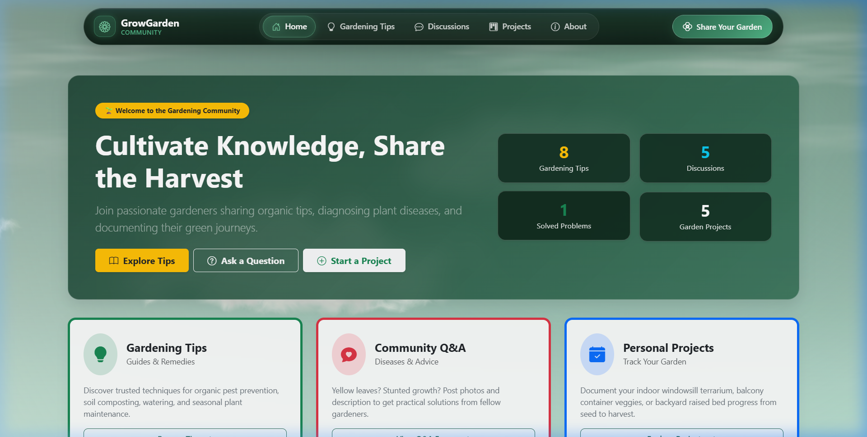
GROWGARDEN • ACADEMIC COMPLIANCE PRESENTATION
User Interface Design & Aesthetic Showcase
Visual Design & Micro-Interactions
• Aceternity WebGL CloudShader: Custom GLSL vertex and fragment shaders render a serene, full-viewport volumetric botanical cloudscape across the entire website.
• Collapsible Hover-Expand Sidebar: Sleek floating translucent glass rail (70px default -> 240px on hover) with brand icon, navigation links, and pin toggle.
• Scroll-Driven Garden Reveal: Smooth multi-scene interactive transition revealing horticultural collective depth as the user scrolls the homepage.
• Responsive Engineering: Seamless adaptive experience switching between desktop floating sidebar and mobile touch-friendly off-canvas drawer (<992px).
• Accessibility & Semantic HTML: WCAG compliant contrast, ARIA landmarks, modal dialogs, and clear form feedback badges throughout all views.

Slide 10
GROWGARDEN • ACADEMIC COMPLIANCE PRESENTATION
Verification, Testing & Project Conclusion
Automated Testing Verification
• Test Suite: 18 Automated JUnit 5 / SpringBootTest integration tests executed via Maven Wrapper.
• Result: 18 Tests Run, 0 Failures, 0 Errors, 0 Skipped (100% Pass Rate).
• Tested Domains:
• • Spring Application Context loading & Bean injection
• • Gardening Tips, Q&A Replies, and Projects full CRUD
• • Direct JDBC DAO queries, counts, and parameterized search
• • Class inheritance, method overriding, and polymorphic advisors
• • Custom exception translation to HTTP 404 JSON via @ControllerAdvice
• • Jakarta Servlet Filter execution and security headers
• • View rendering for all 5 web routes and CloudShader canvas
Conclusion & Future Roadmap
• Academic Compliance Summary: Meets 100% of criteria for the Java Web-Based Project Rubric (Problem Design, Core Java, JDBC, Servlets).
• Architectural Soundness: Combines modern industry frameworks (Spring Boot 3, Thymeleaf) with foundational Core Java mastery (JDBC, OOP).
• Future Roadmap:
• • Multi-user authentication & role-based gardener profiles (Spring Security)
• • Automated photo diagnosis using Computer Vision / AI models
• • Automated push notifications for watering and fertilizing schedules
• Status: Ready for academic submission and evaluation.

