Slide 1
Meeting
Septemeber 2, 2022

Slide 2
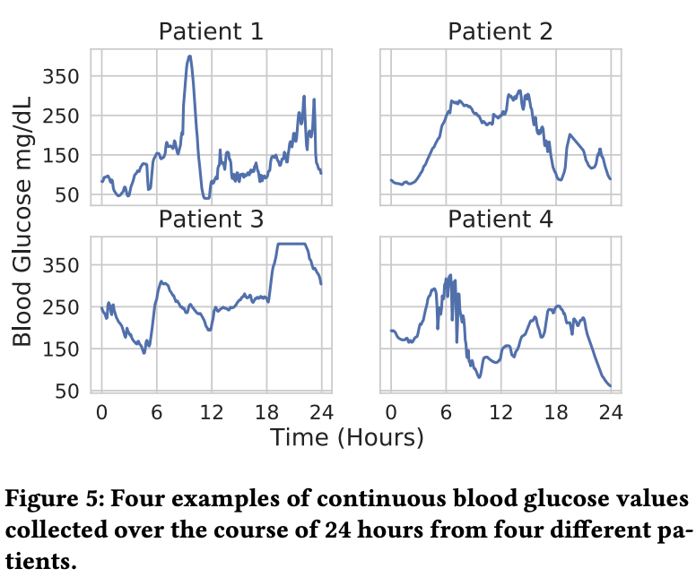
Glucose data

Slide 3
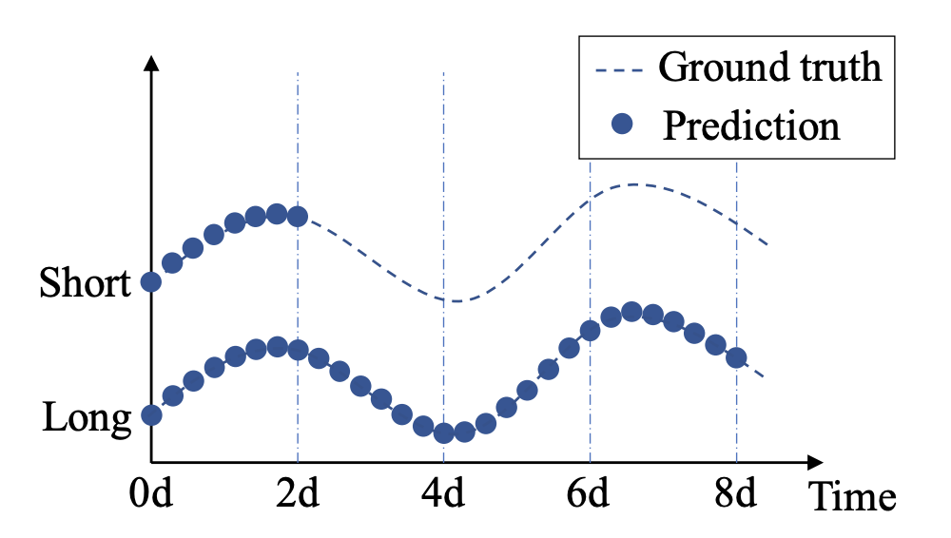
Main task
Main metrics for performance:
Average percent error across prediction window
Mean squared error across prediction window
Possibly others
Figure: multi-output sequence forecasting

Slide 4
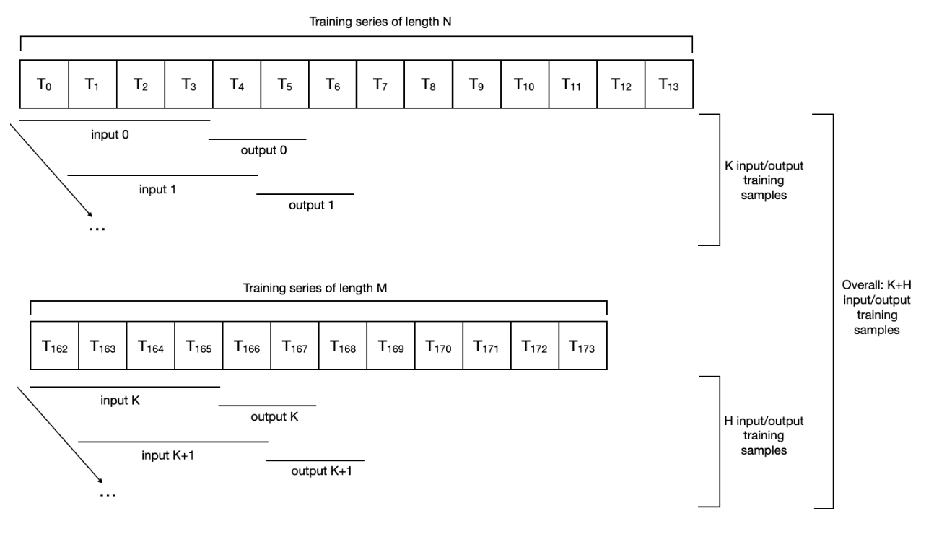
Main tool: PyTorch
For now, the major focus is on building DataSet and DataLoader classes and making it work with the data sets:
DataLoader
Runs on top of DataSet
Collates samples and supplies (batch_size) items to the optimizer at each iteration
DataSet
Workhorse of DataLoader
Main function inside is __getitem__()

Slide 5
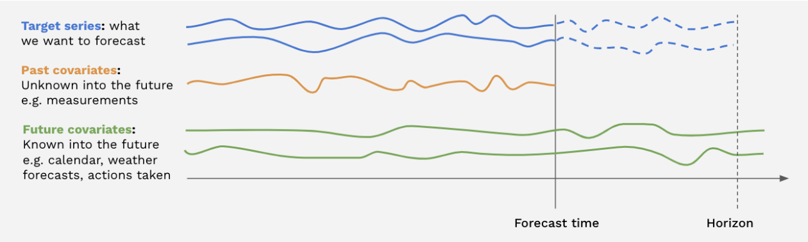
Investgating data sets
Need to create a table to collect properties of data sets, something like:
# of subjects | # of segments per subject (min, max, median) | Frequency of reads | Length of series (min, max, median) | Static covariates | Dynamic covariates (known in the future) | Dynamic covariates (unknown in the future)
…

Slide 6
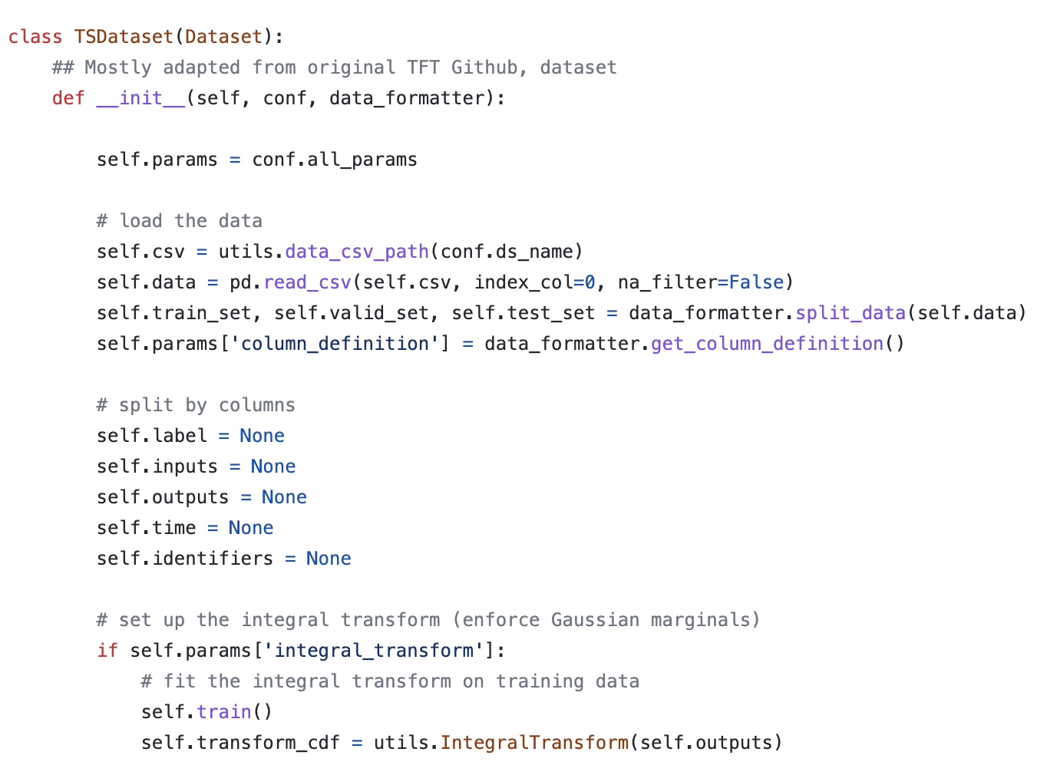
Implementing a simple dataset
On GitHub, starter code is provided for pre-processing and creating DataSet. Some examples are also provided.
Goal:
Investigate the code
Improve?
Load data from IGLU package
Wrap it into the provided dataset code

