Slide 1
Predicting NFL
Team Records
A data-driven approach to game-by-game win projection using
Pro Football Reference and custom ELO ratings
Chicago Bears Analytics Interview | 2025 NFL Season | Asa Arnold

Slide 2
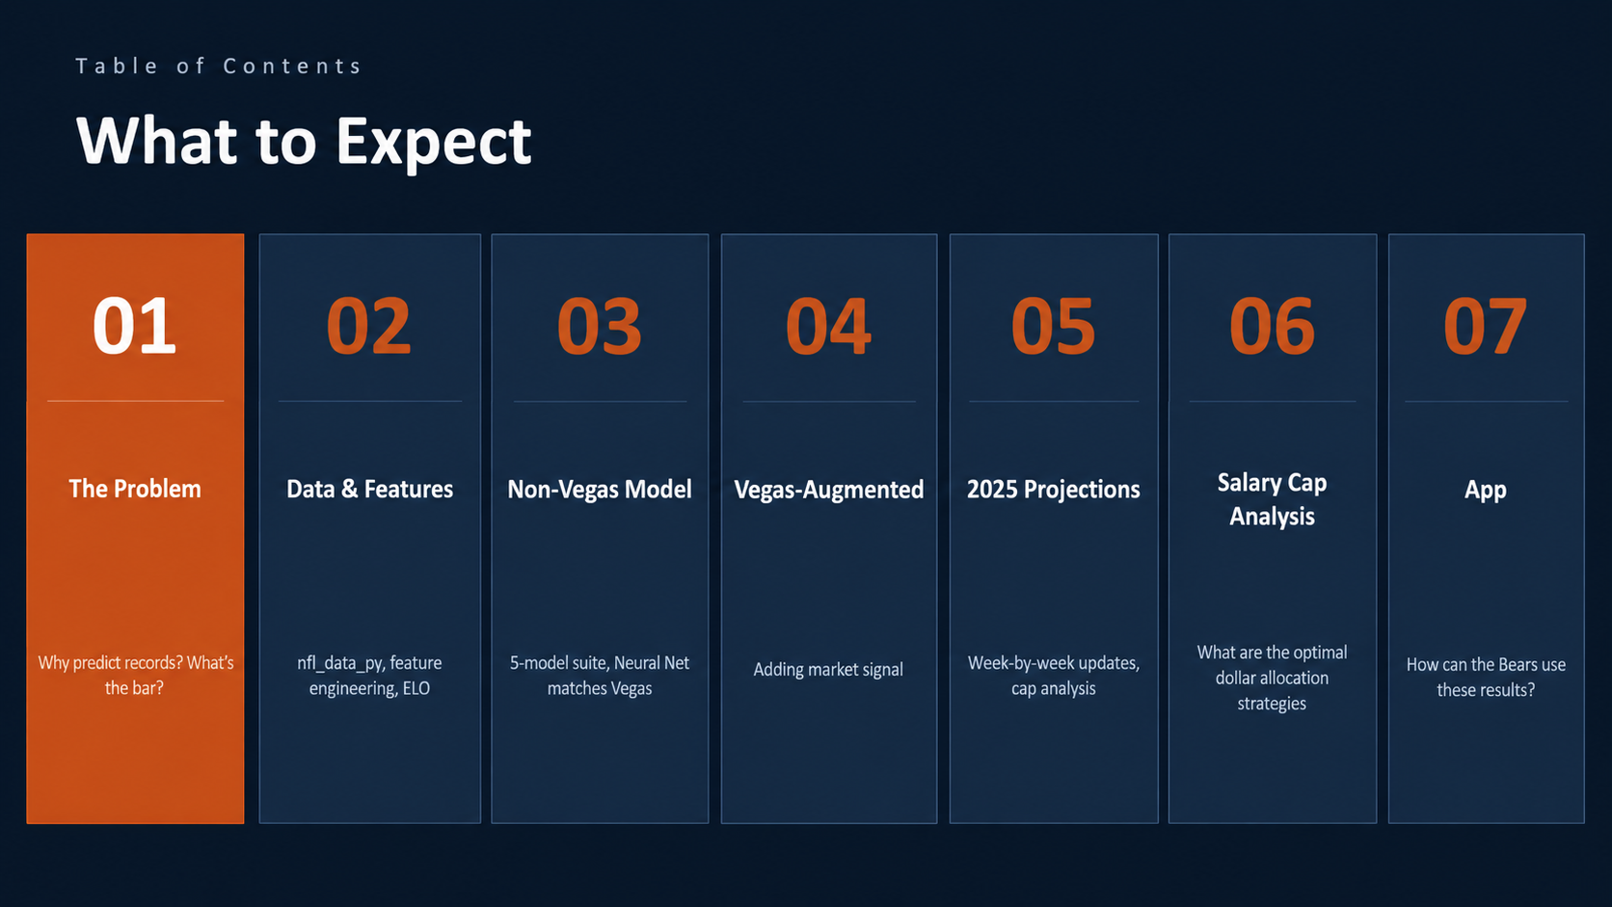
Table of Contents
What to Expect
01
02
03
04
05
The Problem
Data & Features
Non-Vegas Model
Vegas-Augmented
2025 Projections
Why predict records? What's the bar?
nfl_data_py, feature engineering, ELO
5-model suite, Neural Net matches Vegas
Adding market signal
Week-by-week updates, cap analysis

Slide 3
01
The
Problem
The Deliverable
Before every game of the 2025 NFL season, produce an updated projected final W-L record for all 32 teams.
Can on-field statistics predict NFL outcomes
as accurately as the betting market?

Slide 4
Data Foundation
THE PROBLEM
Source: Pro Football Reference via nfl_data_py | Seasons: 2018-2025 | Train: 2018-2024 | Test: 2025
4,254
2 rows
42+
2018+
7 yrs
Game rows
Per game
Features
engineered
Advanced stats
window
Training
window
(2018-2025)
(one per team)
Base + Vegas
+ context
PFR pressure rate,
YAC, coverage
2018-2024 train
2025 test
Rolling Efficiency
Net YPA diff, 3rd down rate, yards per target, pressure rate — all lagged pre-game
Custom ELO Ratings
Separate offensive & defensive ELO per team, updated after each game, carried season-to-season with decay
Game Context
Home/away, rest days, week of season, playoff stakes flags, division game indicator
Vegas Lines
Spread and total as optional features — kept in a separate model track to avoid double-counting

Slide 5
THE PROBLEM
Feature Engineering Approach
PFR advanced stats sourced via nfl_data_py | Situational features rebuilt from play-by-play data
Why nfl_data_py?
Play-by-Play Reconstruction
Initial scraping of PFR proved unstable — rate-limited and HTML changes
3rd Down Conv. Rate
Rebuilt from PBP — not available as a pre-computed game stat
Net YPA Differential
nfl_data_py exposes the same PFR advanced metrics via a clean, versioned API
Pass yards / attempts per team minus opponent
Pressure Rate Diff
More reproducible and avoids scraping fragility while preserving full PFR fidelity
% of pass plays with QB pressure, home vs away
Turnover Margin
Fumbles + interceptions, net differential per game

Slide 6
02
Exploratory
Data
Analysis
Before building any model,
what does the data actually tell us?

Slide 7
What Actually Predicts Winning?
EDA
Game-level correlation with win probability — 2018-2024 data | Higher = stronger predictor

Slide 8
EDA
Setting the Bar: Vegas
Vegas spread accuracy measured on 2025 test set W1-17 | Spread converts to win prob via normal distribution
Why not just use the spread?
65.6%
Vegas prices in injuries, weather, travel, and private scouting. Including it as a feature collapses all other variables and obscures what stats actually drive wins.
Vegas straight-up accuracy
Two-track approach
2025 season, W1-17 game-level
Track 1: Stats-only model (can we explain wins?)
Track 2: Vegas-augmented (how much does the market add?)

Slide 9
THE PROBLEM
Why ELO? And Why Split It?
ELO win = did the team eclipse the season-to-date median net yards per play (passing + rushing, net of sack yards)?
What is ELO?
Why Split Offense/Defense?
Team Offense ELO
Range: 1340-1644
Above season-to-date median net yards per play?
Self-correcting rating system — updates after every result
Football has two distinct contests per game — one-unit ELO misses this
Team Defense ELO
Range: 1383-1636
Held opponent below median net YPP?
Beating a strong opponent earns more than beating a weak one
17-game seasons = small sample; splitting gives 2x signal per game
Opp. Offense ELO
Range: 1340-1644
How strong is the opponent's offensive efficiency rating?
Provides game-to-game memory without explicit form features
Each component is more stable and matters most early in the season
Opp. Defense ELO
Range: 1383-1636
How well does the opponent suppress net YPP?

Slide 10
03
Non-Vegas
Model
5-model suite. Train: 2018-2024. Test: 2025 W1-17.

Slide 11
NON-VEGAS MODEL
Non-Vegas Model Performance
Test set: 2025 W1-17 game-level accuracy | One independent prediction per game | Primary metric: Test Acc (game)
Model
Test Acc (Game)
Train Acc
Gap
AUC
Brier
XGBoost
62.11%
75.74%
+13.6%
0.661
0.233
Random Forest
61.72%
68.68%
+7.0%
0.676
0.227
Logistic Regression
60.94%
63.12%
+2.2%
0.673
0.227
Ridge Classifier
60.55%
63.23%
+2.7%
--
--
Neural Network (MLP)
65.62%
62.65%
-3.0%
0.673
0.227
Vegas Baseline
65.62%
--
--
--
--
Neural Network (MLP): 65.62% accuracy — ties Vegas straight-up at 65.6%
Walk-forward CV tuning | No future data used in training

Slide 12
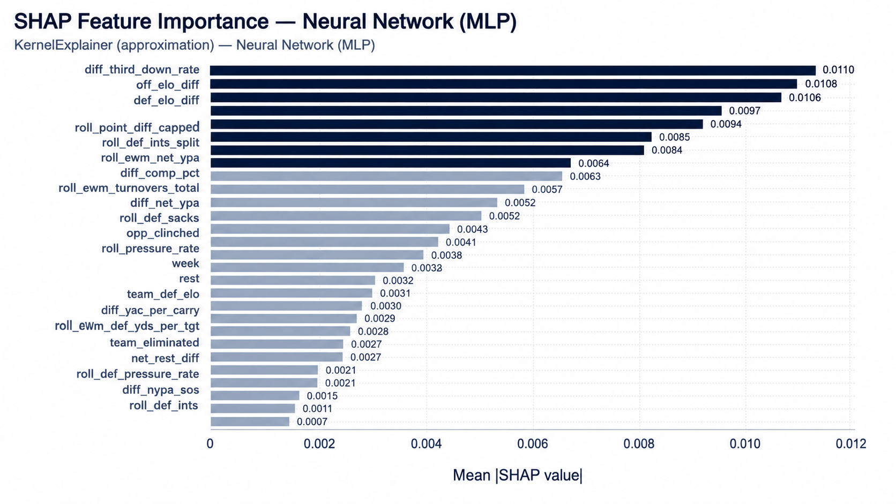
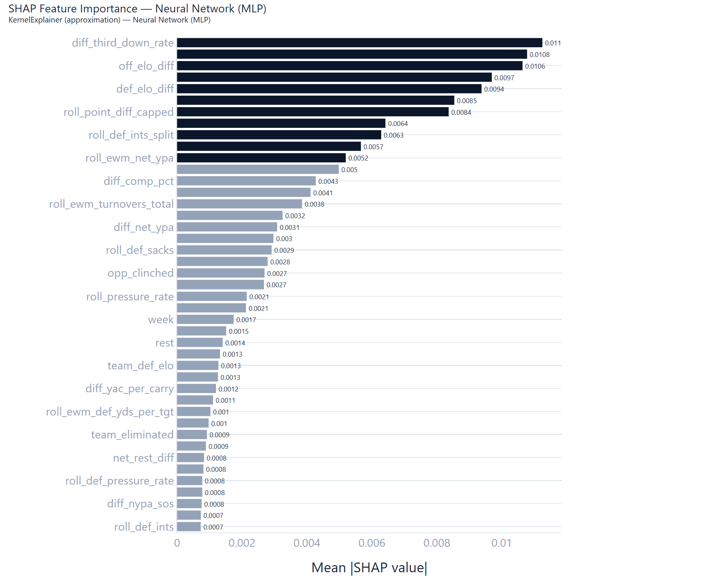
What the Neural Network Learned
NON-VEGAS MODEL
MLP Neural Network | KernelExplainer (approximation) | Top features by mean |SHAP value| | Note: MLP features are harder to interpret than tree models

Slide 13
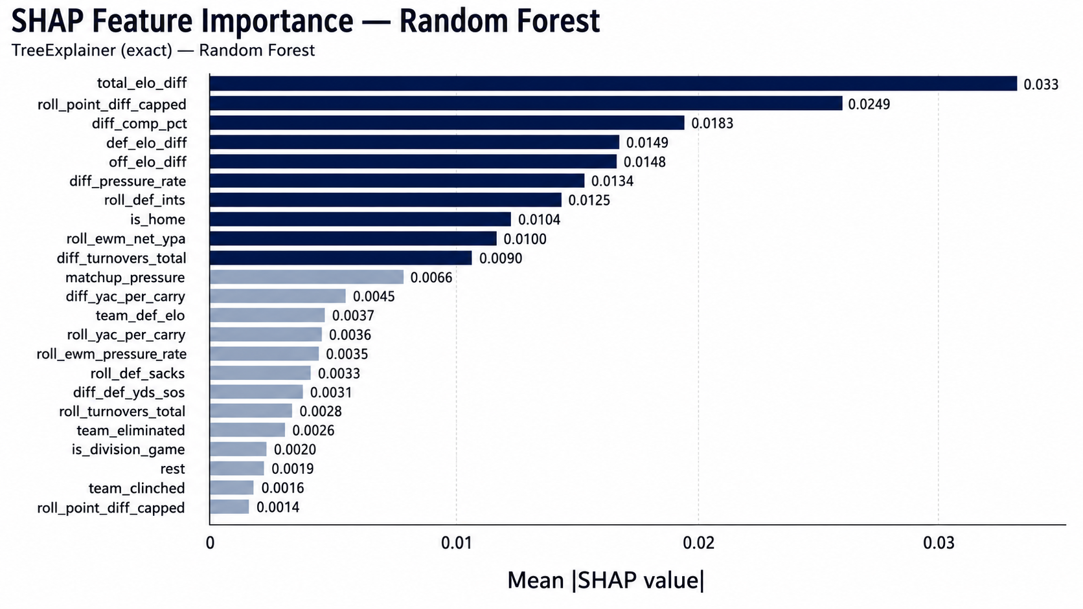
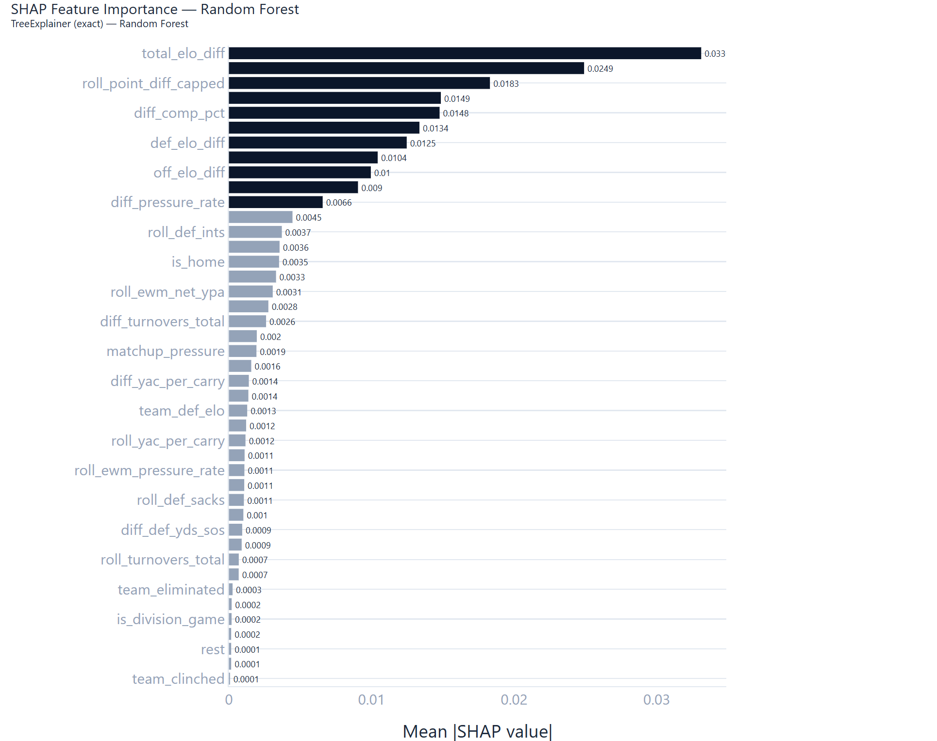
What Drives a Win? (Random Forest)
NON-VEGAS MODEL
Random Forest (64.45% accuracy) | TreeExplainer — exact SHAP values | Slightly less accurate than MLP but far more interpretable

Slide 14
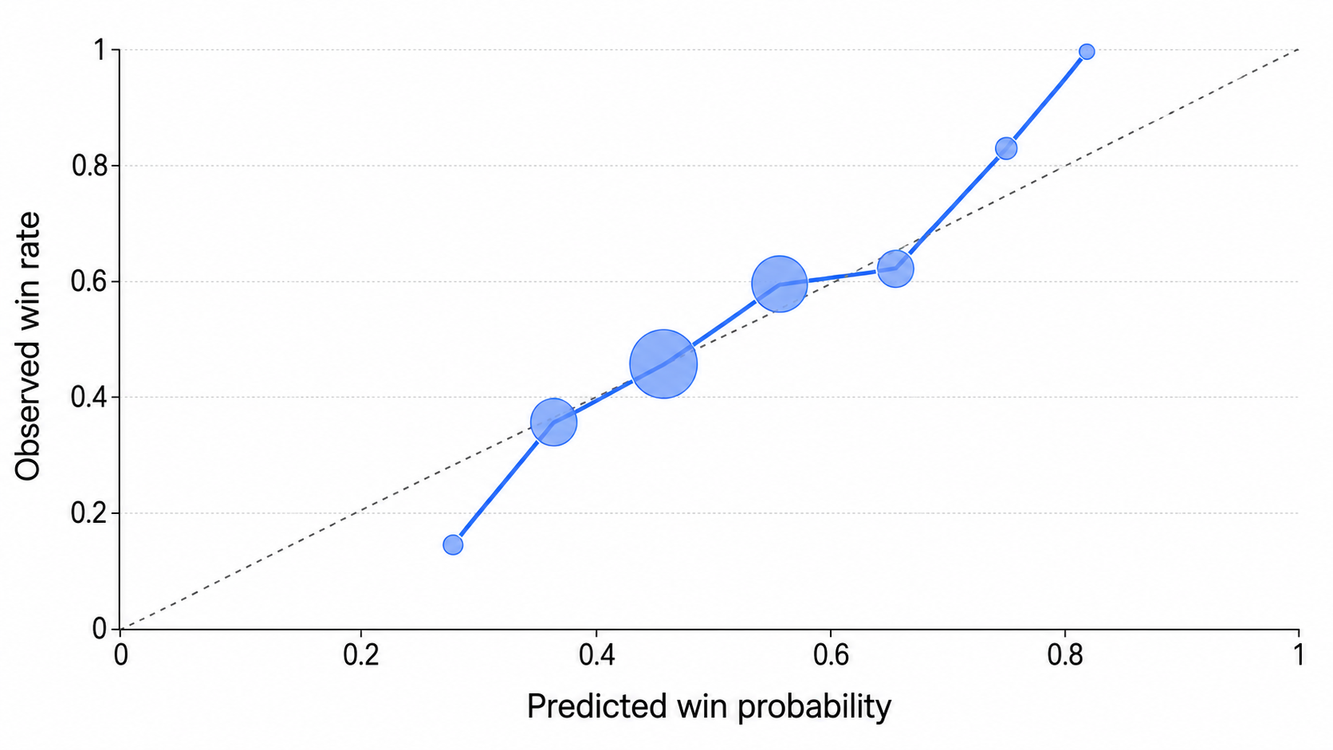
Model Calibration
NON-VEGAS MODEL
Predicted win probability vs observed win rate | Bubble size = games in bin | Dashed = perfect calibration

Slide 15
04
Vegas-
Augmented
Model
Same 5 classifiers — now with spread and total as features.

Slide 16
VEGAS MODEL
Vegas-Augmented Model Performance
Test set: 2025 W1-17 | Vegas features: spread_line_team, total_line | Training: 2018-2024
Model
Test Acc (Game)
Train Acc
Gap
AUC
Brier
XGBoost (Vegas)
63.28%
77.67%
+14.4%
0.691
0.225
Random Forest (Vegas)
64.45%
76.74%
+12.3%
0.707
0.218
Logistic Regression (Vegas)
64.84%
67.50%
+2.7%
0.698
0.219
Ridge Classifier (Vegas)
65.23%
67.53%
+2.3%
--
--
Neural Network (MLP) (Vegas)
63.67%
71.38%
+7.7%
0.680
0.232
Vegas Baseline
65.62%
--
--
--
--
Best Vegas model: Ridge Classifier — 65.23% accuracy, just below Vegas baseline (65.6%)
Non-Vegas MLP already matches Vegas — market data adds limited further signal

Slide 17
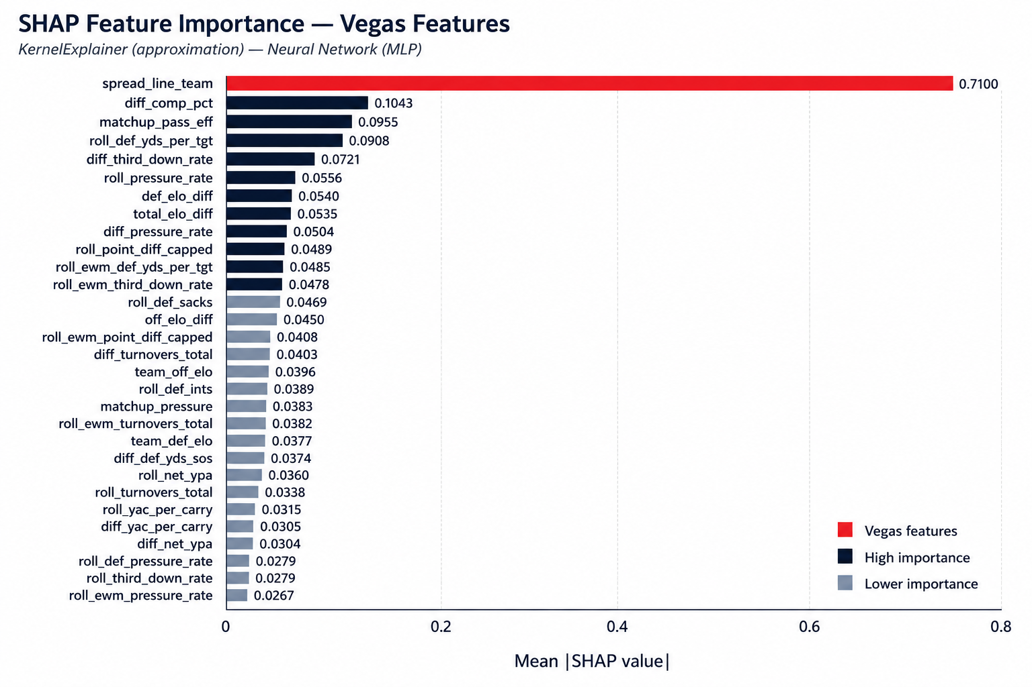
What the Vegas Model Learned
VEGAS MODEL
XGBoost Vegas model | Spread dominates at 0.711 — 6x any other feature | Top non-vegas features: completion %, matchup pass efficiency, def yards per target

Slide 18
05
2025
Season
Projections
Updated before every game of the 2025 season.

Slide 19
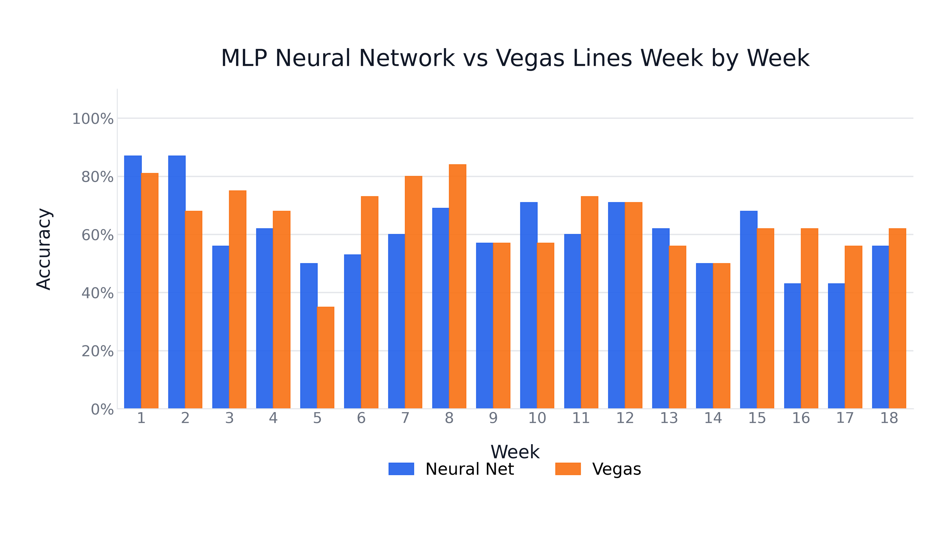
Week-by-Week Accuracy: Neural Net vs Vegas
2025 PROJECTIONS
Neural Network (MLP) vs Vegas baseline | W1-17 avg accuracy nearly identical | MLP W18: model drops, Vegas holds

Slide 20
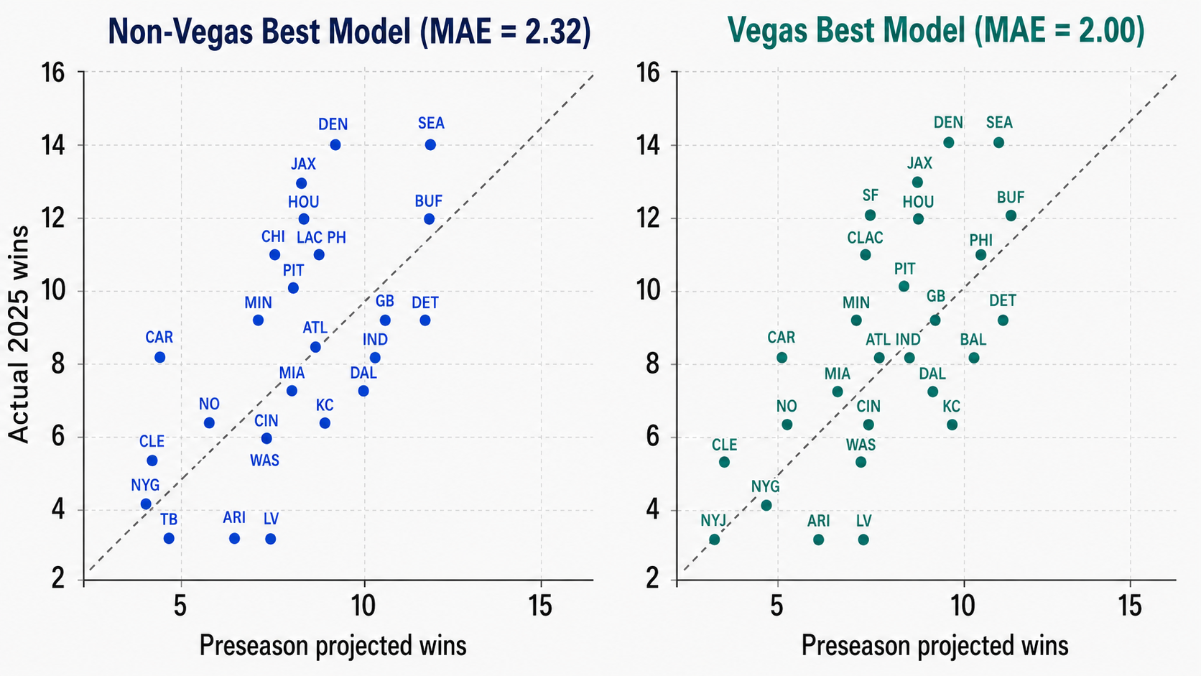
Preseason Accuracy: Projected vs Actual 2025 Wins
2025 PROJECTIONS
Non-Vegas model MAE = 2.32 wins | Vegas model MAE = 2.00 wins | Both models competitive before a game is played

Slide 21
06
Salary Cap
Analysis
What are the optimal dollar allocation strategies?

Slide 22
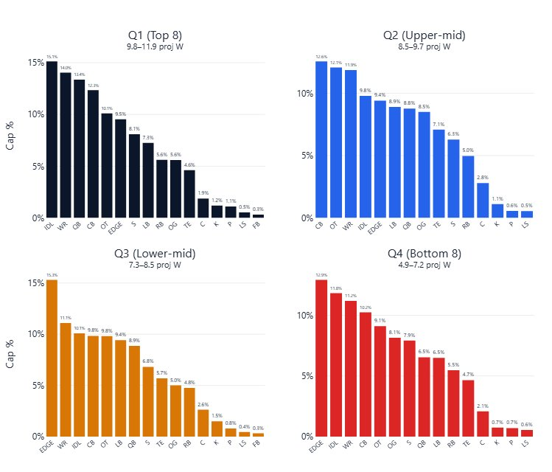
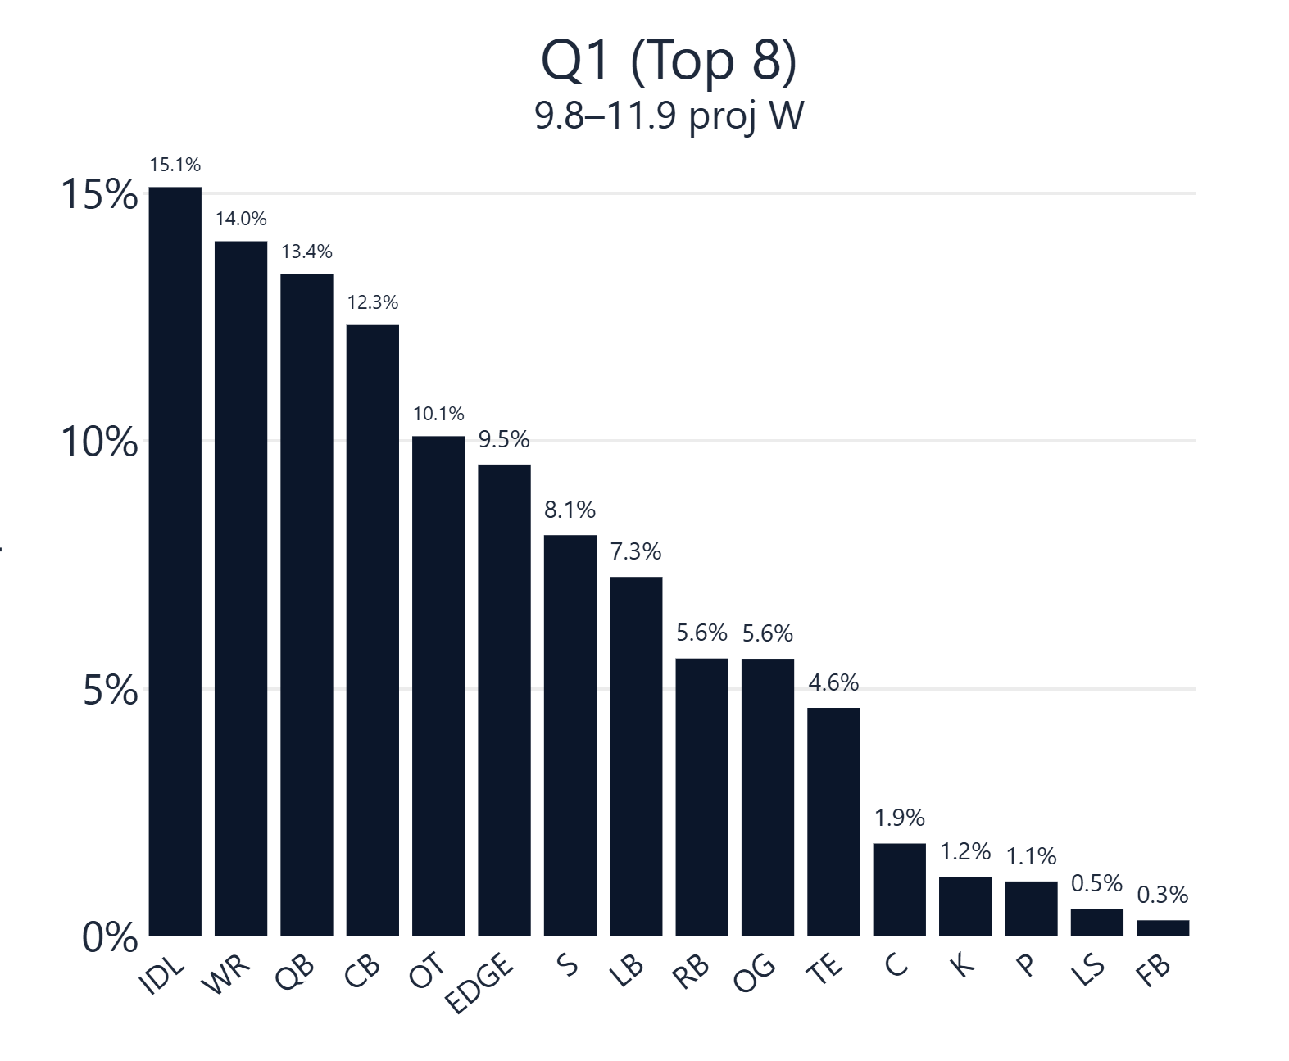
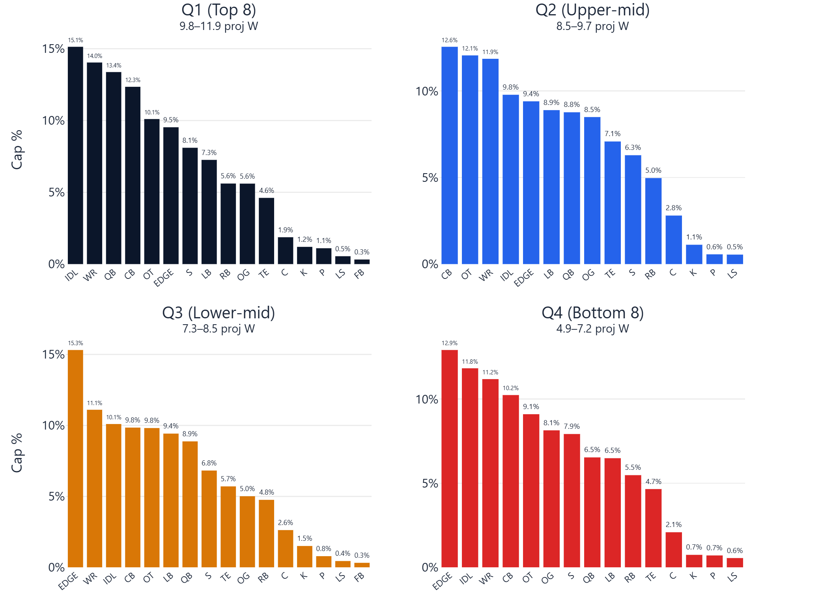

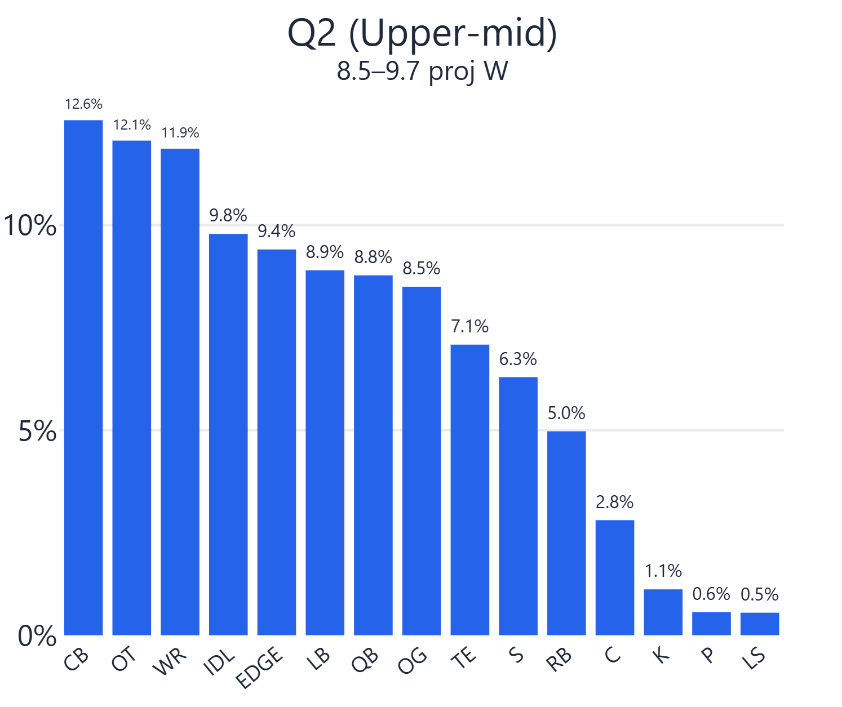
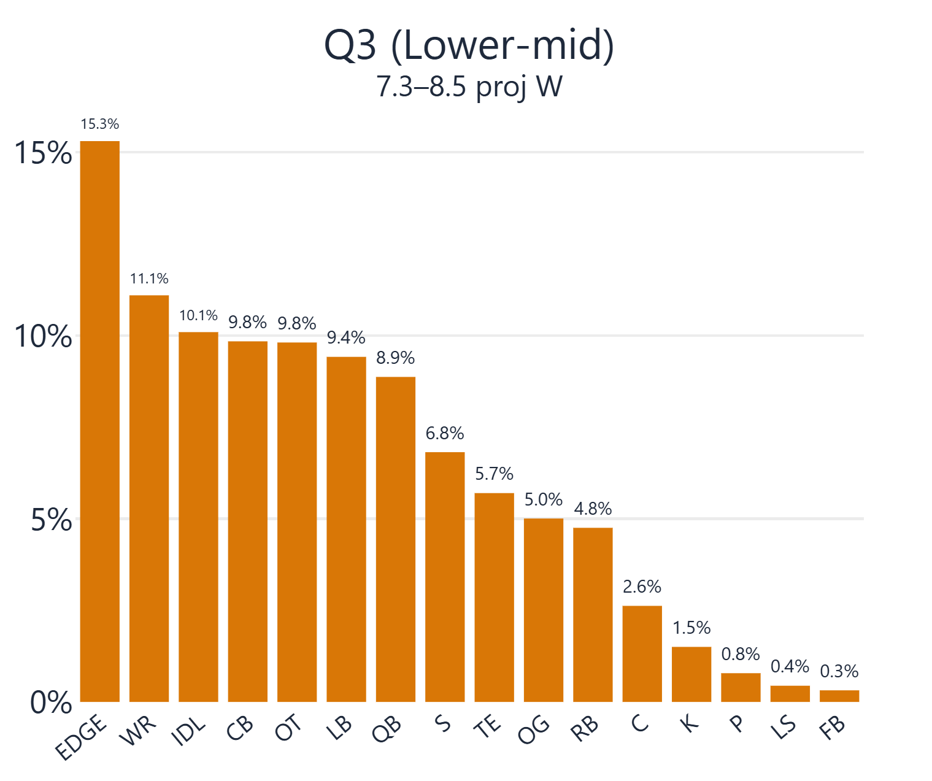
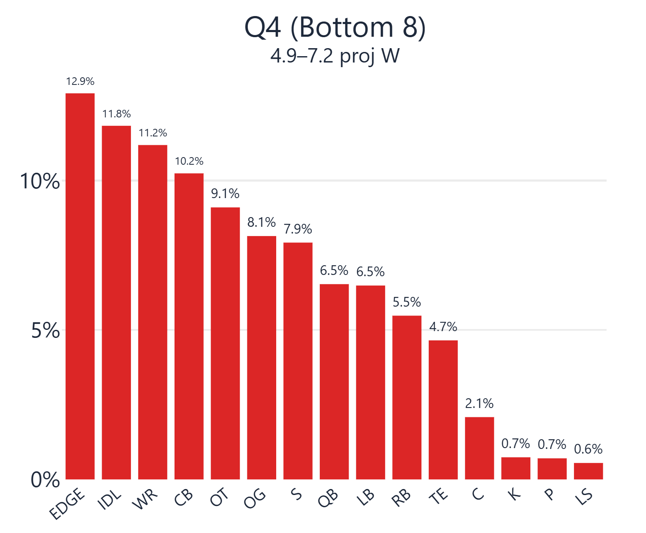

Slide 23
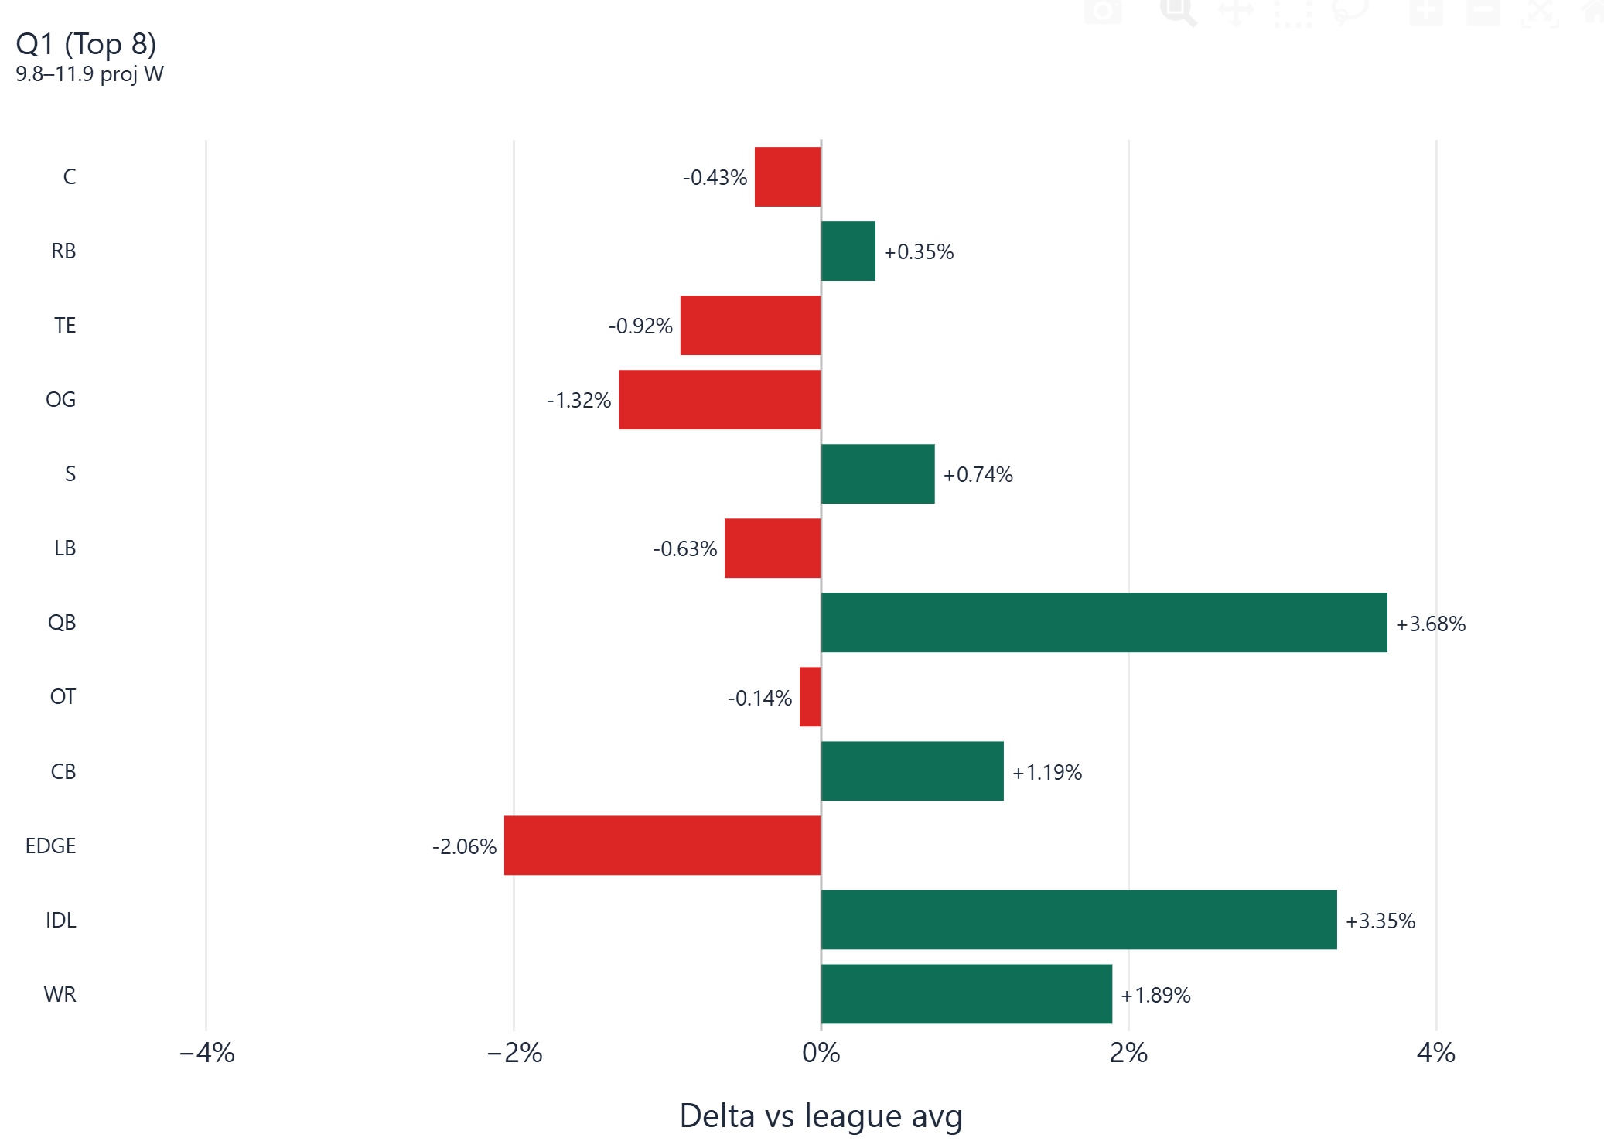

Slide 24
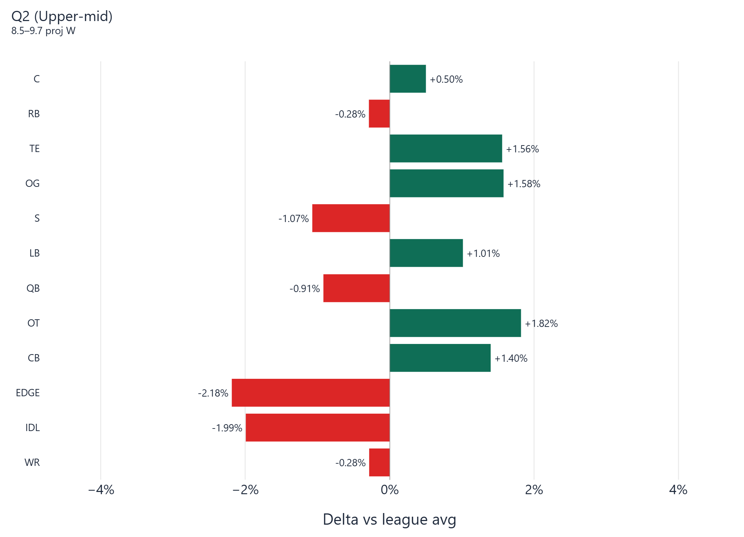

Slide 25
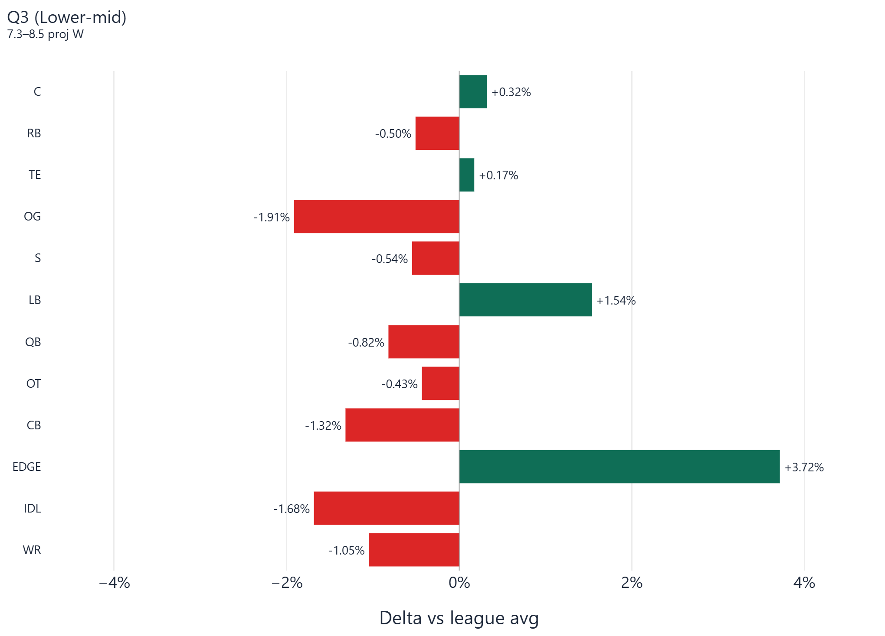

Slide 26
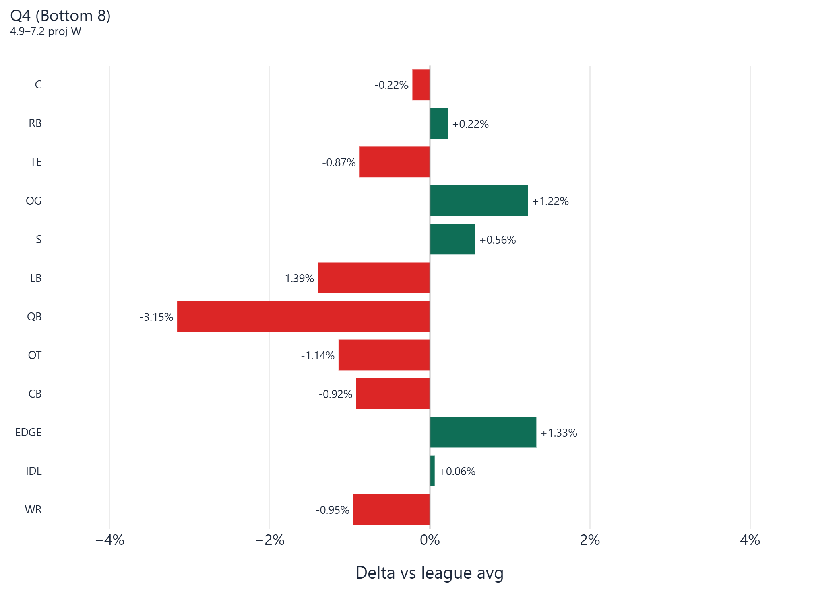

Slide 27
07
App
The Deliverable
https://projectionapppy-umylt56cxndy9qpanf6yom.streamlit.app/
How can the Bears use these results?

Slide 28
Takeaways
Key Findings
01
ELO drives wins
The custom yards-per-play ELO system is the strongest single predictor in both model tracks. Splitting offense and defense gives 2x the signal per game and outperforms every raw efficiency stat.
02
Neural Net matches Vegas
The MLP Neural Network reaches 65.6% game-level accuracy using only on-field statistics — exactly matching the Vegas straight-up baseline. This is the key result: publicly available stats alone can match market efficiency.
03
Vegas model adds limited further signal
Adding the spread to the model (Ridge Classifier Vegas) reaches 65.23% — actually slightly below both the non-Vegas MLP and the raw Vegas baseline. The MLP already extracts most of the available signal without market data.
NEXT: Red zone efficiency | Injury indicators | EPA integration | Expanded ELO variants

