Slide 1


FYP
Smart Paw
SUBHAN (571-2019)
HARIS BIN MOHSIN (1516-2020)
M.ASAAD IBRAHIM (2602-2021)
Supervisor SIR ABDUL RAZZAQUE
Department of Computing, FEST
Hamdard University

Slide 2
Summary
Problem Statement
Objective
FYP Scope
Our methodology
Our Project Plan (Time lines)
Budget / Costing (if any)
FYP Deliverables
Literature Review
Demo of 100% of Work
Experimental Evaluations & Results
Test Plan & Test Cases
References

Slide 3
Problem Statement
Problem Description
What: The Smart Paw is designed to address the challenges faced by pet owners in managing their pet’s health and well-being. The app will offer features such as health monitoring, personalized care schedules, community engagement, and an AI-driven disease detection tool that analyzes symptoms and provides potential diagnoses based on user input.
Why: Pet owners often struggle to keep track of their pets' health needs due to busy lifestyles or lack of knowledge. This can lead to missed appointments, overlooked symptoms, and delayed veterinary care, ultimately affecting the pet’s quality of life. Moreover, many owners may not recognize early warning signs of illness, making timely intervention difficult. The incorporation of AI can empower pet owners with early disease detection, increasing the chances of successful treatment and improved health outcomes.

Slide 4
Objective
Objective
To develop a user-friendly mobile application that assists pet owners in managing their pet care tasks, accessing resources, and leveraging AI technology to detect potential diseases in their pets early on..
Validation and Verification
To tackle these challenges, we will adopt an agile development methodology, allowing for iterative enhancements based on user feedback. The application will be built using Kotlin, and java for Android development, with Firebase as the backend to handle data storage and real-time synchronization. Key features will include algorithms for personalized reminders and notifications based on user input and pet health data. For the AI disease detection tool, we will utilize machine learning models trained on veterinary data to analyze symptoms and provide potential diagnoses. Third-party libraries such as Retrofit will be utilized for networking, while the Room library will be implemented for local database management

Slide 5
FYP Scope
The project will focus on developing a pet care app with core features like pet health monitoring, care scheduling, community engagement, and AI-driven disease detection. Users will be able to track their pets' well-being through updates and alerts, manage appointments and care routines, and connect with other pet owners for advice and support.
A key feature is the AI-driven disease detection tool, which will analyze pet images to identify potential health issues. Users can upload photos of their pets, and the AI will use image recognition techniques and deep learning models to detect visible symptoms like rashes, swelling, or hair loss. Based on these signs, the AI will classify possible diseases such as skin infections, allergies, or tumors and provide detailed reports and next-step recommendations, such as consulting a vet. The AI system will improve over time with more data, becoming more accurate.
The app will rely on cloud-based resources and require an internet connection, with basic security measures in place, though detailed encryption will not be included initially. Future updates may add advanced features like telemedicine or wearable device integration, but these are beyond the current scope.

Slide 6
Our Methodology
The project will involve developing a mobile application using agile methodologies, ensuring adaptability and user feedback incorporation. Machine learning algorithms will be employed to create the AI tool that analyzes symptoms reported by users. This system will be designed with a focus on user-friendly interfaces, robust data security, and seamless connectivity to foster a supportive community among pet owners. Special attention will be given to ensuring the AI tool's reliability and accuracy to instill trust in users while adhering to ethical guidelines for data usage.

Slide 7
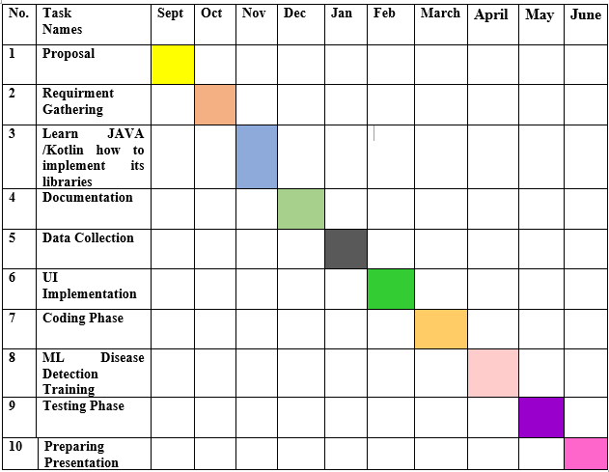
Our Project Plan

Slide 8
Budget / Costing
S No | Product Name | Price*
1 | Laptop | 50,000
2 | Mobile | 30,000
3 | Developer | 180,000
4 | Miscellaneous expenses | 10,000
 | Total | 270,000

Slide 9
FYP Deliverables
FYP 1 Deliverables | FYP 2 Deliverables
Project Plan | Mobile App Development
Documentation (FYP 1 Report) | AI Tool (Final Model)
Data Set Collection & Preprocessing | Documentation (FYP 2 Report)
AI Tool (Initial Model) | Source Code
 | Final Presentation & Demo

Slide 10
Literature Review
AI in Health (Human & Veterinary): AI, especially CNNs and LSTMs, has advanced human diagnostics but is underutilized in veterinary care. There’s a lack of systems combining image and text for pet disease prediction.
Deep Learning for Image Diagnosis: CNNs excel in medical imaging (e.g., skin, X-rays). Their success in human health supports their use in pet symptom image analysis. Smart Paw uses this for real-time photo-based detection.
Text-Based Symptom Analysis: Platforms like Ada and Babylon use NLP and LSTMs for human health inputs. Smart Paw applies similar models to understand pet symptom descriptions in natural language.
Multimodal AI in Healthcare: Combining image and text input improves diagnostic accuracy. Smart Paw integrates both for a holistic pet health assessment.

Slide 11
Literature Review
Gaps Identified:
Unexplored: Few AI-based apps offer real-time pet disease prediction using user-generated data.
Underexplored: Most pet apps focus on reminders, not diagnosis using deep learning.
Methodological Gap: Lack of comparative analysis of CNNs and LSTMs in vet care.
Contextual Gap: Existing studies are region-specific. Smart Paw aims for global adaptability.
Temporal Gap: Many models use outdated data. Smart Paw learns dynamically from real-time inputs.

Slide 12
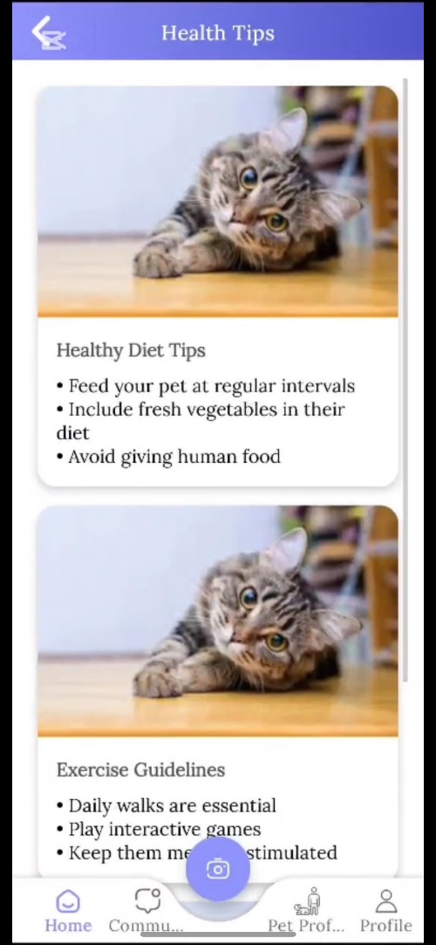
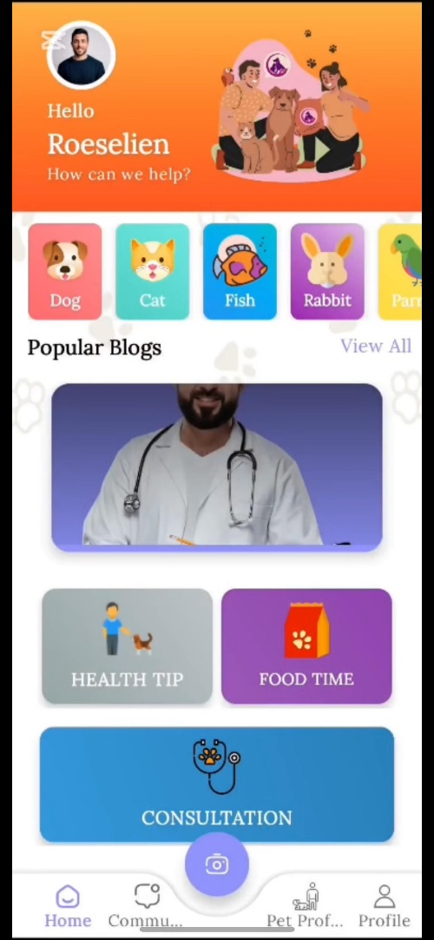
Demo of 100% of Work

Slide 13
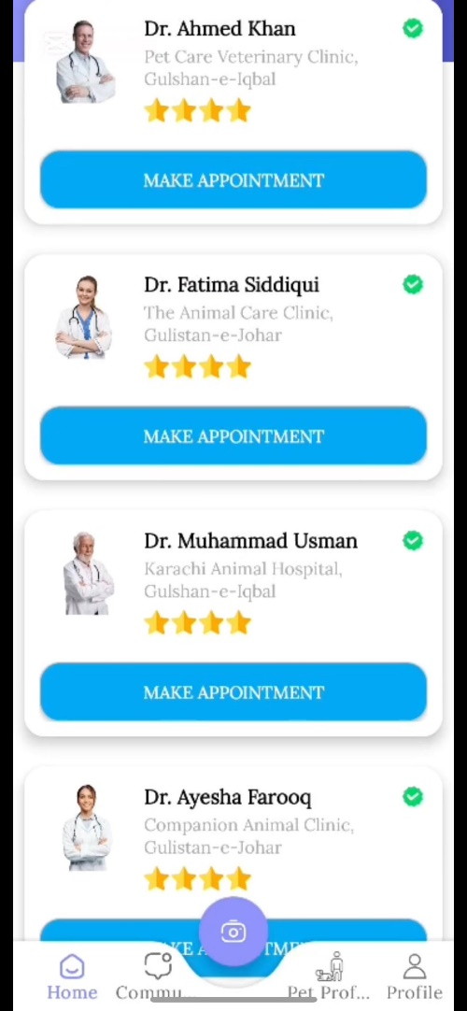
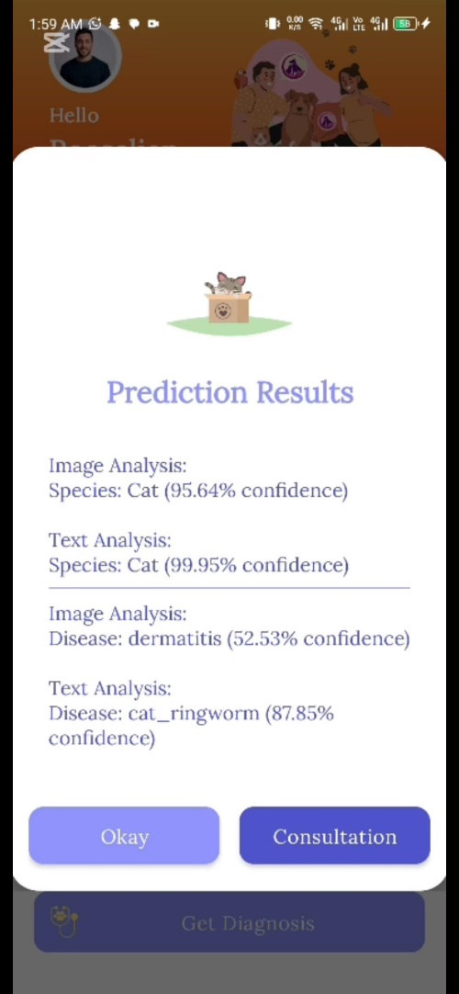
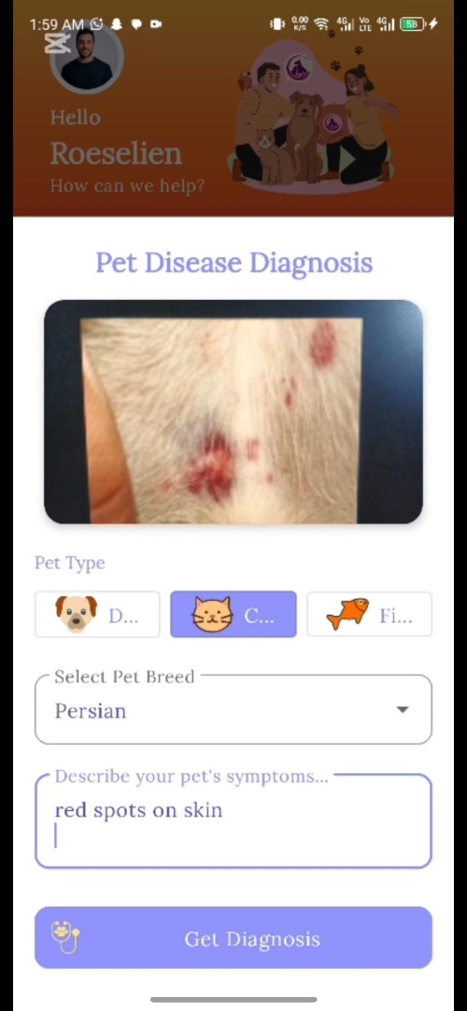
Demo of 100% of Work

Slide 14
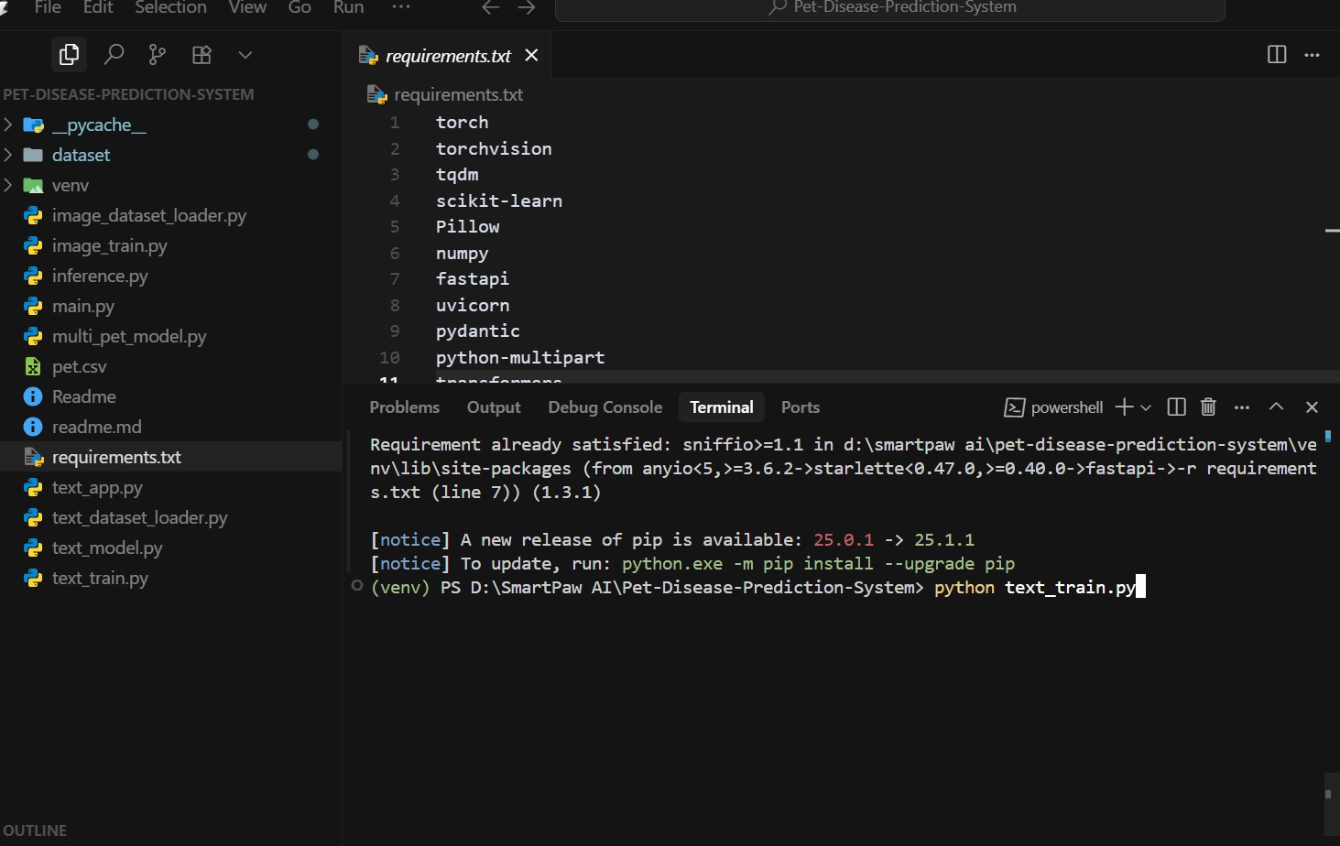
Experimental Evaluations & Results
Test Model Training:

Slide 15
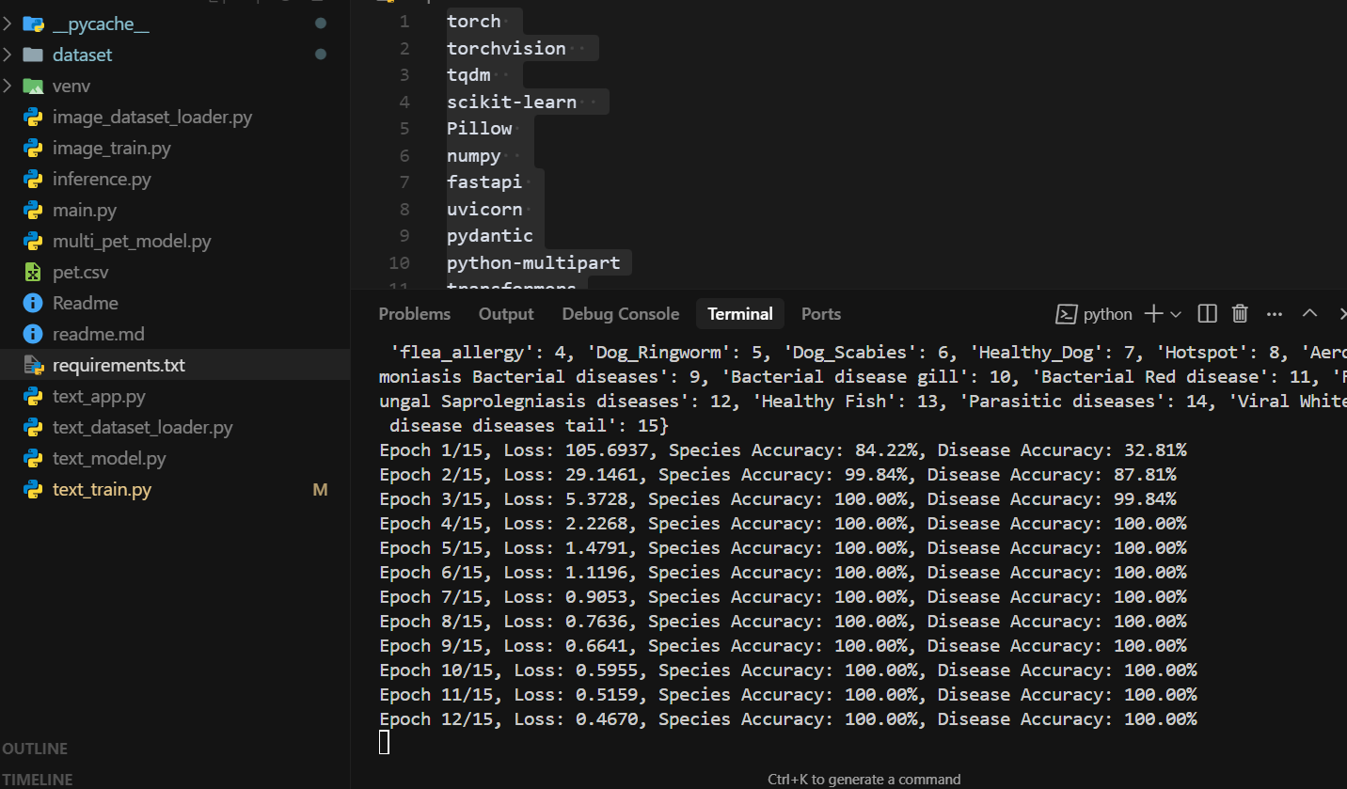
Experimental Evaluations & Results
Test Model Training:

Slide 16
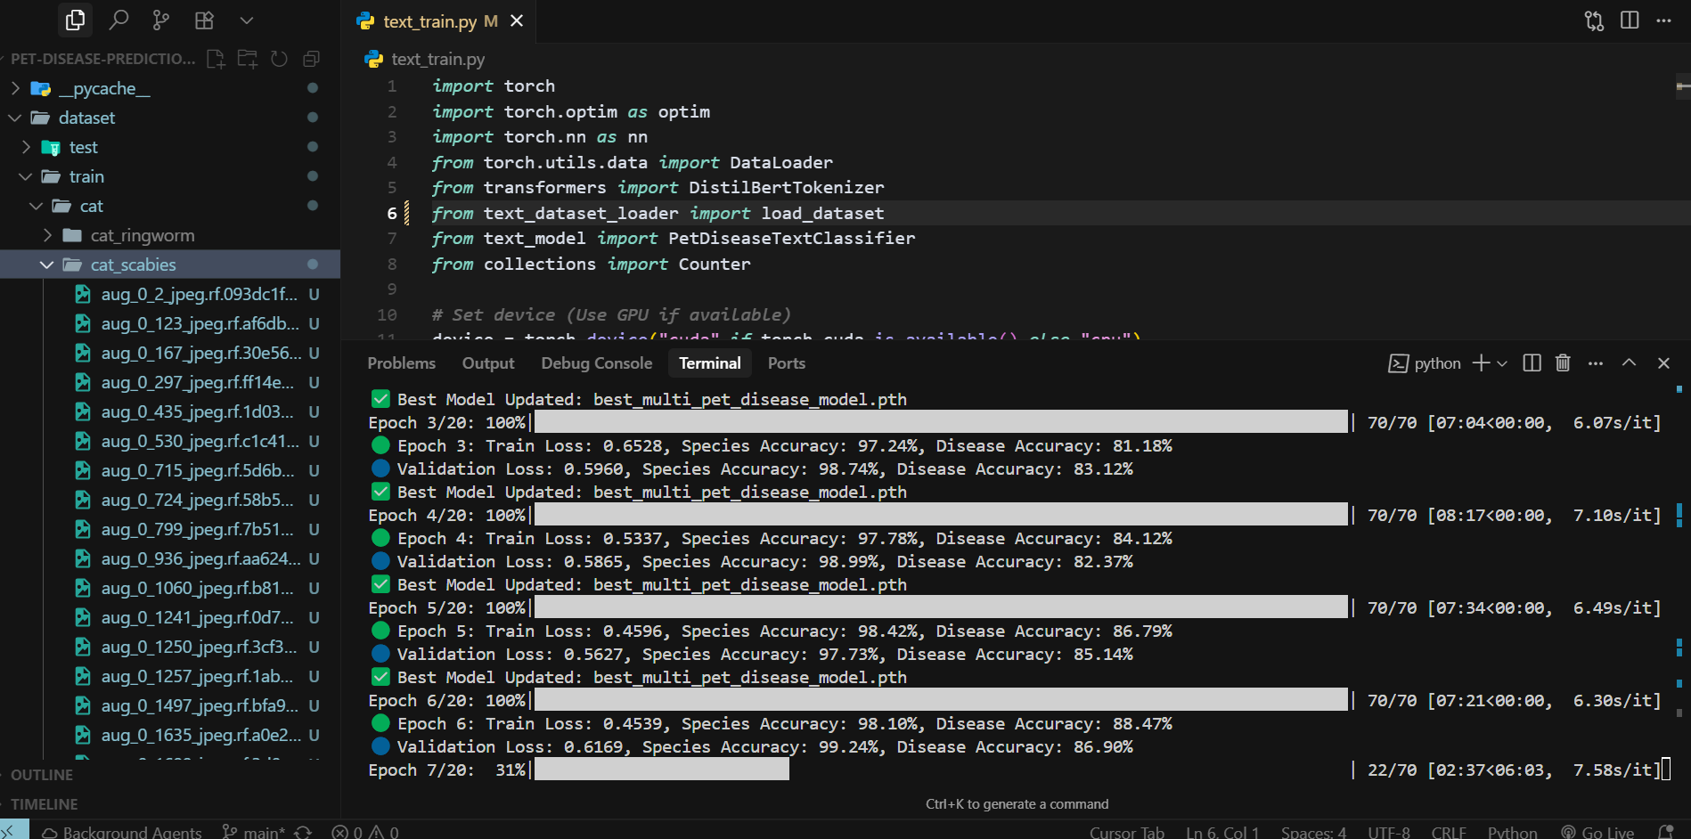
Experimental Evaluations & Results
Image Model Training:

Slide 17
Test Plan & Test Cases
Test Plan:
S.No | Feature | Test Engineer | Date
1 | Login Screen | M Asad Ibrahim | 3-May-25
2 | Registration Screen | M Asad Ibrahim | 3-May-25
3 | Dashboard Navigation | Subhan | 4-May-25
4 | Add Pet | Haris Bin Mohsin | 5-May-25
5 | Community Blog | Haris Bin Mohsin | 6-May-25
6 | Doctor Consultation | Subhan | 7-May-25
7 | Push Notifications | M Asad Ibrahim | 8-May-25
8 | Disease Prediction | Haris Bin Mohsin | 9-May-25

Slide 18
Test Plan & Test Cases
Test Case:
TC ID | Description | Module | Test Engineer | Date | Status
TC-1 | User Login Verification | User Authentication | M Asad Ibrahim | 3-May-25 | ✅ Pass
TC-2 | Add Pet Functionality | Pet Management | Haris Bin Mohsin | 5-May-25 | ✅ Pass
TC-3 | Community Blog Post Creation | Community Features | Haris Bin Mohsin | 6-May-25 | ⚠️ 1 Fail (Blog Title), others Pass
TC-4 | Meal Reminder Push Notification | Notification System | M Asad Ibrahim | 8-May-25 | ⚠️ 1 Fail (Meal Setting), others Pass
TC-5 | View Emergency Doctor List | Doctor Consultation | Subhan | 7-May-25 | ✅ Pass
TC-6 | Disease Prediction Result Display | AI Prediction System | Haris Bin Mohsin | 9-May-25 | ✅ Pass

Slide 19
Reference
· Russell, Stuart J., and Norvig, Peter. Artificial Intelligence: A Modern Approach. 4th ed., Upper Saddle River: Prentice Hall, 2021, pp. 500-520.
· King, Mary. "AI-Powered Pet Care: The Future of Veterinary Medicine." Tech Innovations Magazine, March 2024, pp. 35-38.
· Smith, John. "The Use of AI in Pet Healthcare: Trends and Challenges." Journal of Veterinary Science, June 2023, pp. 102-115.
· PetMD. "Common Pet Diseases and Symptoms." 2022. Chewy Inc. Accessed September 30, 2024. https://www.petmd.com/dog/conditions.
· Jones, Alice. "AI Tools for Pet Disease Diagnosis." Pet Health Weekly, May 2023. Reproduced in ProQuest Database. National Library of Medicine, Washington, D.C. Accessed September 30, 2024.
· Briggs, Thomas. "Virtual Reality and AI in Modern Pet Care." Pet Care Today, February 2024, pp. 24-30.
· Veterinary AI Lab. "AI and Machine Learning Applications in Veterinary Diagnostics." VetTech Innovations Blog. 2023. Accessed September 30, 2024. https://vettechinnovations.com/ai-diagnostics.

