Slide 1
Transfer Learning using ResNet50
Application of the data
Here in this study, we used the CIFAR-10 dataset to explore the application of transfer learning using ResNet50.
This dataset is widely used in machine learning benchmarks for image classification tasks. Its popularity is due to:
Simplicity: It consists of 60,000 small (32x32 pixels) color images representing 10 distinct classes of everyday objects, such as airplanes, cars, and animals.
Accessibility: The dataset is publicly available and easy to work with, making it an ideal choice for both research and educational purposes.
Challenge: Although seemingly straightforward, CIFAR-10 presents considerable complexity to test and compare the performance of different machine learning algorithms.
Balanced: While containing 5,000 images per class, the dataset shows a slight imbalance in favor of common objects such as aeroplanes, forcing algorithms to learn effectively from limited examples of rarer classes like frogs or trucks.

Slide 2
Preprocessing of the dataset-CIFAR-10
Normalization: We normalize pixel values ​​to a constant range (0 to 1), ensuring that all features contribute equally during training. This prevents features with large numerical ranges from dominating characteristics with small ranges, causing model learning bias. It also shrinks the range of values ​​and improves the performance of gradient descent, resulting in faster convergence and potentially better generalization.
Categorization: By converting classical class labels (“airplane", "cat", "truck") into binary vectors where each vector contains a single 1 and 0 for other classes. This format is often preferred by neural networks for multi-class classification. The categorical_crossentropy loss function, commonly used in multi-class classification, expects labels in this binary format for accurate loss calculation and model optimization.

Slide 3
Transfer learning and its importance
Transfer learning is a powerful machine learning technique that leverages knowledge gained from solving a problem to tackle a new, related problem.
Traditional machine learning involves training models tailored for different tasks, which often lack adaptation to novel, unpredictable challenges. Transfer learning seeks to use the insights gained from solving one problem to increase skill in solving a separate but related problem.
It empowers models to use understandings from an expansive dataset in a task, to increase performance on a related task, even with limited data, and to overcome the challenges of impractical or expensive data collection.
Fixing a pre-trained model on a new task is faster due to the learned features, and is beneficial for rapid deployment or iteration.
It yields models with better generalization to new data, as the pre-trained model learns valuable general features across tasks, enhancing pattern recognition in new data.
It achieves superior performance on a target task, leveraging pre-trained models to learn relevant patterns and representations.
It features transfer learning using pre-trained models, pre-trained embeddings, and feature extraction, improving resourceful adaptation to new machine learning challenges.

Slide 4
Keras
Keras is a popular deep learning library, makes it easy to utilize the power of transfer learning. Keras provides built-in access to a wide range of pre-trained models, like ResNet50, trained on massive datasets like ImageNet. These models can be seamlessly integrated into your own Keras code, allowing you to:
Simply import the desired model from Keras Applications and specify the pre-trained weights to load Load pre-trained models.
Prevent pre-trained weights from being updated during training, by freezing the base model layers and focusing on adapting the top layers of the model to your specific task.
Build your neural network layers on top of a pre-trained base model to tailor its outputs to your specific needs. By providing a user-friendly interface and powerful building blocks, Keras allows developers of all skill levels to take advantage of the benefits of transfer learning.

Slide 5
ResNet50 and its detailed breakdown of its layers:
In this study, we used ResNet50, a large 50-layer deep learning model that rocked the deep learning world with its performance in classification tasks. The secret lies in these intelligent residual blocks that bypass traditional layers and add direct information flow for better learning. ResNet50's imaginative block shortcuts increase signal strength, overcome the vanishing gradient problem and enable high image accuracy in deep networks.
Step 1 In the initial step, a 224x224x3 RGB image undergoes a 7x7 convolutional operation with 64 filters and 2 additions, resulting in reduced sample dimensions. Then, maximum pooling with increments of 2 is applied, further reducing the spatial dimensions of the processed data.
Step 2 In this step, residual blocks of three constraints are used, each consisting of 3x3 convolutions with 64 filters. These blocks add identity connections to secure the flow of information across the network.
Step 3 In the third step, residual blocks of four constraints are implemented, with each block using 128 filters with 3x3 convolutions. This phase introduces identity-leaving connections to protect information and increase complexity in the network architecture.

Slide 6
Step 4 In step 4, residual blocks of six constraints are deployed, including 3x3 convolutions using 256 filters. This step involves a higher level of complexity, facilitating the extraction of deeper features in the network architecture.
Step 5 In this fifth and final step, residual blocks of three constraints are used, adding 3x3 convolutions with 512 filters. This step achieves the peak of feature extraction by enabling the creation of complex representations within the network architecture.
Output:
In the output stage, a global average pooling layer is applied, followed by a 1000-neuron fully connected layer designed for the specific task of classifying images into 1000 classes defined by the ImageNet dataset. has been done The final predictions are generated using the softmax activation function, which yields the class probabilities.

Slide 7
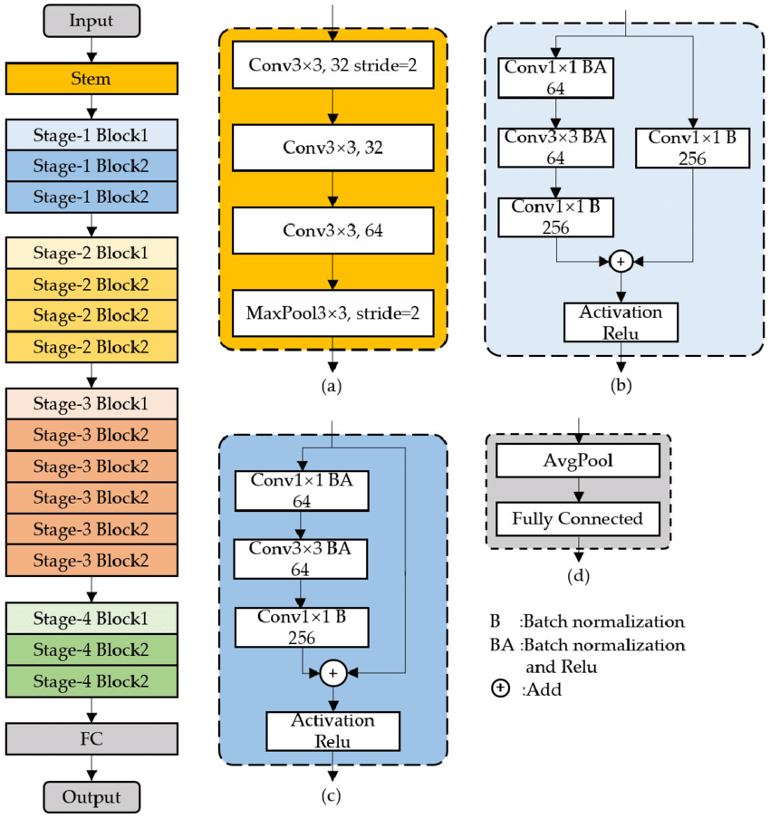
Model Architect

Slide 8
Bottleneck Residual Blocks in ResNet50:
These are the main architectural elements of ResNet50. These include:
1x1 convolution to reduce channels
3x3 convolution with enhanced filters for feature extraction
1x1 convolution to stretch the channels to match the input
Skip the connection adding the input directly to the output.
Non-linear activation (ReLU) after each convolution
This architectural configuration facilitates the construction of deep neural networks by reducing the vanishing gradient problem, thus contributing to the outstanding performance of ResNet50.
Reference:
Wang, Shuai & Xia, Xiaojun & Ye, Lanqing & Yang, Binbin. (2021). Automatic Detection and Classification of Steel Surface Defect Using Deep Convolutional Neural Networks. Metals. 11. 388. 10.3390/met11030388.

Slide 9
Required Changes in the architecture
Our images size is 32x32 but ResNet50 expects the input of 224x224 pixels image so bridge this gap we have employed 3 consecutive UpSampling2D layers.
We used flatten layer to flatten the outputs into a single vector for the upcoming dense layers.
We had to use batchnormalization layers too, in this architecture as our model was not performing well on validation dataset. Batchnormalization act as an regularization.
For the same reason we also introduced the dropout layers, as random dropping of connections make model generalize better.
The final dense layer has 10 neurons as cifar-10 has 10 classes.

Slide 10
Evaluation
Evaluation of the ResNet50 Model: After completion of the training phase, the model is tested, showing an admirable accuracy rate of 93% during testing.
Plotting Confusion Matrix: Using a heat map is a better way to display the confusion matrix, as it allows a clearer visualization of the classes in our model that are often confused. For example, if the model predicts the class of dog as cat 107 times, examining the heatmap reveals that particular misclassification. Such faults can have various causes, such as both cats and dogs having four legs and two pointed ears.

Slide 11
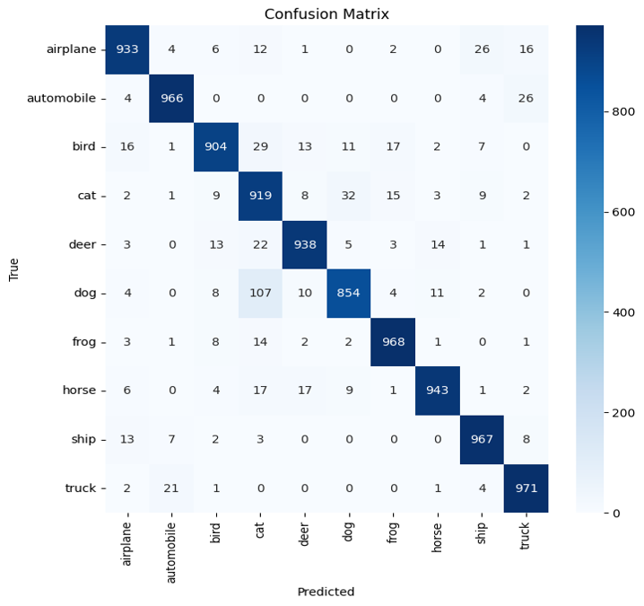

Slide 12
Comparison of models
In our experiment, the significant jump in accuracy from 86% to 93% when utilizing transfer learning with ResNet50 on CIFAR-10 dataset provides evidence for its advantages over training from scratch. This performance gap highlights the power of leveraging pre-trained knowledge.
ResNet50 is initially trained on a massive dataset of images and has already learned fundamental features for recognizing visual patterns. Applying this pre-trained model to CIFAR-10 which is a related task in image classification, allows it to adapt its existing knowledge to the specific patterns of CIFAR-10 images. This avoids starting from scratch with random weights, significantly shortening the learning process and enhancing accuracy.
Therefore, if a pre-trained model exists for a similar task, transfer learning an attractive choice. It offers benefits in terms of faster training, better accuracy, and reduced data requirements. While training from scratch may be necessary for highly domain-specific tasks or when no suitable pre-trained model exists, transfer learning often emerges as the preferred approach when applicable, as demonstrated by this example.

