Slide 1
Application of the transfer learning in the field of image classification by using the VGG16 model
Used Data set in this study : The CIFAR-10 dataset plays an important role in this study as it provides a diverse and challenging set of 60,000 labeled images divided into 10 classes. Its value lies in presenting a representative range of real-world scenarios, allowing the VGG16 model to be effectively generalized. By leveraging transfer learning on CIFAR-10, the model gains robustness, enabling practical applications in various image classification tasks.
Diversity of Classes: It consists of a diverse array of 10 classes, including common objects such as animals, vehicles and everyday objects. This diversity ensures that the model is exposed to a wide range of visual features.
Benchmarking Criteria: This dataset has become a standard in the field of computer vision, facilitating fair comparisons and evaluations of model performance. Using this dataset increases the credibility of the VGG16 model evaluation.
Challenging variation: It includes images with variations in illumination, angles, and background, similar to the challenges faced in real-world image classification problems. Training on such diverse data helps to generalize the model effectively.

Slide 2
Transfer learning and its Importance
Transfer learning is a machine learning technique where a model trained on one task is adapted to a different but related task. Instead of starting the learning process from scratch, transfer learning takes the knowledge gained from solving one problem and applies it to a different, yet related, problem.
The utility of this machine learning technique lies in its ability to improve a model's performance on a target task with limited labeled data. It takes advantage of features learned from the source task, which may have a large amount of available data, and transfers this knowledge to the target task, where data achievement may be scarce or expensive.
This approach can lead to faster training times, better generalization, and better accuracy, especially in situations where it is difficult to collect enough labeled data for a specific task.

Slide 3
Selection and purpose of the pre-trained VGG-16 model
The reason for selecting the VGG-16 model is that it has been pre-trained on a large and diverse dataset, specifically the ImageNet dataset, which comprises millions of images spanning a wide range of categories. The pre-training on ImageNet endows the model with a rich understanding of general visual features, textures, and patterns. This learned knowledge can be leveraged through transfer learning to boost the performance on a different but related task, such as the CIFAR-10 classification.

Slide 4
Preprocessing the CIFAR-10 Dataset for VGG16 Model:
Step 1: Partitioning the data set
Use the cifar10.load_data() function to split the CIFAR-10 dataset into training (X_train, y_train) and testing (X_test, y_test) subsets.
Step 2: Pixel Normalization
Apply pixel normalization to the image data by converting the pixel values ​​to the range [0, 1].
Change the data type to float32.
Divide each pixel value by 255.0.
Step 3: Categorical encoding
Perform a hot encoding on the class labels (y_train and y_test) using the to_categorical function.
Convert the integer-based class labels to a binary vector of length 10.
Step 4: UpSampling for VGG16 compatibility
To accommodate the VGG16 model's input size expectations, an additional preprocessing step is introduced but this step is performed inside the model in batches of data as it takes too much memory to upsample all the images.

Slide 5
Continue.
The images in both the training and testing sets are upsampled to match the dimensions of 224x224 pixels, as required by the VGG16 architecture.
The UpSampling2D is utilized for this purpose. This preprocessing, pixel normalization and image upsampling, collectively optimizes the CIFAR-10 dataset for subsequent transfer learning with VGG16, adhering to established conventions for effective neural network convergence and classification accuracy.

Slide 6
Pre-trained Model: VGG16
VGG16: A Deep Convolutional Neural Network for Image Classification
Key Features of the VGG16 Model:
Layer Architecture: VGG16 is characterized by a total of 16 layers, comprising 13 convolutional layers and 3 fully connected layers, thus earning its nomenclature.
Filter Size: Compact uses 3x3 filters, systematically stacked in multiple layers to facilitate effective feature extraction.
Architectural Simplicity: Maintains a straightforward and consistent structure, enhances interpretability and eases implementation.
ImageNet Pre-Training: Pre-trained on a vast ImageNet dataset, containing more than 14 million images in 1000 classes, providing a strong foundation for various computer vision tasks.
Reference:
Yang, Dandi & Martinez-Rendon, Cristhian & Visuña Pérez, Lara & Khandhar, Hardev & Bhatt, Chintan & Carretero, Jesus. (2021). Detection and analysis of COVID-19 in medical images using deep learning techniques. Scientific Reports. 11. 19638. 10.1038/s41598-021-99015-3.

Slide 7
Few Changes in the Model
Frozen Base Layer:
The strategic decision to freeze the initial 15 layers of the VGG16 model is based on the fact that these layers capture basic visual properties, such as edges and colors.
In CNNs, initial layers pre-trained on image nets provide valuable general knowledge for diverse computer vision tasks.
Untrained initial layers prevent over-fitting, improve computational efficiency, and are compatible with transfer learning principles.
Adding new classification layers:
In the transfer learning scenario, all VGG16 layers are frozen, taking advantage of the pre-trained weights from ImageNet.
Additional layers are added to adapt the model to the new task, starting with UpSampling2D to adjust the spatial dimensions to 224x224.

Slide 8
Continue.
A flat layer transforms the output of the base model, and Batch Normalization increases training stability.
Two dense layers (128 units with RELU activation, 64 units with ReLU activation) capture complex patterns, with a dropout layer preventing overfitting.
The final density layer (10 units, softmax activation) facilitates multiclass classification.
Architectural choices aim to balance complexity and generality for effective transfer learning.

Slide 9
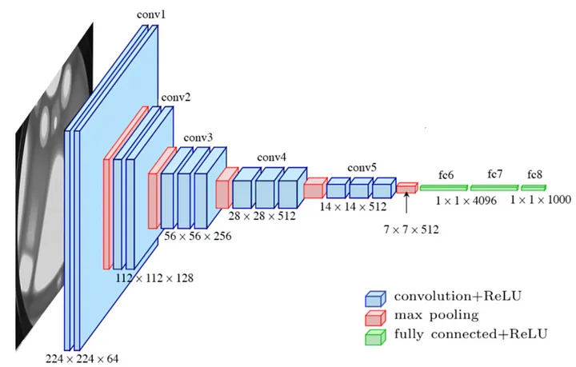
Model Architect

Slide 10
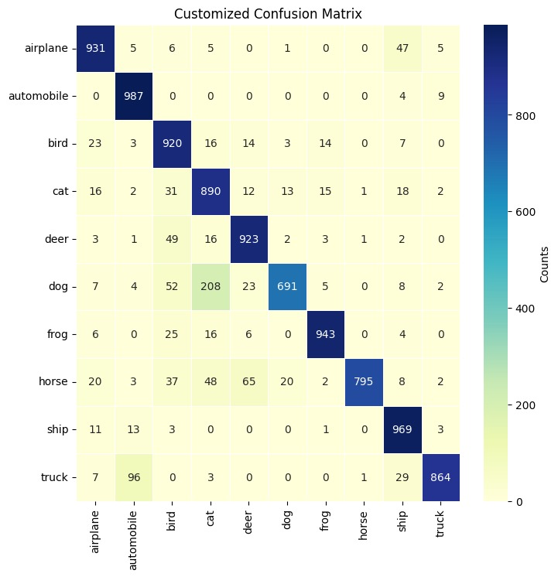
Fine-Tuned VGG-16 Results
On fine-tuned model we got the accuracy of 91% on the test dataset

Slide 11
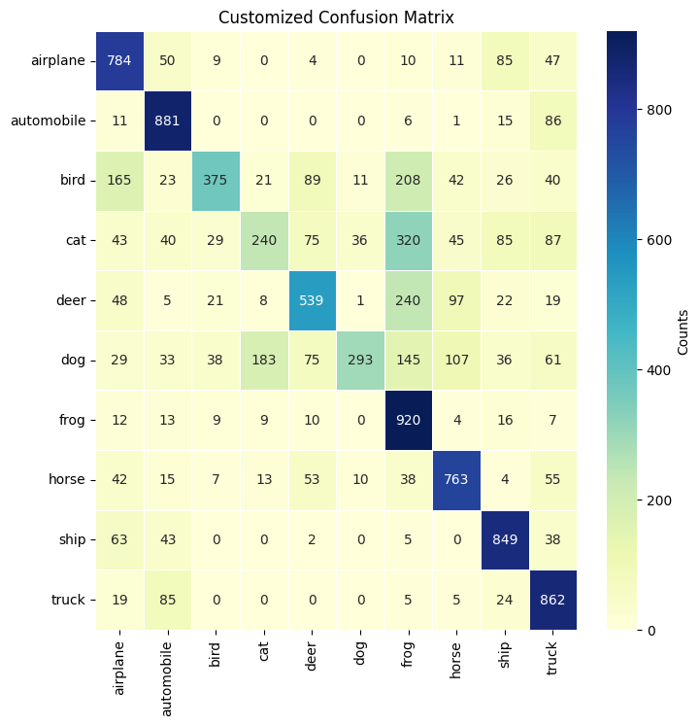
Training from Scratch Model Results
When we trained the same model but from scratch using cifar10 dataset, we got model that is a lot less accurate than the model that used the pre-trained weights. We got the accuracy of only 65% on the test dataset.

Slide 12
Transfer Learning VS. Training from Scratch
In the comparison between transfer learning and training a VGG16 model from scratch on the CIFAR-10 dataset, the results reveal a significant performance advantage for transfer learning. When leveraging the pre-trained weights of the VGG16 model, the achieved accuracy reached 89%, showcasing the effectiveness of transferring knowledge learned from a different but related task. The model was able to use the learned features and representations embedded in the pre-trained weights, resulting in a more accurate classification on the CIFAR-10 dataset.
On the other hand, when opting for training from scratch, where the model parameters are initialized randomly and optimized solely on the task at hand, the accuracy dropped to 65%. This notable discrepancy in performance emphasizes the inherent benefits of transfer learning when confronted with limited labeled data. Transfer learning allows the model to capitalize on knowledge gained from vast datasets used in pre-training, offering a substantial head start in capturing intricate patterns and features.

