Slide 1
Remote Environment Cell Phone Finder
Group 1:
Assaad Howayek Alexander Onofrei
Amin Saber
Cagan Eraydin
Doga Uras
Eda Su Bicer

Slide 2
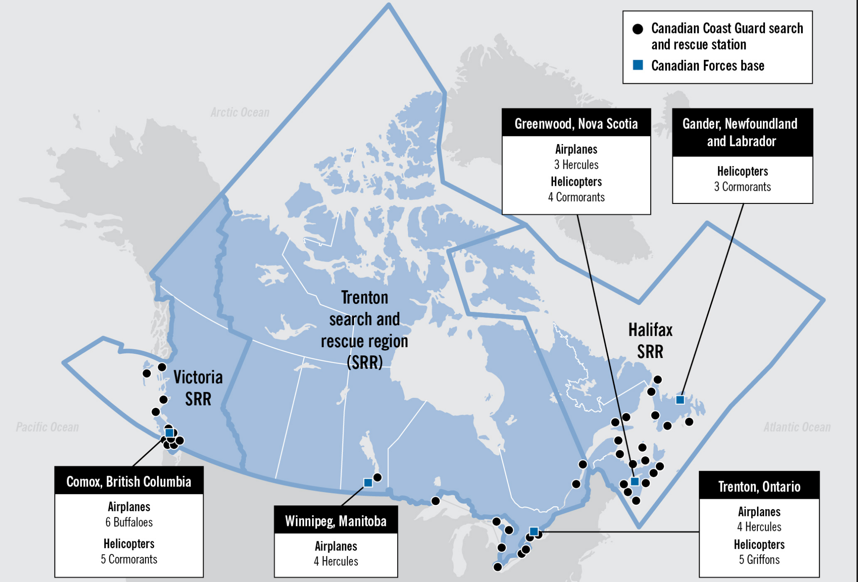
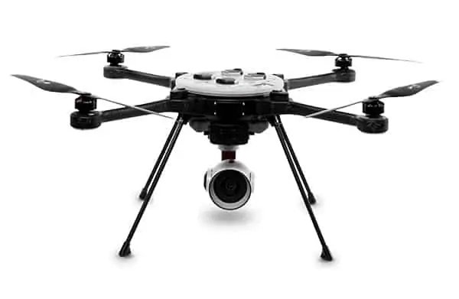
Project Description
Canadian Armed Forces launches SAR air assets for 1,000 out of +9000 search and rescue calls annually.
Goal is to build a remote location cellular phone finder that detects and locate ping signals emitted by the victim’s cell phone.
Revector Detector Drone (RDD) deployed in UK in 2021
Costly alternative, ~90K $
RDD mimics a base station that cell phones can ping to
More effective to locate injured or lost individuals
Minimizes crew involvement and workload
Narrows down the search area
Customer: Patrick Foré - Senior Pilot and Managing Director at the Canadian Aerial Support Inc.
Notes:
Doga - 1 min

Slide 3
Requirements
Functional Requirements
The system must be self powered
The system must have an antenna to broaden the beamwidth
The system must let the user know once a signal is detected
Non-Functional Requirements
The system must be able to operate in temperatures ranging from -40℃ to 40℃
The system must weigh in the range of 500g to 750g
The system must have enough power to last 40 minutes
The system must be able to detect frequencies ranging from 1.7GHz to 2.4 Ghz
Notes:
Cagan

Slide 4
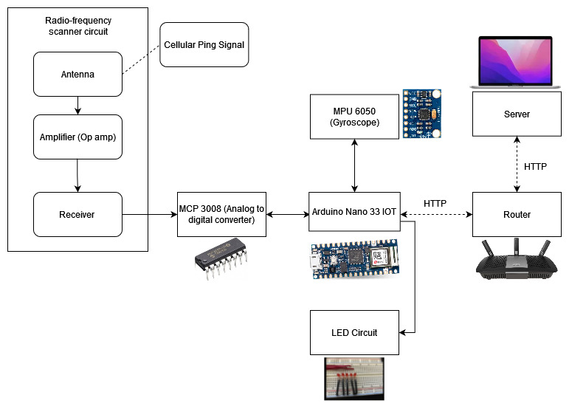
Hardware Architecture - Overview
Notes:
Assaad + Amin

Slide 5
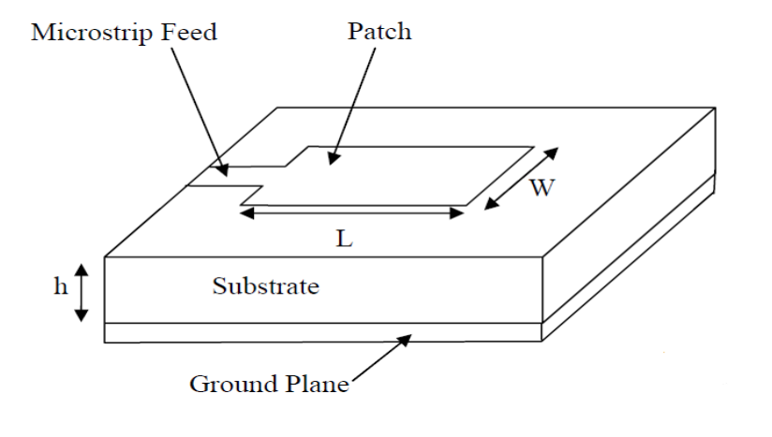
Hardware Architecture - Antenna
LTE Frequency range of 2.4GHz
Research and Design
Width = 38mm, Length = 30mm
FR-4 substrate, height = 1.6mm
Light-weight, low-cost solution
AWR Microwave Office

Slide 6
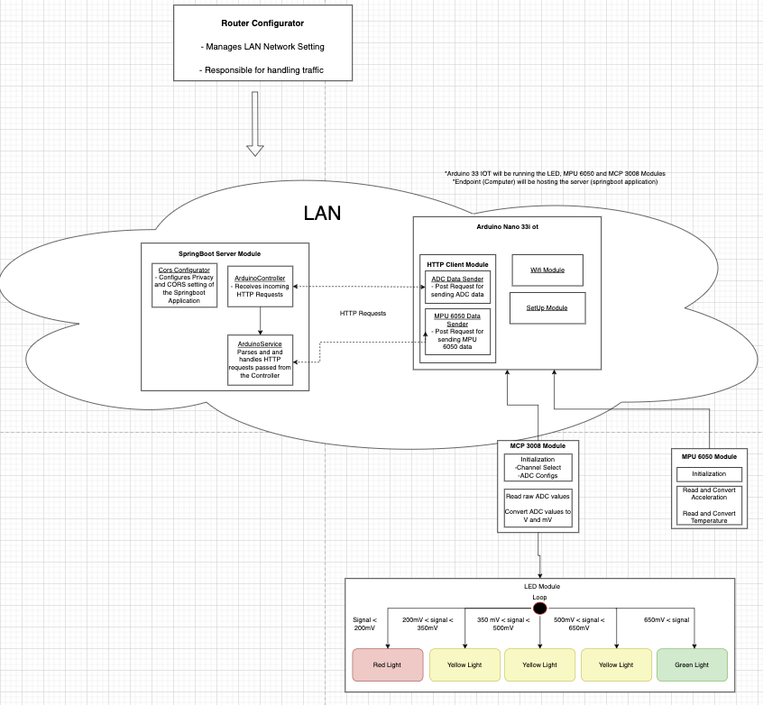
Software Architecture
Notes:
Alexander

Slide 7
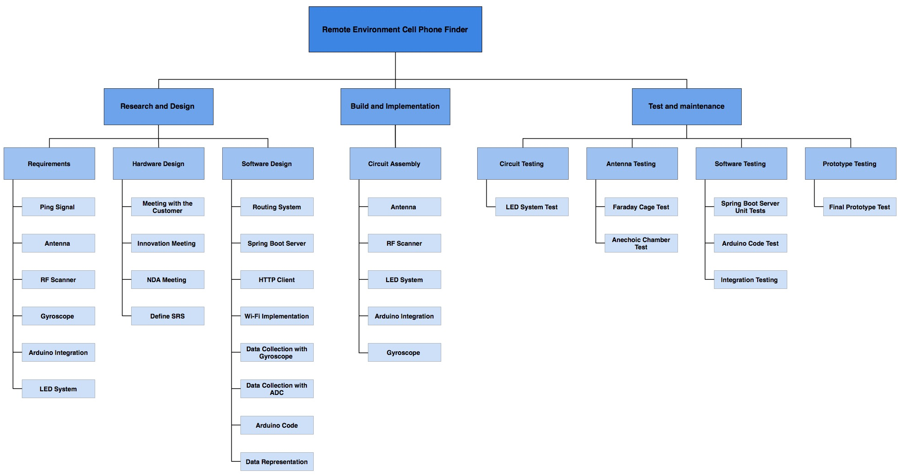
WBS
Notes:
Eda Su

Slide 8
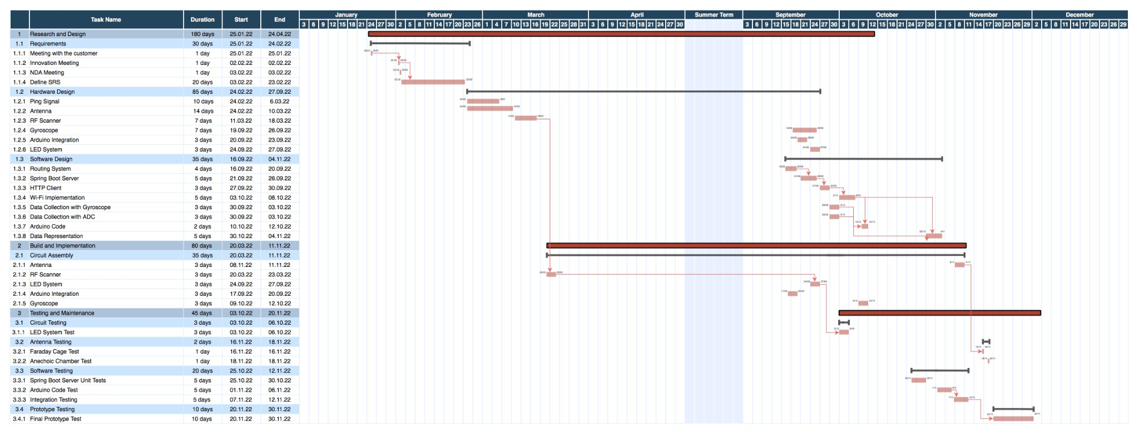
Gantt Chart
Notes:
Eda Su

Slide 9
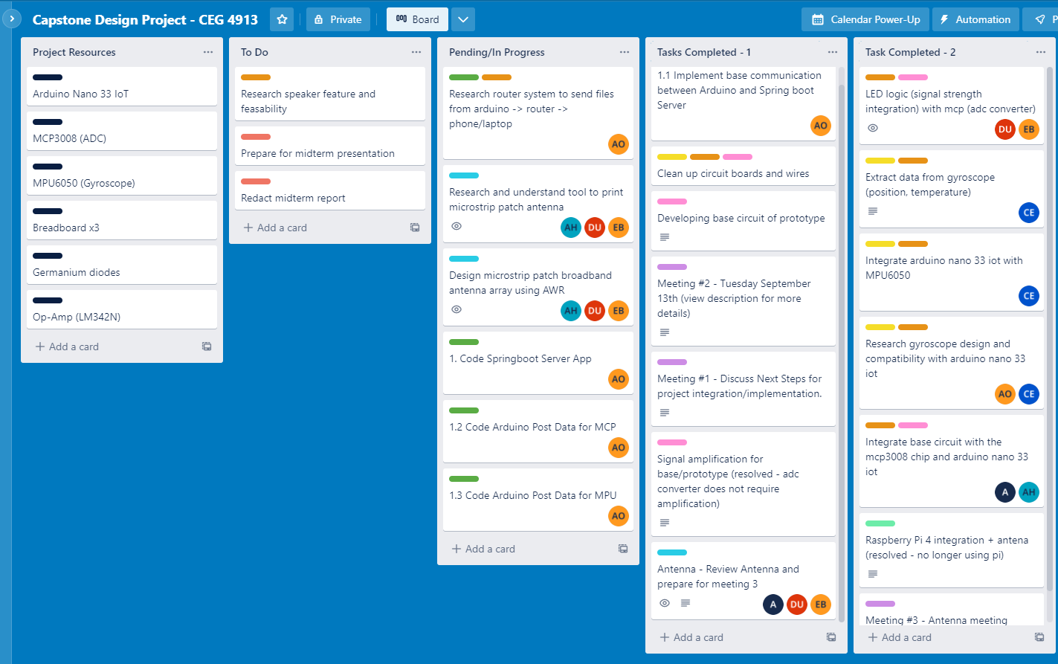
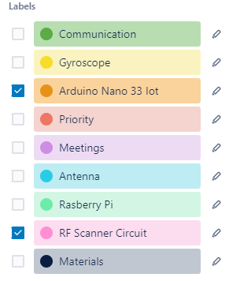
Project Management - Trello
Notes:
Doga - 1:20

Slide 10
Implemented Work Distribution
Tasks | Amin Saber | Assaad Howayek | Doga Uras | Eda Su Bicer | Alexander Onofrei | Cagan Eraydin
MCP Integration | 50% | 50% | 0% | 0% | 0% | 0%
LED Module | 0% | 0% | 50% | 50% | 0% | 0%
MPU Integration | 0% | 0% | 0% | 0% | 0% | 100%
Spring Boot | 0% | 0% | 0% | 0% | 100% | 0%
Antenna | 16.67% | 16.67% | 16.67% | 16.67% | 16.67% | 16.67%
Testing | 16.67% | 16.67% | 16.67% | 16.67% | 16.67% | 16.67%
Total | 16.67% | 16.67% | 16.67% | 16.67% | 16.67% | 16.67%
Notes:
Assaad + Amin

Slide 11



