Slide 1

Md. Asad Al Mahmud-1515
Tarek Jamil Adnan-1520
Supervised By:
Dr. Ahmedul Kabir

Slide 2
Motivation:
Road accidents remain a major concern due to poor infrastructure and lack of safety awareness. BanRAP seeks to bridge this gap by introducing a data-driven approach to evaluate and improve road safety across Bangladesh.
Bangladesh lacks a reliable system to measure or share road safety data.
Existing tools like Google Maps show the fastest routes, not the safest.
BanRAP aims to assess, rate, and visualize road safety to guide users toward safer travel decisions.

Slide 3
Description:
BanRAP provides an interactive mapping and labeling tool inspired by iRAP standards. It enables users and authorities to visualize road conditions, identify high-risk areas, and promote safer route planning through a combination of geographic data, automation, and intelligent analysis.
BanRAP (Bangladesh Road Assessment Program) is a web-based platform for road safety analysis.
It allows analysts to label roads using Google Maps and generate star ratings based on safety conditions.
The system integrates these ratings into a navigation module that adjusts travel time according to road safety.
NB. All Requirements were given by ARI,BUET

Slide 4

Interactive Road Selection: Select and view specific roads directly on Google Maps.
Key Features:
Interactive Road Selection: Select and view specific roads directly on Google Maps.
Automatic Segmentation: Divide selected roads into 100-meter sections for detailed analysis.
2D, 3D & Street View Labeling: Label road segments visually for accurate safety assessment.
Star Rating System: Generate safety ratings following iRAP-inspired logic.
User Registration & Login: Secure access for users and analysts.

Slide 5
Interactive Road Selection: Select and view specific roads directly on Google Maps.
Exciting Features:
Safety-Aware Navigation: Suggests routes and adjusts ETA based on road safety levels.
Feedback & Complaint Module: Users can report incorrect data or suggest updates.

Slide 6
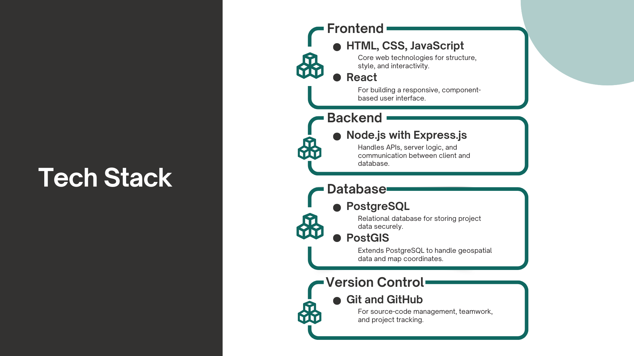

Slide 7
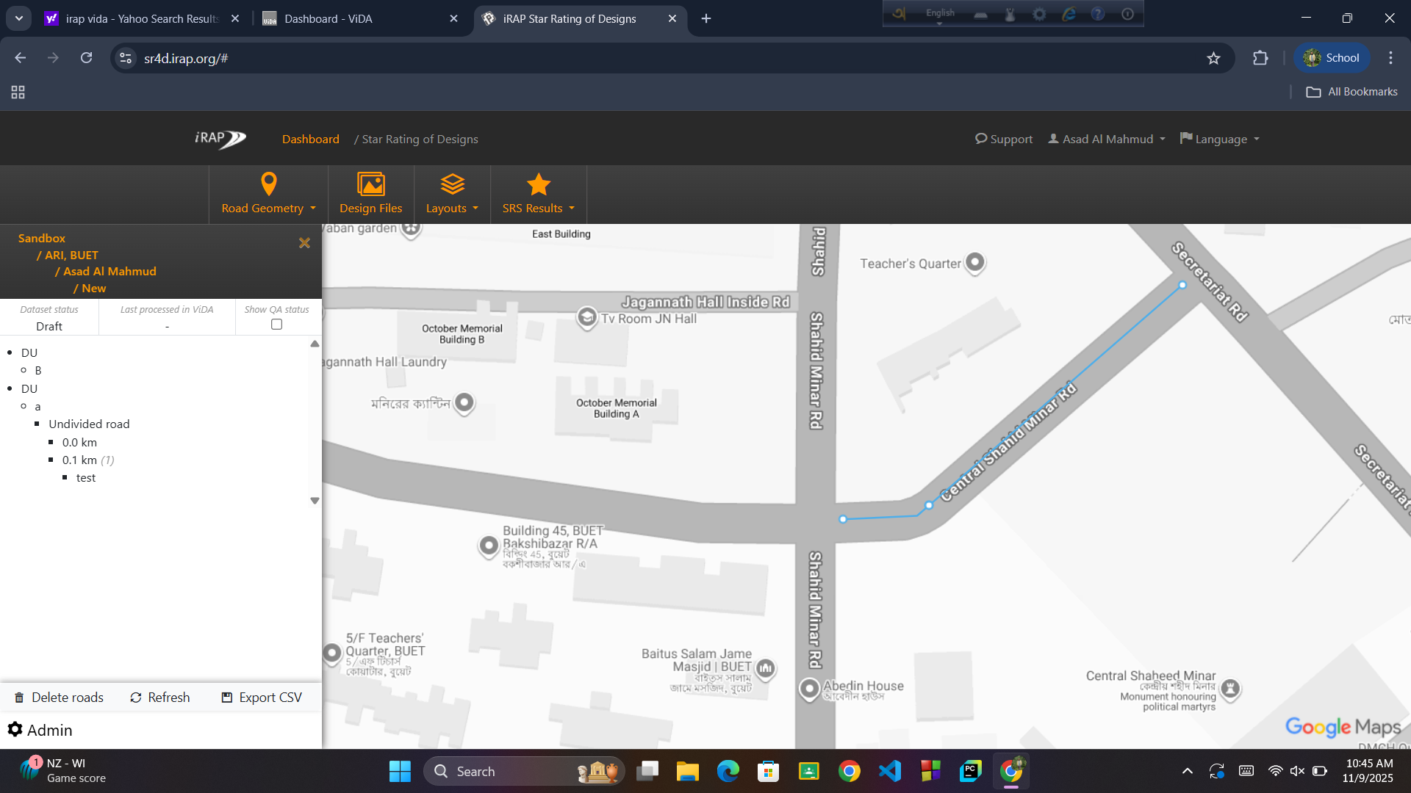
Reference Interface:

Slide 8
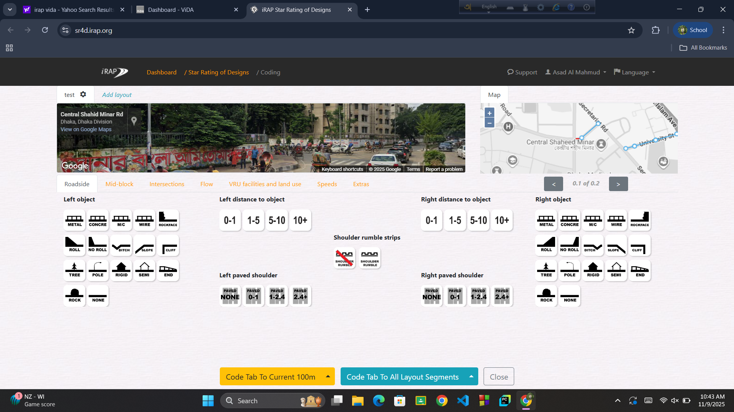

Slide 9


