Slide 1
Credit Application Prediction
Asad Ismail

Slide 2
Problem Statement
Business Objective:
Goal: Predict credit applications to foster proactive engagement.
Benefits: Enhances customer satisfaction & streamlines resource use.
ML Problem Statement:
Nature: Binary classification task.
Prediction Target: credit_application (1 = likely to apply, 0 = unlikely).
Challenges:
Data Skew: Disproportionate ratio of non-applications to applications (6.7% credit applications)

Slide 3
Exploratory Data Analysis (EDA)
Data Overview:
Period Analyzed: Jan 2014 - Aug 2016.
Sources: Two datasets - customers and credit_applications.
Dataset Details:
credit_applications: 4 fields (client_nr, yearmonth, credit_application, nr_credit_applications).
customers: 10 field (client_nr, yearmonth, total_nr_trx, nr_debit_trx, volume_debit_trx, nr_credit_trx, volume_credit_trx, min_balance, max_balance, CRG).
Data Integration:
Merge Criteria: client_nr and yearmonth.
Total Records: 29,996.
Credit Application Instances: 2,025 (6.7% of total).

Slide 4
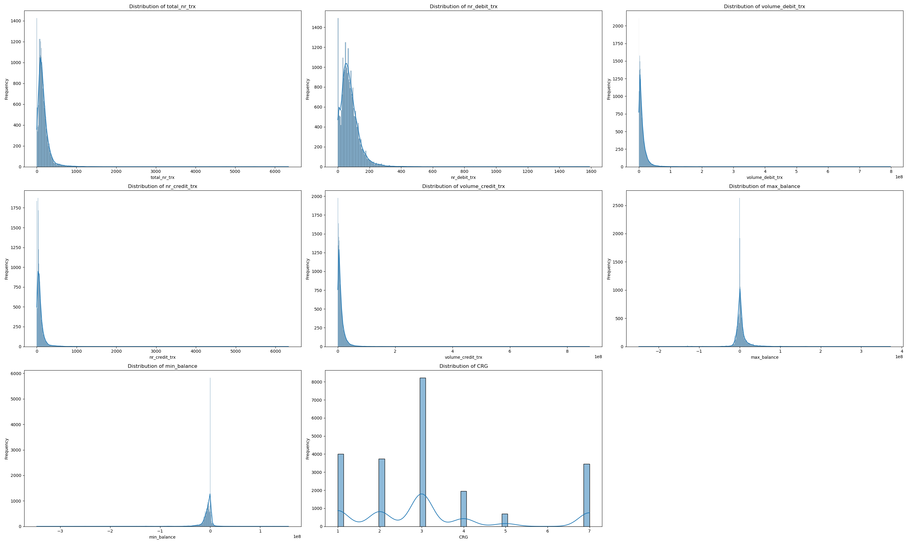
Exploratory Data Analysis (EDA)
Data Distribution of different features

Slide 5
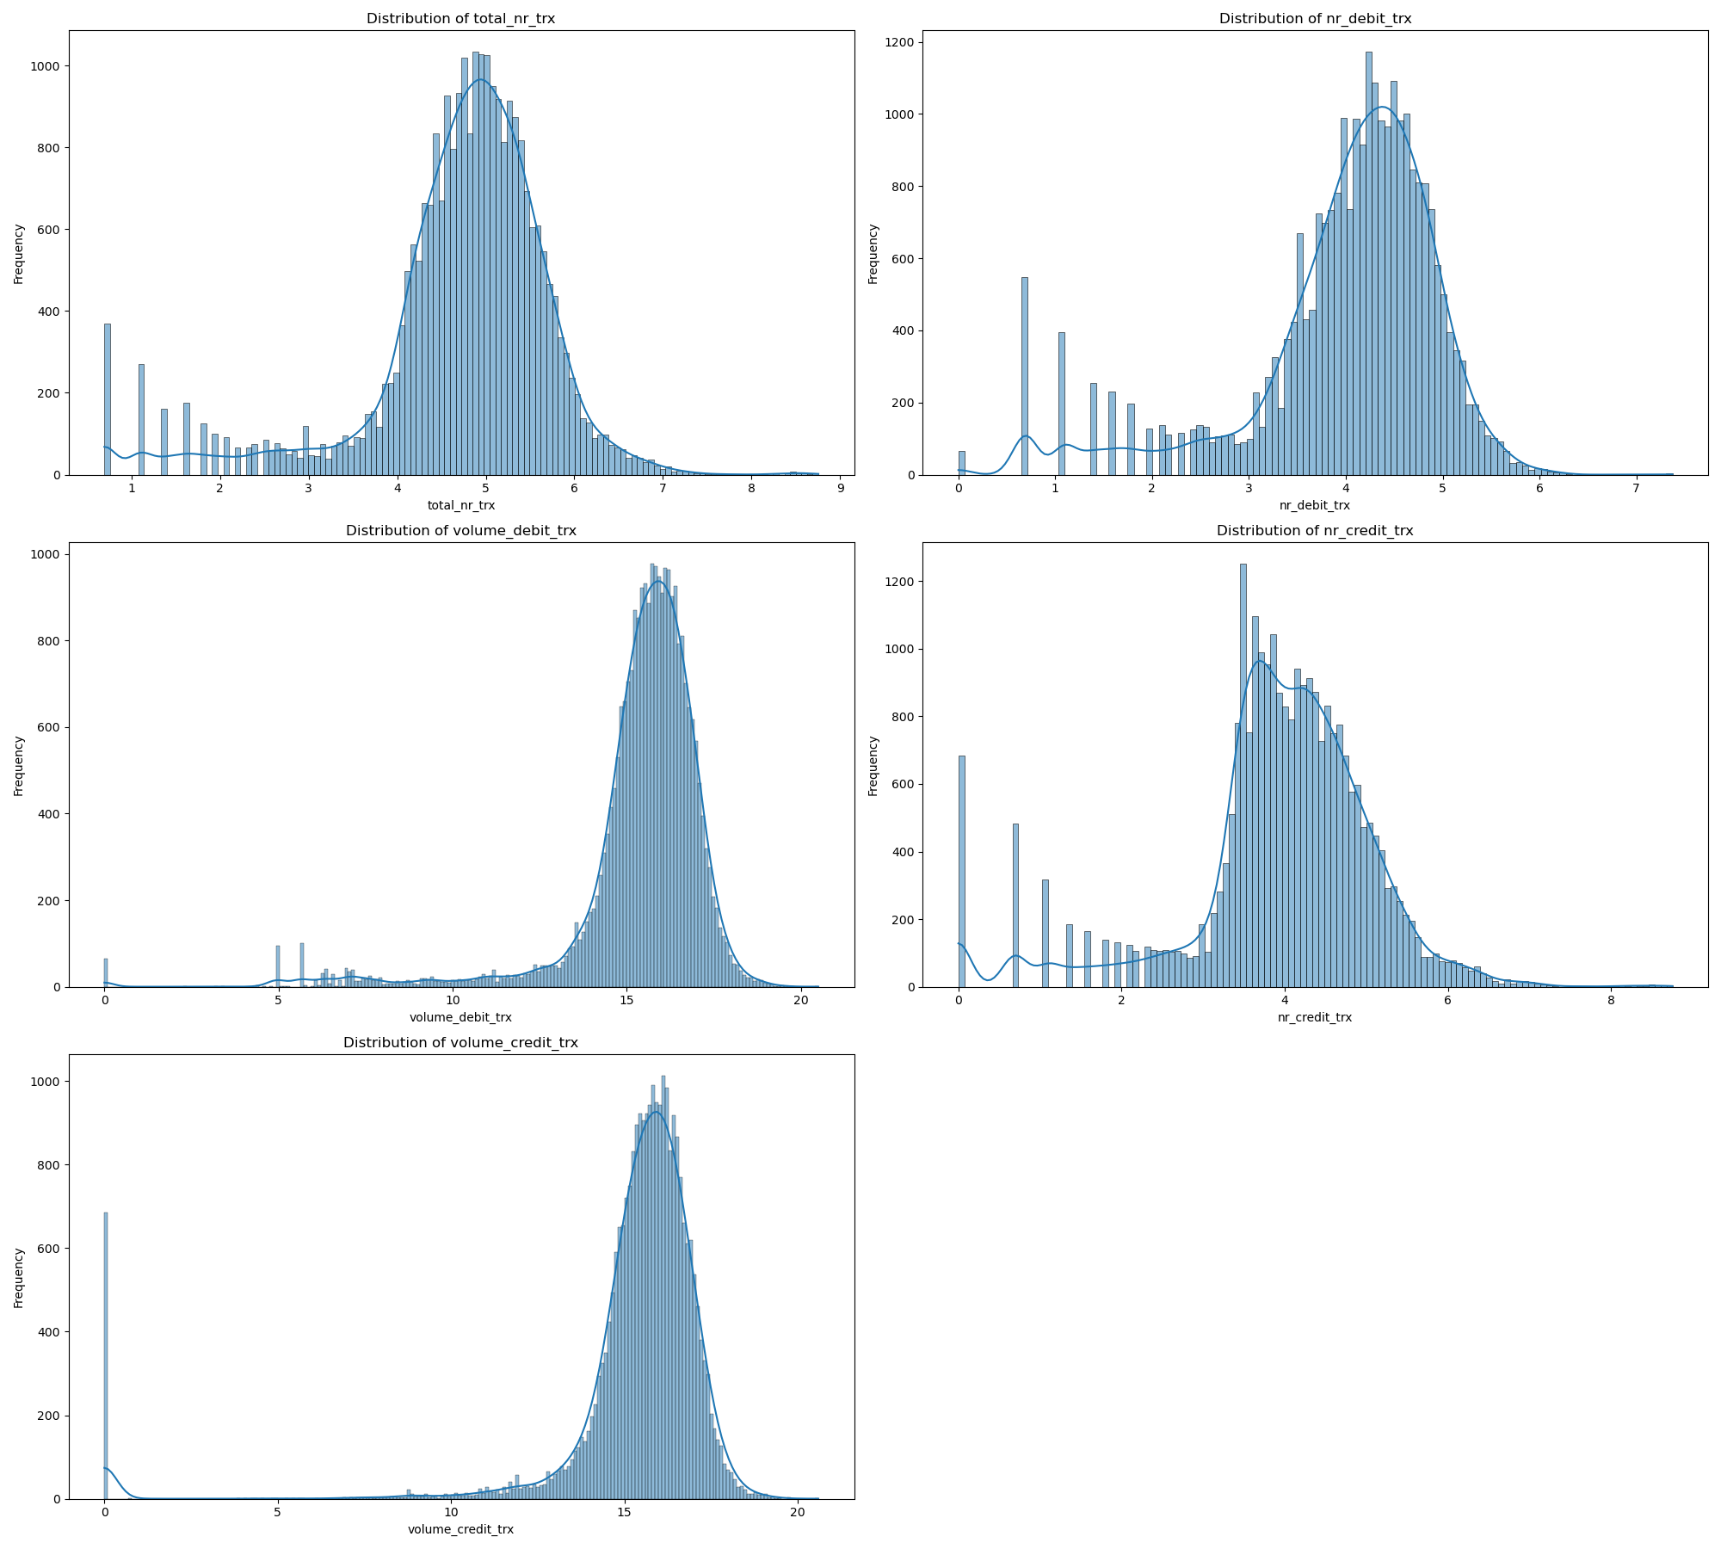
Data Preprocessing
Many features are skewed distributions and are non-negative we can apply log transformation to improve.

Slide 6
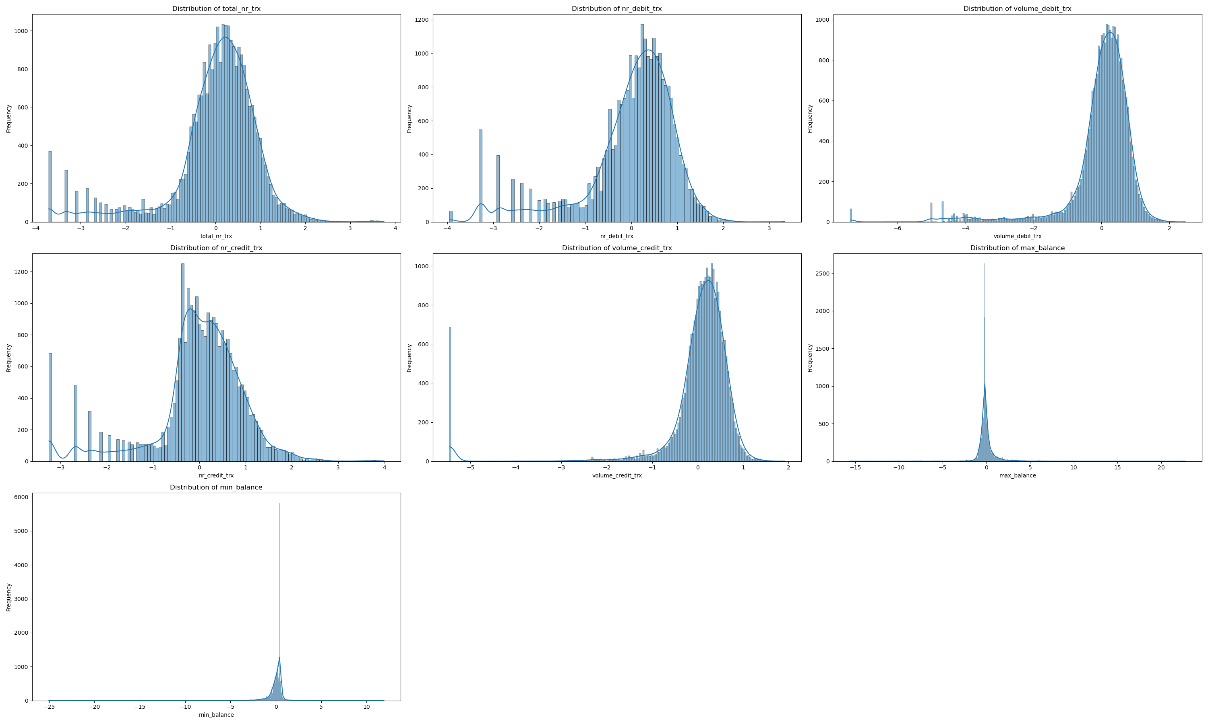
Data Preprocessing
CRG missing values are imputed
Data Scaling (standardization)

Slide 7
Data Preprocessing
Data Split:
Evaluation Set: Reserve the final three months of data per user for testing.
Split Ratio: Training and validation sets divided at 90/10%
Data Distribution:
Training Set: 93% class 0 (non-applicants), 7% class 1 (applicants).
Validation Set: 95% class 0, 5% class 1.
Data Cleaning Steps:
Feature Removal: Omit nr_credit_applications to avoid predictive bias.
Non-predictive Attributes: Discard client_nr and yearmonth from the dataset.

Slide 8
Metric selction
Considerations for Metric Selection:
Class Imbalance: Standard metrics like accuracy are misleading.
Cost of Errors: Different costs associated with false positives (FP) and false negatives (FN).
Proposed Evaluation Metrics:
Precision-Recall AUC (PR AUC): Focuses on the minority class and is sensitive to FP and FN.
Recall: Focuses on how many actual positive class were classified as positive
F1 : Harmonic mean of precision and recall, useful when seeking a balance between FP and FN.
ROC AUC: Provides an aggregate measure of performance across all classification thresholds.

Slide 9
Model Selection
Model Diversity:
Experimented with different models, including tree-based (XGBoost, Random Forest) and linear (Logistic Regression) models.
Model Strengths:
XGBoost: Handles non-linear patterns well and can automatically provide feature importance.
Random Forest: Good for avoiding overfitting and providing robustness through ensemble learning.
Logistic Regression: Offers simplicity, speed, and interpretability for linear relationships.

Slide 10
Handling Class Imbalance
Weighted Class/Loss Learning:
Assigns higher importance to the minority class during training.
Utilize class weights in the loss function to penalize misclassification of the minority class more heavily.
Oversampling (SMOTE):
Synthetic Minority Over-sampling Technique generates synthetic samples for the minority class.
Create synthetic examples of the minority class to achieve a more balanced dataset.
Undersampling:
Reduces the number of instances in the majority class to match the minority class count.
Randomly remove samples from the majority class to prevent its dominance during model training.
Weighted Class-Based Learning:
This method has shown the most promising results for the given problem.

Slide 11
Hyper Parameter Optimization
Significance of HPO:
HPO fine-tunes the model by exploring the best possible configurations.
HPO Techniques:
Grid Search:
Conducts a comprehensive search across a specified range of hyperparameter values.
Random Search:
Approach: Selects random combinations of hyperparameters to evaluate.
Selected Method: Implement Grid Search for Hyperparameter Optimization.
Justification: Ensures a thorough examination of the parameter space, which is critical for identifying the optimal model settings.
Optimization Metrics:
Primary Metric: Focus on optimizing the Precision-Recall Area Under Curve (PR AUC).

Slide 12
Hyper Parameter Optimization Results
Model | Average Precision | Recall (%) | Precision (%) | F1 Score (%) | ROC AUC (%) | Confusion Matrix
XGBoost | 0.1421 | 72.19 | 10.55 | 18.41 | 76.76 | TP: 109, FP: 924, TN: 1892, FN: 42
Random Forest | 0.1395 | 20.53 | 21.23 | 20.88 | 75.68 | TP: 31, FP: 115, TN: 2701, FN: 120
Logistic Regression | 0.1221 | 59.60 | 9.40 | 16.25 | 71.62 | TP: 90, FP: 867, TN: 1949, FN: 61

Slide 13
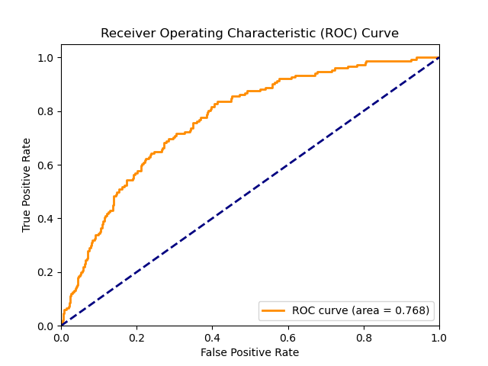
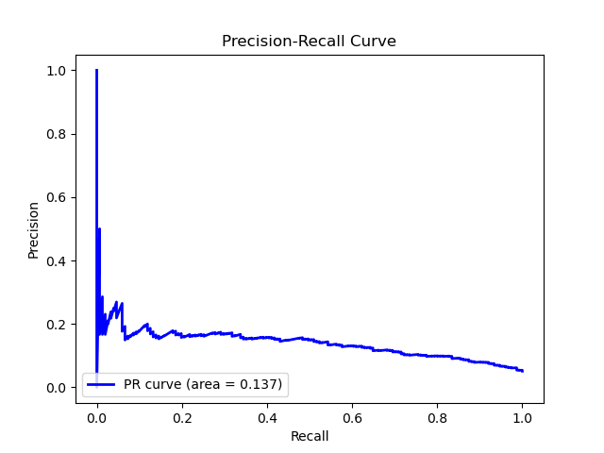
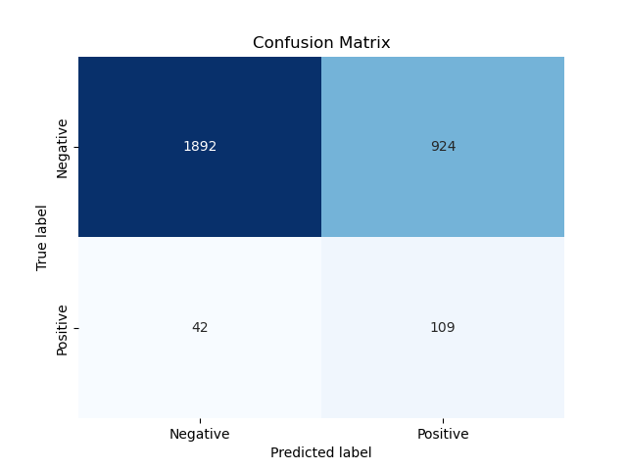
Hyper Parameter Optimization Results
XGboost

Slide 14
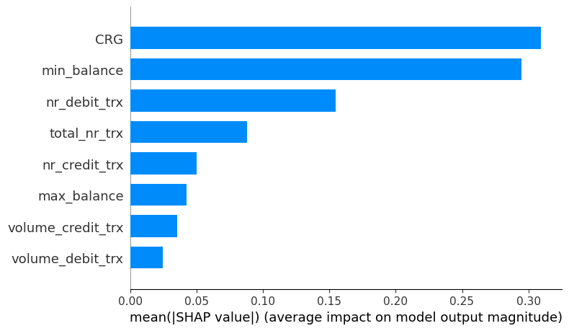
Explaibality
Role of Explainability:
To demystify model predictions and understand feature influence.
Fosters trust and facilitates model debugging by providing insights into the decision-making process.
SHAP Values (SHapley Additive exPlanations):
Offers attributions that reveal the impact of each feature on the model output.

Slide 15
Deployment
Deployment Objectives:
To provide relationship managers with timely predictions about potential credit applications.
Deployment Process:
API Development: Develop Rest API for the model to receive customer data inputs and send predictions back to the business application.
Automation: Automate the data pipeline to periodically re-train the model with new data for maintaining its performance.
Monitoring and Maintenance:
Monitor model performance over time to detect data drift or performance degradation.
Establish a re-training schedule based on the model's predictive stability and the availability of new data.

