Slide 1
MLOps Design
We will use AWS for our use case since most of the ML services offered by AWS are fully managed and can easily be scaled up and down based on traffic and requirements.
In our design we will isolate development and deployment (better they will be in separate aws accounts)
Making this seperation gives freedom for developer/ML scientist to develop their algorithms with freedom
Code for this sample pipeline can be fond in https://github.com/Asad-Ismail/ML_OPS/tree/main/aws_MLOPS

Slide 2
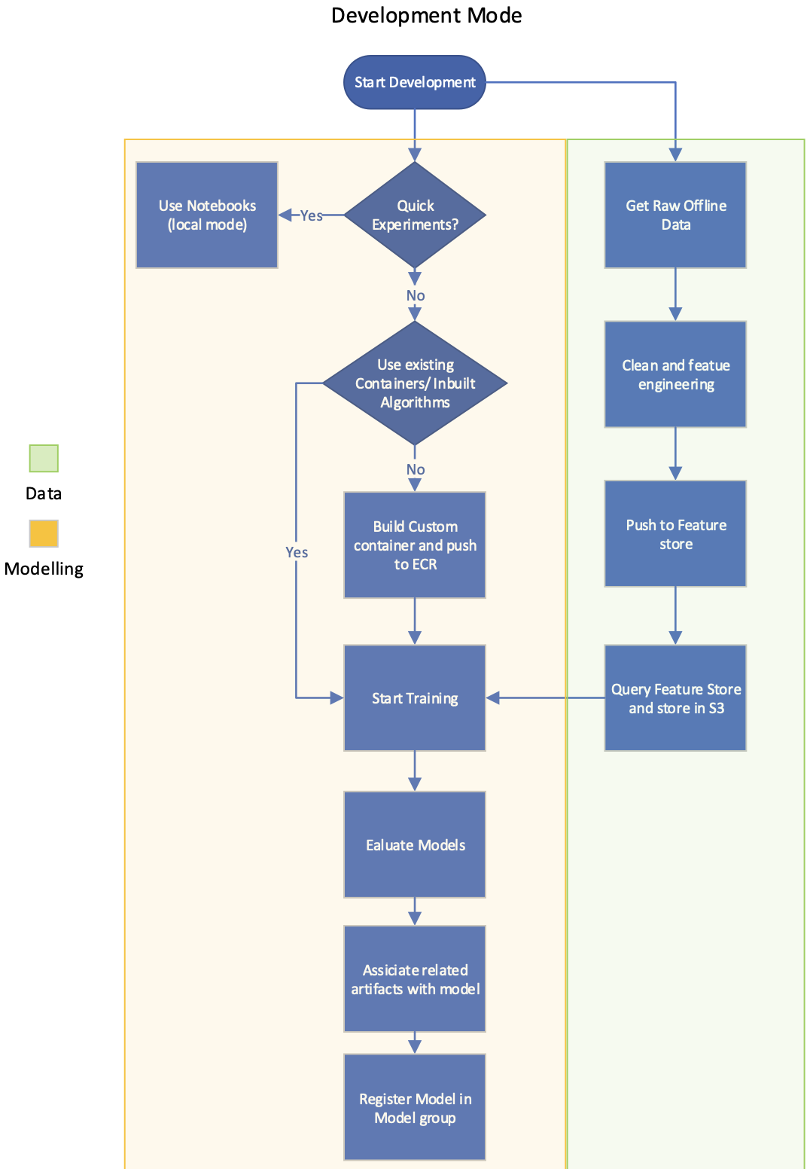
Development
Data:
Processing and storing the data in feature store alows for team members to use same data in centralized location
Feature store in offline mode for using it for training data or online mode for retrieving near realtime
Feature Store can be versioned and we can track when the data was added and modified
Modeling:
Building custom container gives the maximum freedom for developers.
Evaluating models should be more than precision/recall should also evaluate bias/fairness
If we are happy with model performance we should include all related artifacts like training data/ validation data/ HP/ Evaluation metrics for lineage tracking and reproduceability.
Register your model by creating model group to manage your models and registering your model to model group

Slide 3
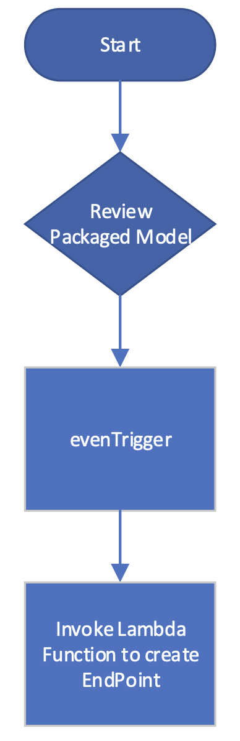
Deployment
Review the models in model group and approve the model
Model approval triggers a triggerEvent
Lambda function listening to triggerEvent receives the model and deploy the model
Model deployment donot can be in a roll out mode like canary deployment where we use the new deployed model for fraction of traffic to test model online like A/B testing

