Slide 1
AI
Key Concepts and Techniques
Asad Liaqat
03/07/2024

Slide 2
CONTENTS
01
Basic Python
02
Machine Learning
03
Deep Learning
04
CNN Architectures
05
Data Augmentation
06
Projects

Slide 3
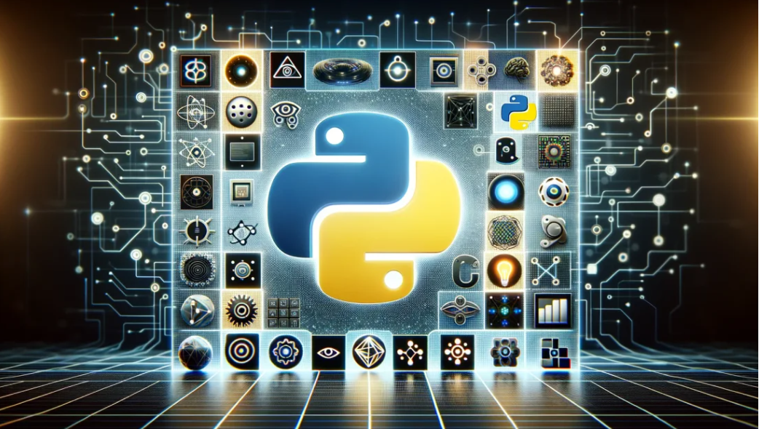
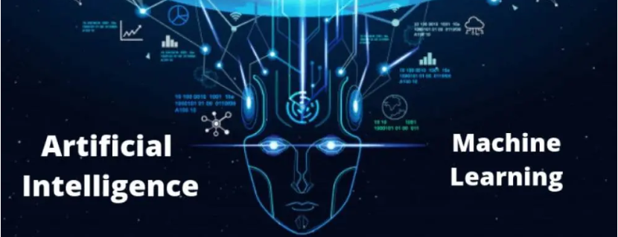
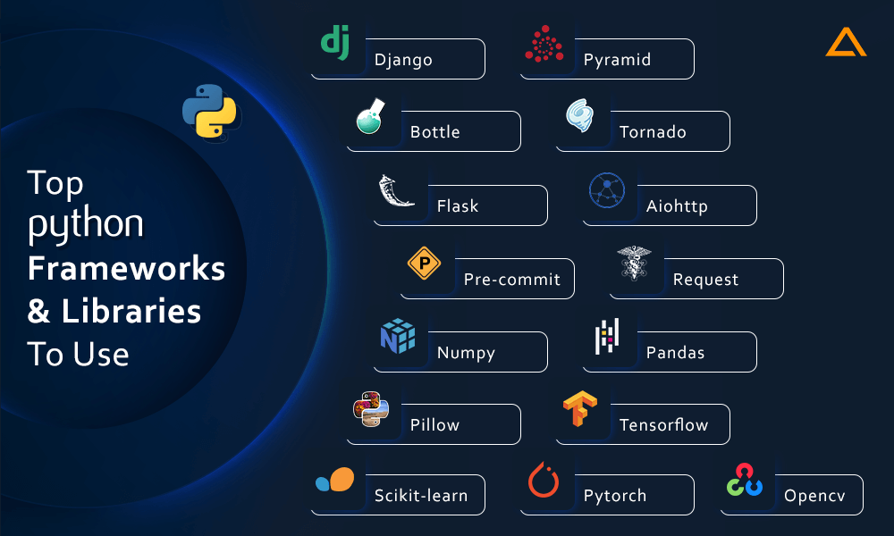
Basic Python Knowledge
Python
Importance of
AI & ML
Powerful Libraries
Guido van Rossum
Feburary 1991
Labeled Version 0.9.0

Slide 4
UnSupervised
Learning
Definition
MLP
Machine Learning
Supervised
Learning
Key Features

Slide 5
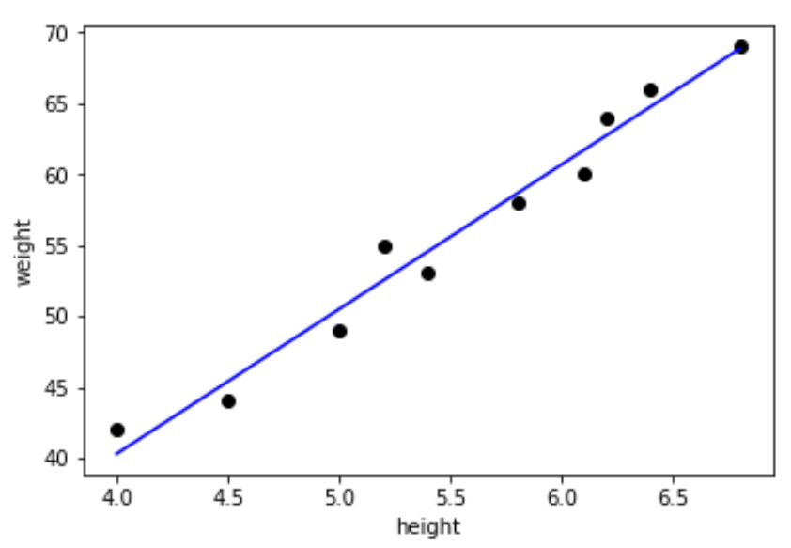
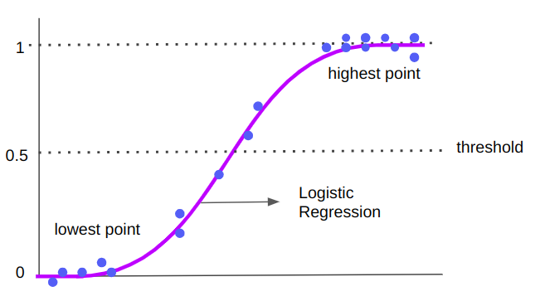
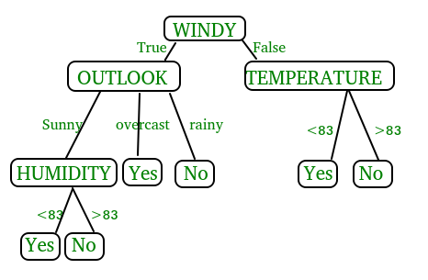
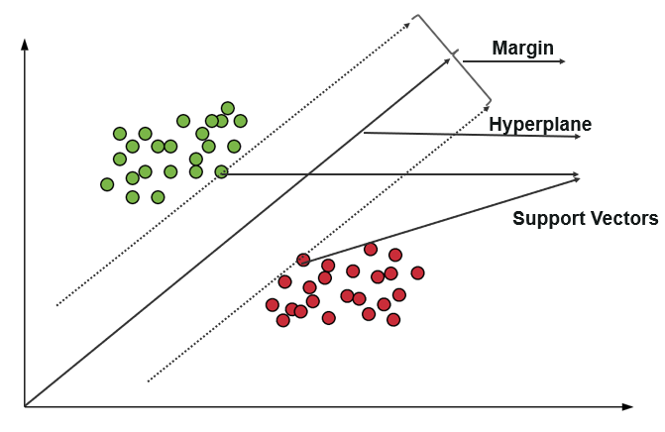
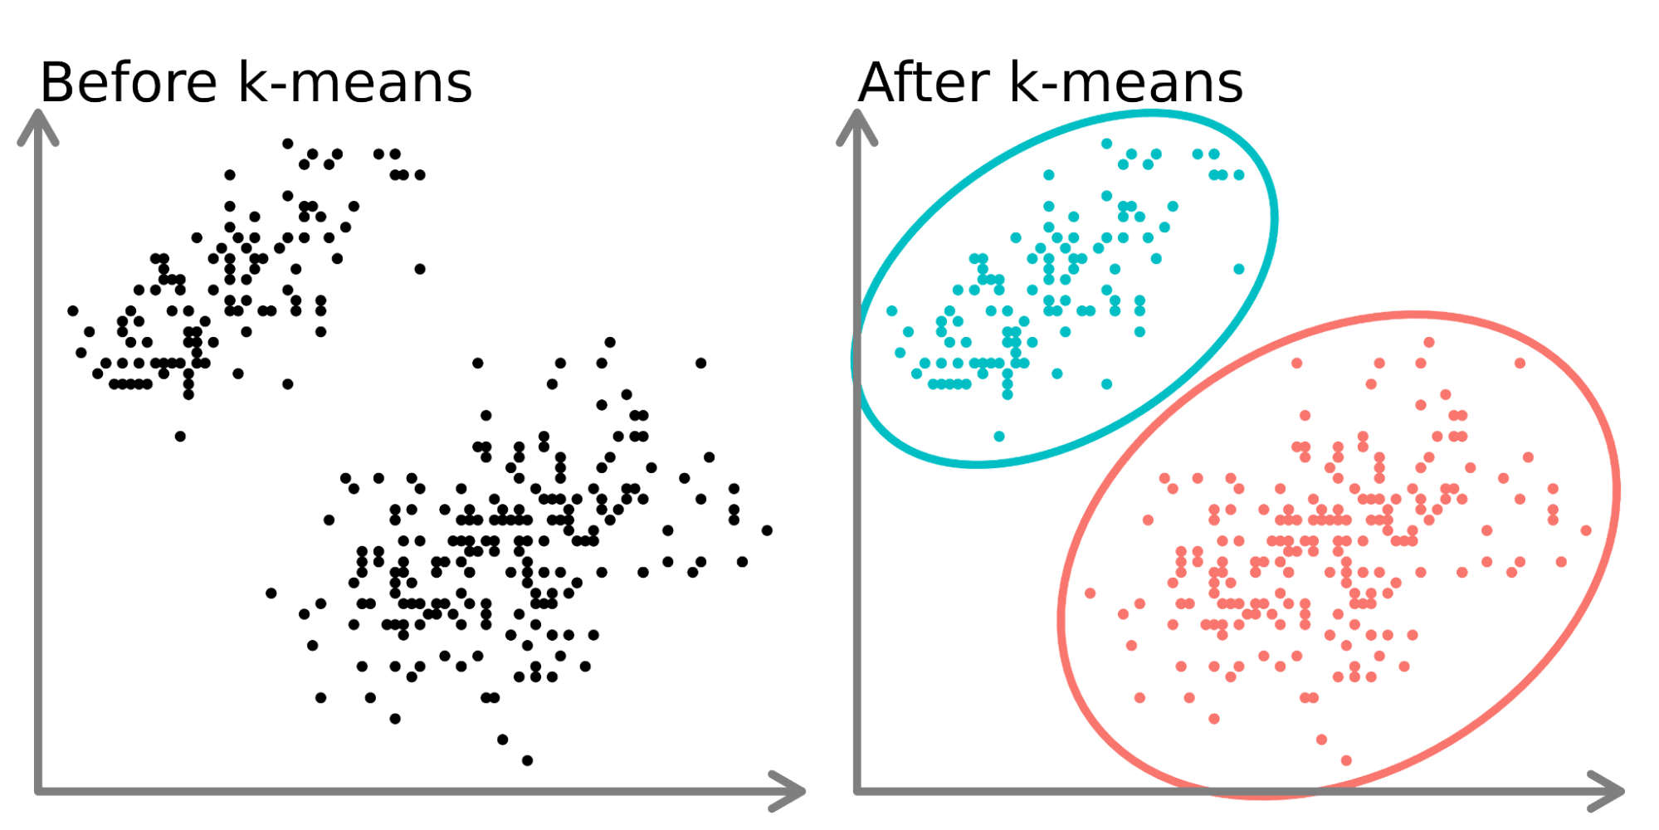
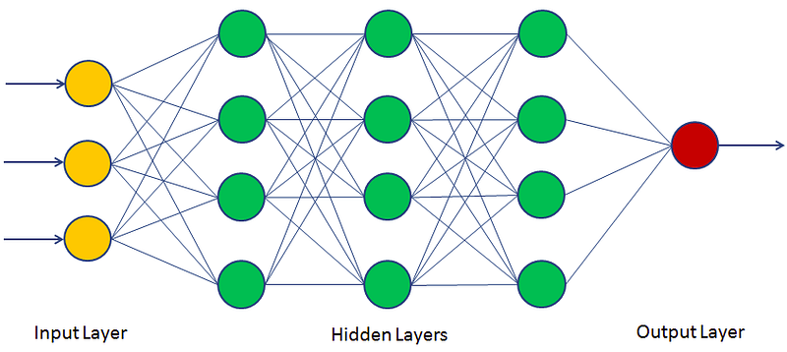
Linear Regression
Logistic Regression
Decision Trees
SVM
Clusters K-Means(UnSupervised)
MLP

Slide 6
Work Done
Data Pre-Processing
Model Training
Model Evaluation(Inference)
Classification:
Regression:
F1 Score
2*((Preciossion.Recall)/Precission+Recall))
Precission
Precision = True positives/ (True positives + False positives)
Recall
Recall = True Positive (TP) / True Positive (TP) + False Negative (FN)
MSE
SSE

Slide 7
Custom Architectures
Definition
Work Done
Deep Learning
CNN
Detection Algorithims

Slide 8
Work Done
Image Pre-Processing
CNN Model Training(Custom and Pre-Trained)
Model Evaluation(Inference)

Slide 9
Projects
House Price Prediction
Salary Prediction Based Upon Experience
Cats and Dogs Classification
Fish Classification
Face Expression Classfication
Horse, Zebra and Donkey Classification
Friuts Classification
Assisted in Annotation and Augmentation of CocaCola Company Dataset

Slide 10
THANKS
2017/5/14

