Slide 1

Automated Quantity Takeoff & BOQ System
Every feature explained in simple words
AI-assisted · the estimator stays in control · every number shows where it came from
Status: ready for a controlled live test with a real Static Group project · October 2026
Notes:
This deck walks through every part of the system in plain language. The short version: the computer reads the drawings and proposes quantities; Static Group's estimators check, correct and approve them. Nothing becomes final without a person.

Slide 2

WHY
The problem we are solving
Manual take-off is slow
An estimator measures every footing, column, beam, slab and wall by hand from dozens of drawings.
Hard to check
Numbers end up in spreadsheets. It is difficult to see later where a quantity came from.
Revisions repeat the work
When the consultant issues new drawings, much of the measuring is done again.
Know-how lives in people's heads
How Static Group measures (heights, depths, allowances) is not written down anywhere.
Management sees little
It is hard to know quickly which projects have problems or missing information.
The goal
Let the computer do the repetitive measuring, show the proof, and let estimators decide.
Static Group · Automated Quantity Takeoff & BOQ System
2
Notes:
These are the everyday pains of preparing a BOQ manually. The system targets each one, without removing the estimator from the process.

Slide 3
OVERVIEW
How it works — the whole system in one picture
Drawings
CAD files (DXF) of the project
Read
Find layers, text, tables
Recognise
Footings, columns, beams, slabs, walls
Measure
Dimensions from drawings & schedules
Calculate
Concrete, blocks, plaster…
Static Group BOQ
Your own format and wording
Estimator
Checks every line
Accept / Correct
Or reject / keep open
Rules
Approve how Static Group measures
Recalculate
Only what is affected
Audit
Who decided what, when
Export
Excel BOQ & reports
• Top row: what the computer does automatically.
• Bottom row: what the estimator does — the computer never makes these decisions.
Static Group · Automated Quantity Takeoff & BOQ System
3
Notes:
The black boxes are start and end points. The top row is automatic. The bottom row is the human control loop that makes the result trustworthy.

Slide 4
PRINCIPLES
Four promises the system keeps
1. It never guesses
If a dimension is missing, the line says 'Missing' or 'Needs Review'. It never invents a number.
2. Every number has proof
Each quantity links back to the drawing, the element, its dimensions and the formula used.
3. The estimator decides
The computer proposes. Only an estimator can accept, correct or approve a measuring rule.
4. Data stays in-house
Runs on Static Group's own computer. Drawings and BOQs are not sent to outside services.
Static Group · Automated Quantity Takeoff & BOQ System
4
Notes:
These four rules were designed in from the start. They are the reason the output can be trusted and audited.

Slide 5
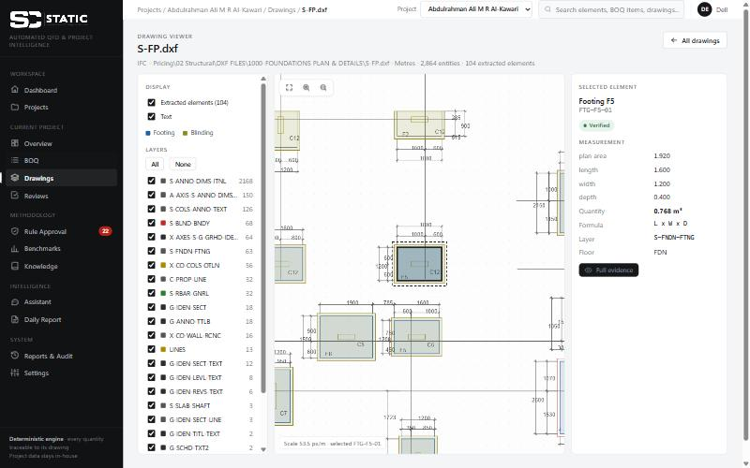
DRAWINGS
Step 1 — Reading the drawings
• Opens every CAD (DXF) file of a project — about 80 files per villa, all disciplines.
• Sorts them: structural, architectural, mechanical, electrical.
• Finds what matters on each drawing: layers, text labels, tables (schedules) and level marks.
• Keeps a drawing register: drawing number, title, revision, source file, upload time and status.
  – Numbers and titles are read from the file name and clearly marked 'parsed' so they can be checked.
  – Revisions are 'not recorded' until someone types them in from the title block — never guessed.
• Files that cannot be read are shown as failed, not hidden.
Static Group · Automated Quantity Takeoff & BOQ System
5
Notes:
The system reads the same DXF files the consultant provides. It does not need PDFs or scans. Everything it reads is listed so nothing is silently skipped.

Slide 6
MEASUREMENT
Step 2 — Recognising and measuring each element
• Finds each footing, raft, blinding, column, beam, slab, pedestal and RC wall.
• Reads its ID label (e.g. F5, C12, T.B1) and its floor.
• Takes sizes from the drawing outline and from the drawing's own schedules (tables).
• Cross-checks: does the drawn size match the schedule? If not, it flags it.
• Example — footing F5 on the foundation plan:
  – 1.60 m × 1.20 m from the outline, 0.40 m depth from the footing schedule
  – 1.60 × 1.20 × 0.40 = 0.768 m³ — with the exact drawing, layer and table row recorded
Ramzi villa
247 elements found and measured
Al-Kawari villa
377 elements found and measured
Al-Sulaiti villa
348 elements found and measured
Static Group · Automated Quantity Takeoff & BOQ System
6
Notes:
This is the core measuring engine. It is deterministic: the same drawings always give the same numbers, and every number can be traced.

Slide 7
QUANTITIES
Step 3 — Calculating the BOQ quantities
Concrete
Footings, ground beams, neck columns, slab on grade, columns & walls, beams, slabs
Blinding
Under footings (and ground beams, if Static Group measures it that way)
Earthworks
Excavation, removal, backfill — needs the natural ground level
Waterproofing
Below-ground surfaces of footings and beams
Block work & plaster
Wall areas by thickness, internal / external faces
Lintels
Over doors and windows
Manholes
Counted from drainage and electrical drawings
Tanks
From tank sizes the estimator enters
Boundary wall
From length and typical section the estimator enters
Static Group · Automated Quantity Takeoff & BOQ System
7
Notes:
Quantities that depend on a Static Group habit (for example how column height is measured) are shown as options until an estimator approves the rule.

Slide 8
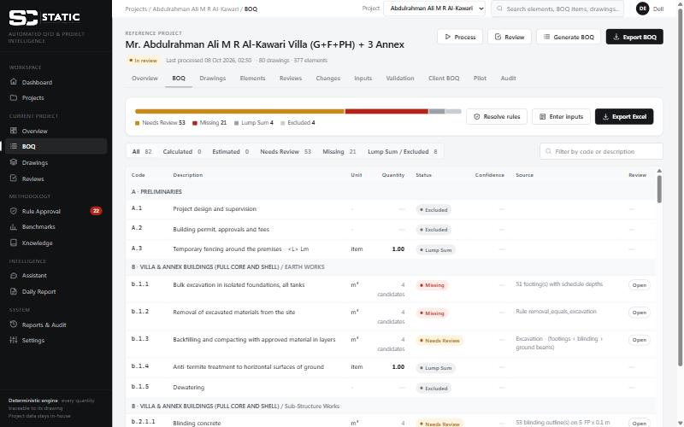
BOQ
Step 4 — The BOQ in Static Group's own format
• Same sections, codes and wording as Static Group's real BOQs (learned from Al-Kawari and Al-Sulaiti).
• 57 standard BOQ items are known to the system.
• Every line shows: code, description, unit, quantity, status, confidence, source and review state.
• Lines are never filled with a number that is not supported — blank means 'not final yet'.
• Exports to Excel in the same structure.
• If a client's BOQ has a line the system does not know, it is flagged as 'New BOQ item detected'.
Static Group · Automated Quantity Takeoff & BOQ System
8
Notes:
The output looks like a Static Group BOQ, not a generic list. The status column is the important part: it tells you how far you can trust each line.

Slide 9
STATUS
Five labels tell you how far to trust a line
Calculated
The measuring rule is confirmed by an estimator and all the information is there.
Estimated
Uses a rule learned from past projects (or a temporary assumption) that no estimator has confirmed yet.
Needs Review
A person must decide: the rule is open (several options shown) or a measured value must be checked.
Missing
Information is not in the drawings — e.g. ground level or tank sizes must be entered.
Lump Sum / Excluded
No measurement needed (e.g. preliminaries, design, permits).
Nothing moves to 'Calculated' by itself. An unknown or assumed rule can never produce a final quantity.
Static Group · Automated Quantity Takeoff & BOQ System
9
Notes:
Today, on the three reference projects, no measured line is final yet: they are waiting for the estimator's rule decisions. That is by design.

Slide 10
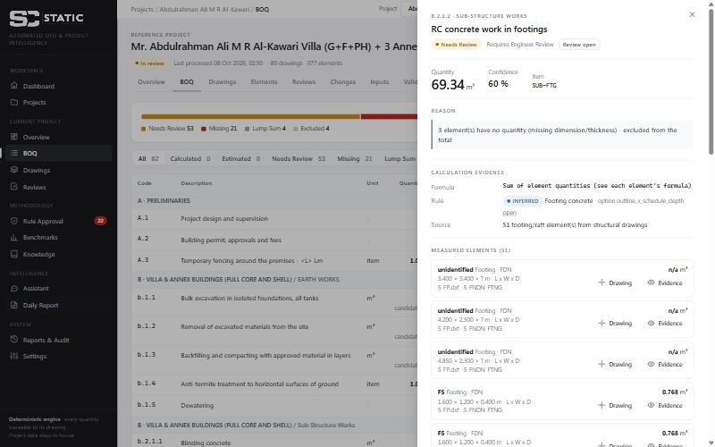
EVIDENCE PANEL
“Where did this number come from?”
• Click any BOQ line to open its evidence on the right.
• You see: the quantity, the reason for its status, the rule used, the formula and the source drawings.
• Below that: every element that was measured, with its sizes.
• Elements missing a dimension are listed first — they are why the line needs review.
• 'Drawing' opens the drawing and highlights the exact element.
Static Group · Automated Quantity Takeoff & BOQ System
10
Notes:
This is the feature estimators usually like most: nothing is a black box. Every number can be checked in seconds.

Slide 11
EVIDENCE
The drawing viewer
• Shows the real CAD drawing inside the application — zoom, pan, fit to screen.
• Measured elements are coloured by type; the selected one is outlined.
• Side panel: the element's sizes, quantity, formula and layer.
• Layers can be switched on and off.
• Opens automatically on the right element when you click 'Drawing' in the BOQ.
Static Group · Automated Quantity Takeoff & BOQ System
11
Notes:
Example on screen: footing F5 on the Al-Kawari foundation plan, 1.6 × 1.2 × 0.4 m = 0.768 m³.

Slide 12
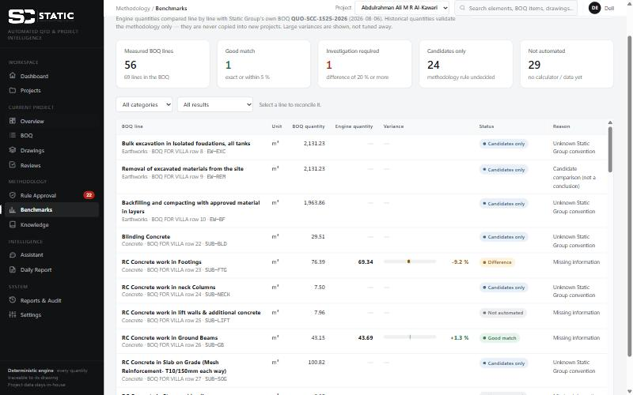
BENCHMARK
Learning from Static Group's past projects
• Al-Kawari and Al-Sulaiti have drawings AND Static Group's own priced BOQ.
• The system measures those drawings itself and compares, line by line, with Static Group's figures.
• The goal is not to copy old numbers — it is to discover how Static Group measures.
• Big differences are shown, not hidden or 'tuned away'. Examples today:
  – Al-Kawari ground beams +1.2 % (good match) · Al-Sulaiti footings −4.4 % (good match)
  – Al-Kawari footings −9.2 % · Al-Sulaiti ground beams −90.5 % (tie-beam depths not readable — under investigation)
• Each line explains 'why is this different?' using data only.
Static Group · Automated Quantity Takeoff & BOQ System
12
Notes:
The benchmark is evidence for investigation. Where the drawings are clear and the method matches, the system lands close to Static Group's figures.

Slide 13
METHODOLOGY — TURNING HABITS INTO WRITTEN RULES
The 22 measuring rules
• Some Static Group practices are not written down. Examples:
  – How is column height measured — floor to floor, or to the underside of the slab?
  – Is beam depth measured full, or below the slab?
  – How far does blinding project beyond the concrete?
  – How much working space is added around excavation?
• The system lists these as 22 rules. Each rule has a status:
CONFIRMED · 0
Approved by an estimator
INFERRED · 3
Seen in past projects, not yet confirmed
ASSUMED · 1
Temporary assumption (storey level)
UNKNOWN · 18
Not decided — options shown, no value chosen
Static Group · Automated Quantity Takeoff & BOQ System
13
Notes:
This is the single most important input Static Group can give: an estimator spending about an hour deciding these 22 rules.

Slide 14
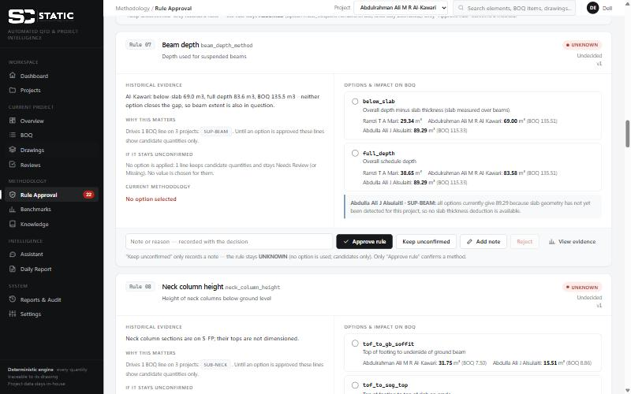
METHODOLOGY
The Rule Approval screen
• One card per rule: the question, the evidence from past projects and why it matters.
• Each option shows the quantity it would give on every project, next to Static Group's real figure.
• Buttons: Approve rule · Keep unconfirmed (only adds a note) · Add note · Reject / Reopen · View evidence.
• Approving asks for confirmation, then recalculates only the projects that use the rule.
• If options give the same number on a project, the card explains why (e.g. no slabs detected on Al-Sulaiti).
Static Group · Automated Quantity Takeoff & BOQ System
14
Notes:
The system never selects an option itself. It shows the consequences of each choice so the estimator can decide quickly and confidently.

Slide 15
TRACEABILITY
Validation sessions — who decided what, and when
• The estimator starts a 'validation session' with their name before reviewing.
• Every decision in that session is tagged to it: rules confirmed, rejected or kept open, and BOQ line decisions.
• Finishing the session freezes a summary: what was reviewed, what changed, which projects were recalculated.
• A session started by mistake can be cancelled — decisions already made are kept, nothing is erased.
• Only one session can be open at a time.
Static Group · Automated Quantity Takeoff & BOQ System
15
Notes:
Sessions make the validation traceable: later you can show exactly which estimator confirmed which rule, and what it changed.

Slide 16
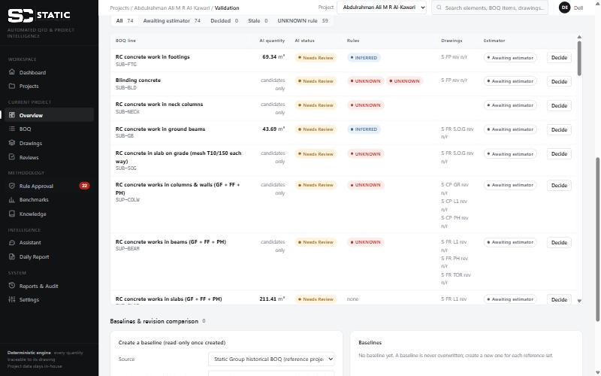
VALIDATION — ACCEPT, CORRECT, REJECT OR KEEP OPEN
Checking every BOQ line
ACCEPT
Approves the computer's quantity. Not possible when there is no computer quantity (e.g. rule still unknown).
CORRECT
The estimator types the right quantity and a short reason. The system stores both numbers and the difference.
REJECT
The proposal is wrong. A reason is required. No quantity is kept.
KEEP UNCONFIRMED
Not decided yet. Nothing becomes final.
Static Group · Automated Quantity Takeoff & BOQ System
16
Notes:
Important: a correction never changes the measuring rule by itself. It becomes evidence that helps the estimator decide the rule later.

Slide 17
REVISIONS
Baselines and drawing revisions
• A baseline is a frozen set of quantities to compare against:
  – Static Group's existing BOQ, an imported client BOQ, or quantities the estimator approved.
  – Once saved it can never be changed — each baseline keeps its revision, source and date.
• When new drawings arrive, the system compares the baseline with the new result, line by line:
  – baseline quantity · new quantity · difference · estimator's quantity · status · rule · drawing revision
  – Clearly lists what was ADDED, OMITTED, CHANGED, or cannot be compared yet.
• If the computer's quantity changes after a decision, that decision is marked 'stale' and must be re-checked.
• Honest status: built and tested, but not yet validated on a real revised drawing set.
Static Group · Automated Quantity Takeoff & BOQ System
17
Notes:
Revision handling is where automation can save the most time later. It still needs one real revised drawing set to prove itself.

Slide 18
INPUTS
Information the drawings cannot give
• Some figures are not in the CAD files in a readable form. The estimator enters them once per project:
  – Natural ground level (needed for excavation and backfill)
  – Tank sizes (length, width, height, wall / base / cover thickness)
  – Boundary wall length and typical section
• Everything entered is labelled 'User input' on the quantities it affects and is recorded in the audit trail.
• If a value is not known, leave it empty — the lines stay 'Missing'. The system never fills the gap itself.
Static Group · Automated Quantity Takeoff & BOQ System
18
Notes:
Today these inputs are missing on all three reference projects, which is why those lines show as Missing.

Slide 19
REVIEW
The review queue — the engineer's to-do list
• Collects everything that needs a person, in priority order:
  – 1. Missing dimensions 2. Drawing conflicts 3. Missing project inputs
  – 4. Large differences from past BOQs 5. Unconfirmed measuring rules 6. Other checks
• Each item shows the problem, the element, the reason, the evidence and the impact.
• Actions: Approve · Resolve · Reject · Reopen — and Correct where a value can be entered (e.g. slab thickness).
• Every action is recorded with name, date and comment.
Static Group · Automated Quantity Takeoff & BOQ System
19
Notes:
Examples of review items: a beam with no depth in the schedule, a label that matches two marks, a slab without a thickness.

Slide 20
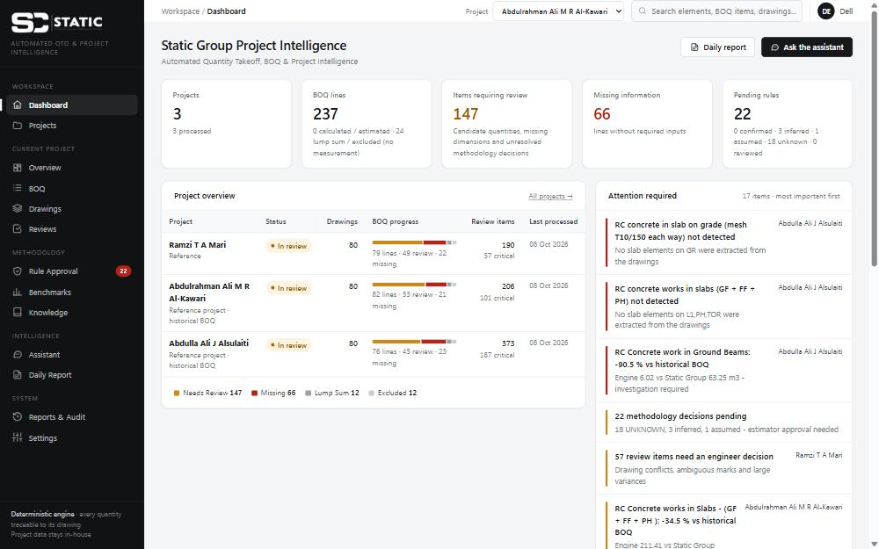
MANAGEMENT — THE WHOLE PICTURE IN 30 SECONDS
Management dashboard
• Real figures only: projects, BOQ lines, items requiring review, missing information, pending rules.
• Project overview with a progress bar for each project.
• 'Attention required' list, most important first.
• 'Automation readiness' table: why quantities are not final yet — no fake percentages.
• Time or cost savings are deliberately not shown until they are measured.
Static Group · Automated Quantity Takeoff & BOQ System
20
Notes:
Current figures: 3 projects, 237 BOQ lines, 147 items requiring review, 66 missing information, 22 pending rules.

Slide 21
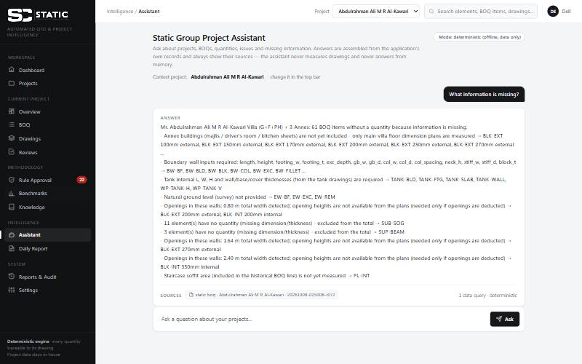
INTELLIGENCE
The project assistant (AI)
• Ask questions in plain English, for example:
  – Which projects need attention? · What information is missing?
  – Why is beam concrete different? · Which BOQ items need review? · What changed?
• Answers come only from the application's own data — with the sources listed underneath.
• It never measures drawings and never answers from general memory.
• If it cannot answer from the data, it says so instead of guessing.
• Works offline by default; no project data leaves the computer.
Static Group · Automated Quantity Takeoff & BOQ System
21
Notes:
The AI helps people find and understand information. It does not calculate quantities and does not make decisions.

Slide 22
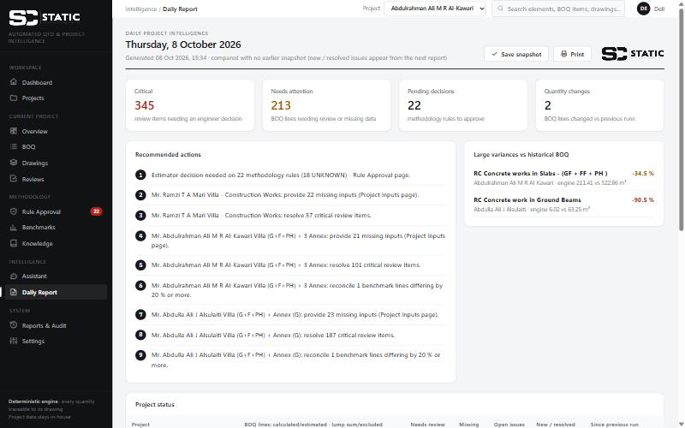
INTELLIGENCE
Daily management report
• One page, readable in under a minute:
  – critical items · items needing attention · pending decisions · quantity changes
  – recommended actions, large differences from past BOQs, missing information per project
• Can be saved as a snapshot each day, so new and resolved issues are shown the next day.
• Can be printed, or produced automatically every morning on a schedule.
Static Group · Automated Quantity Takeoff & BOQ System
22
Notes:
No e-mail or Teams delivery is connected yet; that would need Static Group's approval of where project data may go.

Slide 23
PILOT RECORD
Measuring the real value
• For the first live project we record, side by side:
  – Manual: take-off hours, BOQ preparation hours, review hours, missing items found, corrections
  – System: processing time, calculation time, BOQ generation time, estimator review hours
  – Quantities: manual vs system for chosen BOQ items
  – Estimator decisions: accepted, corrected, rejected, still open — and the size of corrections
• A difference is only shown when both numbers exist.
• No accuracy %, savings or ROI are claimed until real estimator data proves them.
• All early figures are clearly labelled 'Preliminary'.
Static Group · Automated Quantity Takeoff & BOQ System
23
Notes:
This is how Static Group will get an honest business case: from its own estimators' numbers on a real tender.

Slide 24
CONTROL
Audit trail and data safety
Everything is recorded
Rule decisions, line decisions, inputs, corrections, review actions, exports — with name, date, comment and before/after values.
Nothing is overwritten
Baselines are frozen. Old processing runs are kept. Rejected or reopened rules keep their history.
Stays in-house
Runs on Static Group's computer. Drawings and BOQs are not sent to outside services.
Test data separated
Test projects are archived: kept on disk, but excluded from dashboards, reports and the assistant.
Static Group · Automated Quantity Takeoff & BOQ System
24
Notes:
For every number in a BOQ you can answer: which drawing, which rule, who approved it and when.

Slide 25
STATUS
Where we are today
3 reference projects
Ramzi, Al-Kawari, Al-Sulaiti — about 80 drawings each, all processed
237 BOQ lines
79 · 82 · 76 lines. 24 lump sum / excluded. No measured line is final yet — by design.
22 measuring rules
18 unknown · 3 inferred · 1 assumed · 0 confirmed — waiting for the estimator
Best matches so far
Al-Kawari ground beams +1.2 %, Al-Sulaiti footings −4.4 %
Known gaps
Annex buildings, parapets, door/window sizes, Al-Sulaiti slab boundaries and tie-beam depths
Quality checks
105 automatic tests passing; screens checked on desktop sizes; production data untouched by testing
Static Group · Automated Quantity Takeoff & BOQ System
25
Notes:
The honest summary: the machinery is built and tested. What remains is Static Group's own knowledge and a real project.

Slide 26
NEXT
What we need from Static Group
• About one hour of an estimator's time to decide the 22 measuring rules.
• One real, unseen tender project: its drawing set (DXF) and, if available, the existing BOQ.
• Drawing revision letters from the title blocks.
• Ground level, tank sizes and boundary-wall section for that project.
• A manual take-off of the same project (with hours) to compare against.
• Later: a revised drawing set, to prove the revision comparison.
Static Group · Automated Quantity Takeoff & BOQ System
26
Notes:
None of these can be produced by the system — they are Static Group's knowledge and data.

Slide 27
NEXT
The first live test — step by step
1. New project
Upload drawings & BOQ
2. Process
Read & measure
3. Register
Enter revisions & inputs
4. Baseline
Freeze the existing BOQ
5. Session
Estimator starts session
6. Rules
Decide the 22 rules
7. Lines
Accept / correct / reject / keep
8. Pilot
Enter manual hours & quantities
9. Compare
Baseline vs system
10. Finish
Close session, export BOQ & audit
• Capture: decision counts, size of corrections, missing information found, time spent — manual and automated.
Static Group · Automated Quantity Takeoff & BOQ System
27
Notes:
The whole test stays under the estimator's control. The output is a measured, honest comparison.

Slide 28
Status
Ready for a controlled live test with a real project
Not yet ready for unsupervised production use, because:
• the 22 measuring rules still need an estimator's decision
• project inputs (ground level, tanks, boundary wall) and drawing revisions are still missing
• some extraction gaps remain, and revision comparison is not yet proven on real revised drawings
• no real manual-vs-system comparison has been measured yet
The computer proposes. The estimator decides. Every number shows its proof.
Notes:
Close by asking for the two things that unlock the next step: an estimator's hour for the rules, and a real tender project.

