Slide 1
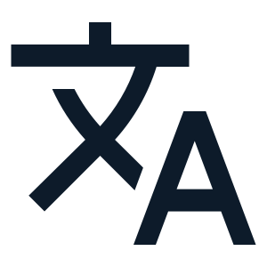
OmniLingo
(English or Urdu to Doogri Translator)
Name: Asad Haroon
ID : CND-02267072
AI-based Machine Translation System
Converts user input into Dogri language using Urdu script
NAVTTC Project — NLP & Deep Learning

Slide 2
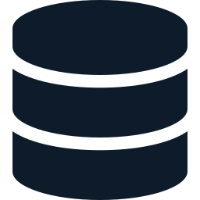
Dataset (Self Created)
1,000
200
JSON
Training Pairs
Testing Pairs
Format
Input / Output
Focus Areas
Input: English / Urdu sentence
Output: Dogri sentence (Urdu script)
Dataset stored in JSON format
Daily conversation
Simple grammar
Short sentences

Slide 3
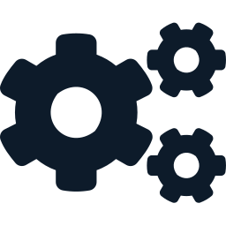
Algorithm
Input
Sentence
Encoder
(LSTM)
Context
Vector
Decoder
(LSTM)
Dogri Output
(Urdu Script)
Seq2Seq Architecture
Model Type
Improvement
Tools
Sequence-to-Sequence (Seq2Seq)
Optional Attention Mechanism
TensorFlow / PyTorch

Slide 4
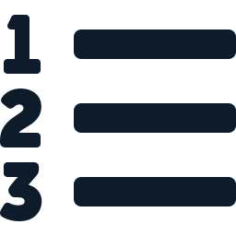
Project Methodology
1
2
3
4
Problem
Definition
Dataset
Creation
Data
Preprocessing
Text → Numeric
Encoding
5
6
7
8
Model
Building
Model
Training
Evaluation
on Test Data
Output
Generation
Key Details
Preprocessing: tokenization + cleaning
Dataset: 1,000 training + 200 testing sentence pairs
Output: Dogri text in Urdu script

Slide 5

Benefits of Project
🌐
Language Preservation
💬
Communication Bridge
🤖
AI & NLP Application
Preserves and digitizes the Dogri language
Helps communication between language communities
Practical implementation of AI and NLP concepts
📱
Mobile / Web Ready
🗣️
Regional Tech Support
🚀
Foundation System
Extendable to mobile and web applications
Supports regional language technology development
Foundation for advanced translation systems

Slide 6
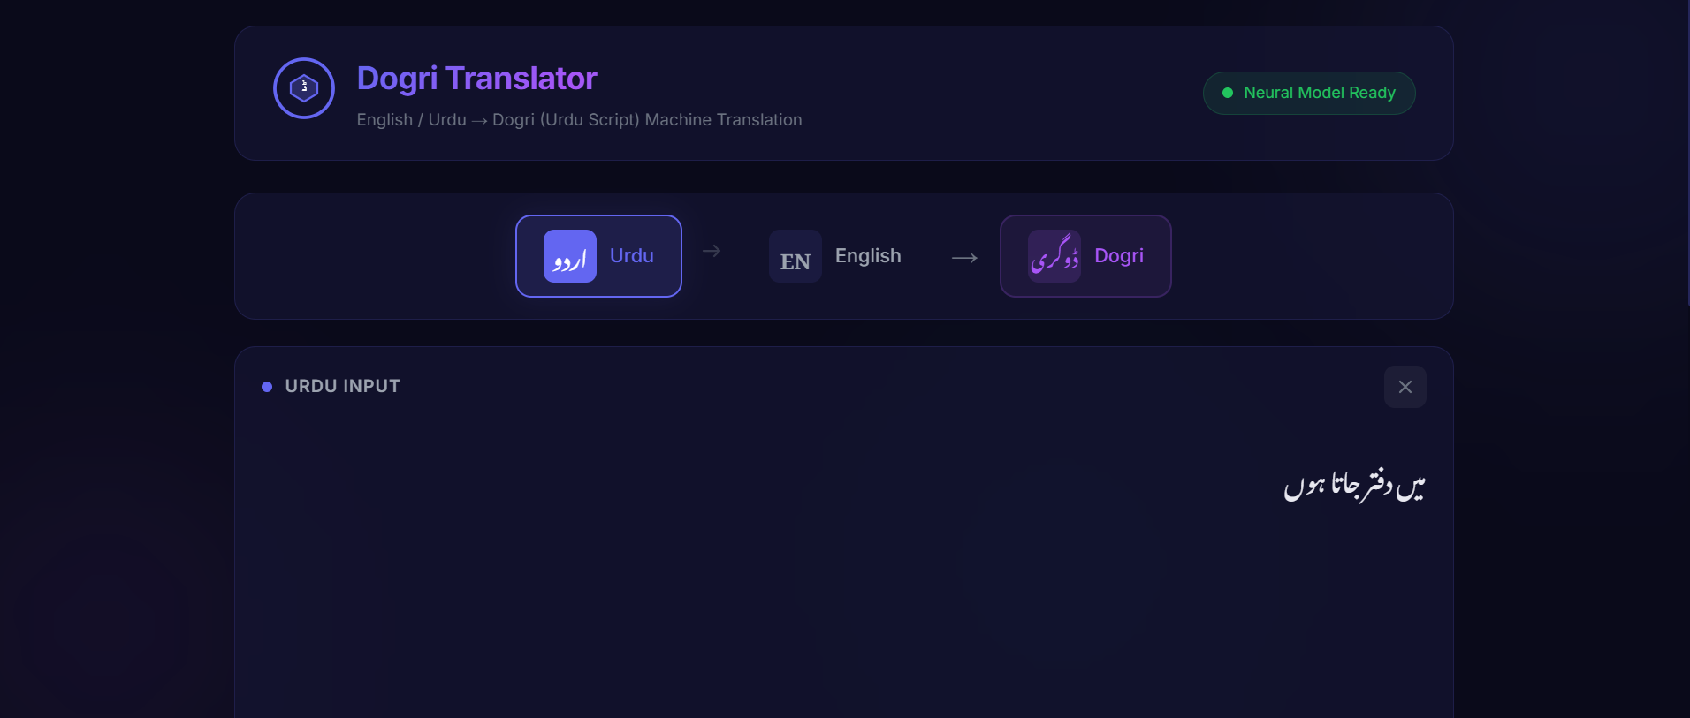
Outputs

Slide 7
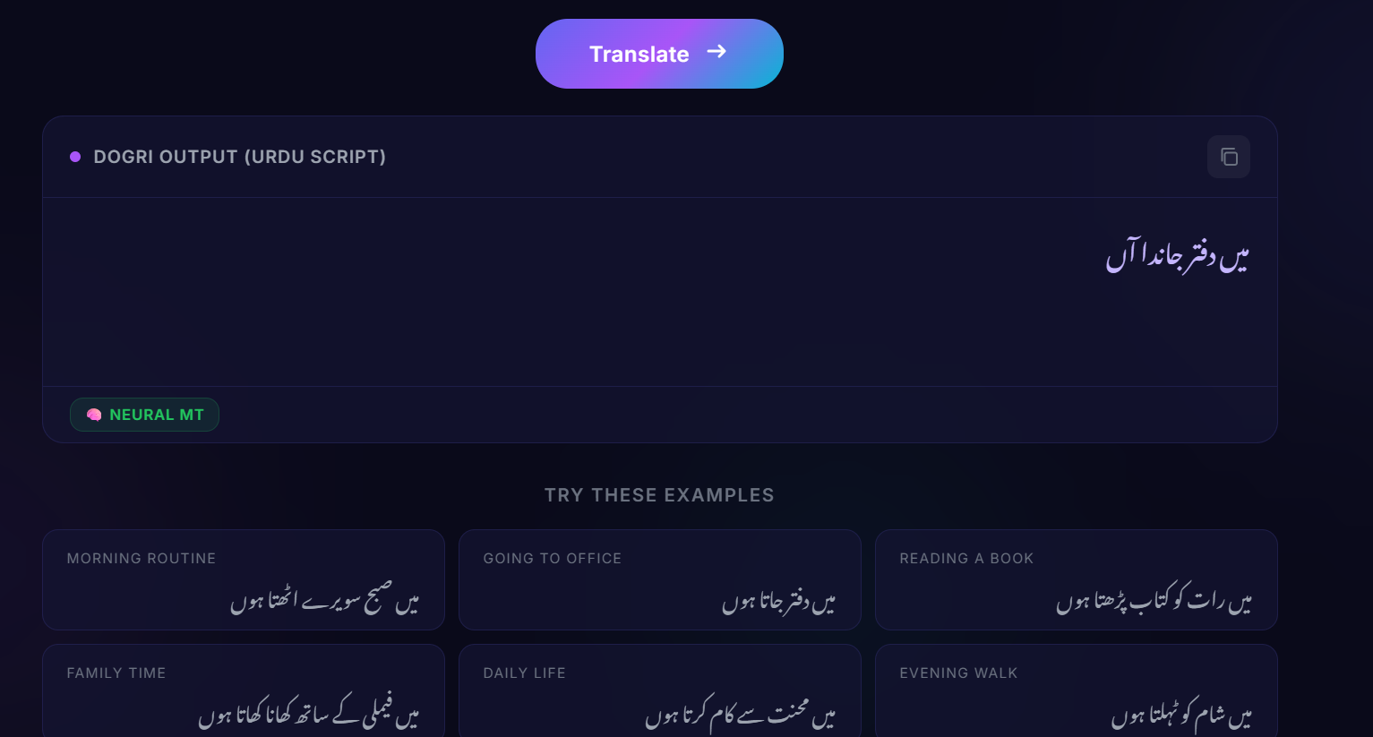
Outputs

