Slide 1
Script2Screen
Automating explainer video creation with AI

Slide 2
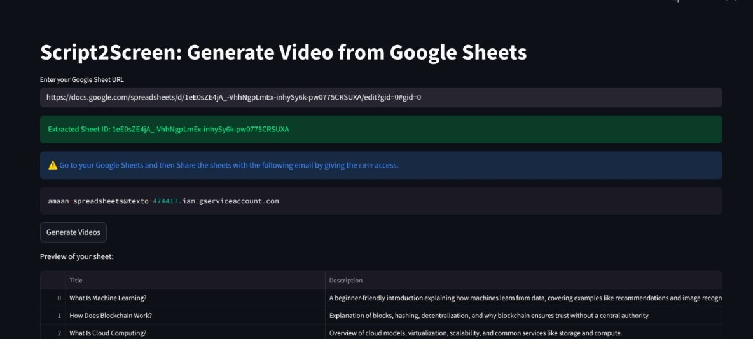
Group Members
Asad Naseer Awan
Malik Muhammad Aman
Muhammad Moosa
Ramesh Kumar
Rafia Banu
Ali Abbas

Slide 3
Problem Statement
Manual video creation is time‑consuming
Requires script writing, voice recording, slide design, editing
Difficult to scale for multiple topics
Need: Automated pipeline from structured data → finished video

Slide 4
Solution Overview
A lightweight automation tool built with Streamlit
Input: Google Sheet (Title + Description)
Output: 3‑minute explainer video (MP4)
Features: narration, slides, diagrams, multiple aspect ratios

Slide 5
Workflow
Data Input → Google Sheet rows (Title, Description)
Script Generation → LLM (TinyLlama / Gemma‑2B) creates structured script
Visual Design → Auto‑generated slides (colors, typography, diagrams)
Voice Narration → Hugging Face TTS synthesizes audio
Video Assembly → MoviePy merges slides + narration
Output → Downloadable MP4 (YouTube, TikTok, Instagram formats)

Slide 6
Streamlit App (Code Demo)
Features in app.py:
Input Google Sheet URL
Extract Sheet ID automatically
Preview sheet data in app
Step‑by‑step progress bars:
  Script generation
  Audio narration
  Video assembly

Slide 7
Technical Stack
Frontend: Streamlit
Backend: Python
AI Models: TinyLlama / Gemma‑2B (script), Hugging Face TTS (voice)
Video Engine: MoviePy
Data Source: Google Sheets API

Slide 8

Output Examples
Explainer video with:
  Narration voiceover
  Color‑themed slides
  Captions + diagrams
Export formats:
  YouTube (16:9)
  TikTok (9:16)
  Instagram (1:1)
Visual: Mockup of video frames in different aspect ratios

Slide 9
Benefits
End‑to‑end automation
Saves time and effort
Scalable for multiple topics
Easy to use (just a Google Sheet)
Ready for social media publishing

Slide 10
Future Enhancements
Karaoke‑style text highlighting with narration
More voice options (multi‑language, accents)
Advanced slide templates
Cloud deployment ( Azure)
.

Slide 11
Thank you
asad

