Slide 1


Software Development Project-I
Welcome To Our Project Presentation

Slide 2
Software Development Project-I
Calendar Using C Programming
Presented By
Supervisor
S. M. Shamim
Assistant Professor
Dept. of ICT
MBSTU
Software Development Project -I
Course code: ICT-1210
Name: Md. Asadul Islam
ID: IT-20049
Name: Emu Bhuiyan
ID: IT- 20051

Slide 3
Our Presentation Contents
Introduction
Objectives
Code Header File
Function name and details
Source Code
Output
Conclusion
Software Development Project-I

Slide 4
Introduction
This project of Calendar in C programming language is a console application without graphics. To make the calendar look colorful, many windows properties have been used in this project.
In this project, you can find out the day corresponding to a given date and view the days and dates corresponding to a particular month + year, adding and view note on a particular date.
This project is aimed to show you “How to make English & Bangla Calendar using C Programming”.
Software Development Project-I

Slide 5
Objectives
Planning our daily activities.
Keeping a track of events.
Managing a daily schedule.
Remembering important dates.
Remembering birthday and keeping notes.
Showing specific dates & week days.
Showing Specific years.
Software Development Project-I

Slide 6
Code Header File
Code Header file:
#include<stdio.h>
#include<stdlib.h>
#include<windows.h>
#include<string.h>
#include<stdio.h>:
stdio.h has the necessary information to include the input/output related functions in our program.
#include<stdlib.h>:
stdlib.h includes functions involving memory allocation, process control, conversions and others.
Software Development Project-I

Slide 7
Code Header File
#include<windows.h>:
windows.h contains declarations for all of the functions in the Windows API, all the
common macros used by Windows programmers.
#include<string.h>:
The string.h header defines one variable type, one macro, and various functions.
Software Development Project-I

Slide 8
Function name and details
firstDayOfTheYear : Used for finding the first day of the English year & this function return a integer value.
checkingLeapYear: Used for checking the specific English year is leap year or not .
PrintingSpecificDate: Used for both English and Bangla Calendar for printing specific date and identifies the weekdays of that date
AddNote: Used for adding note both for English and Bangla Calendar .
ViewNote: Used for viewing the added note.
Software Development Project-I

Slide 9
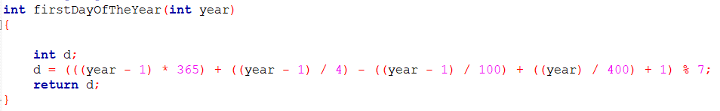
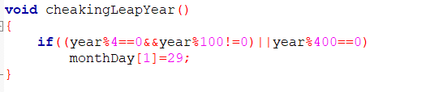
Source Code
Software Development Project-I

Slide 10
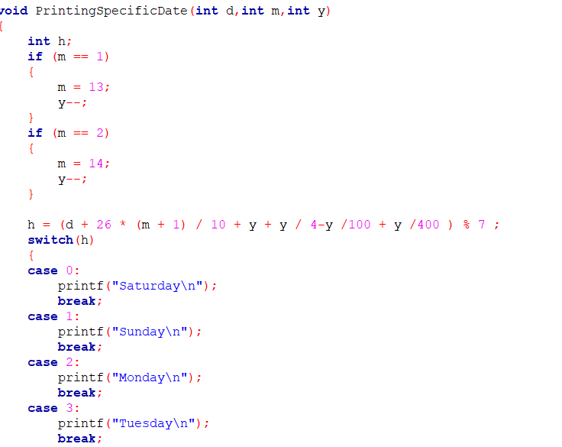
Source Code
Software Development Project-I

Slide 11
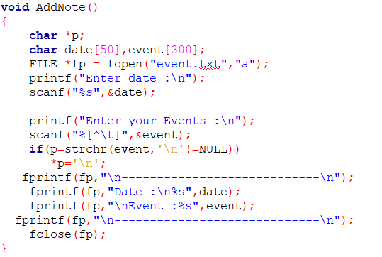
Source Code
Software Development Project-I

Slide 12
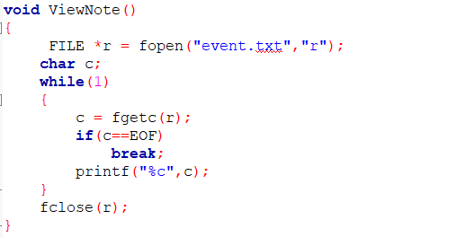
Source Code
Software Development Project-I

Slide 13
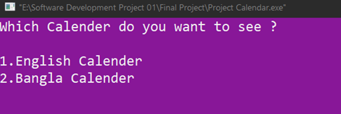
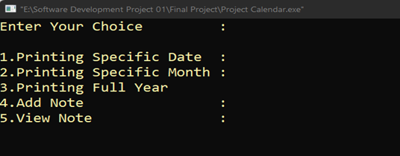
Output
Printing type of Calendar:
Choice menu of English Calendar :
Software Development Project-I

Slide 14
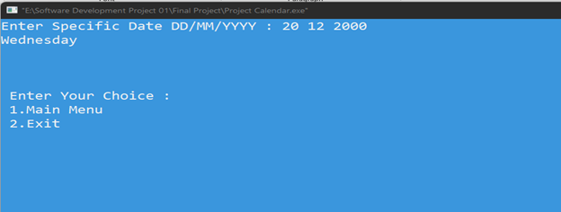
Output
Printing Specific Date:
Software Development Project-I

Slide 15
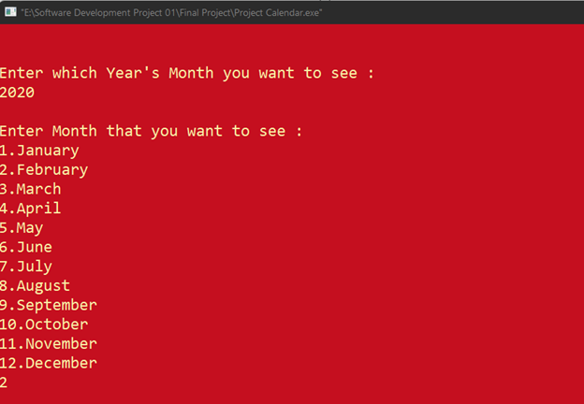
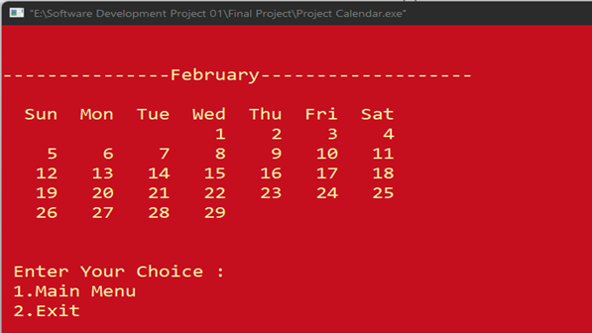
Output
Printing Specific Month:
Software Development Project-I

Slide 16
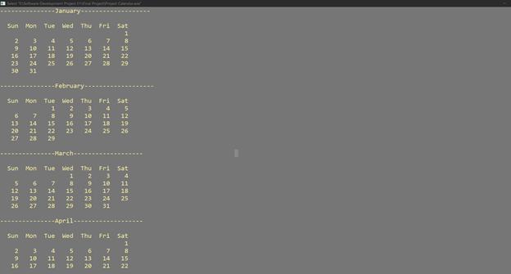
Output
Printing Full Year:
Software Development Project-I

Slide 17
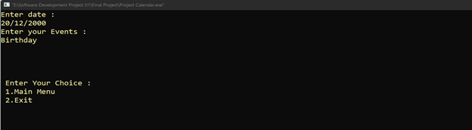
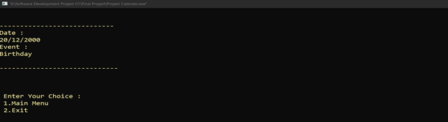
Output
Adding Note:
View Note:
Software Development Project-I

Slide 18
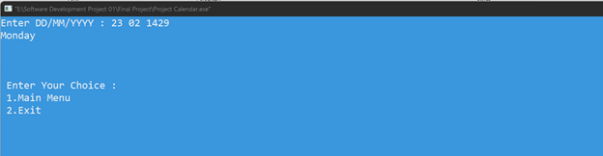
Output
Printing Specific Bangla date:
Software Development Project-I

Slide 19
Conclusion
For developing this project we faced some difficulties which are solved by the directions of our honorable supervisor sir. We are still working on it for adding some additional features to make this project more user friendly.

Slide 20
Title Defense
Thank You!
Software Development Project-I

