Slide 1
Yummy Opinion Advisor
CS 410 FA2019

Slide 2
Our Team
Asad Imtiaz -
Ron Swan
Karun Veluru

Slide 3
Why Yummy?
Everyone loves a nice meal and wants to avoid poor food and service
Owners want to cut through the noise and understand the overall sentiment surrounding their businesses.

Slide 4
Our Goals
Apply the topics the Text Mining and Analysis concepts learned in this course
Mine the publicly available Yelp data set
Clean and curate the data
Produce topics, aspects, and sentiment of user reviews
Develop a user interface to falcate data exploration

Slide 5
Task breakdown:
Review text preprocessing
Topic Modeling
Aspect Clustering
Sentiment Classification
Aspect Rating
UI

Slide 6
Review Text Preprocessing
Input: Review Text
Process: Clean Text
tokenize
POS tagging
Stop word removal
Output:
Topic Text [PN, N, V]
Sentiment Text [PN, N, V, Adj, Adv]

Slide 7
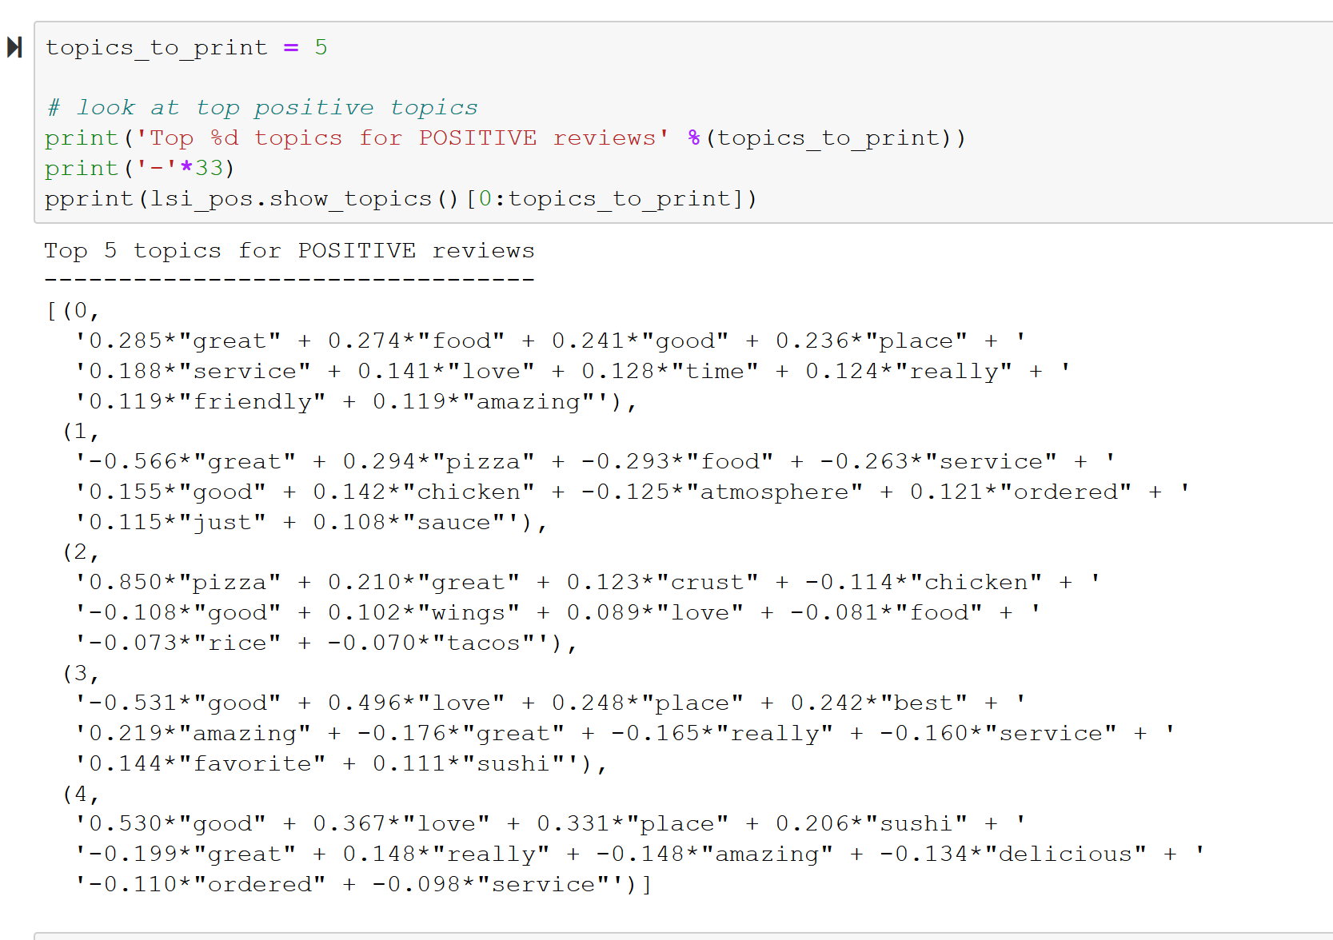
Topic Modeling

Slide 9
Example Analysis
ChinaTown Buffet:
I give it three stars for size alone.
IMHO, the bigger the Chinese buffet, the better. You know what the food is gonna taste like (meh), you know how much you will eat (too much), and you know how it will make you feel afterward (like a meat turtle: http://thisiswhyyourefat.com/post/385824028/bacon-cheese-turtleburgers-ground-beef-pattie).
So, this place is huge. It has lots and lots of choices of crap Chinese fast food to eat. The food is not at all bad when compared to most crap Chinese fast food, but a fried turd is still a turd. Also, and this is the biggest highlight of the restaurant, they have a station where you can select ingredients for them to cook you in a wok, like at Flattop Grill. Their crab rangoons are pretty good. There is also a gift shop (WTF?) in case you want to relish your trip here forever. They will let you take some with you, though I never have. Expect to spend about $10 with a drink, a little less for lunch.
Topic Text
Sentiment Text
star size know food go taste know eat will feel meat turtle bacon cheese lot lot choice crap eat food compare crap fry turd turd station select ingredient cook wok flattop_grill crab_rangoon want relish trip will expect spend dollar drink
star size. imho big chinese_buffet well. know food go taste know. much_will eat much_know will feel afterward meat turtle. post bacon cheese huge. lot lot choice. crap chinese fast_food eat. food. not_bad compare. crap chinese fast_food fry turd turd. big_highlight station select ingredient. cook wok flattop_grill. crab_rangoon. pretty good. gift_shop. want relish trip forever. will never. expect spend dollar drink little_lunch.

Slide 10
Aspect clustering
Input:
Topic vocab
Topic <> Aspect mapping (manual)
Output:
Aspect Classifier
Example:
IN Topic : Food Chinese pizza
OUT Aspect: Food

Slide 11
Sentiment Analysis
Input
Sentiment Text
(any text)
Output:
Train:
sentiment Classifier
Test:
Star Rating

Slide 12
Aspect Classification
Input
Review Text
Aspect Classifier
Output
Classified text
Example:
IN 'Food was good. Service was no good'
Out {'food':'Food was good','service':'Service was not good'}

Slide 13
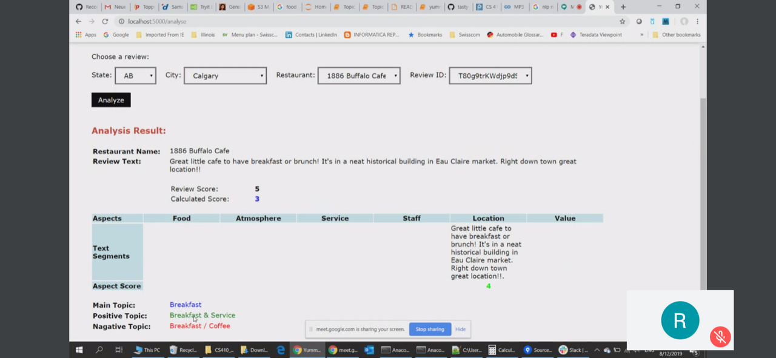
User Interface

