Slide 1


ICS 502 – MACHINE LEARNING PROJECT
Credit Card
Fraud Detection
GROUP 12 - FINAL PROJECT PRESENTATION

Slide 2
The Growing Threat
Credit card fraud is the most common form of identity theft, costing billions annually and eroding consumer trust.
449k
Fraud Reports in 2024
8%
YoY Increase

Slide 3
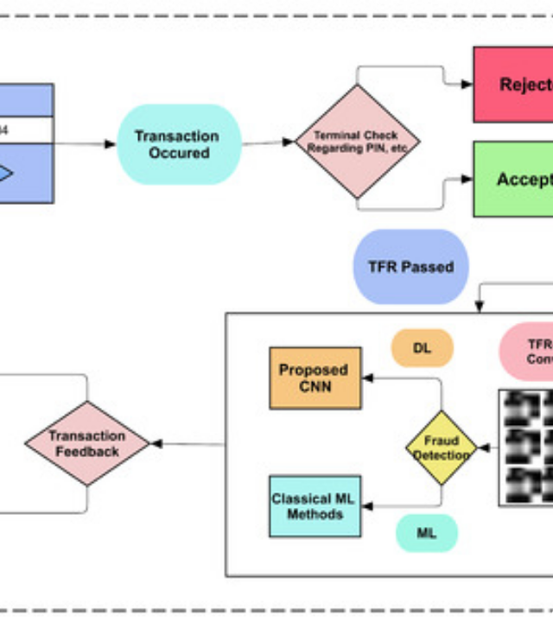
The Data
Credit Card Transactions
We utilized a massive, real-world dataset sourced from Kaggle to train our models.
Volume: 1.29 Million+ Records
Type: Labeled Data (Supervised Learning)
Features: 24 columns including time, amount, merchant details, and demographics.
Challenge: Extreme Class Imbalance.

Slide 4


Project Methodology
Data Prep
Feature Eng
Modeling
Evaluation
Cleaning &
Exploration
Contextual &
Behavioral
Ensemble
Methods
Recall &
PR-AUC

Slide 5
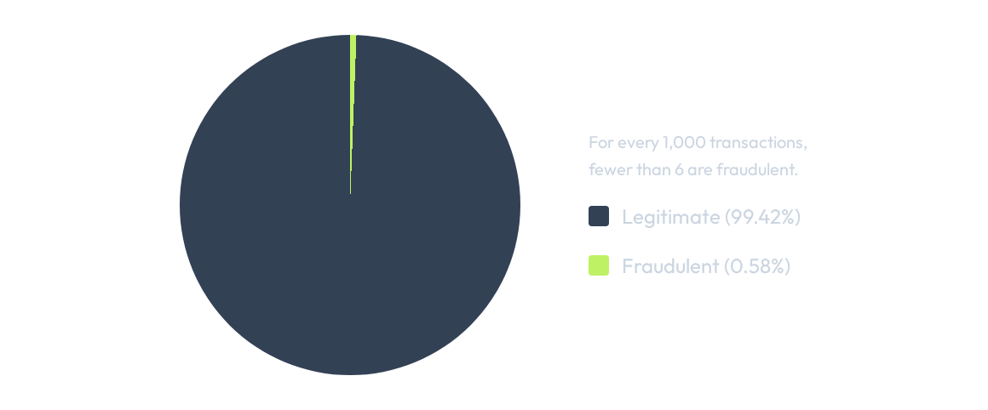
The Core Challenge: Imbalance

Slide 6







Feature Engineering: Behavioral
Temporal Analysis
Transaction Velocity
Extracted Hour of Day and Day of Week. Fraud often peaks during late nights or specific days when user vigilance is low.
Per recent discussion: We included num_of_tx_day. This feature counts daily transactions per card to immediately flag abnormal frequency spikes.
Demographics
Scaling
Derived Cardholder Age. Spending patterns often correlate with age groups; deviations from the norm trigger alerts.
Applied StandardScaler to transaction amounts to normalize high-variance financial data for distance-based models.

Slide 7

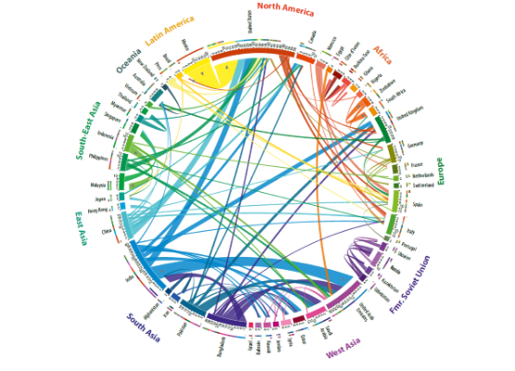
Feature Engineering: Contextual & Geospatial
Refined Geospatial Features
As discussed, we moved beyond raw coordinates to more robust indicators:
User-to-Merchant Distance: Calculated the specific Euclidean distance between the User's home location and the Merchant's location.
Significance: This indicates the physical feasibility of the transaction. Impossible travel distances (e.g., 500km in 10 mins) are prime fraud indicators.
Processing: We applied Standard Scaling to this distance feature to ensure outlier distances do not skew the model's weights.

Slide 8
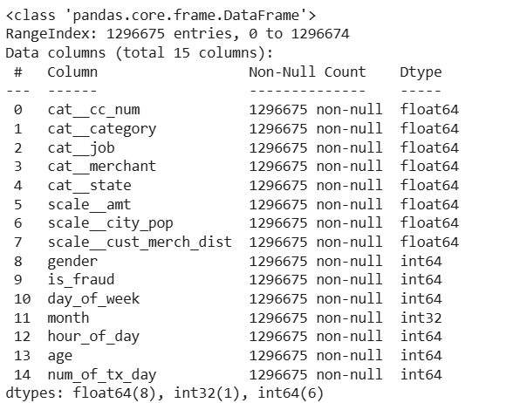
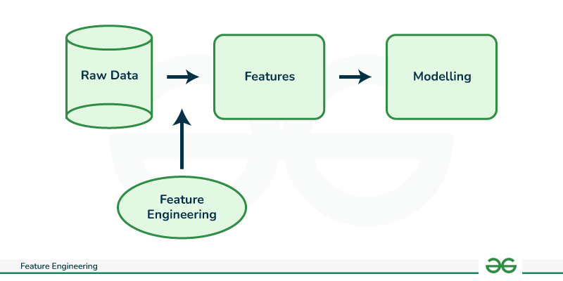
Final Feature Set

Slide 9




Model Selection & Strategy Pivot
Strategic Pivot: Removing LR & KNN
Linear SVC
Initial models, Logistic Regression (too simplistic/cannot capture complexity) and KNN (O(N) complexity), were inefficient for the 1.3M record dataset and failed to capture complex fraud patterns required for high Recall.
Chosen as the new **linear baseline**. Using hinge loss, it efficiently finds the optimal hyperplane in high-dimensional space and handles imbalance via class_weight.
HistGradientBoosting
XGBoost
Selected for **efficiency**. Its histogram-based binning allows for rapid training on 1M+ records, solving standard ensemble slowness.
The **champion model**. Optimized for speed and performance with native scale_pos_weight parameter to handle imbalance natively.

Slide 10



Evaluation Strategy
Why Accuracy Fails
The Solution: PR-AUC
With 99.4% legitimate transactions, a "dumb" model that predicts No Fraud every time achieves 99.4% accuracy but catches 0% of fraud.
We prioritize Recall (finding all fraud) and Precision (minimizing false alarms). Area Under the Precision-Recall Curve is the gold standard for imbalance.

Slide 11
Model Hyper-Parameter Tuning - GridSearch
GridSearch systematically explores every hyper-parameter combination for optimal model configuration.
To manage the 0.58% fraud rate challenge, use of stratified cross validation which perfectly preserves the severe class imbalance across every validation fold. Crucially, the search is guided by objective scoring (scoring=’recall’), which focuses the hyper-parameter tuning on maximizing the detection of fraud.
Pipeline architecture for maintaining experimental integrity and preventing data leakage. This workflow ensures that all preprocessing is applied consistently to all folds guaranteeing a fair and reproducible evaluation.

Slide 12
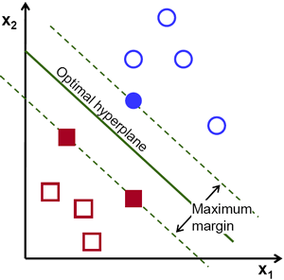
Model Training: LinearSVC (Baseline)
Linear Baseline Selection:
Chosen to determine the maximum predictive power of a single, optimal linear decision boundary in our high-dimensional feature space, contrasting with the ensemble complexity.
Critical Imbalance Handling:
Set class_weight = ‘balanced’. This assigns higher penalties to misclassified fraudulent samples, forcing the hyperplane to prioritize the minority class.
Max Margin Loss:
Utilized loss=’hinge’ to maximize the margin between classes, creating a decision boundary robust against noise and outliers.
Optimized Hyperparameters:
Tuned for maximum recall while defining convergence thresholds.
Evaluation Strategy:

Slide 13
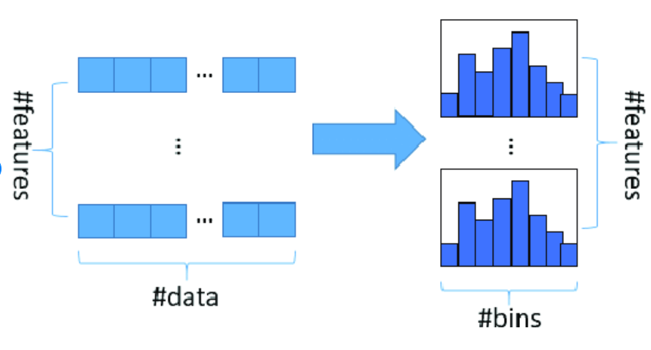
Model Training: HistGradientBoosting
Computational Efficiency:
Uses a fast, histogram-based algorithm to bin continuous features. This allows for rapid training, significantly outperforming traditional GMBs.
High Predictive Power:
As an ensemble method, it sequentially corrects errors from previous trees. It excels at capturing complex, non-linear interactions between features.
Optimized Complexity:
To balance depth and regularization, preventing overfitting to minority classes.

Slide 14
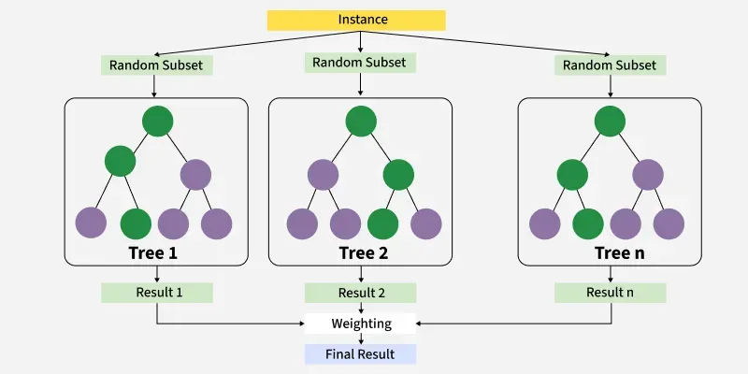
Model Training: XGBoost
Model Selection:
Chosen as the most advanced ensemble method, representing the performance ceiling for tree-based prediction on structured data.
Native Imbalance Handling:
Setting scale_pos_weight = 15, allows for a higher penalty for missing a fraudulent transaction, directly addressing the severe imbalance.
Regularization & Structure:
Balanced complexity and robustness to migrate overfitting.
Efficiency:
utilized tree_method="hist for scalability, ensuring fast training times on the large dataset.

Slide 15
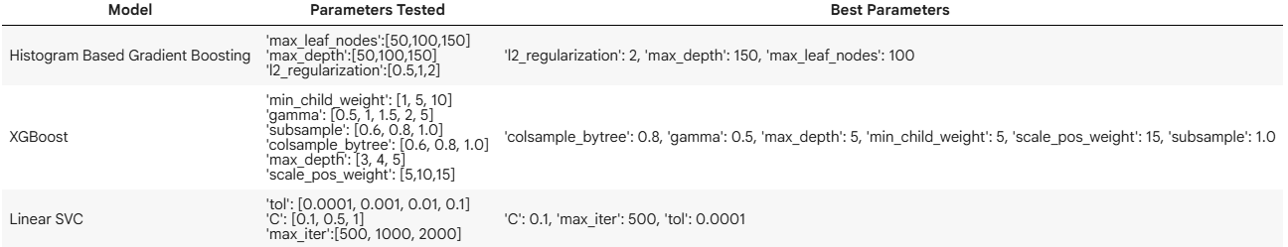
Final Optimal Params

Slide 16
Final Model Training & Evaluation
Overview:
All models were retrained using optimal parameters and evaluated on the test set. The results clearly show that fraud detection requires non-linear models capable of capturing rare and complex patterns.
Key Results:
Linear SVC → Baseline model; completely ineffective
HistGradientBoostingClassifier → Best overall balance
XGBoost → Highest recall (best fraud catcher)

Slide 17
Comparative Model Performance
Model | Recall | Precision | F1-Score | Key Insight
HistGradientBoosting | 0.857 | 0.972 | 0.91 | Excellent precision & strong recall. Best balance.
XGBoost | 0.921 | 0.729 | 0.81 | Highest recall; suitable when missing fraud is unacceptable.
Linear SVC | 0.000 | 0.000 | 0.00 | Fails to detect fraud. Linear boundary insufficient.
Takeaway: Fraud detection is highly non-linear → Boosting models outperform linear models by a large margin.

Slide 18
Key Findings & Lessons Learned
    Discussion Points:
    Boosting models excel because they iteratively correct errors, focusing on minority-class fraud cases.
    HistGradientBoosting provides the best balance between high precision (less noise) and strong recall.
    XGBoost captures the most fraud cases but introduces more false positives.
    Linear SVC confirms that fraud patterns cannot be separated linearly.

Slide 19
Key Findings & Lessons Learned
    Lessons Learned:
Model choice is critical for imbalanced data.
Precision–Recall trade-off must be aligned with business goals.
Accuracy is misleading → Recall, F1, and PR-AUC matter more.
Confusion matrices reveal costly errors, especially false negatives.

Slide 20
Future Enhancements & Recommendations
    Discussion Points:
Threshold tuning to adjust precision-recall balance.
SMOTE / Oversampling / Undersampling to better represent minority class.
Feature engineering using transaction velocity, customer profiles, and behavioral patterns.
Hybrid systems combining Boosting + Anomaly Detection (Autoencoders, Isolation Forest).
Explainability (SHAP values) to identify fraud-driving features.
Real-time pipeline optimization for deployment at scale.
Active learning using investigator feedback.

Slide 21
Future Enhancements & Recommendations
    Discussion Points:
Deep temporal Features: Use time-series techniques like RNN or LSTM networks to model sequential order of transactions. This would allow model to learn complex fraud sequences.
Customer behavioral profiles: User’s statistics over past 30 days and then note any sudden changes in patterns.
Real-time API integration
Concept Drift Detection: Fraudsters constantly change their tactics, causing changes in patterns. Implement continuous monitoring that tracks model’s performance on new, unseen data. This would allow model to be more adaptive.

Slide 22
Questions?
Thank you.
Group 12 | ICS 502

