Slide 1
INFORMATION RETRIEVAL · PROJECT
A Multimedia Knowledge Graph
for the FIFA World Cup 2022
RDF/OWL knowledge graph · ResNet-50 visual layer · SPARQL & content-based retrieval · GraphDB
Prof. Antonio Maria Rinaldi · Cristiano Russo University of Naples Federico II
Asad Raza · D03000182

Slide 2
GOAL
Objectives: a seven-step retrieval pipeline
A sports knowledge graph for information retrieval on the FIFA World Cup 2022, and evaluate against querying the datasets separately.
1
Process the sports data
5
Store in a graph database
Inventory & clean four heterogeneous sources
Load the graph into GraphDB
2
Design an ontological schema
6
Define retrieval queries
A 10-class OWL TBox for the domain
13 SPARQL needs + image similarity
3
Extract multimedia features
7
Evaluate vs the raw datasets
ResNet-50 vectors from player photos
How KG helped
4
Construct the KG
Emit RDF triples (ABox) and merge with TBox
3

Slide 3
OUR MODEL
Modelling the domain as one graph
I turned all four sources into a single RDF graph. Every fact is a triple ⟨subject, predicate, object⟩ over global IRIs, so the same player appearing in three datasets becomes one node.
A real fact from our graph
wc:player_P_14758
(subject)
Schema (TBox). Wrote the worldcup_tbox.ttl by hand— 10 classes and 15 object properties, with inverse and domain/range axioms.
Instances (ABox). 03_build_kg.py generated the data triples — 20,023 in total — from the clean tables.
wc:representsTeam → wc:team_ARG
Deterministic IRIs. Minted nodes, e.g. wc:player_P_14758, wc:team_ARG, … so records from all sources resolve to one node.
predicate object
Reasoning. GraphDB's RDFS-Plus ruleset materialises our inverse edges (hasGoal ↔ scoredInMatch) automatically.
Retrieval. We query the graph with 13 SPARQL patterns plus content-based image similarity.
4

Slide 4
MOTIVATION
Why a knowledge graph, not SQL / pandas?
Both can answer a single-source question. The difference shows the moment a need spans several sources.
Aspect
Per-dataset (SQL / pandas)
Knowledge graph
Cross-source joins
Explicit join keys, re-coded in every query
Implicit — shared IRIs make it one connected pattern
Data integration
Repeated in each analysis script
Materialised once, at build time, as edges
Entity identity
Fragile string keys, resolved per query
Global IRIs — the entity is resolved once
Adding a source
Write a new merge / join by hand
Add triples; existing queries are unchanged
Reasoning
None — you code every derived fact
RDFS-Plus derives inverse & subclass edges
What this bought us: when we added the standings source late in the project, we only appended triples — all 13 existing SPARQL queries ran unchanged.
5

Slide 5
DATA
Four mandatory sources, three textual + one image
1
jfjelstul/worldcup (GitHub)
2
Kaggle — WC 2022 player statistics
27 RELATIONAL CSVS
1 CSV, PER-PLAYER
Tournaments, teams, confederations, players (bio), squads, matches, goals, stadiums
Appearances, goals, assists, per-90 dribbles / tackles / duels, save %, clean sheets, club
3
Kaggle — all-players image dataset
4
Kaggle — FIFA-2022 standings
820 PHOTO FOLDERS
1 CSV, PER-TEAM
One folder of JPGs per player → PlayerImage (folder, count, feature vector)
Final position, W/D/L, goals for/against, goal difference, points
Ten entity categories emerge: Tournament · Confederation · Team · Player · Club · Match · Goal · Stadium · Position · PlayerImage.
6

Slide 6
PREPROCESSING
Cleaning & integration decides retrievability
831
11
754/831
4
players scoped
clean tables
matched by name
sources fused
Three structural problems, three fixes
Mixed encodings. Files mix UTF-8 and Latin-1 → detect encoding at the byte level so accented names aren't corrupted.
Mojibake image folders. Folder names are double-encoded UTF-8 (cp437/cp850) → keep the true path in a folderPath field.
No shared key. Statistics & image sets share no id with worldcup → resolve players by a normalised name (name_norm).
How we did it: 01_inventory.py profiled every raw file; 02_preprocess.py scoped all tables to WC-2022 and built player_master_2022 — the spine that resolves each player across the three vocabularies by name_norm.
7

Slide 7
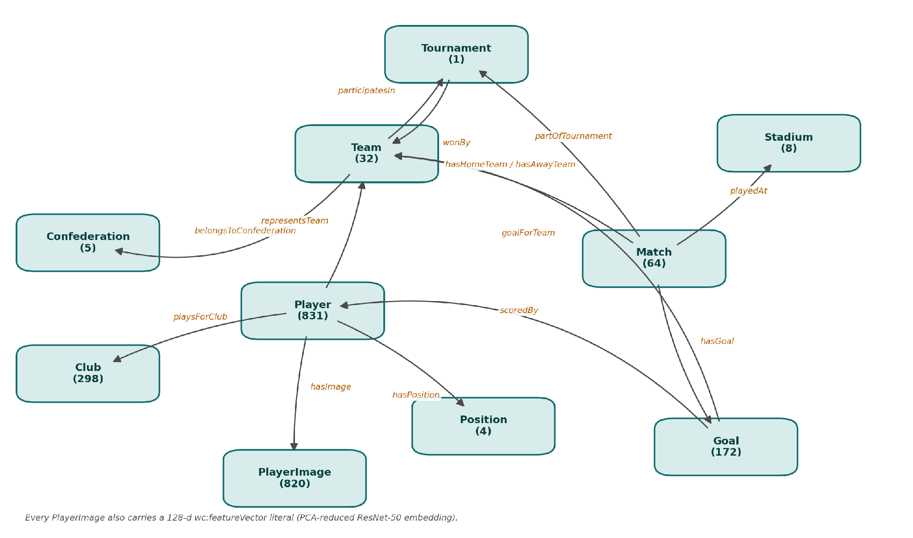
SCHEMA
Ontology: 10 classes linked by 15 object properties
Instance counts in parentheses; datatype attributes omitted. Every PlayerImage also stores a 128-d PCA-reduced ResNet-50 vector.
8

Slide 8
CONSTRUCTION
Populating the graph: 20,023 triples
Instances per class
ABox fragment (Turtle)
Player
831
PlayerImage
820
wc:player_P_14758 a wc:Player ;
wc:playerName "Lionel Messi" ;
wc:representsTeam wc:team_ARG ;
wc:playsForClub wc:club_psg ;
wc:hasPosition wc:pos_FW ;
wc:hasImage wc:img_P_14758 ;
wc:matchesPlayed 7 ;
wc:goalsScored 7 ; wc:assists 3 .
wc:img_P_14758 a wc:PlayerImage ;
wc:imageCount 32 ;
wc:folderPath "...\Lionel Messi" ;
wc:featureVector "0.0123 -0.09 ... 0.0055" .
Club
298
Goal
172
Match
64
Team
32
Stadium
8
Confederation
5
Position
4
Tournament
1
Our build: 03_build_kg.py reads the 11 tables and writes typed instances; 04_image_features.py adds the vectors; the two Turtle outputs merge into worldcup_full.ttl (20,023 triples).
9

Slide 9
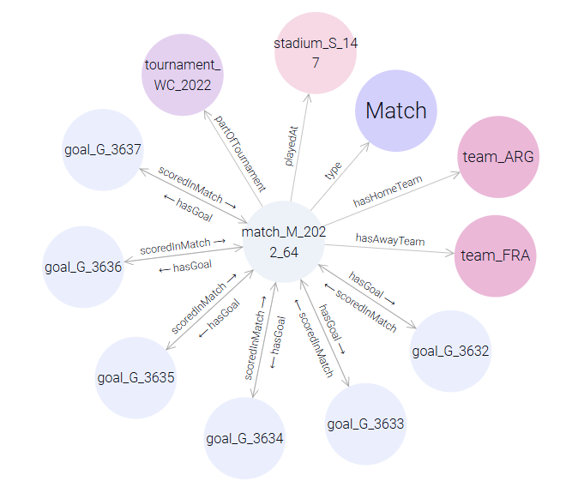
EXPLORING
The graph in GraphDB (Visual graph)
Final — match_M_2022_64. Argentina vs France: the match node links out to both teams, its goals and the scorers — a multi-hop view.
10

Slide 10
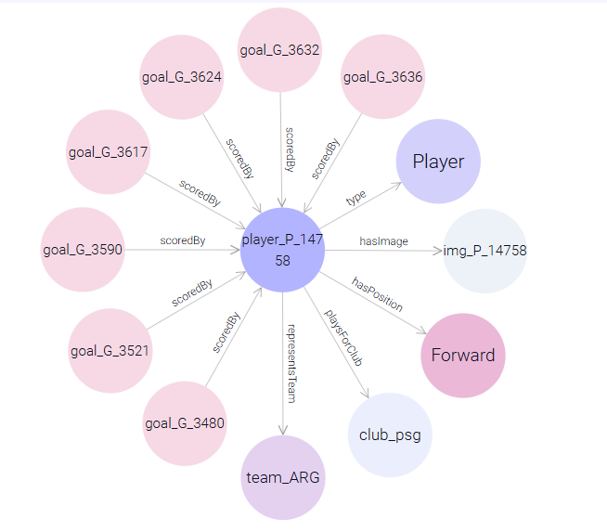
EXPLORING
The graph in GraphDB (Visual graph)
Lionel Messi (wc:player_P_14758):
One node linking his goals, national team, club, position and image — facts drawn from three sources, fused on a single IRI.
10

Slide 11
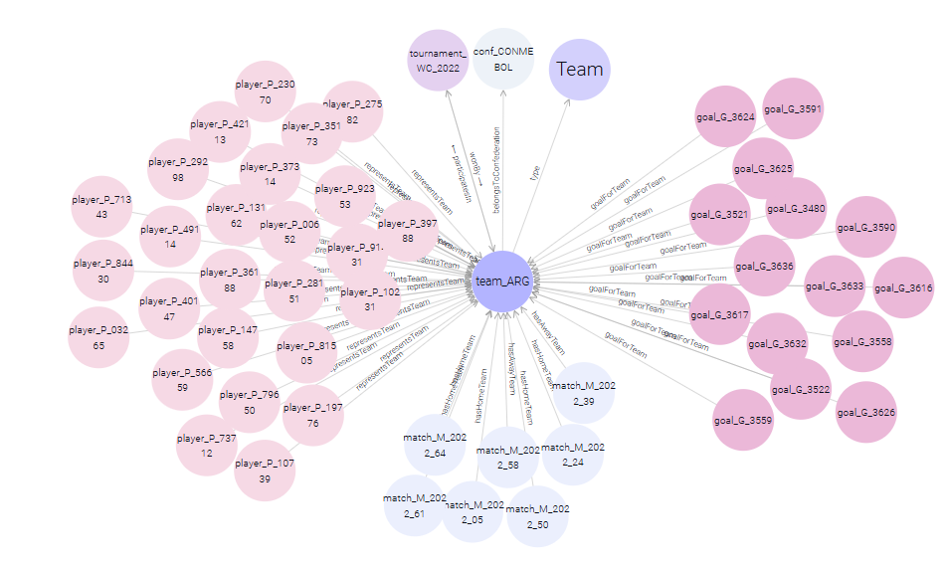
EXPLORING
The graph in GraphDB (Visual graph)
Argentina hub (team_ARG). Squad, goals, matches, confederation and tournament fused on one IRI, from several sources.
10

Slide 12
RETRIEVAL
Two retrieval layers
SPARQL query layer
Image-similarity layer
13 queries q01–q13 in queries/, run in GraphDB and by run_all.py. Features we used:
image_similarity.py ranks players by cosine over the stored visual vectors. How we built it:
Implicit joins — q05 spans worldcup + statistics with no join key.
Property paths
— belongsToConfederation/confederationCode "CONMEBOL" in q05.
Sets & negation
— VALUES (20 PL clubs) in q05; FILTER NOT EXISTS own goals in q02.
Aggregation
— COUNT / GROUP BY squad size in q13.
Entailment
— RDFS-Plus lets us use hasGoal or its inverse interchangeably.
Feature extraction — 04_image_features.py runs each photo through ImageNet ResNet-50 → 2048-d penultimate layer, L2-normalised.
Stored in the graph
— PCA-128 vector as wc:featureVector on 820 PlayerImage nodes.
Query-by-example
— give a player name, get the visually nearest players by cosine.
Linked results
— each hit is a wc:player IRI, so a visual match connects to team, club, stats.
11

Slide 13
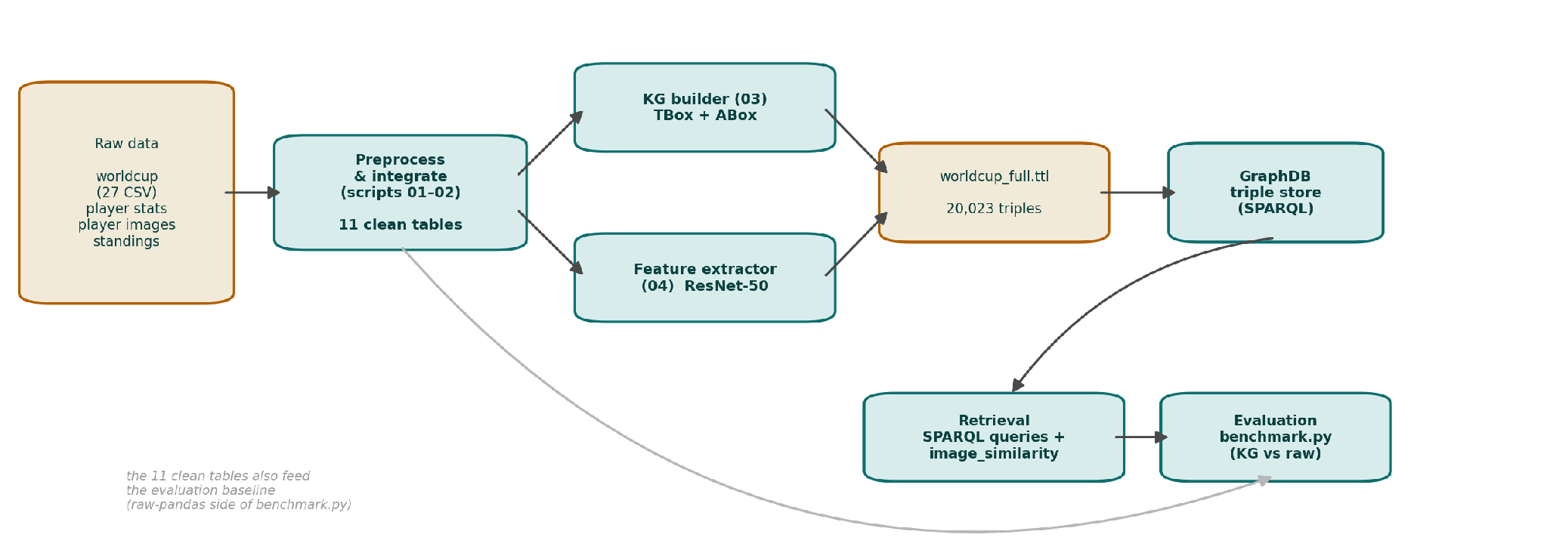
SYSTEM
End-to-end architecture: a scripted pipeline
Eleven clean tables fork into the KG builder (schema + instances) and the ResNet-50 feature extractor; outputs merge into one Turtle file loaded into GraphDB and queried by the SPARQL and image-similarity layers. The same tables feed the raw-pandas evaluation, so both sides start from identical inputs. Each stage writes a file, so any stage can be re-run in isolation.
13

Slide 14
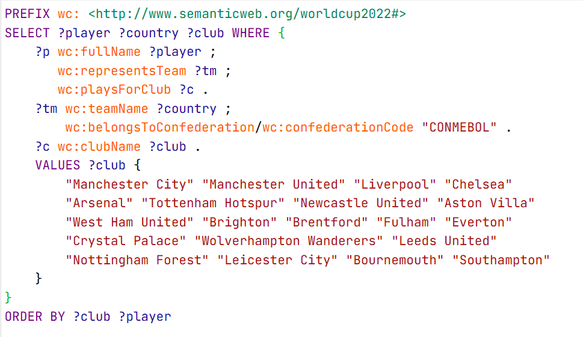
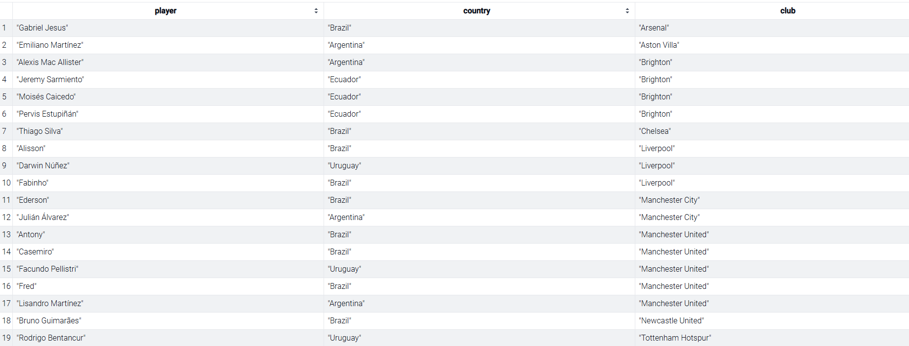
QUERIES
13 SPARQL needs — worked example q05
Need. Which CONMEBOL internationals were playing their club football in England during the tournament?
One connected pattern spanning worldcup + statistics data (no answer in either alone): a two-step property path for CONMEBOL, VALUES for the 20 Premier-League clubs, and an implicit cross-source join.
→ 19 rows returned live from GraphDB — the raw side needs two CSV loads + a hand-keyed merge + a confederation lookup.
14

Slide 15
QUERIES
The payoff query — q10: one player, four sources
A single unified profile that no individual dataset can produce. Four sources resolve to one wc:player IRI:
worldcup
statistics
Team ARG · position FW · bio
7 apps · 7 goals · 3 assists · club PSG
Lionel Messi wc:player_P_14758
images
standings
photo folder (32) · 128-d feature vector
Argentina — final position 1 (champions)
3 explicit joins on the raw side · one connected pattern on the graph. Spans worldcup + statistics + images + standings.
15

Slide 16
EVALUATION
The KG reproduces every per-dataset answer
Six needs, each solved twice: (A) one SPARQL query over the KG, (B) an equivalent hand-written pandas pipeline over the raw CSVs. Primary check: answer equivalence A == B.
# | Information need | Sets | Joins | LoC KG/raw | A==B
1 | Tournament winner + host | 1 | 0 | 1 / 1 | yes
2 | Top-10 goalscorers (own goals excl.) | 1 | 1 | 4 / 3 | yes
3 | Argentina squad with club side | 2 | 1 | 3 / 3 | yes
4 | CONMEBOL players at English clubs | 3 | 2 | 4 / 4 | yes
5 | Goalkeepers ranked by save % | 2 | 1 | 5 / 3 | yes
6 | World Cup final top-4 + confederation | 2 | 1 | 4 / 3 | yes
6 / 6
answers identical to the baseline
Precision = Recall = P@k = MAP = 1.0. The needs are factual with a single correct answer set, so once A==B holds these metrics are trivially 1 — the evaluation is integration-centric, not ranking-centric.
How we tested it: benchmark.py runs each need both ways and checks A==B — the raw side needed up to 2 extra CSV loads and hand-keyed merges to match what the KG answers in one query.
16

Slide 17
MULTIMEDIA
Content-based image retrieval
Query-by-example for Lionel Messi — six visually nearest players by ResNet-50 cosine:
Rank | Nearest player (visual) | Cosine
1 | Noa Lang (Netherlands) | 0.784
2 | Stefan de Vrij (Netherlands) | 0.772
3 | Martin Caceres (Uruguay) | 0.772
4 | Arkadiusz Milik (Poland) | 0.770
5 | Lautaro Martinez (Argentina) | 0.767
6 | Neymar (Brazil) | 0.755
Neighbours are visually coherent (framing, kit, pose) but not the same identity — the limit of a single global CNN descriptor.
17

Slide 18
DEMO
GraphDB — explore the graph live
The full graph is loaded in GraphDB Desktop 11.4.3 (repository worldcup2022, ruleset RDFS-Plus), which exposes a Workbench UI and a SPARQL endpoint.
WORKBENCH UI
http://localhost:7200
Using GraphDB, we can:
Explore → Visual graph — search a node (e.g. team_ARG) and expand its links.
SPARQL tab — run any of the 13 benchmark queries q01–q13 live.
Import → RDF — the graph is loaded from worldcup_full.ttl (20,023 triples).
SPARQL ENDPOINT
http://localhost:7200/repositories/worldcup2022
18

Slide 19
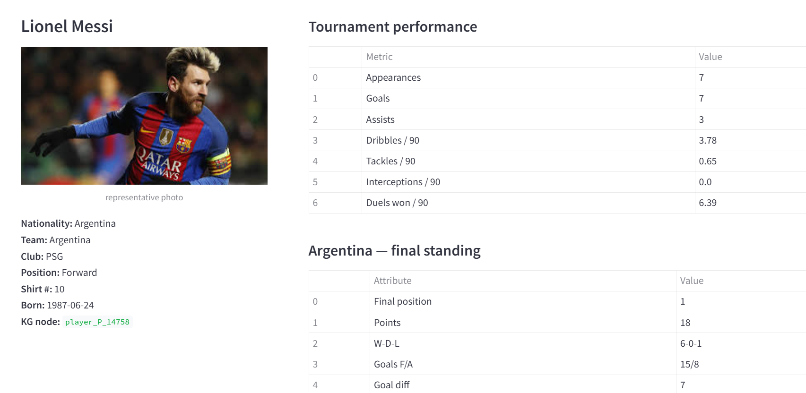
DEMO
Interactive KG explorer (Streamlit)
Streamlit demo
One tab per ontology class (Player, Team, Match, Goal, …), each with search + dropdown.
A generic renderer resolves IRIs to readable names and shows incoming edges (squad, goals).
The Player tab shows photo, stats and final standing.
…plus the six most visually similar players, by cosine over the stored ResNet-50 vectors.
Runs on the same worldcup_full.ttl graph — retrieval and multimedia layers, made browsable.
19

Slide 20
CONCLUSIONS
What the graph delivers — and its limits
Contributions
Limits
10-class OWL ontology + 20,023-triple graph from all four sources.
A visual layer of 820 ResNet-50 vectors as first-class linkable nodes.
Declarative cross-source retrieval over stable IRIs; disambiguation by identifier.
Every benchmark answer reproduced — the KG encodes the integration logic once, reusably.
A fully scripted pipeline; each stage independently re-runnable.
Entity resolution is name-based — 77 of 831 players lack a statistics link.
One global CNN descriptor per player, so pose / kit / background can outweigh identity.
Evaluation is integration-centric — no graded relevance, hence no P@k / MAP / nDCG.
None of these affect answer correctness — but each bounds how far the system generalises.
20

Slide 21
OUTLOOK
Future work
1
Richer multimedia
Ingest highlight video & commentary audio with shot/scene segmentation, MPEG-7 descriptors and MFCC features, so events become retrievable.
2
Scalable visual search
Store full-dimensional embeddings behind an approximate-nearest-neighbour index for sub-second query-by-example at scale.
3
Identity-based evaluation
Embed every photo per player and run image-to-image retrieval, reporting rank-1 accuracy.
4
KG embeddings & neural ranking
Train TransE / DistMult / RotatE for link prediction; add a BERT / K-NRM re-ranker over the textual literals.
5
Stronger entity resolution
Link players and clubs to external authorities (e.g. Wikidata) to close the name-matching gap.
21

Slide 22
Thank you
A Multimedia Knowledge Graph for the FIFA World Cup 2022
Asad Raza · D03000182

