Slide 1


Slide 2
A Methodology for Caption Generation of Images with Machine Learning
MS Candidate
Muhammad Asad
Supervisor
Dr. Kaleem Razzaq
Notes:
My name Muhammad Asad and I am here to represent my MS Research Work and the topic is “A Methodology for Caption Generation of Images with Machine Learning”

Slide 3
Outline
Introduction
Related Work
Research Gap
Problem Statement
Research Contributions
Proposed Methodology
Results
Conclusion and Future Work

Slide 4
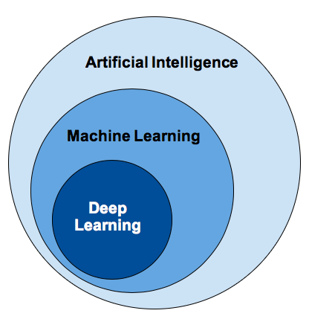
Introduction
What is Computer Vision
Image to Caption Generation
CNNs
Need of Image to Caption Generation
Notes:
Computer vision is an interdisciplinary scientific field that deals with how computers can be made to gain high-level understanding from digital images or videos. Object Detection & Classification
Artificial neural networks (ANN) or connectionist systems are computing systems that are inspired by, but not necessarily identical to, the biological neural networks that constitute animal brains. Such systems "learn" to perform tasks by considering examples, generally without being programmed with any task-specific rules. For example, in image recognition, they might learn to identify images that contain cats by analyzing example images that have been manually labeled as "cat" or "no cat" and using the results to identify cats in other images. An ANN is based on a collection of connected units or nodes called artificial neurons, which loosely model the neurons in a biological brain.
A deep neural network (DNN) is an artificial neural network (ANN) with multiple layers between the input and output layers.. in deep learning, a convolutional neural network (CNN, or ConvNet) is a class of deep neural networks, most commonly applied to analyzing visual imagery
Cnn intro

Slide 5
Related Work (Different Papers)
 | Approach | Measures | Augmentation
Gong et al. (2014) | MultiRetrieval | R@k | X
Kiros et al. (2015) | MultiRetrieval | R@k | X
Donahue et al. (2015) | MultiRetrieval | Human, BLEU, R@k | X
Vinyals et al. (2015) | MultiRetrieval | BLEU, Meteor, CIDEr, R@k | X
Xu et al. (2015) | MultiRetrieval | BLEU, Meteor | X
Hodosh et al. (2013) | MultiRetrieval | Human, BLEU, ROUGE, R@k | X
Lebret et al. (2015) | MultiRetrieval | BLEU, R@k | X
Karpathy et al. (2014) | MultiRetrieval | BLEU, Meteor, CIDEr | X
Yagcioglu et al. (2015) | VisRetrieval | Human, BLEU | X
Karpathy and Fei-Fei (2015) | MultiRetrieval | BLEU, Meteor | X
Notes:
In the visual space-based methods, the image features and the corresponding captions are
independently passed to the language decoder. In contrast, in a multimodal space case, a shared
multimodal space is learned from the images and the corresponding caption text. This multimodal
representation is then passed to the language decoder.
harmonic mean of
unigram precision and recall, with recall
weighted higher than precision.

Slide 6
Problem Statement
Researchers generate models in iterations and present a best model generated in iteration. Iteration generate models with random evaluation scores. But to make those caption models stable in nature with respect to evaluation score is the main problem which is addressed in our research.

Slide 7
Research Gap
According to our study, we didn’t find any research work showing Augmentation to Generate Stable Image Caption Generation Models

Slide 8
Research Contributions
Pre-Processing Data Augmentation on Flickr8k Dataset
Bringing stability on model generation

Slide 9
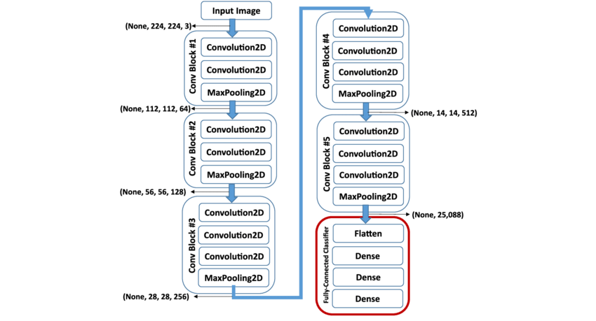
Proposed Methodology

Slide 10
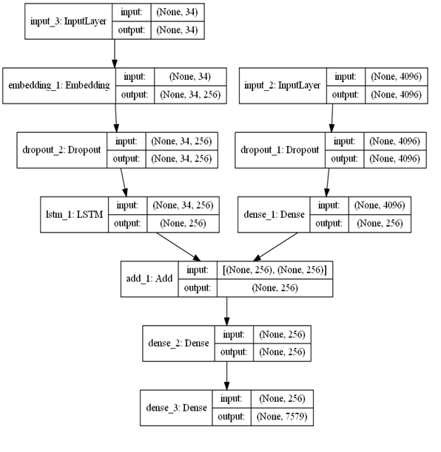
Proposed Methodology
Notes:
CNN is a feed forward neural network that is generally used for Image recognition and object classification. While RNN works on the principle of saving the output of a layer and feeding this back to the input in order to predict the output of the layer.
CNN considers only the current input while RNN considers the current input and also the previously received inputs. It can memorize previous inputs due to its internal memory.
CNN has 4 layers namely: Convolution layer, ReLU layer, Pooling and Fully Connected Layer. Every layer has its own functionality and performs feature extractions and finds out hidden patterns.
There are 4 types of RNN namely: One to One, One to Many, Many to One and Many to Many.

Slide 11
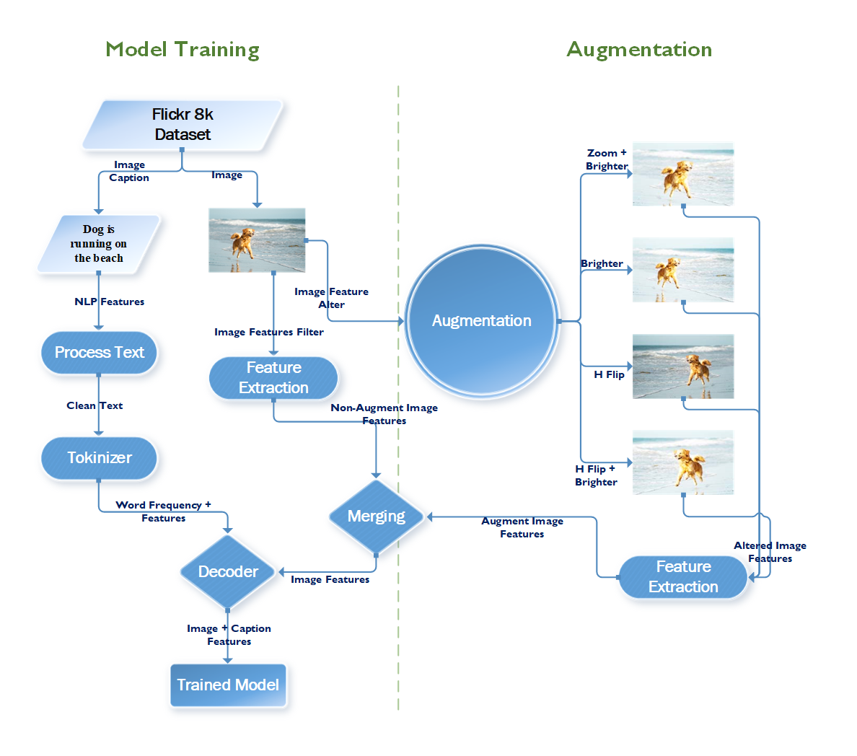
Proposed Methodology

Slide 12
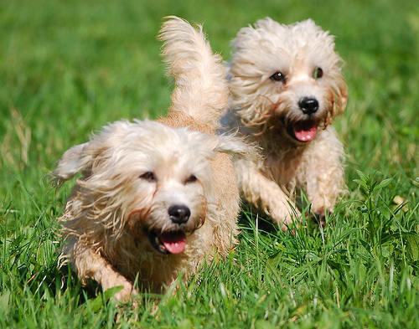
Results
Models | Augmentation | BLEU 1 | BLEU 2 | BLEU 3 | BLEU 4 | No Augmentation | BLEU 1 | BLEU 2 | BLEU 3 | BLEU 4
epoch1 | dog is running through the grass | 0.846 | 0.846 | 0.846 | 0.846 | dog is running through the grass | 0.5643 | 0.5079 | 0.4232 | 0.2822
epoch2 | dog is running through the grass | 0.846 | 0.846 | 0.846 | 0.846 | dog is running through the grass | 0.5643 | 0.5079 | 0.4232 | 0.2822
epoch3 | white dog is running through the grass | 1 | 1 | 1 | 1 | dog is running through the grass | 0.5643 | 0.5079 | 0.4232 | 0.2822
epoch4 | dog runs through the grass | 0.536 | 0.335 | 0.223 | 0 | white dog is running through the grass | 0.5714 | 0.5 | 0.4 | 0.25
epoch5 | white dog is running through the grass | 1 | 1 | 1 | 1 | dog is running through the grass | 0.5643 | 0.5079 | 0.4232 | 0.2822
epoch6 | white dog runs through the grass | 0.705 | 0.508 | 0.212 | 0 | two dogs are running through the grass | 1 | 1 | 1 | 1
epoch7 | dog runs through the grass | 0.536 | 0.335 | 0.223 | 0 | the brown dog is running through the grass | 0.5 | 0.4286 | 0.3333 | 0.2
epoch8 | white dog is running through the grass | 1 | 1 | 1 | 1 | white dog running through the grass | 0.5643 | 0.5079 | 0.4232 | 0.2822
epoch9 | white dog is running through the grass | 1 | 1 | 1 | 1 | dog running through the grass | 0.5363 | 0.5027 | 0.4469 | 0.3352
epoch10 | white dog is running through the grass | 1 | 1 | 1 | 1 | dog running through the grass | 0.5363 | 0.5027 | 0.4469 | 0.3352
 | Average | 0.847 | 0.787 | 0.735 | 0.669 | Average | 0.5966 | 0.5473 | 0.4743 | 0.3531

Slide 13
Results

Slide 14
Conclusion (BLEU Evaluation)
BLEU-1
BLEU-2
BLEU-3
BLEU-4
Notes:
Test Images Results

Slide 15
Future work
The future directions are to reduce the model over/under fitting and to make it optimized for mobile devices and bring benefits of this technique to develop intelligent mobile apps as well as try this method on other datasets.
Notes:
Overfitting: too much reliance on the training data
Underfitting: a failure to learn the relationships in the training data

Slide 16
Thank You
Questions and Discussion

