Slide 1
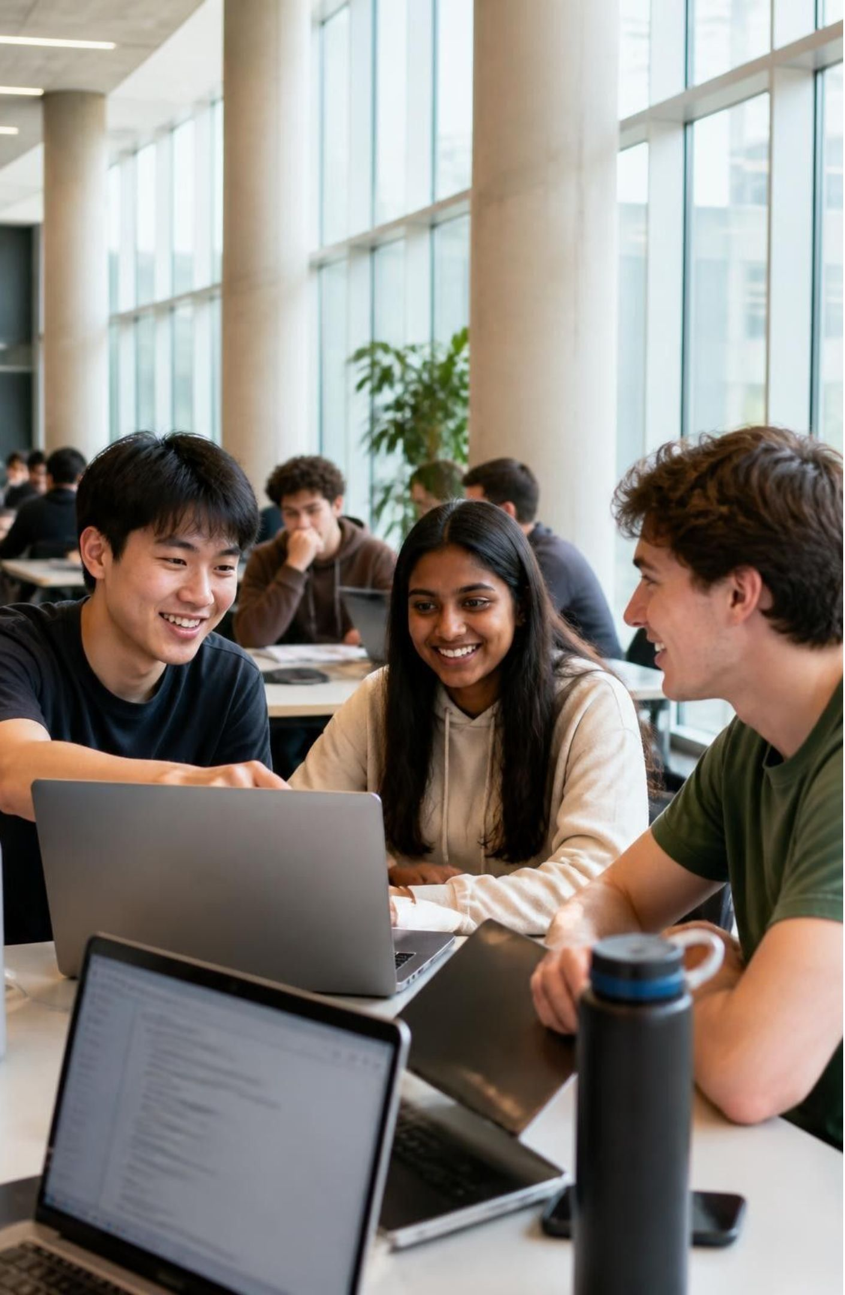
BS SOFTWARE ENGINEERING | SEMESTER PROJECT
CampConnect
More than a campus app.
A platform for meaningful connections.
Student & Alumni Collaboration and Communication Platform
Presented by: Asadullah Sadiq • Muhammad Tayyab • Muhammad Bilal
01

Slide 2
THE STORY
One student. One idea. Too many disconnected paths.
Imagine a student with a strong final-year project idea.
Needs guidance
Needs knowledge
Needs a team
The right senior or alumnus is difficult to find.
Useful notes and resources are scattered across groups.
Finding students with matching skills takes time.
The people who can help may already be on the same campus —
but the connection is missing.
The problem is not a lack of talent. It is a lack of meaningful connection.

Slide 3
PROBLEM
The problem we set out to solve
Disconnected communities
Scattered academic support
Students, seniors and alumni often interact through separate channels.
Resources and guidance can be difficult to discover in one place.
Unstructured collaboration
Fragmented communication
Students need a clearer way to find project opportunities and teammates.
Requests, mentorship and private conversations need clear access rules.
CampConnect brings these student-to-student and student-to-alumni journeys into one platform.

Slide 4
SOLUTION
Our solution: bring the campus network closer
CampConnect is a mobile platform designed to connect four campus roles.
STUDENT
SENIOR
ALUMNI
ADMIN
Learn • Share • Collaborate
Guide • Support • Mentor
Advise • Share experience
Manage • Moderate • Announce
One connected experience across the student journey.
The goal is not to replace every campus interaction — it is to make useful connections easier to discover, start and manage.

Slide 5
OBJECTIVES
What CampConnect aims to achieve
1
Connect — Bring students, seniors and alumni into a shared digital space.
2
Enable learning — Make academic resources and peer guidance easier to access.
3
Support mentorship — Provide a structured request-and-accept journey.
4
Build collaboration — Help students discover projects and express interest.
5
Organize communication — Apply clear rules to private messaging and announcements.

Slide 6
CORE FEATURES
The platform is organized around real student needs
Community & Discussions
Mentorship
Project Collaboration
Join communities, create posts, comment and react.
Browse alumni, request mentorship and track decisions.
Discover opportunities and express interest.
Resources
Messaging
Profiles & Admin
Browse, search, upload and report academic resources.
Use request-based access and authorized conversations.
Manage profiles, users, announcements and moderation.

Slide 7
USER JOURNEY
A simple journey: from a student problem to a connection
01
02
03
Create account
Build a profile
Find a community
Preview registration and OTP screens
Show academic identity and interests
Explore posts and shared resources
04
05
06
Discover an opportunity
Request mentorship
Communicate
Browse projects and express interest
Alumnus accepts or rejects the request
Access follows the applicable authorization rule

Slide 8
TECHNICAL DESIGN
How the current application is structured
PRESENTATION
Screens, navigation, reusable widgets
Flutter + Dart UI
FEATURE MODULES
Authentication, profile, community, mentorship, collaboration, messaging, resources, admin
Feature-based organization
PREVIEW DATA
Demonstrates flows without a live backend
Mock data + in-memory state
Architecture direction:
Flutter client
→
backend API
→
MariaDB
(planned, not integrated)
8

Slide 9
BUSINESS LOGIC
Trust depends on clear rules — not just attractive screens
Mentorship ≠ friendship | Accepting a mentorship request authorizes mentorship communication; it does not create friendship.
Private messaging is controlled | Normal private messaging requires an active friendship; mentorship is a separate authorization path.
Resources have lifecycle states | Published, Under Review, Restricted and Removed; only Published resources are discoverable/downloadable.
Admin controls are preview-level | Admin screens demonstrate management and moderation; real server-side authorization is still future work.

Slide 10
THE BIGGER IDEA
A university is more than lectures and classrooms.
It is where ideas grow, knowledge is shared,
and one meaningful connection can shape a future.
CampConnect — bringing those connections closer.
Thank you.

