Slide 1
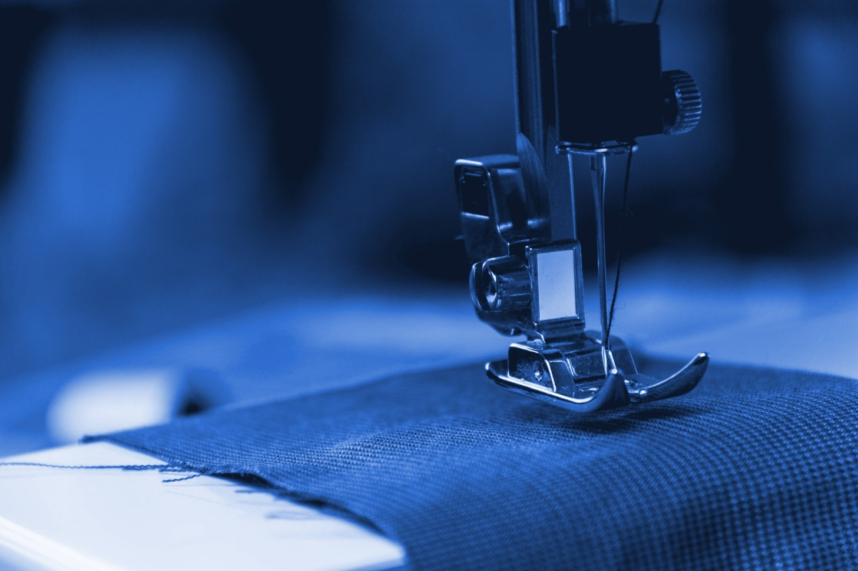
A VISION FOR THE
UZBEK TEXTILE INDUSTRY
Tashkent
8 october 2021

Slide 2
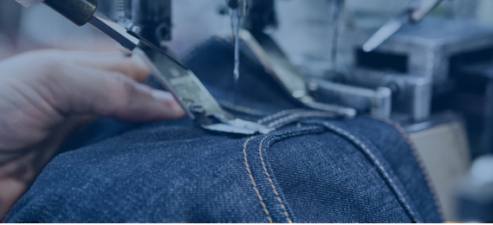




UZBEKISTAN IS AN OLD COUNTRY OF TEXTILE TRADITION ON ITS WAY TO BECOME A LEADING EXPORT-ORIENTED TEXTILE PRODUCTION PLATFORM
-
dynamic government empowering businesses and creating an enabling economic environment
strategic geographical location between Europe and Asia
own production of one of the best cottons in the world with a fully integrated manufacturing chain
fully integrated champions (from ﬁber to ﬁnished products under one roof)
wide base of young and modern designers
Uzbek textile industry will focus on sharpening its offering and reaching out to the rest of the world with unique product and service
-
A V I S I O N F O R T H E U Z B E K T E X T I L E I N D U S T R Y 02

Slide 3
UZBEKISTAN
~100%
GSP+
Regime since April 10th 2021
of cotton converted into
yarn in the country
0.035
14
Days to EU by truck
Cost of electricity (EUR/kWh)
~2 bn US$
Textile and clothing export in 2020
X 2.7
Export growth performance
from 2016 to 2020 (value-wise)
A V I S I O N F O R T H E U Z B E K T E X T I L E I N D U S T R Y 03

Slide 4
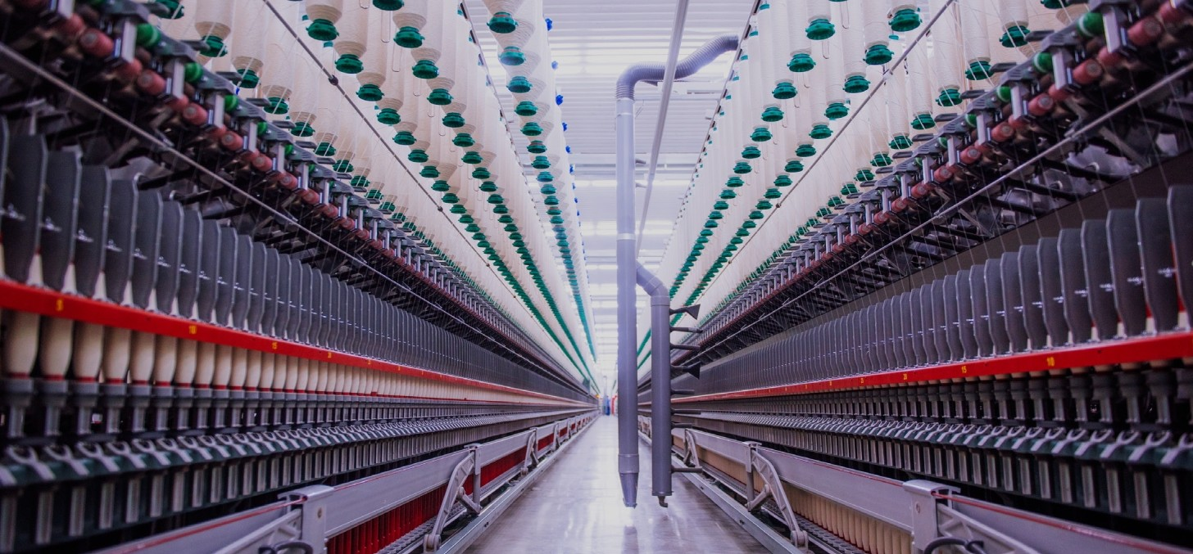



STRATEGY ARTICULATED IN FOUR PILLARS: THE TOP PRIORITIES FOR 2025
GUARANTEEING SUSTAINABILITY AND TRACEABILITY
BECOMING A NEW SOURCING HUB
ACCELERATING GLOBALIZATION
RAISING DIVERSIFICATION
Uzbekistan is only country for the last
25 years which manage to process 100% of its cotton
A V I S I O N F O R T H E U Z B E K T E X T I L E I N D U S T R Y 04

Slide 5
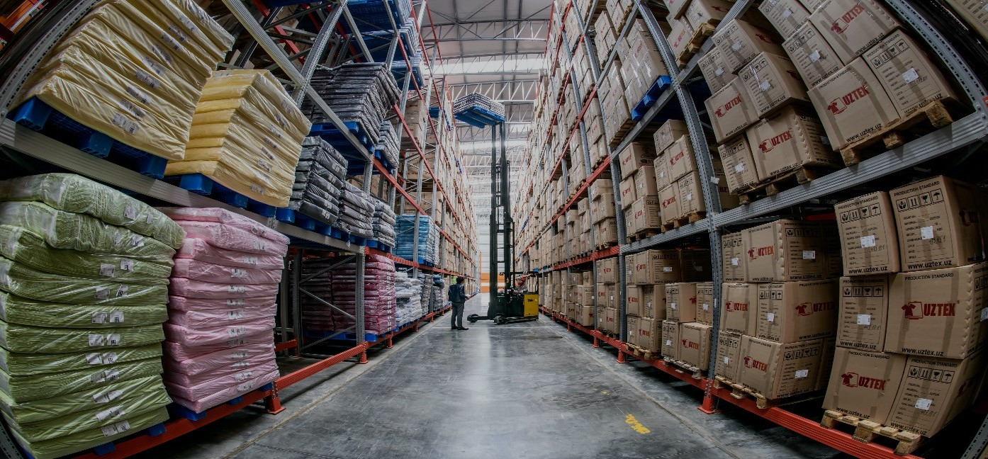
READY FOR THE FUTURE: OUR INDUSTRY IS AHEAD OF THE CURVE, DRIVING MODERNITY IN EVERY CORNER
CREATIVITY
-
MEETING THE WORLD
STATE-OF-THE-ART
NEW GENERATION
A V I S I O N F O R T H E U Z B E K T E X T I L E I N D U S T R Y 05

Slide 6
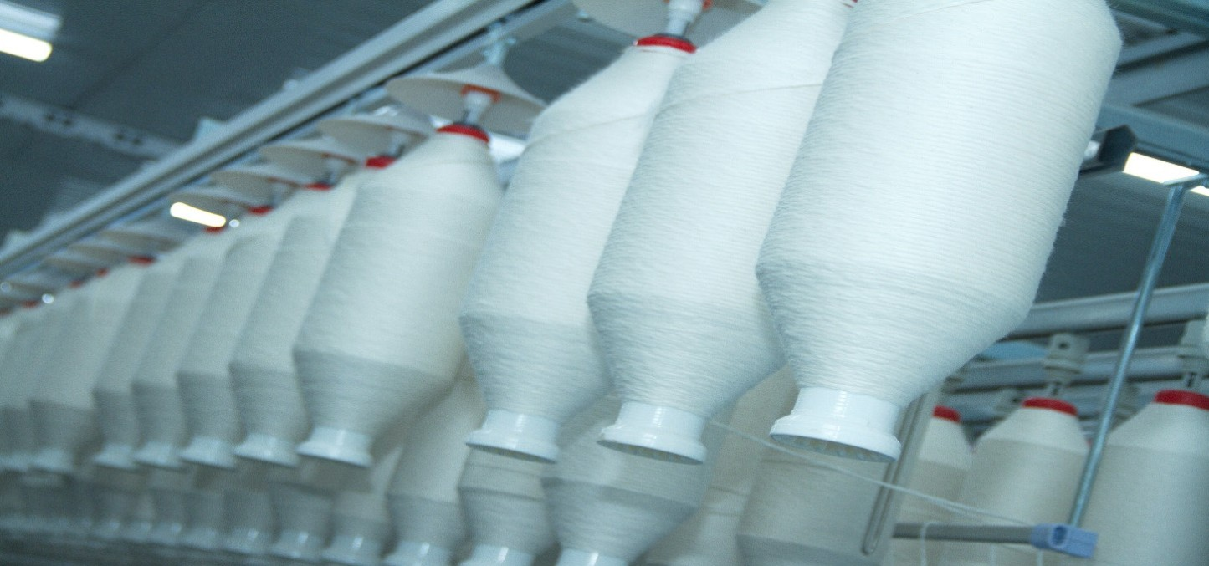
THE GAME CHANGER A WORLD LEADER IN THE MAKING
Uzbekistan has all the strategic tools to change the entire chain by offering a rare combination of speed to market and price competitiveness coupled with a fully transparent and integrated value chain
FULLY TRANSPARENT
Fully integrated value chain from
ﬁber to ﬁnished product.
RIGHT NEXT DOOR
Only 14 days by truck to Europe making it the supplier of choice for short lead times
DUTY FREE
Since April 10th 2021, GSP+ status allowing 6,200 Uzbek products to access the EU without custom duties
ASIAN COSTS IN EUROPE
Low manufacturing costs from labor to utilities and transportation.
GREAT COTTON
Home grown cotton world renowned for its superior quality.
CUTTING EDGE
Continuous investment in state-of- the-art manufacturing facilities
A V I S I O N F O R T H E U Z B E K T E X T I L E I N D U S T R Y 06

Slide 7
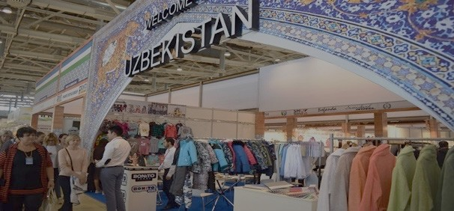


WHAT ARE OUR CHALLENGES?
-
DIVERSIFICATION
KNOW-HOW
MARKET ACCESS
GLOBAL INTEGRATION
A V I S I O N F O R T H E U Z B E K T E X T I L E I N D U S T R Y 07

Slide 8





Uzbekistan
A SOLUTION PROVIDER AND A FULL SOURCING PARTNER
UZBEKISTAN TEXTILE AND GARMENT INDUSTRY ASSOCIATION

