Slide 1
Image Quality Improvement using Deep Learning
Group E Members:
Aditya Kumar Singh(x20140410)
Aryan Rajput(x20128088)
Priyanka Ashok Sujgure (x20136706)

Slide 2
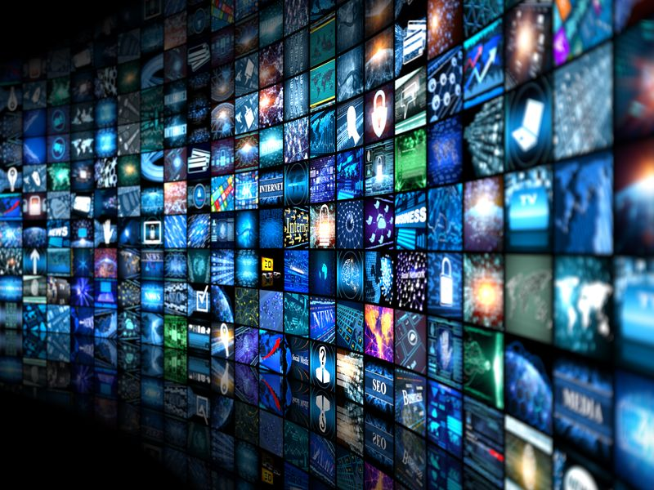
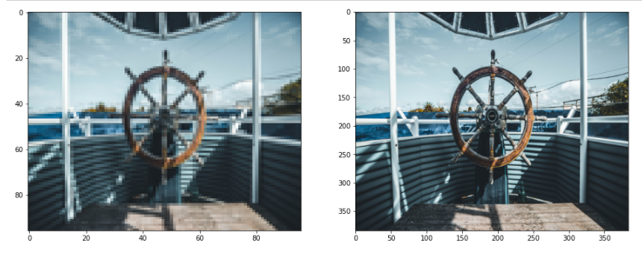
Introduction
Visual experience are important drivers in entertainment industry.
Imagery data consisting of 59% mobile internet traffic in 2017
This is further expected to rise to 79% till 2022

Slide 3

Research Question
Can deep learning algorithms be applied in image quality enhancement process to obtain super resolved images from a low-quality image input?

Slide 4
Methodology
Business understanding
Data understanding
Data preparation
Modeling
Evaluation
Deployment

Slide 5
GAN Structure

Slide 6
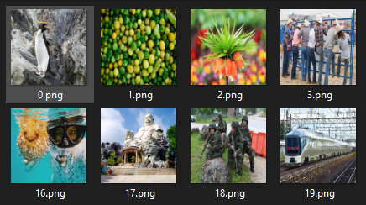
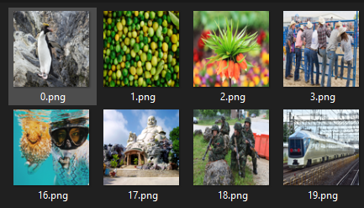
Data
High Resolution Images
Low Resolution Images

Slide 7
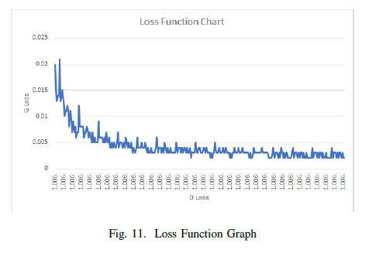
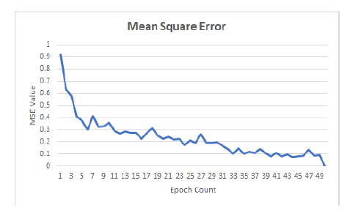
Model Training
Loss function chart
MSE for the trained model

Slide 8
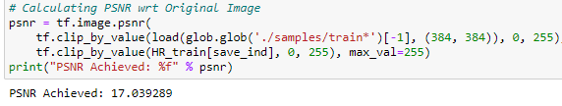
Model Evaluation

Slide 9
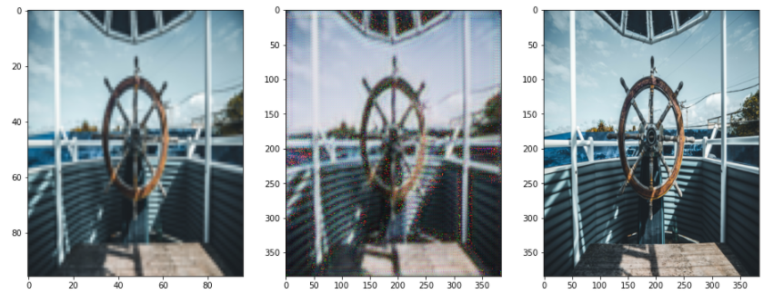
Project Evaluation
ORG. LOW RESOLUTION CONSTRUCTED IMAGE ORG. HIGH RESOLUTION

Slide 10
Conclusion and Future Works
Overall, 28.02 PSNR, value is achieved.
One drawback faced due to GAN is the lack of intrinsic metric for evaluation. It is unable to predict the density of an image.
The applied technique can be used on videos rather than single image.

Slide 11
Thank You.
Notes:
Thanks for your time.

