Slide 1

Employee Management System
Presented by: Asadullah Syed
Batch: 502

Slide 2
About me :
Background : B.COM(Computer Application)
LinkedIn : www.linkedin.com/in/asadullah-syed-b45451333
Github : https://github.com/Asadullah244
Joined Innomatics Research Labs to upskill in Data Anaylsis

Slide 3
Agenda :
• Business Problem
• Problem Statement
• Introduction
• Objective
• Table Overview
• ER Diagram
• SQL Queries & Results
• Business Insights
. Recommendation
• Conclusion

Slide 4
Business Problem
Organizations face difficulties in managing employee records, payroll, leave tracking, qualifications, and departmental information using manual processes. These challenges lead to data redundancy, payroll errors, inefficient reporting, and delayed decision-making. The proposed Employee Management System provides a centralized database solution to automate employee management, payroll processing, leave tracking, and report generation, thereby improving efficiency, accuracy, and productivity.

Slide 5
Problem Statement
Employee records are managed manually, making data handling difficult and time-consuming.
Payroll processing is prone to errors due to disconnected systems and manual calculations.
Tracking employee leaves and qualifications becomes challenging as the organization grows.
Generating reports for management takes more time and may lead to inaccurate decision-making.
A centralized Employee Management System is required to improve efficiency, accuracy, and data management.

Slide 6
Introduction
The Employee Management System is a database-driven solution designed to efficiently manage employee information, job departments, payroll, qualifications, and leave records within an organization. It centralizes workforce data into a single system, reducing manual effort and improving data accuracy.

Slide 7
Objective of the Project
• Centralized employee database
• Manage qualifications and leave records
• Automate payroll
• Ensure data integrity
• Support decision-making

Slide 8
Table Overview
Job Department : Stores job roles and department details.
Salary Bonus : Stores salary and bonus information.
Employee : Stores employee personal information
Qualification : Stores employee qualifications and skills.
Leaves : Stores employee leave records.
Payroll : Stores employee payroll and payment details.

Slide 9
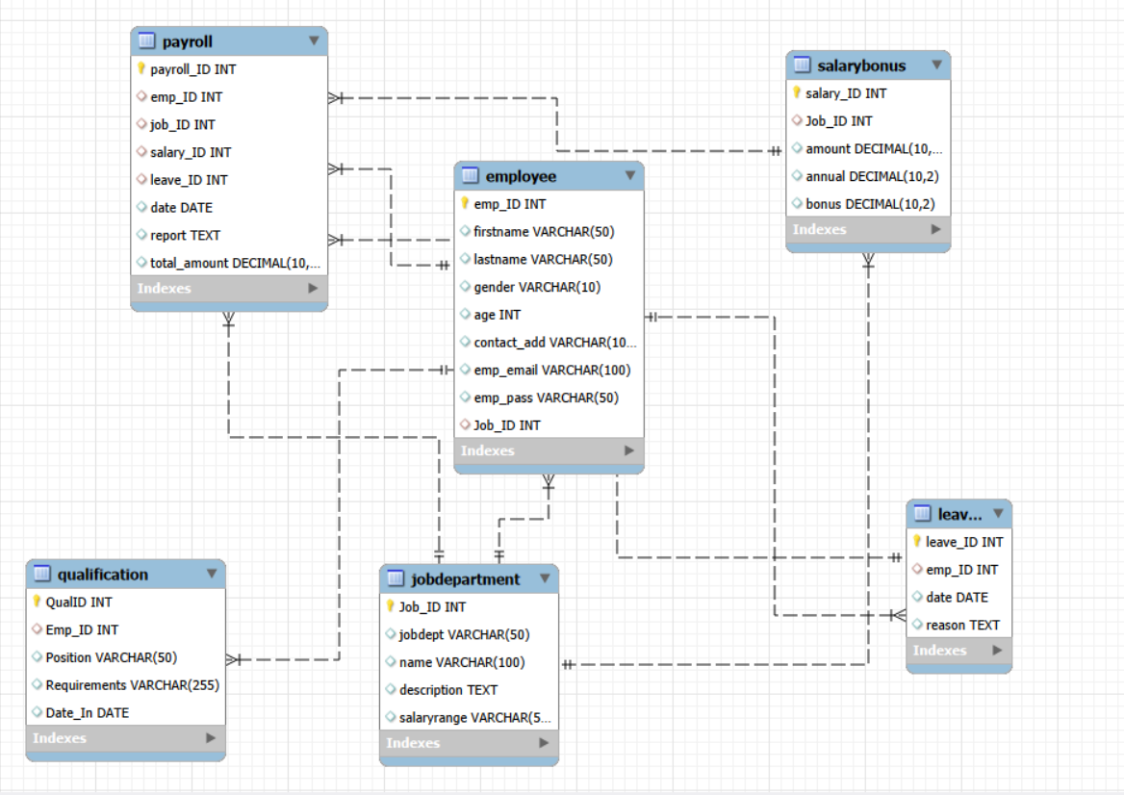
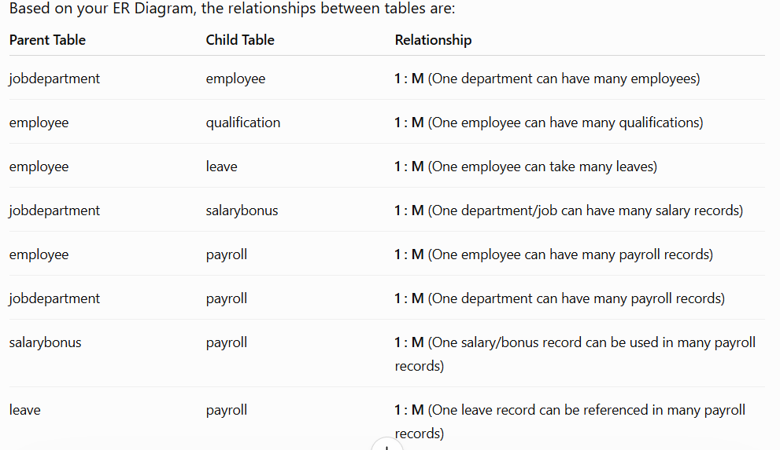
ER Diagram

Slide 10
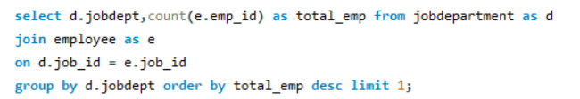

Which departments have the highest number of employees?
Business Insight: This query helps management identify the largest departments, understand workforce distribution, and plan hiring, budgeting, and resource allocation accordingly.

Slide 11
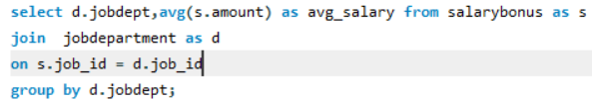
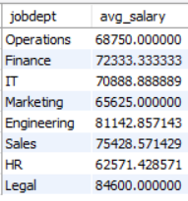
What is the average salary per department?
Business Insight : The IT department has the highest average salary, indicating a greater investment in technical talent.

Slide 12

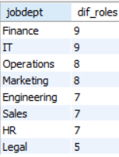
How many Different job roles in each department.
Business Insight: Departments with a higher number of job roles indicate a more diverse

Slide 13
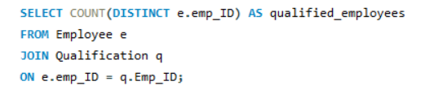

How many employees have at least one qualification listed?
Business Insight: This metric helps assess the overall qualification level of the workforce and identify skill gaps within the organization.

Slide 14
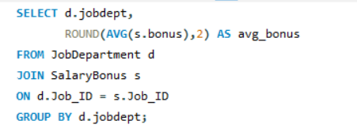
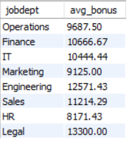
Average bonus per department.
Business Insight: This analysis helps identify departments receiving the highest average bonuses.

Slide 15
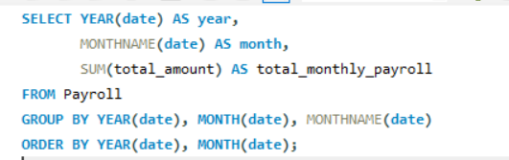

What is the total monthly payroll processed
Business Insight: This metric shows the total salary expenditure processed by the company

Slide 16
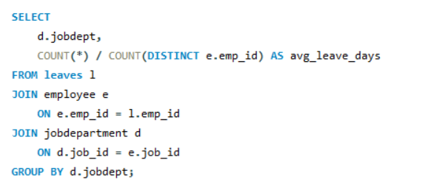
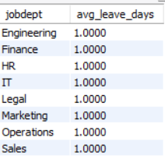
Average leave days per department.
Business Insight: This metric helps identify departments with higher absenteeism and evaluate employee attendance patterns

Slide 17
Business Key Insights
Insights on employee distribution, salaries, qualifications, leaves, and payroll expenses support workforce planning and budgeting.
The Finance Department has the highest number of employees, indicating a larger workforce requirement.
The IT Department has the highest average salary, reflecting the demand for specialized technical skills.
Employee qualification and payroll analysis help management make better decisions regarding workforce planning and budget allocation.

Slide 18
Recommendation :
Improve data accuracy by regularly updating employee records.
Automate employee and payroll management to save time.
Use the system for better tracking of employee performance and attendance.

Slide 19
Conclusion
The Employee Management System provides an efficient way to manage employee records, payroll, qualifications, and leave details in a centralized database. It improves data accuracy, reduces manual work, and helps organizations make better workforce and payroll management decisions.

Slide 20

THANK YOU

