Slide 1
Womanium Quantum+AI 2024 Project: Quantum Machine Learning for Conspicuity Detection in Production
By - Dirac Dynamics/Asadullah Bin Rahman

Slide 2
Outline
Task 4: Quantum Regression Model for sine function
Task 3: Quanvolutional Neural Network for MNIST digit classification
Task 5: Quanvolutional Neural Network for Conspicuity Detection in Production
02/21

Slide 3
Task 4
Problem statement: Implement a Quantum Machine Learning model that reproduces the values of the sine function
03/21

Slide 4
Task 4
Problem solution: Implemented 2 methods: 1 layer and 4 layer 1 qubit Quantum Regression Model
Approach:
Data Generation: 100 data points, 30% for testing
Quantum Regression Model: Encoding: Angle Embedding, Ansatz(e): 1 layer and 4 layer of rotation gates
Cost function and Optimization: Gradient Descent Optimizer
Result & Discussion
04/21

Slide 5
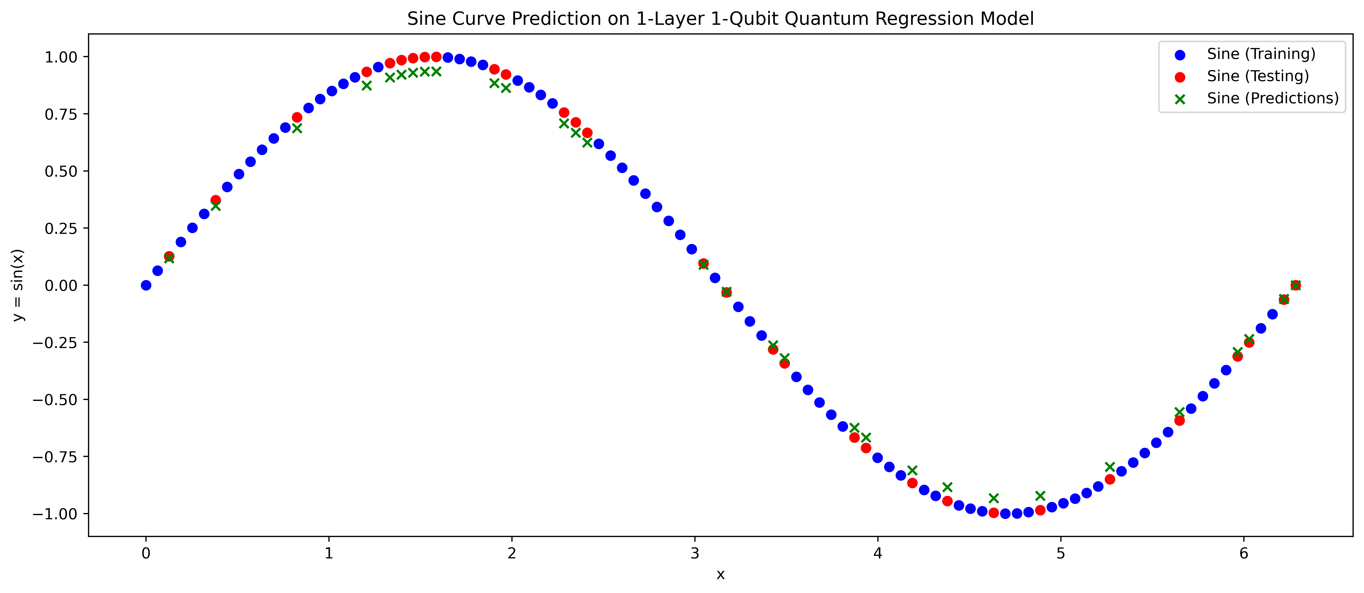
Task 4
05/21

Slide 6
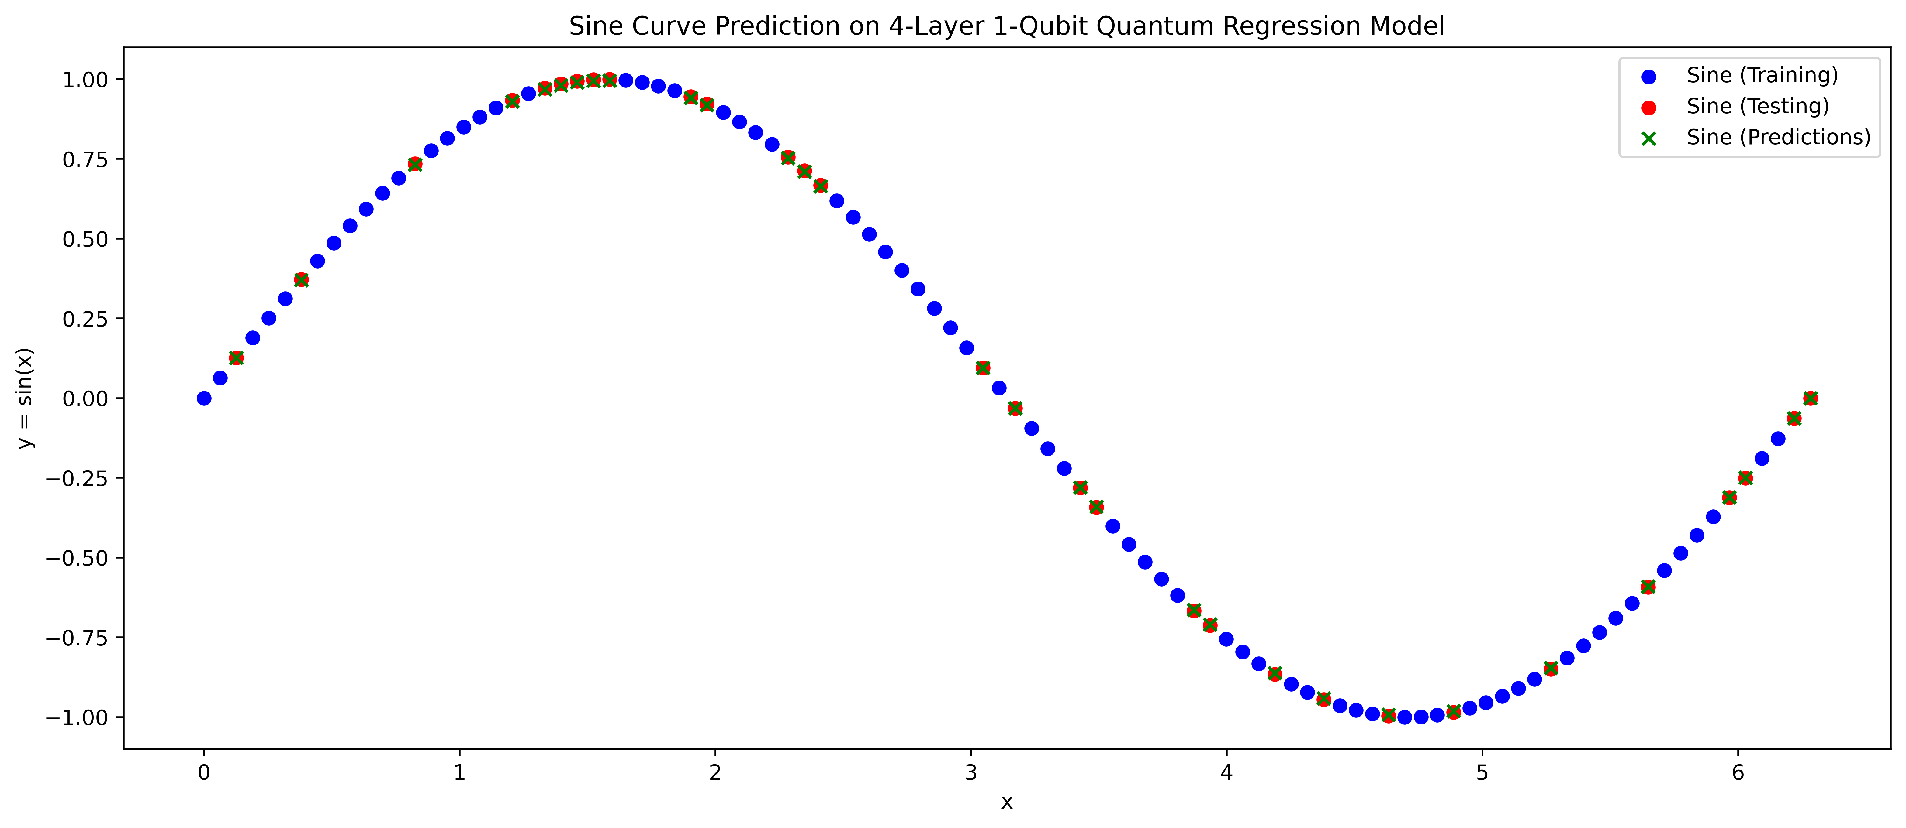
Task 4
06/21

Slide 7
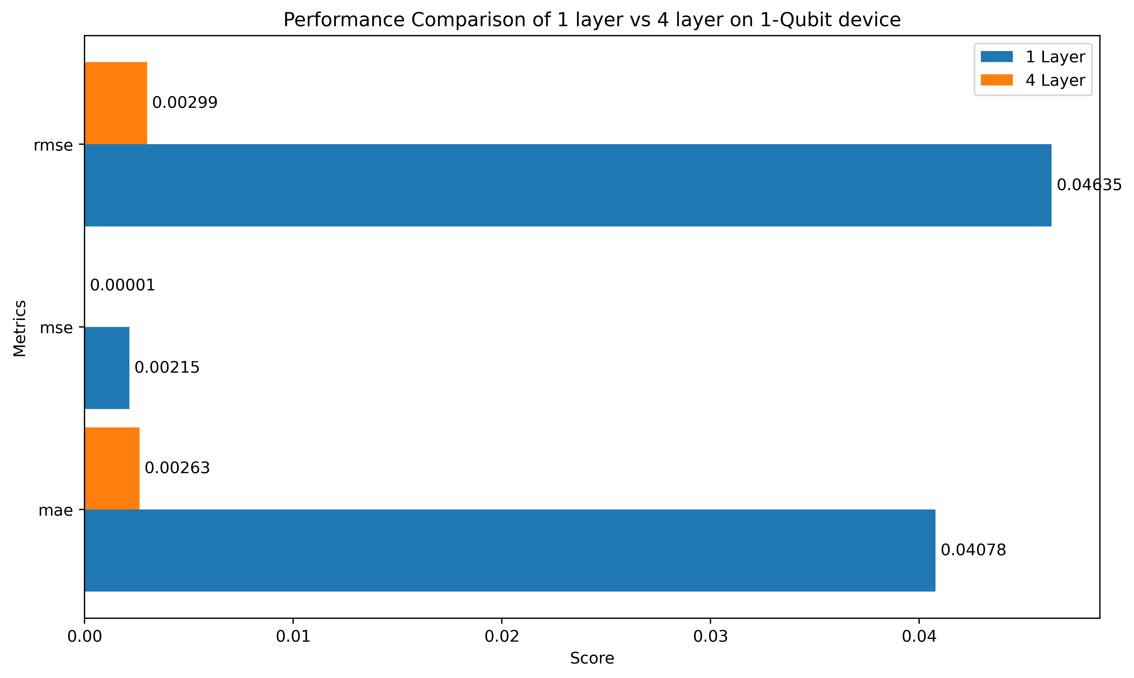
Task 4
07/21

Slide 8
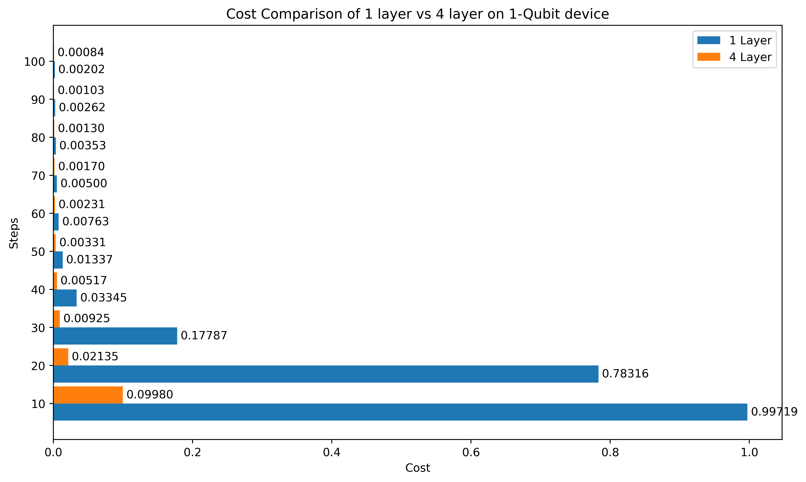
Task 4
08/21

Slide 9
Task 4
References:
How to start learning quantum machine learning by Catalina Albornoz - https://pennylane.ai/blog/2021/10/how-to-start-learning-quantum-machine-learning/
And her forum discussion: Variational Quantum Regressor in Pennylane - https://discuss.pennylane.ai/t/variational-quantum-regressor-in-pennylane/1515 and Help with Regression Model Training: https://discuss.pennylane.ai/t/help-with-regression-model-training/4615/3
High expressibility/more parameters give access to more Hilbert space - Expressibility and entangling capability of parameterized quantum circuits for hybrid quantum-classical algorithms: https://arxiv.org/abs/1905.10876
09/21

Slide 10
Task 3
Problem statement: Implement a Quanvolutional Neural Network for MNIST digit classification
Approach:
Dataset: 350 training, 50 validation, 100 data for final testing
Models: Quantum classical hybrid CNN model, Classical CNN model
Hybrid CNN model(Quantum part): 3x3 kernel with stride = 2 for the quanvolutional layer, Encoding: RY gate, Ansatz: 4 Strongly Entangling layers with imprimitive = CZ
10/21

Slide 11
Task 3
Approach cont.:
Hybrid CNN model(Classical part): Convolutional 3x3 kernel with 32 channels, Maxpooling with 2x2 kernel, Dense layer with 64 nodes, 10 classifying dense nodes, dropout of 50% is imposed in the middle
Classical CNN: Hybrid CNN(Classical part)
Performance comparison
11/21

Slide 12
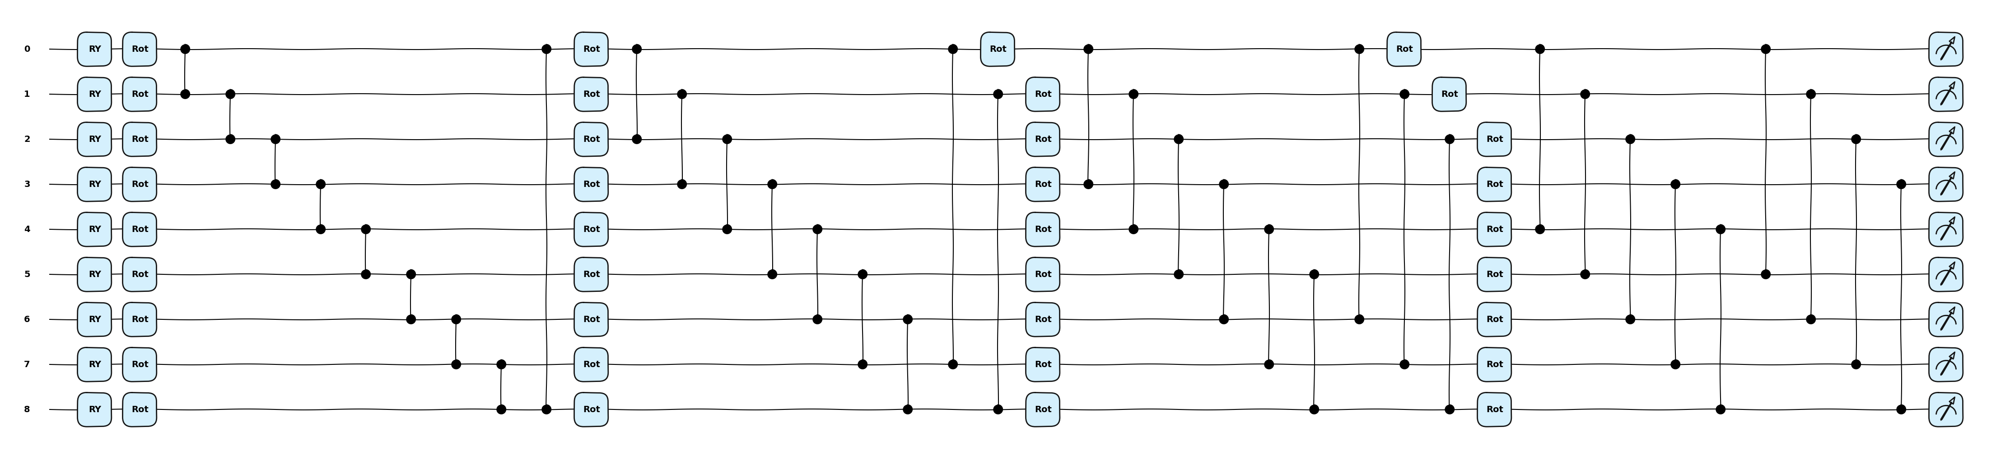
Task 3
Ansatz
12/21

Slide 13
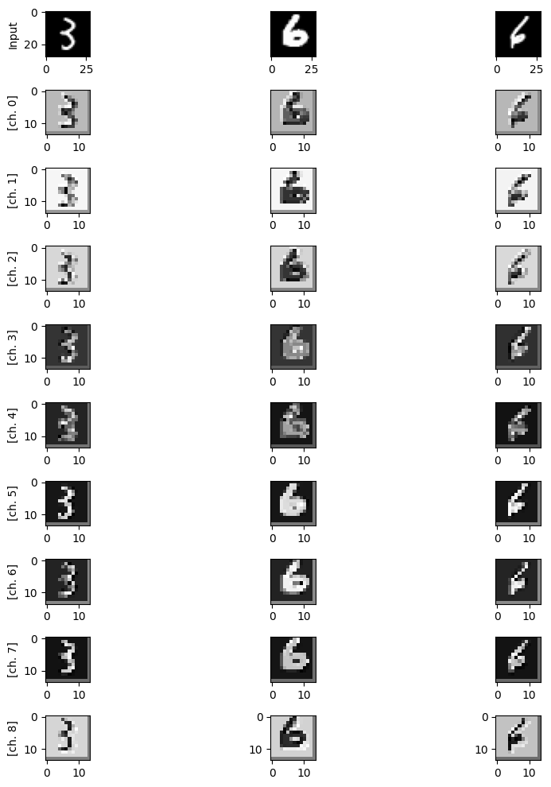
Task 3
9 output channels
13/21

Slide 14
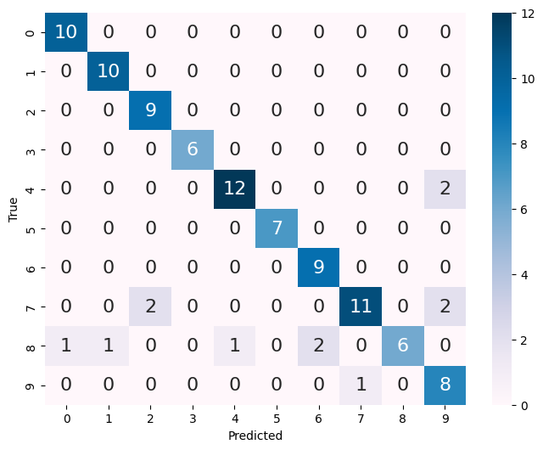
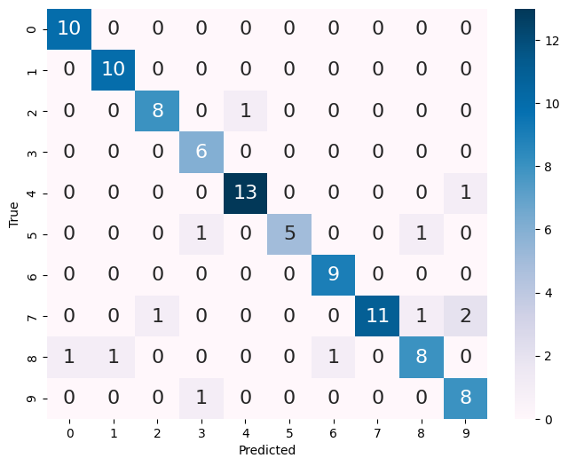
Task 3
Confusion matrix(Hybrid)
Confusion matrix(Classical)
14/21

Slide 15
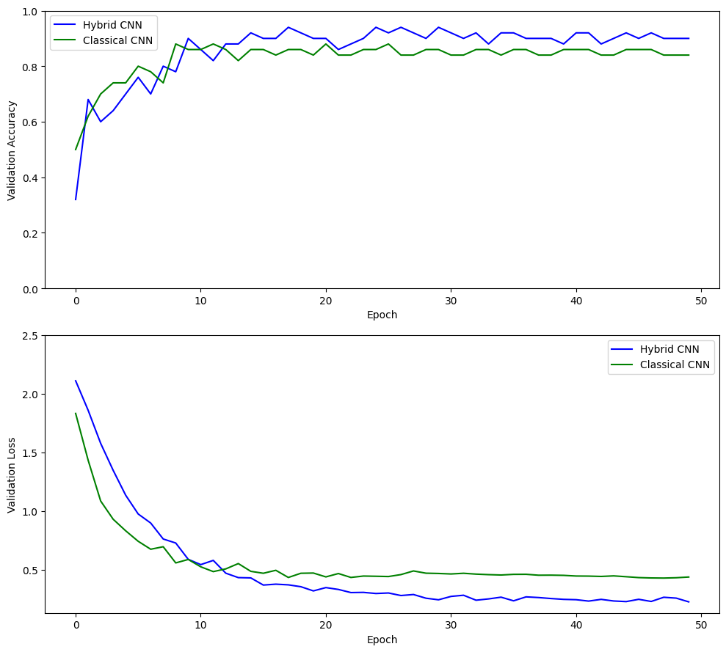
Task 3
Hybrid Model Performance:
Overall Accuracy (OA): 88.00%
Cohen's Kappa: 86.6086%
Average Accuracy (AA): 90.25%
Classical Model Performance:
Overall Accuracy (OA): 88.00%
Cohen's Kappa: 86.6012%
Average Accuracy (AA): 88.81%
15/21

Slide 16
Task 3
References:
Quanvolutional Neural Networks https://pennylane.ai/qml/demos/tutorial_quanvolution/ by Andrea Mari
16/21

Slide 17
Task 5
Problem statement: Implement a Quanvolutional Neural Network for Conspicuity Detection in Production
Approach:
Dataset: 100 training, 10 validation, 50 data for final testing. 2 classes 0, and 1, from 6 classes.
Model: Quantum classical hybrid CNN model from task 3
Quantum Circuit as a layer: tf.py_function to wrap the output from the quantum circuit to tensorflow and implemented a new layer, QuantumConv2D.
17/21

Slide 18
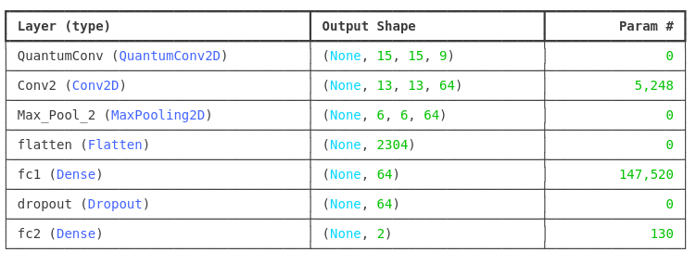
Task 5
Hybrid Model
18/21

Slide 19
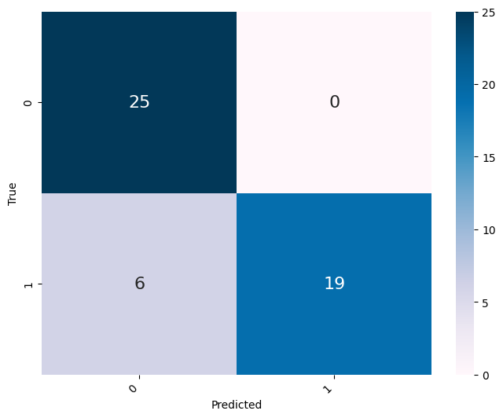
Task 5
Accuracy: 88.00%
Cohen's Kappa: 76.00%
Precision: 1.0000
Recall (Sensitivity): 0.7600
Specificity: 1.0000
F1 Score: 0.8636
Confusion matrix
19/21

Slide 20
Task 5
Future work:
More comprehensive analysis using the whole dataset to see how the model performs
Different embedding and ansatze
Choosing other classes as well
20/21

Slide 21
Q&A
Thank You!
21/21

