Slide 1

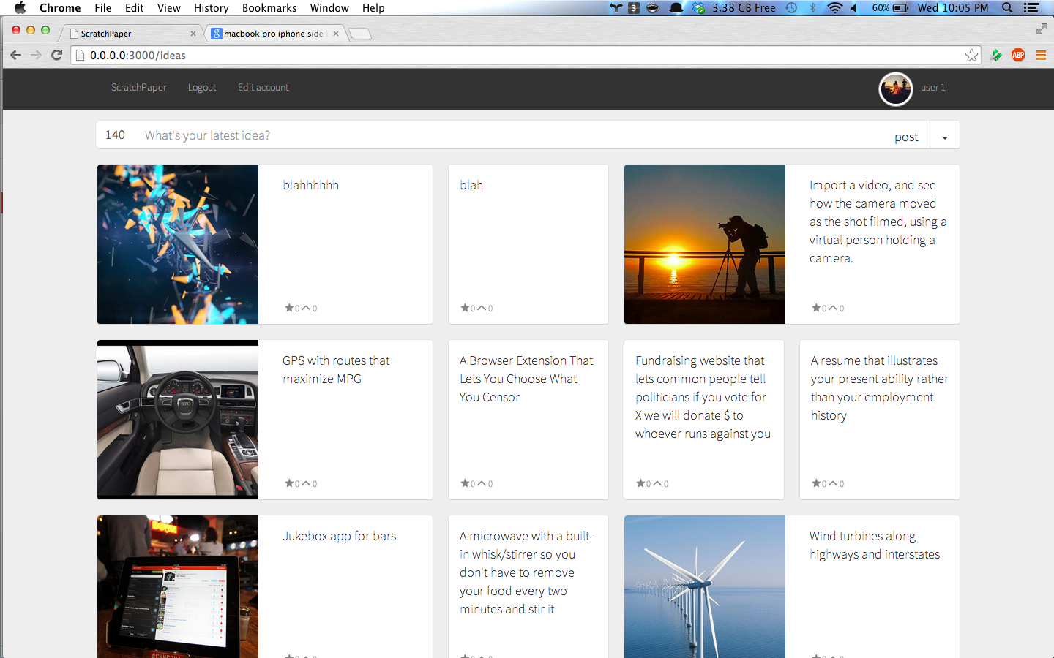
Scratchpaper

Slide 2
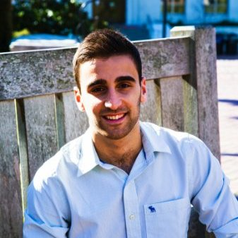

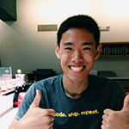
Meet the Team
Scratchpaper
Asaf Avidan Antonir
Nick Freeman
James Sha
Berkeley EECS
Previous: LinkedIn
Future: Microsoft
Berkeley CS/Econ
Previous: LinkedIn
Future: Microsoft
Berkeley EECS
Previous: Research
Future: Facebook
Team | Mission | Features | Market | Conclusion

Slide 3


The Mission
Scratchpaper
We aim to help the best developers around the world work on today’s most pressing problems.
We empower those who face day to day problems with a voice within the tech industry
Team | Mission | Features | Market | Conclusion

Slide 4
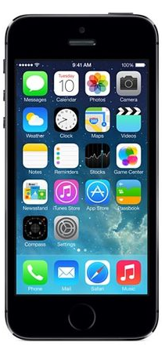
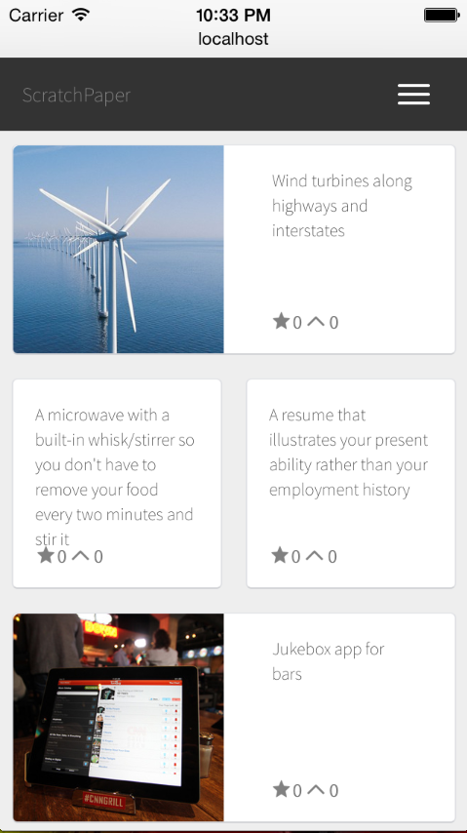
The Feed
Scratchpaper
Team | Mission | Features | Market | Conclusion

Slide 5
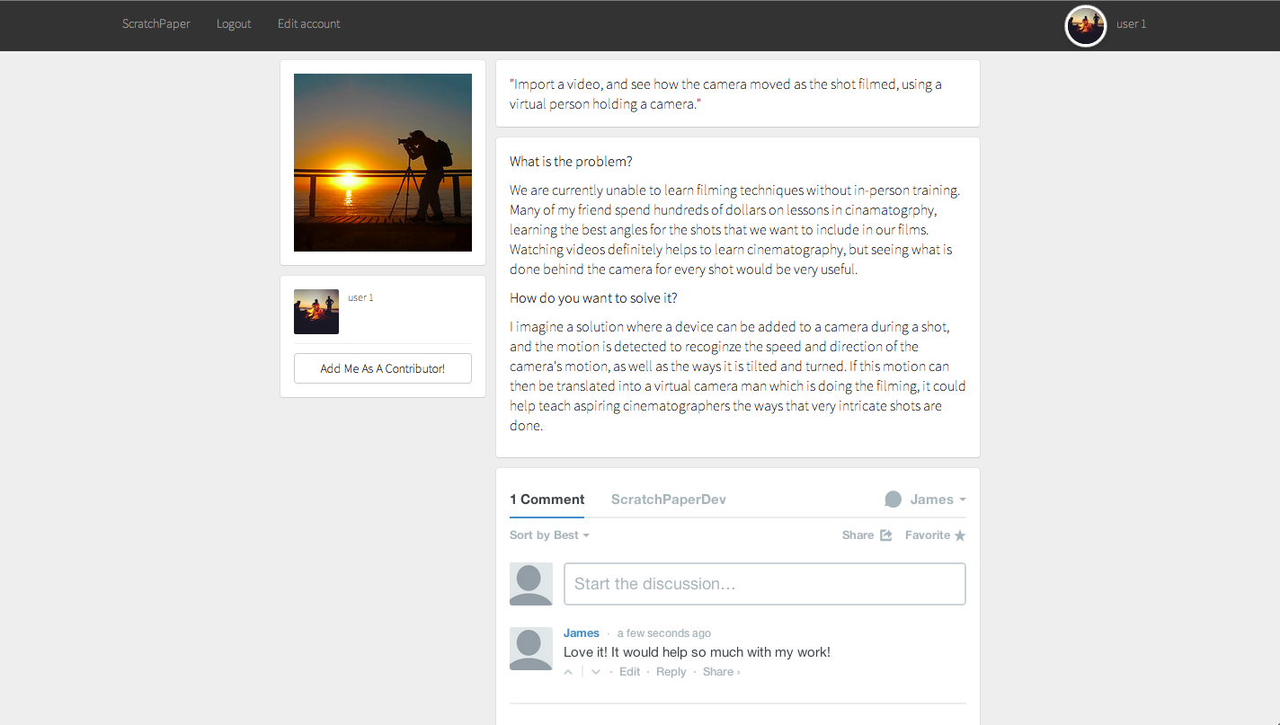
The Idea
Scratchpaper
Team | Mission | Features | Market | Conclusion

Slide 6

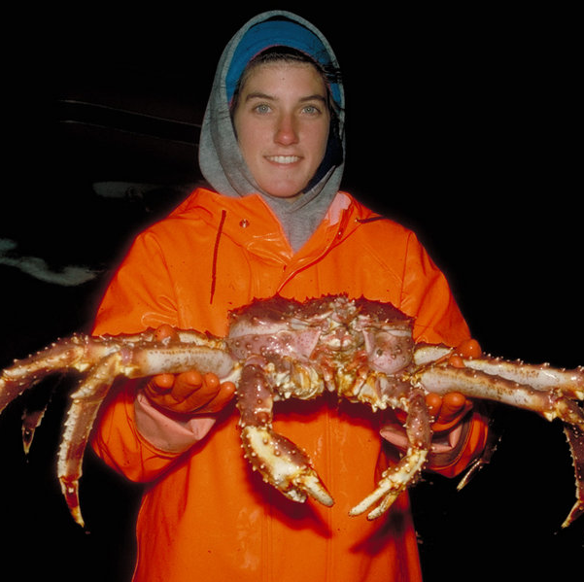






The Users
Scratchpaper
Thinkers
Creators
Team | Mission | Features | Market | Conclusion

Slide 7
Scratchpaper
Scratchpaper
Build what Matters
Team | Mission | Features | Market | Conclusion

Slide 8
Scratchpaper
Q/A

