Slide 1










DOPA
Doctor’s Personal Assistance

Slide 2

The Problem
37%
Time spent on EMR and
paper work

Slide 3
Our Solution
Automated Medical Transcription
Summarization of Medical Records
Personal Recommendations

Slide 4
DEMO

Slide 5
Business Plan
S
STRENGTHS
WEAKNESS
T
W
SWOT
THREATS
OPPORTUNITIES
O
Notes:
Strengths – Skilled Engineers
Weakness – Needed an expert in the healthcare industry
Threats – HIPAA Compliance
Strengths – Skilled Engineers

Slide 6
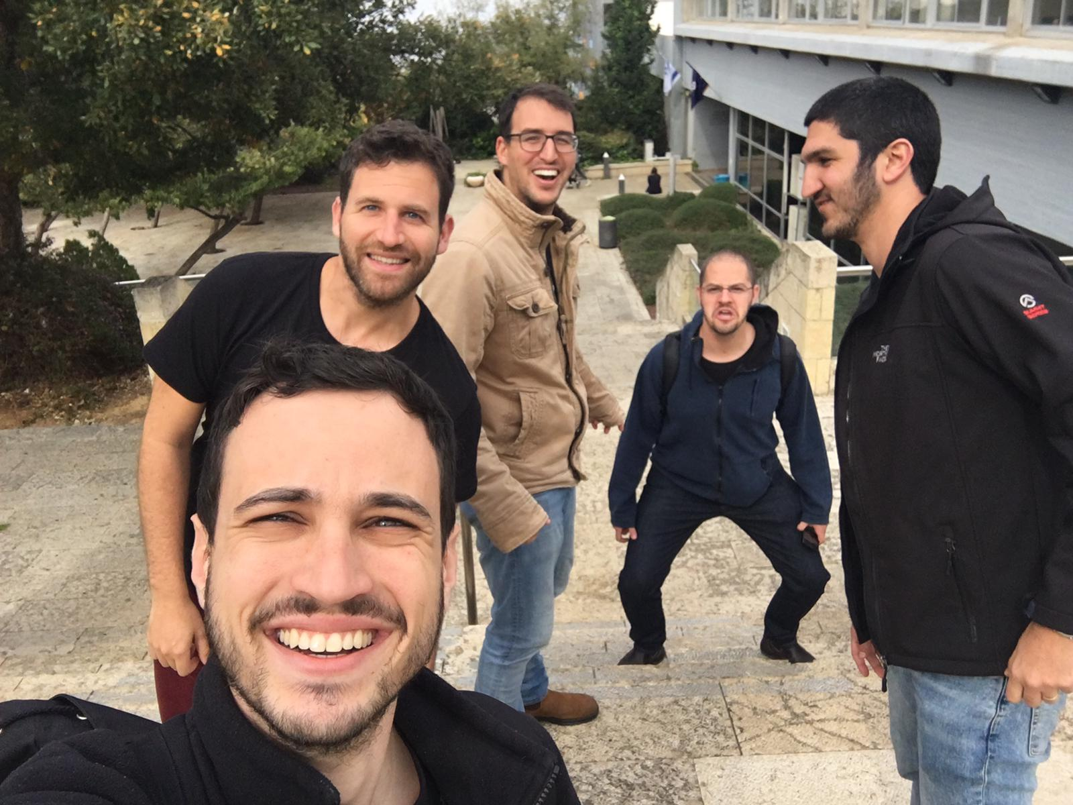
Our Team

Slide 7

Thank You

