Slide 1
Developing an 8-Bit Atari game Created by Yaron Nir (yaronnir2006@gmail.com)

Slide 2
Starting questions
How many developers
Leading languages
Game developers

Slide 3
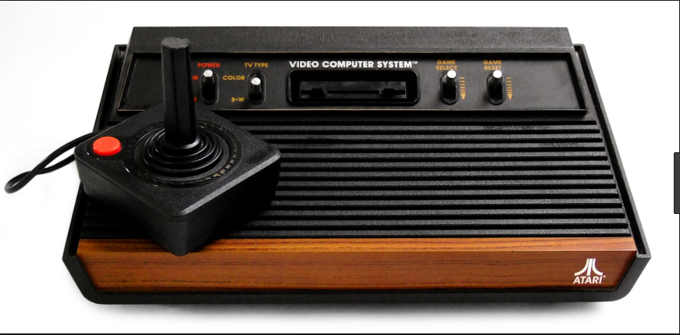
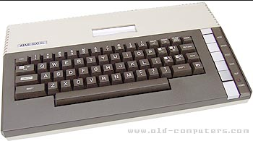
About myself
44 , married + 2 children
Teva Pharmaceutical, Technical owner , Digital Health Platform
ooVoo startup company, 13 year, last role VP R&D

Slide 4
Back in the 80s
Either Basic or Assembly (needed special cartridge)
Monthly magazines
Small collection of books
No strong debugger
No development IDE
No sound tools
No stack overflow
No internet examples
No social media
No YouTube lessons
NOTHING!

Slide 5
What do we have now?
High languages (C, Action!, Pascal, Turbo Basic and more)
Strong assembly compilers
Strong tools to create levels, characters, sprites, splash screens and much more
PC emulators such as Altirra, AtariWinPlus
Sound utilities such as RTM128
Online reference
Strong leading forums such as Atari Age
YouTube tutorials
Social Media

Slide 6
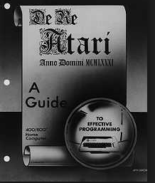
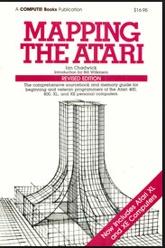
Learn The Atari Inside Out

Slide 7
Atari 8 Bit Internals
Main processor – 6502 instructions
Graphics chips – ANTIC/GTIA
POKEY chip – sound and I/O
ANTIC Display List
Graphics modes
Multi-color screens
Hi-Res
Screen Scrolling – Fine Scrolling
Hardware Sprites – 4 players, 4 missiles (5th player)
Software Sprites
Custom characters
Joystick controllers
Sound

Slide 8
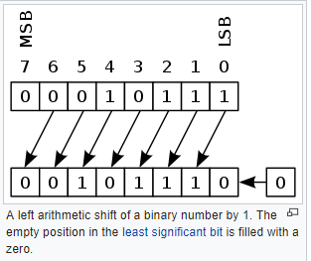
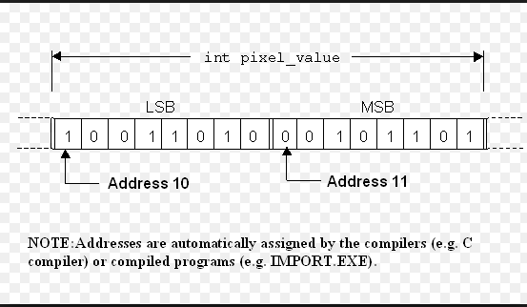
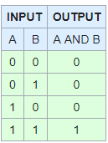
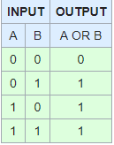
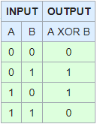
Arithmetic and Bitwise
Bit Shifting
Peek & Poke
And/Or/XOR

Slide 9
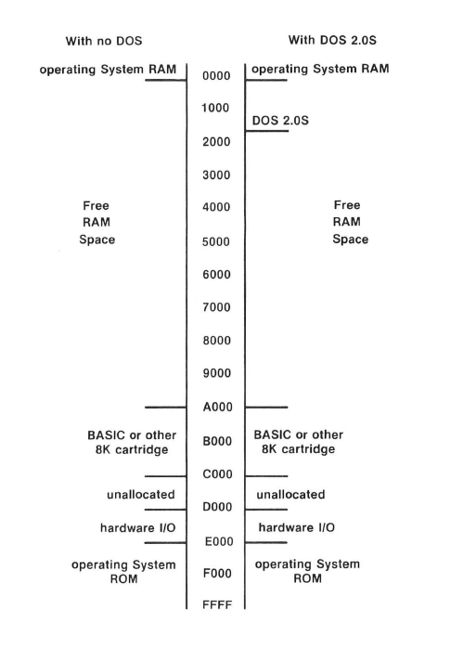
Atari Memory Layout

Slide 10
Atari Memory
$00-$FF - zero page for the operating system (don’t use)
$80-$FF - zero page to be used in your program
$100-1FF - CPU stack
$200-$2FF – OS vectors , registers (for example color registers)
$300-$3FF – OS vectors, registers
$400-$5FF – OS buffers (used for example for converting operations)
$600-$6FF – Page 6. used for object code in basic programs (don’t use)
$700 - $1FFF – Disk operating system (don’t use)
$2000-RAMTOP – our code
$8000-$9FFF – used for cartridge (8K cart / part of 16K cart)
$A000-$BFFF – used for cart (8K cart / high part of 16K cart)
$C000 - $CFFF – operating system part 1
$CC00 - $CFFF – operating system international character set
$D800 - $DFFF – FPP –(Floating point package for operating system floating point operations)
$E000 - $FFFF – operating system part 2
$E000-$E3FF – operating system default character set

Slide 11
Chip Memory Map
Each chip map holds 1 page (256 bytes) but not all of the page is used
$D000-$D0FF – GTIA chip (television interface adapter, provides pixels, colors, sprites/player missiles, console input keys, beep)
$D100- $D1FF – PBI (parallel ports, external chips that are not built in)
$D200 – $D2FF - POKEY (paddle, keyboard, serial IO and Audio)
$D300 - $D3FF – PIA (joystick, MMU memory layout, for example switching off basic or OS)
$D400 - $D4FF – ANTIC (DMA to feed GTIA with data)
$D500 - $D5FF – Module Port (R/W)
$D600-$D7FF – Reserved (for built in extensions such as VBXE(

Slide 12
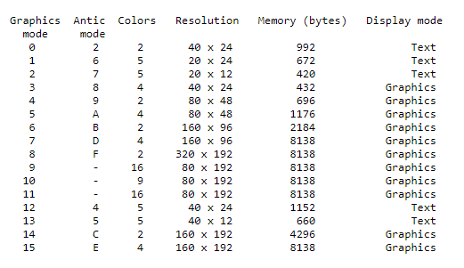
Atari Graphics

Slide 13
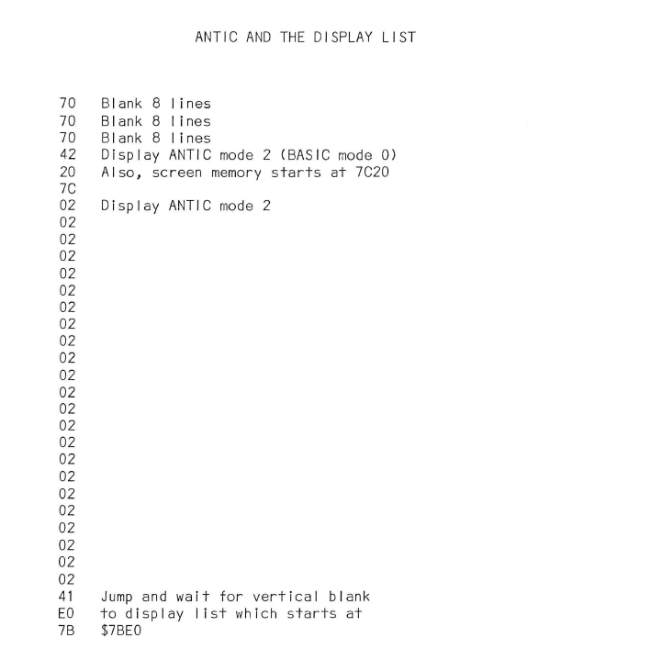
Display List

Slide 14
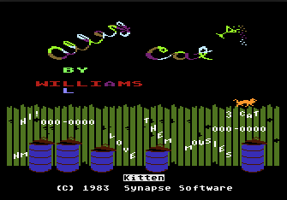

Slide 15
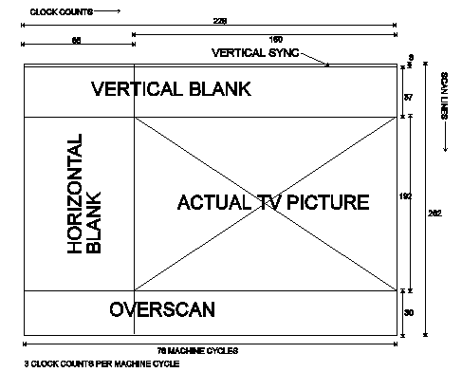
Display List Interrupt - DLI

Slide 16
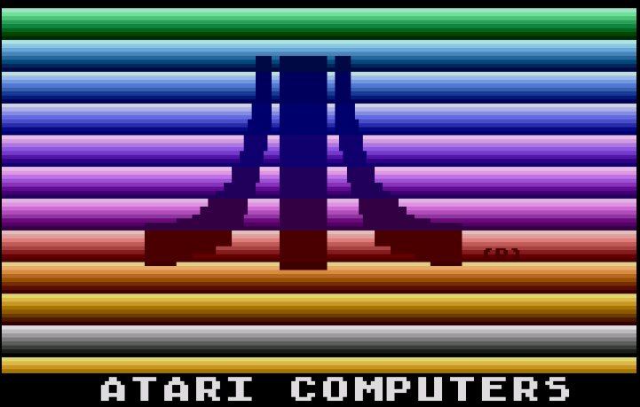

Slide 17
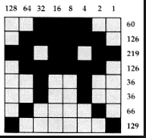
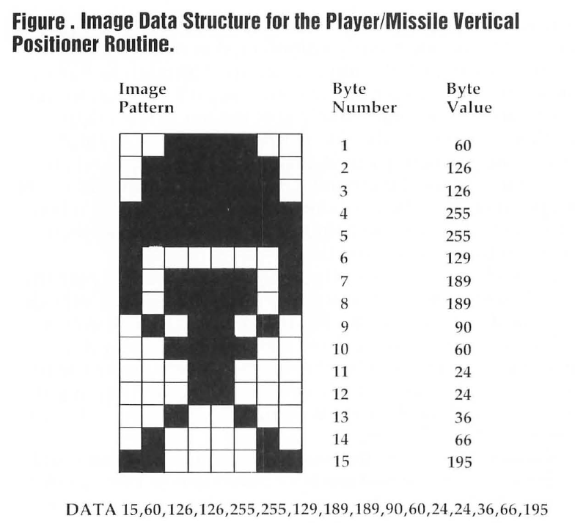
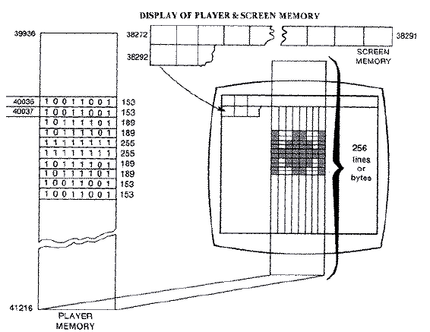
Sprites

Slide 18
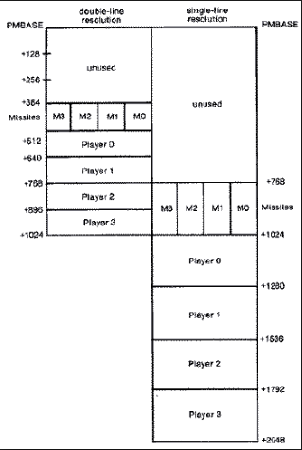
Player Missile Graphics – Hardware Sprites

Slide 19
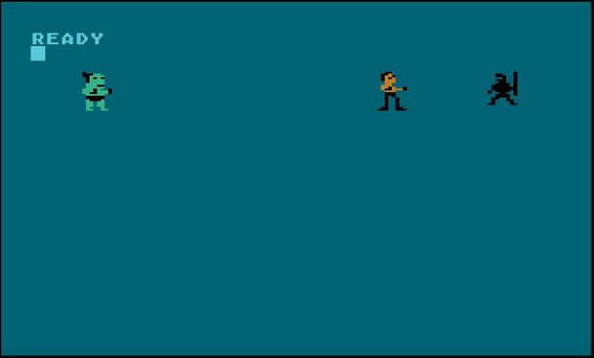
Player Missile Single Line

Slide 20
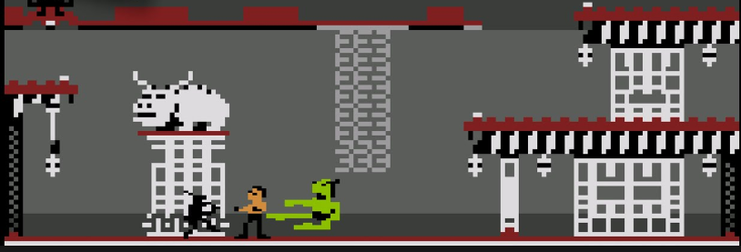
Player Missile Double Line

Slide 21
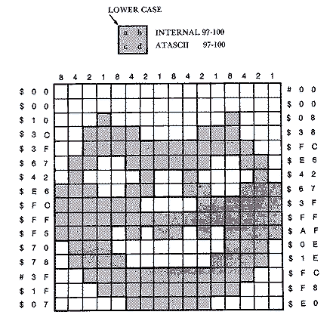
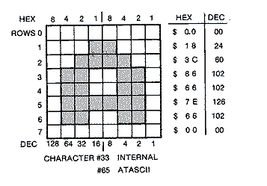
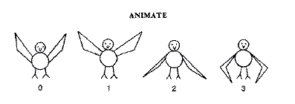
Characters Set

Slide 22
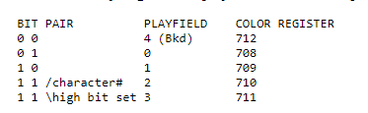
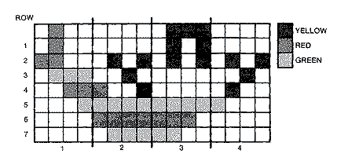
Multicolor Character Set

Slide 23
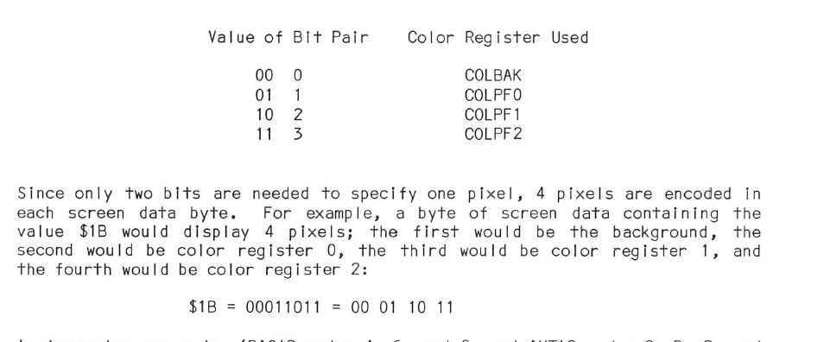
Multicolor Character Set – Continue

Slide 24
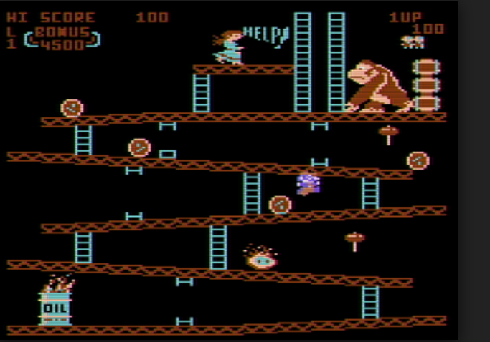
Game screen

Slide 25
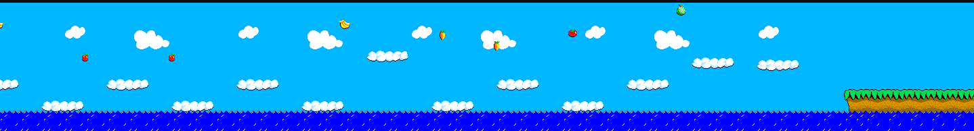
Game Screen

Slide 26
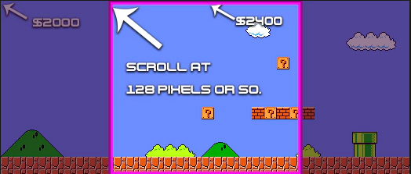
Screen Scrolling

Slide 27
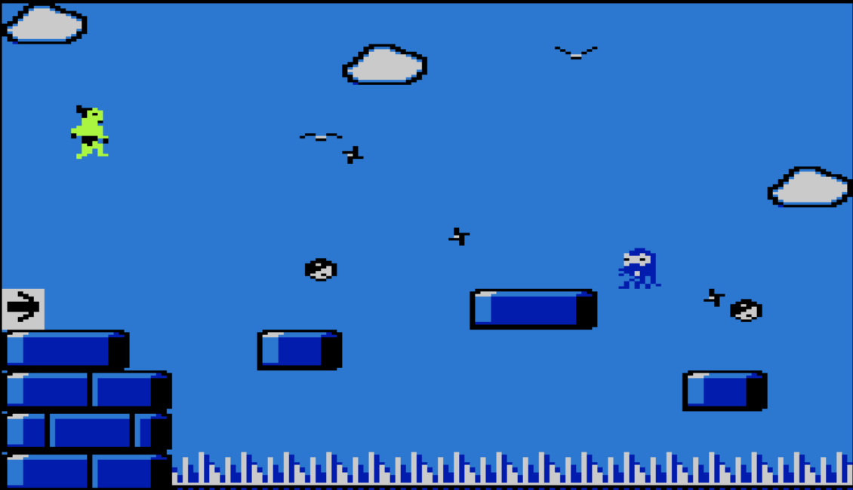
Everything happens in the main loop

Slide 28
Where do I start?

Slide 29
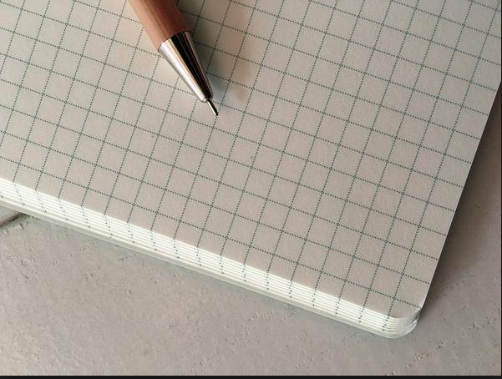
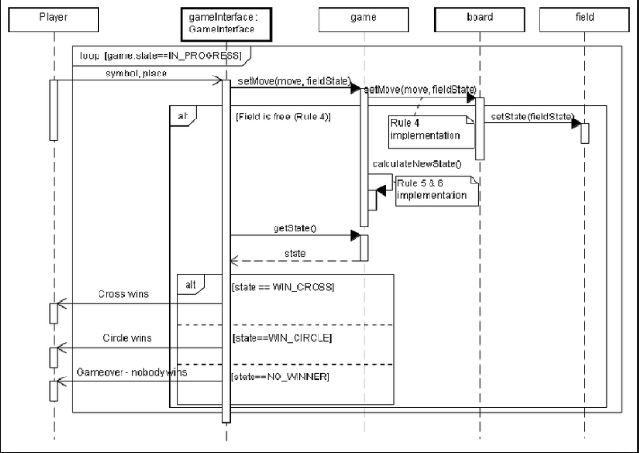
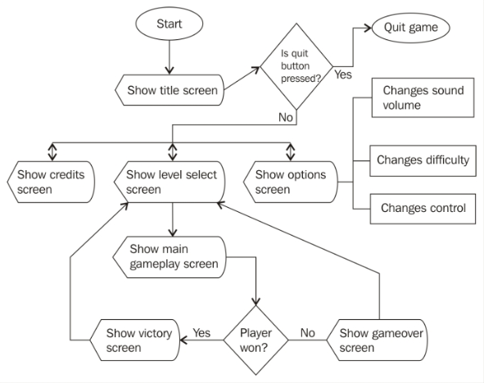

Slide 30
IDE used for development

Slide 31
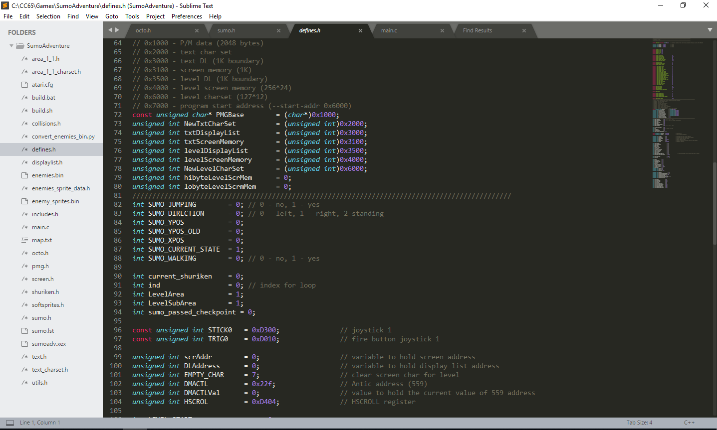

Slide 32
Emulators for Atari

Slide 33
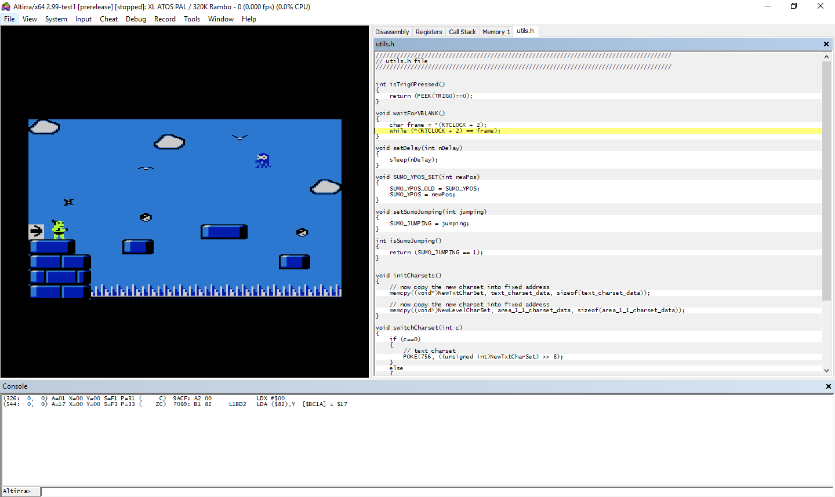

Slide 34
Tools to build custom character set

Slide 35
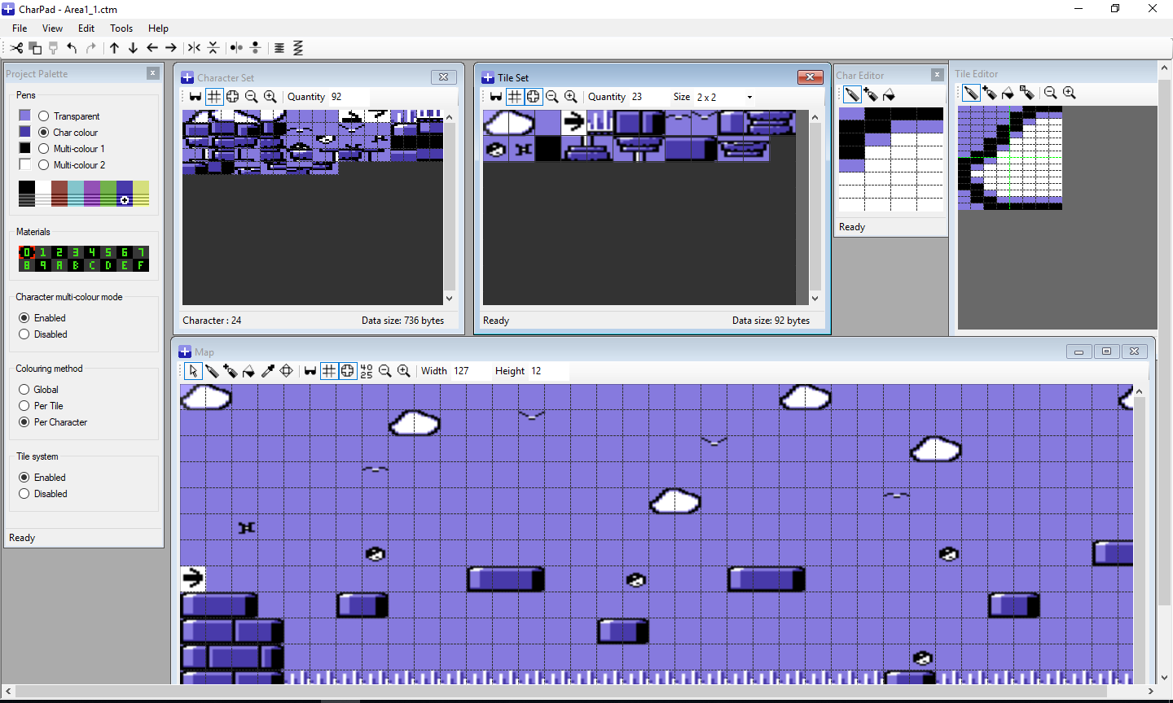

Slide 36
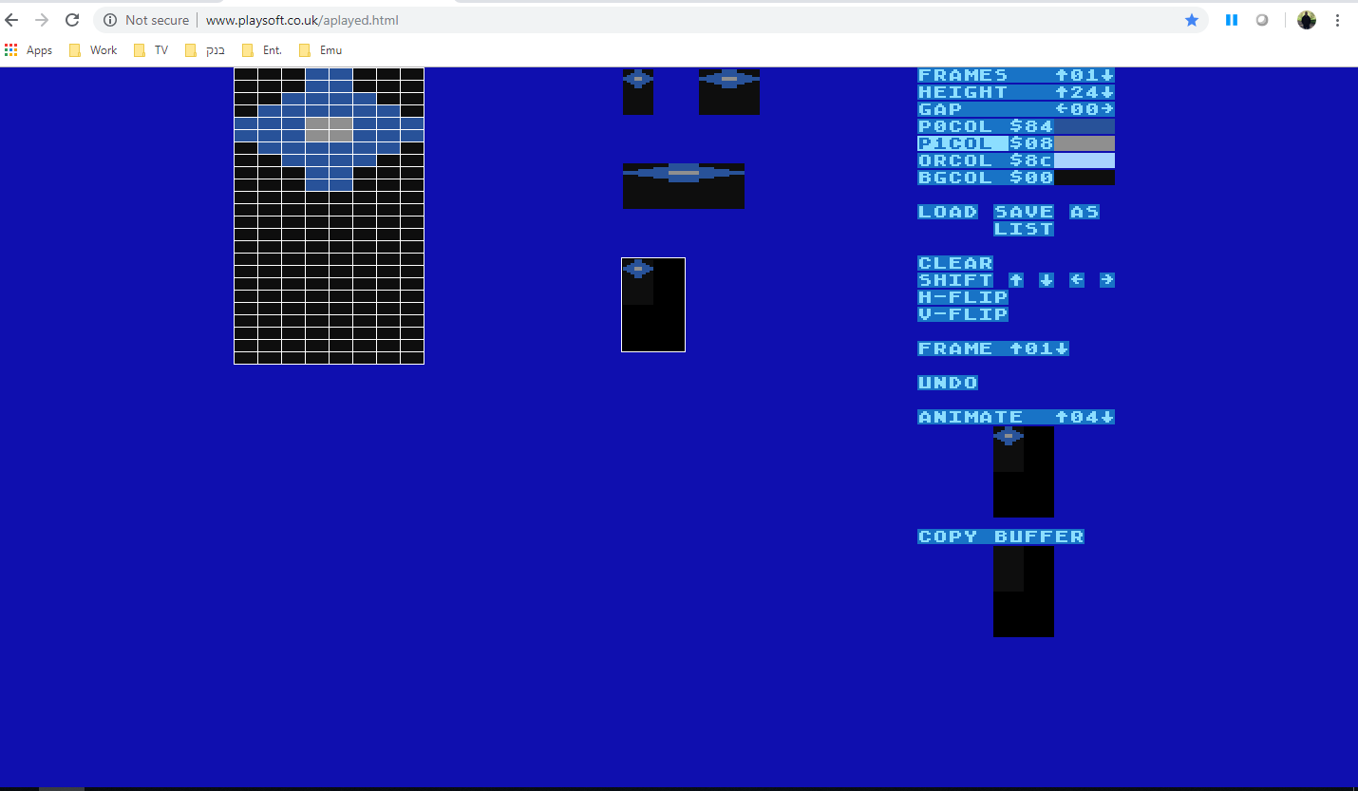
Sprite Editor http://www.playsoft.co.uk/aplayed.html

Slide 37
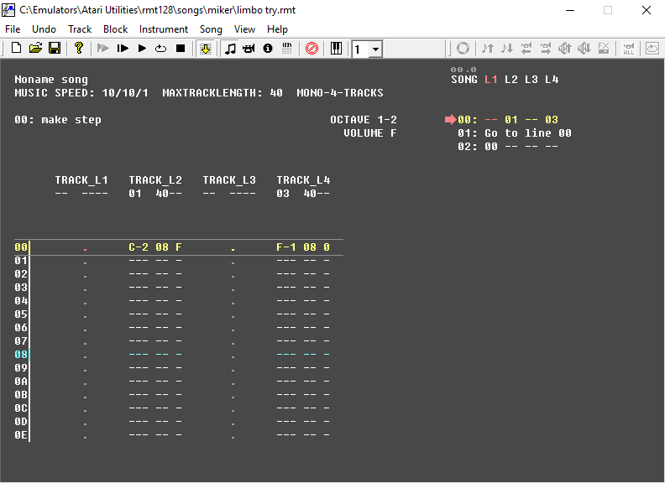
Sound Utility - RASTER Music Tracker
RMT 128

Slide 38
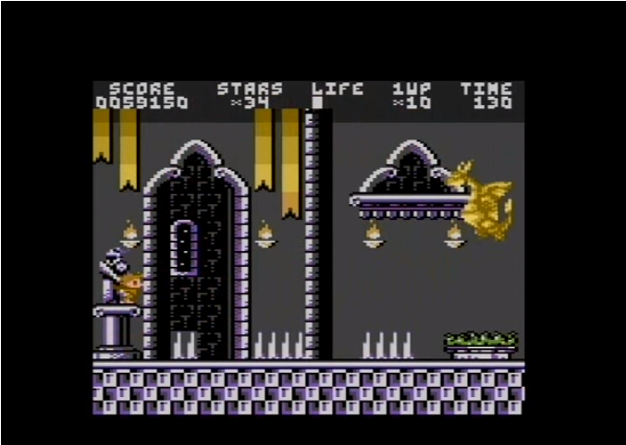
Homebrew Games
Crown Land

Slide 39
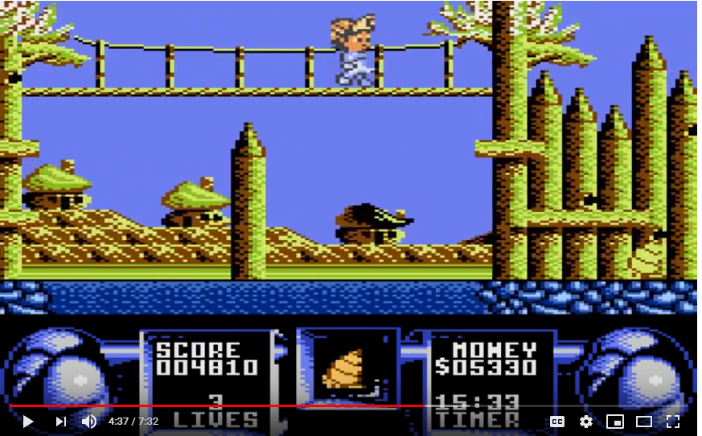
Homebrew Games
Flimbo’s Quest

Slide 40
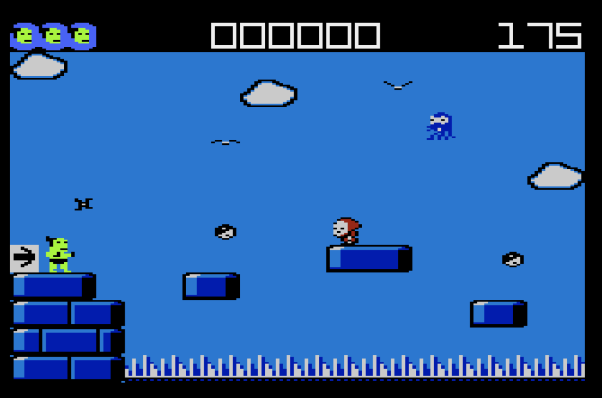
W.I.P – Sumo Adventure

Slide 41
https://www.youtube.com/watch?v=C1XJwG0FFso

Slide 42
Thank You!

